Slide 1
ANZREG Webinar – 26 October 2016 Meredith Mooi
IGeLU Conference 2016
Impressions & Feedback

Slide 2
About USC
Regional university just north of Brisbane
Implemented Alma and Primo in December 2015. Leganto early adopter.
Migrated from 3 separate systems:
VTLS Virtua LMS
Proquest 360 ERMS, including 360 Link (resolver)
EBSCO EDS Discovery
Notes:
Virtua from 1996 when the university was established
360ERMS since 2007 (SerialsSolutions)
After the takeover of SerialsSolutions by Proquest, we experienced a decline in formal opportunities to provide feedback and contribute to product development, mainly the feedback forums associated with the major conferences such as Information Online and VALA. This was both frustrating and disappointing as these were valuable opportunities to engage with the vendor and share ideas.

Slide 3
Community makes a Difference
Notes:
No real Virtua user community in Australia. Only four universities used it, all regional so it was difficult for us to get together but we did the best we could
Little scope for advocacy with the US-based vendor. Being such a small market for them we were essentially voiceless. VTLS had discussion lists and an enhancements voting system but outcomes were heavily influenced by North America and Europe
One of main reasons for selecting Alma & Primo was that there was a supportive Ex Libris ANZ user community.
As we’ve worked through Alma implementation and now our first year of use, what continually impresses me is how much Ex Libris is willing to listen, seek feedback, ideas for enhancements and does something with it. It has created the forums to make the communication happen – NERS voting, discussion lists, product working groups, regional user group meetings and the international IGeLU conference
Roadmaps are published and timeframes adhered to
Strong ANZ regional group, as well as the international user community with product working groups pushing ideas back to Ex Libris. IGeLU provides an opportunity to come together and bring all the ideas and developments into one place
[click image] For USC, its like going from a barren wasteland to an oasis, not perfect but we’ve come from almost nothing so it means a great deal to be part of something bigger and so positive.

Slide 4
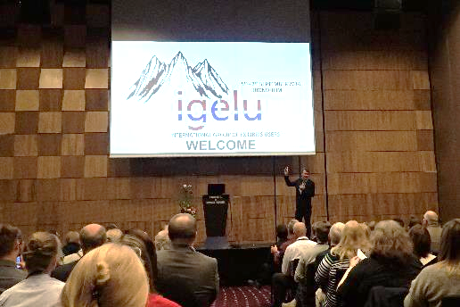
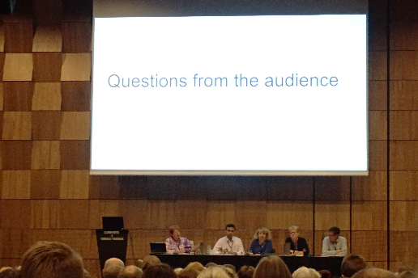
Questions & Answers
Submitted three questions to Conference Q&A
As a new customer, areas of interest/concern:
Proquest merger and implications for future development and roadmaps
Alma design – clicking, navigation, workflows
Primo content, metadata, access to full text
Notes:
IGeLU experience. I mostly attended product sessions, Q&A and product working group business meetings for updates.
[click] Fantastic that there was opportunity to submit questions.
As a first-timer I was interested to see whether they would get up, if they would be answered. During the Q&A session 29 questions were addressed, and all my questions were answered. Not perfect, some re-worded. One was misinterpreted/misunderstood.
[click] Went to conference with a number of focal areas/issues that I hoped would be answered –
concern about Proquest merger and what it would mean.
Staff difficulties adjusting to Alma – clicking, unnecessary workflows (smaller library).
Really positive experience of EDS implementation and configuration – we’ve struggled with Primo. Activating metadata, defining search scopes, linking to full text. Moving from EDS we lost widgets and other functionality such as a fully customisable resource recommender.

Slide 5
Takeaways
New Primo UI and integrations of Proquest/ Summon functionality and metadata, resource recommender
Redesign of Alma (reducing clicks, optional workflows)
Expanded Analytics reporting, benchmarking and trends (Intota); expansion of COUNTER uploads and reporting via Analytics
Leganto copyright
Notes:
Very pleased to hear that merger will have no impact on roadmaps or commitment to product development.
[click] That PQ functionality such as IEDL enhanced linking will be incorporated into Primo, that record quality will be enhanced by merging PQ KB and metadata. Resource recommender function will be introduced. This has placed us in a position to contribute to its development – our librarians have clear and strong ideas about what we want in a recommender, based on our EDS success and what we learned throughout that implementation process. At IGeLU I was able to make direct contact with Christine Stohn (Senior Product Manager for Discovery and Delivery) and we are keen to contribute our ideas for the development of the resource recommender. We will certainly have a lot to say about it ☺
[click] Alma issues around excessive clicking, unnecessary workflow steps for smaller libraries, had already been fed back by other libraries and had been taken on board – redesign of Alma interface is planned.
[click] It was great to hear that more reports will be made available in November, including cost per use, trends data, overlap analysis etc. based on Intota Assessment functionality
[click] Knowing this will make a big difference to our planning. We will be sharing this with our staff as well as other Virtua libraries who are implementing Alma or have just done so. As an early adopter of Leganto we will contribute to its development, especially around copyright workflows

Slide 6
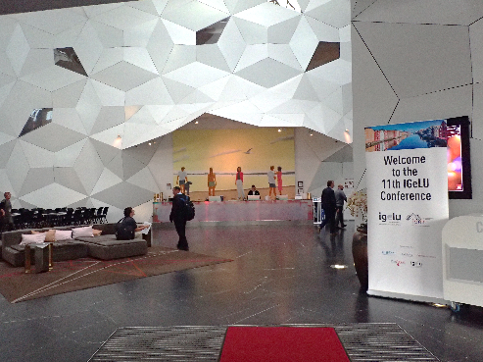
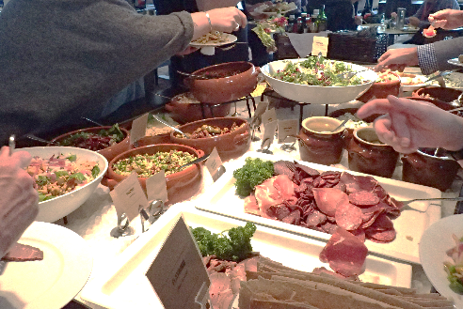
Value of User Communities
Value of conference
forum for Ex Libris to report on plans and respond to feedback
for product working groups to report on progress
to hear what other libraries are doing with products and how they’re re-thinking processes and services
making contacts via ANZREG and IGeLU
Notes:
Coming from nothing, attending IGeLU and becoming involved in the ANZREG community is like a breath of fresh air. Given the focus areas I was seeking answers to, I mostly attended product development sessions, some of the working group sessions and the Q&A sessions.
Have been able to see how product working groups engage with Ex Libris developers, how libraries can engage with the process and advocate functionality enhancements, particularly for the ANZ context e.g. Australian copyright with Leganto. Have seen how Ex Libris responds to this feedback and how it is incorporated into their product planning and development
Another valuable outcome is being able to make contact with Ex Libris developers and contribute to functionality development e.g. Primo resource recommender. This will also be a way of engaging our staff in the process of product and functionality development.
I will be bringing this back to our own library and sharing with staff to begin engaging them with the process, but also sharing with other communities such as QULOC and the group of 3 other ex-Virtua libraries who are now using Alma or in the process of implementing it.
Overall, continually impressed by Ex Libris as a company willing to listen, keen to get feedback and action ideas. We are keen to contribute as much as we can.

Slide 7
Thank you
Meredith Mooi
Systems & Technologies Manager, Information Services
University of the Sunshine Coast
MMooi@usc.edu.au
+61 7 5430 2801

Slide 8
UQL: Implementation Background
Millennium & Summon to Alma & Primo
Up to 1996 – Innopac
1996 – Millennium (III) introduced to replace Innopac
2008 – Encore (III) introduced as discovery layer
2010 – Summon introduced to replace Encore
Mid 2014 – Summon 2.0 rolled out
End 2015 – New LSP project initiated, to replace Millennium & Summon, with Alma & Primo
27 June 2016 – Go Live with Alma & Primo
LSP Implementation Project – 9 months
Eric Hornsby, Project Manager
Stacey van Groll, Coordinator
Plus 22 staff from around the Library
Two months of support, with Switch to Support on 27th August
Project closure at the end of August 2016, coinciding with IGeLU in early September 2016

Slide 9
IGeLU Conference Highlights
Personal 1 on 1 session to present 3 key issues
Judith Fraenkel (Director of Support Tier 2 and 3) and Evgenia Polyachek (Support Manager Tier 1)
Known Alma items missing from Primo – resolved by Ex Libris over approx. 6 weeks
Full text discovery in Primo – resolved by internal learning curve
Performance issues with Alma and Primo – unresolved and ongoing
Too many sessions…not enough time
Attended 17 of 65+ sessions
Focused on Ex Libris run sessions such as:
Product Development
Primo: New UI
Q & A
Alma Analytics – Yoel is seriously awesome
Best benefit thus far?
Opportunity to make connections with other APAC institutions such as Bond, USC, and SLQ
Become a bigger part of the international community via participating on the ListServs

Slide 10
IGeLU 2016 Developers Day notes
Trondheim, Norway

Slide 11
Introduction/organisation by the co-ordinators of Interoperability, Linked Open Data and Analytics Special Interest Working Groups.
143 attendees from many countries…. Conducted in English
Website at: http://developersday.info

Slide 12
Sessions in Program
Now We're Talking... Two-way Communication with Alma Using Webhooks (Ex Libris presenting) )
Primo and Alma Analytics APIs with Perl (presented remotely by David Lewis from Curtin University)
Primo new UI hacks and UX experiences (Primo Product Working Group impressions of working with new UI)
Customisation of Primo new UI (Ex Libris presenting)
A simple collection viewer for the new Primo UI (Mehmet Celik – author of jQuery.PRIMO)
Reducing cognitive load in Primo (Karsten Hansen – Aalborg University)
Extending Alma Functionality using APIs: Booking, Inventory, Search (Dean Lingley – Purdue University)
From Symbiosis to Synthesis - Alma and bibliotheca RFID Integration (Bettina Kaldenberg)
Creating an Angular.JS/Ionic based web/mobile app - challenges, problems, pitfalls and lessons learned (Matthias Einbrodt)
Visualising and Sharing Multi-Platform Library Analytics with Tableau (Joan Kolarik - Weizmann Institute of Science)
Expanded Scanning Service at MIT Library (Christine Moulen and Rich Wenger)
Red/Green system (Cindy Greenspun, Yale University) – an ‘item checker’ security system
EAD, PRIMO and a data management hub (Lukas Koster – Uni of Amsterdam)
- Extra session snuck in at end (by Theo Engelman from Utrecht University, Netherlands): A RESTful handshake between Aleph and WorldCat

Slide 13
Sessions on YouTube - mostly usable quality:
Part 1 – Starts with Ex Libris – Josh Weisman describing new Web Hooks integration type in Alma including demo implementations of listener in AWS Lambda
Part 2 – Ex Libris - Guy Ben-Porat describing their approach to UX development and Noam Amit demonstrating how to work with the new node.JS customisation dev environment
Part 3 – starts with Mehmet Celik
Part 4 – starts with Tableau presentation from Joan Kolarik

Slide 14
Next IGeLU Conference Location
APAC Issues
Authentication Focus Group – ISO 27018
Regression Issues

