Slide 1
Workflows: creating the happy path to an Alma mindset
Sue Harmer, Carmel Carlsen

Slide 2
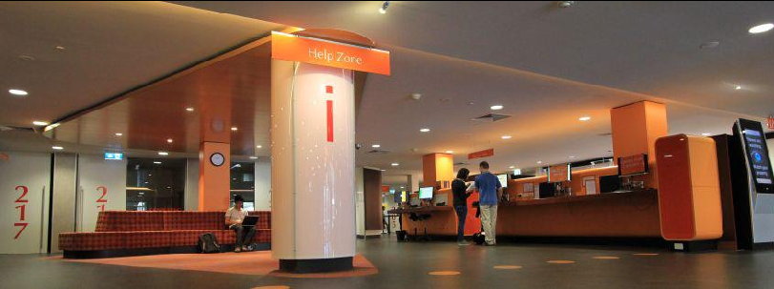
The University of New South Wales
52,000 students: 15,000 post graduates, 14,000 international students
7,700 staff: 4,200 academics, 3,800 professional
3 campuses; 2 cities, 8 Faculties, 66 Schools, 97 affiliated institutes
5 libraries, 180 library staff
300,000 e-books, 800,000 print books
88,250 online journals, <2,000 active print
5,500,000 searches in 2012

Slide 3
Background on Alma at UNSW
Kick off and Sandbox
18 Mar
1st functional workshop
4 June
2nd functional workshop
18 July
Data extract for migration
26 Oct
Mar | Apr | May | Jun | Jul | Aug | Sept | Oct | Nov
Alma Production
8 May
Primo over Alma
8 July
Signoff migration
14 Oct
Go Live
4 Nov

Slide 4
Alma – the business challenge
Unify and simplify policies
Stop thinking Aleph/Voyager/SFX: new workflows
Test data migration and workflows
Document issues
Decide what we need/don’t need at Go Live

Slide 5
Skills needed
Determine core business functions
Work out what’s important
Write test plans and find test data
Two half-day workshops:
Modelling business processes using workflow diagrams
Regression testing

Slide 6
Alma timeline
Kick off and Sandbox
18 Mar
1st functional workshop
4 June
2nd functional workshop
18 July
Data extract for migration
26 Oct
Mar | Apr | May | Jun | Jul | Aug | Sept | Oct | Nov
Alma Production
8 May
Primo over Alma
8 July
Signoff migration
14 Oct
Go Live
4 Nov
Modelling workflows
15+23 April
Regression testing
30 April

Slide 7
Modelling business processes: happy path to Alma
Learning outcomes
Identify the components of a process
Understand the purpose of a business process
Represent and model a business process using a workflow diagram

Slide 8
Modelling business processes: happy path to Alma
What was taught in the course:
Focus on core business functions and what is important
Make sure the process is not related to any system, especially Aleph, Voyager, and SFX
First write down the Happy Path for a process, the normal course of activity, also known as ‘basic flow’ or ‘main flow’

Slide 9
Modelling business processes: happy path to Alma
Modelling is an iterative process
Review the completed model and ask other people to also review
Ensure the activities are accurate and the flow between actors is properly defined
Used Swim Lane diagrams to document the business processes

Slide 10
The happy path: swim lane diagrams

Slide 12
The happy path
Two group exercises:
Create a swim lane diagram for the business process “Applying for Recreation Leave”
In your work unit groups, model a business process from your unit using a swim lane diagram
Present your workflow to the class

Slide 13
Before the Happy Path training
I don’t know how to start
I can’t work out what the next step is in Alma
Alma won’t do what I want
This is what I do in Aleph, how do I do it in Alma

Slide 14
After the Alma Happy Path training
the Alma Happy Path course
Core workflows written immediately
Policy changes relevant to business needs
Unifying, simplifying borrowing privileges
Which libraries can receive inter-campus loans
Confident decisions on what to configure

Slide 15
After the Alma Happy Path training
Made for better test plans
Good documentation of issues
expected outcome well documented
Copy-and-paste into SalesForce for Ex Libris
Able to rank issues
High: must be fixed before Go Live
Medium: would really like before Go Live
Low: can Go Live without

Slide 16
When someone raises an issue
Write a workflow for that

Slide 17
The happy path effect
Document Supply service for Relais implementation
Academic Services Unit to write procedure manuals

Slide 18
Thank you

