Slide 1
ANZ Alma Roadshow
Alma at Swinburne
Tony Davies
Manager, Information Support Services
Notes:
1

Slide 2

ANZ Alma Roadshow
About Swinburne
(5) 4 campuses in eastern Melbourne
18,000 University FTE
15,000 TAFE
Resources budget $5 m
Over 80% on e-resources
About 250k print books and 400k ebooks
About 400 print journals and 74,000 ejournals
Notes:
A little about Swinburne in case you don’t know.
If I had given this presentation last month we would have had 5 campus libraries. We now have 4 and by the end of the year we’ll have 3.
Swinburne has been going through a lot of changes which is part of our Alma story, so I’ll be talking about those in a bit more detail.
We are a dual sector university although with a substantial TAFE component which has been impacted by state government budget cuts in Victoria. I know there have been similar cuts in other states.
We are a medium sized university and our resource funding is probably at the lower end for our size.
We aren’t a well funded library and we don’t have many staff, and we now have even fewer staff.
We have had a preference for e-resources for many years and this is now accelerating, even more so given some of the changes I’ll be talking about.
Our 2013 resources spend is projected to be about 90% on e-resources.

Slide 3
ANZ Alma Roadshow
Moving towards Alma
Direction was set in our library system tender in 2008/9.
Migrated from Dynix to a suite of Ex Libris products (Aleph, Primo, SFX) implemented in Jan 2010.
Purchased Verde ERM but did not implement.
Joined as an Alma Regional Collaborative Development Partner in mid 2010.
Notes:
3
We got approval to tender for a completely new library system including discovery.
As well as Dynix we had been using Metalib and SFX since 2001 as a member of the AARLIN consortium.
Tender was originally to be released in 2008 but was stalled by the GFC and finally released at the beginning of 2009. Maybe that was a good thing because 2009 was a year of big developments in the library system world. At Information Online in Sydney in January 2009 our tender had just been released, we had breakfast with Serialssolutions where they told us about their new product Summon, and we had a meeting with Ex Libris where they talked about their ideas with Primo. It was a bit later in the year that we started to learn about Primo Central. It looked like our library system tender was coming out at just the right time.
The tender process selected: Primo for discovery, Aleph for ILMS, Verde for ERM and we would leave AARLIN and have our own version of Metalib and SFX.
DISCUSS VERDE ON SLIDE 6
We had only just implemented Aleph but we were already planning to migrate to something else…
We signed up as one of the ANZ regional collaborative partners.

Slide 4
ANZ Alma Roadshow
Alma ANZ Regional Collaboration
Swinburne University
Monash University
University of Adelaide
University of SA
Flinders University
Univ of Western Sydney
UNSW
Unilinc
State Library of Qld
University of Otago
Curtin University
Alma partner release meetings:
Nov 2010 Melbourne
Feb 2011 Sydney
July 2011 Brisbane
Feb 2012 Melbourne
Final meeting in Adelaide Oct 2012
Notes:
THE ANZ collaborative partners was a parallel consultative process as Ex Libris was developing Alma with the early adopters in North America and Europe.
The ANZ partners were shown Partner Releases of the Alma development every few months and we got a chance to give our feedback on how it was going.
Libraries in ANZ might have different requirements to libraries in North America and Europe, but also we might have a different perspective.
We came up with an agreed prioritised list of ANZ regional requirements but some of these were functions that we thought any library in the world might need.

Slide 5
ANZ Alma Roadshow
Regional collaboration requirements
Uploading to Libraries Australia
Support for accrual accounting
Support for GST
CAUL statistics analysis
Exporting blocks to student systems
Notes:
These were the accepted regional requirements.
Swinburne was a sponsor for the Accrual accounting and Exporting blocks requirements.
We worked with Ex Libris developers on functional specifications, were shown mock-ups of how they were planning for things to work and then the group signed off.
Not all of these requirements are currently available – accrual accounting likely beginning of 2014.

Slide 6
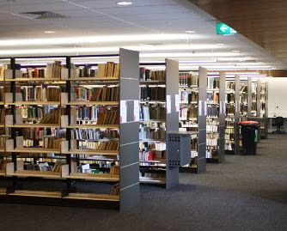
ANZ Alma Roadshow
The case for Alma
Aleph was a mature system for managing the old library that we are moving away from.
We need a system to help us manage the new library that we are moving towards.
Decision taken not to implement Verde and move towards URM.
Notes:
(image of the old library)
Signing on as a regional collaborative partner was really giving an in principle decision that we would agree to migrate to Alma at some stage.
Having just implemented a new library system why were we planning to migrate again so soon?
Aleph was a mature system for managing physical resources but not a great leap forward from our old end-of-life system Dynix.
We selected Verde and received training in it but we already knew that a separate system for managing e-resources wasn’t what we wanted.
We wanted a unified resource management system to manage all our resources in any format and the URM was beginning to take shape. It was really brought home to us during 3 days of Verde training. We didn’t want separate systems for managing different resources just because of the format. Ordering print book is the same as ordering an ebook but different processes happen after that. Aleph looked after the print books but really didn’t help at all with the ebooks.
We had already been making big moves towards e-preferred and we knew that would become even more important in future. Aleph was about managing the past and we needed a system to help us manage the future.

Slide 7
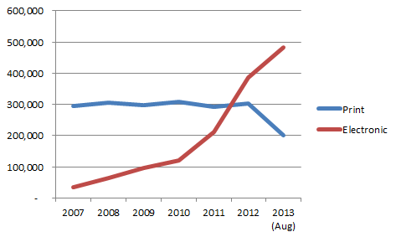
ANZ Alma Roadshow
Holdings of print & electronic books

Slide 8
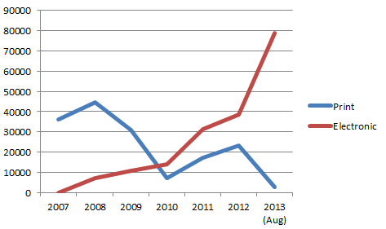
ANZ Alma Roadshow
Purchase of print & electronic books

Slide 9
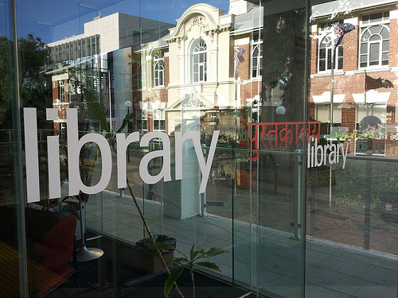
ANZ Alma Roadshow
In mid-2012… Why now?
We had funding & approval.
Local servers were coming up to renewal.
University about to install a new student system.
Library’s collections changing rapidly to online.
It seemed like a good idea at the time.
Notes:
Going back to mid 2012 we had several reasons for going ahead with Alma.
We had secured funding for the migration.
Our local servers for all our systems had been installed in late 2009 so were coming up for renewal in late 2012.
The university was planning to install a new student system within the next 2 years. We knew this would be hugely expensive and would involve a huge resourcing issue for ITS. It would also be a project that could take years. If we didn’t get in before the student system project started it might be years before we moved to Alma.
Our move towards e-resources was major and expanding and Aleph really wasn’t helping us to manage our e-resources. Example: Because the university use accrual accounting for serials we were managing 2/3 of our resources budget in an Excel spreadsheet and we were managing renewals via a wiki.
We were relying on Monograph Acquisitions staff ordering ebooks to remember to tell the SFX person to activate the ebooks in the knowledgebase. As we did more work with e-resources, more mistakes were happening.
And famous last words, it just seemed like the time was right to proceed. Little did we know that Swinburne was about to face some major changes.

Slide 10
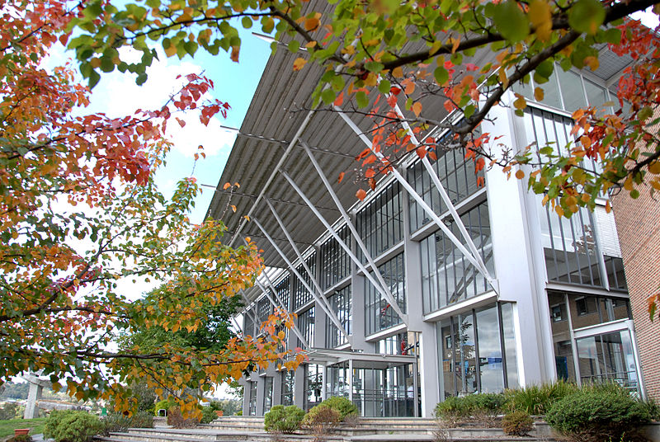
ANZ Alma Roadshow
Mid-2012 – “Transforming Swinburne”
TAFE funding cuts
In 2012
Swinburne lost 240 staff
Library lost 15 staff
Lilydale campus closed June 2013
Prahran campus will close Dec 2013
Notes:
(picture of Lilydale campus which has now closed)
At about the time that we had decided to go ahead with Alma there were momentous changes at Swinburne.
The state government had announced cuts to TAFE funding and Swinburne would lose $35 million a year.
Rather than piecemeal cuts at the edges, the university embarked on a major restructure across the entire organisation called “Transforming Swinburne”.
By the end of 2012 Swinburne would lose 240 staff (120 from corporate sector) including 15 library staff (about 15% cut).
In my department Information Support Services we went from 15 staff to 12.
By June 2013 our third largest campus at Lilydale would close, with the second largest campus at Prahran to close by the end of the year. Swinburne would transform from a multi-campus dual-sector university to a large university campus at Hawthorn and with small TAFE campuses at Croydon and Wantirna.
With the magnitude of the changes we sometimes wonder looking back whether it was right to keep going with Alma and we always end up deciding that we really had to keep going.

Slide 11

ANZ Alma Roadshow
Transforming Swinburne
The Transforming Swinburne program is one way we are working towards having the right processes, systems and structures in place to achieve our 2020 plan.
Transforming Swinburne is focused on design, aligning and streamlining process…
Notes:
Transforming Swinburne wasn’t just about coping with the changes, but about taking this as an opportunity to refocus what Swinburne was all about.
The university began to look at everything we were doing, to see that we had the best processes and systems and structures in place to achieve what we were all about.
You can see that Alma fits pretty well into that approach and if we hadn’t already started down the Alma path we would probably have had to seriously look at doing something like this anyway.
So, although these were some tough times, the plan was to keep going, because we had to.

Slide 12
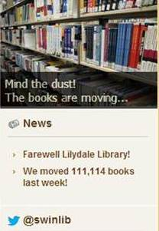
ANZ Alma Roadshow
Transforming Collections
Relocate collections from 5 campus libraries to 3.
Close second & third biggest libraries.
No room for collection growth.
Discard program with some collections moved off-site.
We would have had to throw away every book after 658.
A stronger focus on e-resources.

Slide 13

ANZ Alma Roadshow
What we did next…
Migrate Aleph/SFX to Alma
Migrate our local Primo and SFX to a hosted environment
Notes:
So, let’s pretend it’s the middle of 2012…
We had the impression, although no firm word, that Alma would work better with Primo also in the cloud so we decided to migrate Primo/SFX from a local installation to the cloud before commencing the Alma implementation.
In reality the Primo move took longer than planned and wasn’t completed until November 2012.
We thought that moving Primo/SFX from local to hosted would also shake out some of the ITS issues and concerns so we could deal with them and that would make the Alma move easier.
We did get early agreement from our ITS with the direction we were planning and while they had some concerns they were generally supportive.

Slide 14
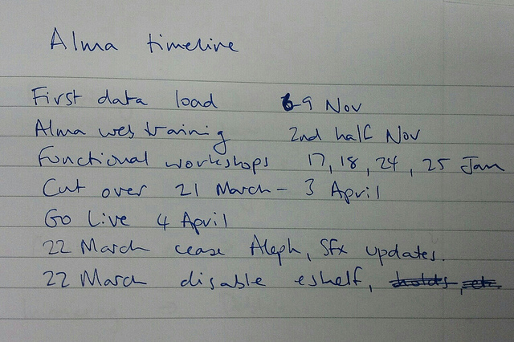
ANZ Alma Roadshow
Timelines
Kick-off meeting 1 Nov
Data migration 6-9 Nov
Functional workshops
17-18, 24-25 Jan
Tech services freeze 19 Mar
Primo read-only 27 Mar
Circulation freeze 2 April
Alma available 4 Apr
Go-live 5 Apr
Notes:
(image: my hand written notes from the kick off meeting)
The migration would take about 6 months from planning to go-live.
We had received from Ex Libris a migration and configuration spreadsheet with dozens of parameters to complete and we were doing this during October 2012. We know because we raised some questions during the last collaborative partners meeting in Adelaide.
We kept pretty close to the plan although some things took longer than expected and caused problems.
The migration of our local Primo/SFX wasn’t ready until late November.
The plan was to build a parallel Primo on our Primo production server in Chicago pointing to Alma. This was delivered late, delivered on time to go-live but significantly impacted on testing.
The tech services freeze was brought forward 3 days earlier than scheduled because Ex Libris wanted extra time to test the new Singapore data centre. I’ll talk about this later, but we had additional problems caused by the fact that the APAC data centre was not ready so our initial migration and installation was on the European data centre in Amsterdam in 2012 with migration to Singapore before go-live in 2013.

Slide 15

ANZ Alma Roadshow
Managing the project
Swinburne Alma Project Manager 0.6.
Should have been full time.
First Project Manager (Gary Hardy) left at end of 2012.
Replaced by Monica from late 2012 until May.
Tony wrapped up the project.
Ex Libris Project Manager: Melanie Fitter.
Relocated from Ex Libris UK to Adelaide.
Had worked on Alma implementation at UEL.
Notes:
The original plan was that an associate director Gary Hardy would take on the role of Project Manager as part of his regular job. This was a mistake. Managing the Alma Project was a massive undertaking.
Because in our Business Plan that was approved in the IT Governance Committee the project manager’s role was to be absorbed into an existing staff member’s normal job, there was no money for staffing in the Project Budget.
Gary decided to take a separation package and would leave Swinburne in December so we employed an external person as Project Manager 0.6: Monica Omodei. The position should definitely have been full time.
We also had an Ex Libris project manager: Melanie Fitter. Melanie had worked on the Alma implementation at University of East London before relocating to the Ex Libris Adelaide office.
Lessons learned: if we ever do another system migration we should employ a full time project manager and include the role in project budget.

Slide 16
ANZ Alma Roadshow
Project Board
High level management of the overall project,
usually met monthly
Led by Library Director & Alma Project Manager
Representatives from ITS and Ex Libris (& Tony)
We should have had more technical expertise on the project board.
Systems librarian brought into the project board but too late.
Notes:
The Project Board first met in June 2012 and managed the overall project. It met roughly monthly, more frequently immediately before and after go-live
It was chaired by the Library Director and included the Alma Project Manager, a staff representative (Tony), a manager from ITS, and Julie Wright from Ex Libris.
The Project Board’s role was to oversee the overall project, keep to timelines and essential milestones, and escalate problems whether internally in the Library or ITS or externally with Ex Libris.
There were a number of staff changes: the project manager Gary Hardy left Swinburne and was replaced as project manager by Monica Omodei; the Library Director Derek Whitehead moved to become the CIO in early 2013 and was replaced by our current Director Teula Morgan; Julie Wright left Ex Libris and was replaced on the Board by Melanie Fitter. Tony was the only person who was on the project board from start to finish.
Having managers overseeing the project at a high level was fine in the early days but from 2013 we needed more technical expertise. In a way having Melanie join the project board to replace Julie worked out well because she brought technical expertise which was needed at that point.
Having the ITS manager on the board was useful for escalating local technical issues such as printing, but we also needed the systems librarian who had more detailed technical knowledge.
After some issues were escalated to Ex Libris, Rona Arnedo, APAC customer service manager based in Singapore, also attended some meetings via teleconference at crucial times.

Slide 17
ANZ Alma Roadshow
Project Team
A broader group that met weekly.
Members from all functional areas.
Members from library systems support.
Usually included a phone call or webex with Melanie.
We needed to be able to make fast decisions, often on the spot. We sometimes had the right manager there but sometimes not.
Notes:
The project team was a larger group which included the project manager, the systems librarian and her team, and functional managers.
At most meetings we had Melanie call in or do a webex, especially in 2013.
The project team met weekly throughout the project, reporting on issues and discussing changes that we needed to make. Some of these were changes to Alma and some were changes to our practices.
We often had to make some fast decisions on changes, both changes to Alma and changes to our processes, procedures or business rules. Sometimes if Melanie was on the phone we would agree to a change and she could make it immediately so we could try it out. For some issues we had a manager who could authorise a change on the spot, for others we had to take a decision off-line which delayed solutions and sometimes made things more difficult.

Slide 18
ANZ Alma Roadshow
Early training and the first data migration
While completing the configuration and migration forms we watched recorded webinars and read the manuals.
1 Nov: Kick-off meeting.
5 Nov: Finalise migration/configuration specifications.
13-14 Nov: Hands-on training together with RMIT.
Training was based on granular tasks in generic sandbox environment, not based on Alma workflows, not based on real-life scenarios.
Notes:
We needed a good general understanding of Alma so that we could complete the initial migration and configuration forms. We were completing the migration forms in October and our training was reading the manuals and watching some recorded webinars.
We knew about Alma in general terms but not in any detail which made it difficult to make the right decisions in the migration/configuration forms.
There were 2 days of hands-on training together with RMIT in mid November, but that would be after we had to get our migration/configuration checklist signed off.
The RMIT training comprised 1 day for Fulfillment and 1 day for acquisitions/resource management. We didn’t have access to our own Alma environments so it was in a generic sandbox working through some granular tasks. The training wasn’t based on Alma workflows or real life scenarios and I think most people didn’t find it very helpful.

Slide 19
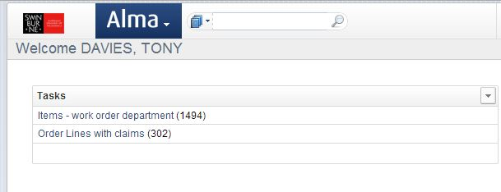
ANZ Alma Roadshow
The first migration
Installed in Amsterdam.
Delivered 23 Nov.
We were now working on our production Alma.
We had a system but there were problems and we didn’t know how to use it.
Notes:
The Alma that was delivered on 23 November would be our production Alma.
Any configuration changes we made would be real changes.
We began using the system and could see some things that obviously were migration or configuration problems.
For example, all our ebooks migrated with physical locations because we hadn’t got the selection criteria correct. We got that wrong.
Other things happened that we weren’t expecting and don’t recall being asked about. Swinburne has centralised technical services with a central Acquisitions unit but our Alma system was implemented with an Acquisitions unit at every campus and items were migrated to these units. Melanie was able to create the central acquisitions unit during functional training in January but because orders had been migrated to the campus-based acquisitions units she wasn’t able to move them to the new central acquisitions so migrated orders remained at these weird campus units and they couldn’t be removed.
We had to trust that mistakes would be fixed in the final migration so there was a concern that mistakes would still creep in.
We had the 2 days hands on training with RMIT is November and the idea was that we would test and use Alma and bring along any problems and issues to the functional woirkshops in January. In reality we were having problems performing any Alma workflows from start to finish, either because things weren’t set up properly or we didn’t understand Alma or both, so it was a very frustrating 2 month period.
We also had Christmas/New Year so, with the Alma frustrations I think a lot of people mentally switched off leading up to the end of 2012 and decided to worry about it in the new year.

Slide 20
ANZ Alma Roadshow
Functional workshops
On-site functional workshops 17-18 and 24-25 Jan.
We asked for additional webex sessions on 7-8 Jan.
Sorted out some of the mistakes from our first migration but we needed to wait for the final migration to see some of them fixed.
Brought lots of examples/scenarios to demonstrate entire workflows. Alma started to make sense.
Feeling a lot more confident after the functional workshops and wish they had happened earlier.
Notes:
The Functional workshops proved to be really helpful but they came way too late for us, almost 2 months after delivery of our Alma environment.
Swinburne and RMIT’s training was at the same time but RMIT were going live more than a month after us so the timing might have worked out better for them.
We had a month from delivery of our Alma environment until Xmas but there were problems in the configuration and migration and we had not had sufficient training in workflows to achieve completion of any work processes. There was a lot of confusion and despondency.
Monica organised for Melanie to present some webex sessions in early January so we could at least make some progress before the functional workshops.
Melanie said we could direct the workshops. Our complaint of the early training was that it was very granular including seemingly unrelated tasks. WE wanted to learn about complete workflows.
All our functional managers were briefed to bring along real life scenarios so that we could work through with Melanie from start to finish. This shook out our own misunderstandings, but alos identified configuration issues when Alma didn’t work as it should have.
It was really only after the functional training that people were able to really start testing and using our Alma system. That’s where we really started finding a lot of the issues so that we could report them and get them fixed.

Slide 21
ANZ Alma Roadshow
Fulfillment - Terms of use
We had simplified our loans matrix when we migrated from Dynix to Aleph in 2010.
We needed to simplify things a lot more for Alma.
Alma loans rules are based around physical locations called fulfillment units. We had a limit of 5.
We had a number of exceptions, mainly for equipment loans.
We simplified as much as we could.
Notes:
As a principle, Alma is set up to simplify processes, especially for physical materials. This makes sense when we realise that we have been putting most of our efforts towards managing physical resources when the great majority of our resources are online.
However, we found the simplification required by Alma was perhaps a step too far and caused a lot of anxiety and concern among our lending staff.
Alma loan rules are based around locations and we did find that we had inconsistencies in our loan rules where it made more sense to go along with Alma. An example of his was our former reference collection. We disbanded the separate reference collection several years ago and a lot of the reference works are now located in the general collection but not for loan. This caused problems with these materials being treated as exceptions, especially where they were ordered as serials and we were faced with creating workarounds in serials for receiving. We took this as an opportunity to standardise and have made everything in our general collection loanable.
During implementation we were permitted 5 fulfillment units, which means that we had 5 sets of loan rules. We managed to reduce our loan periods to 5 but we had problems especially with equipment where we could fit things into standard loan periods but they had different fines, or might not be available for renewals, etc. This caused us a lot of difficulty and was probably the main aggravation among our lending staff. If we could have had 2 more fulfillment units we would have been able to manage almost everything without treating things like equipment as exceptions. So we support the concept of simplification but maybe Alma was trying to simplify things too much too soon.
We were told that Alma would be able to dynamically change loan periods where an item was in high demand based on number of requests. We had previously had a static 7 day loan collection that was managed manually for high demand items, so we used this to simplify the TOU and set all these items high demand items to standard loan and use the dynamic loan shortening. It turned out that sometimes we were given incorrect advice and sometimes Alma didn’t have the flexibility we needed. It was some time after go-live that we discovered that this option could only be applied to any item with a request not a specific number of requests.
Sometimes we made a decision to simplify processes but we need an Alma enhancement to go ahead. An example is that we decided to make all print journals available for loans, holds and renewals. But the Alma holds pick list doesn’t include the Copy/Volume statement which would make it impossible to fill a hold for a journal. We have a development request in for this and will go ahead once we can.

Slide 22
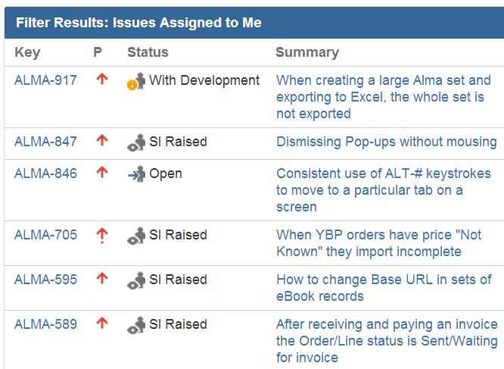
ANZ Alma Roadshow
Recording and tracking problems
We set up a project Jira for tracking problems locally and with Melanie.
We lodged Support Incidents when suggested by Melanie.
Often fixes would be in an upcoming Alma release so we would create a testing task in Jira.
Notes:
We had a fairly large group of 15-20 staff internally who would be testing, recording problems and following up solutions. We set up an internal mailing list but we needed more than that to manage of project of this size and complexity.
Luckily our second project manager Monica had a lot of expertise in using Jira. Swinburne ITS had a site licence to Jira but we would have had to use its standard implementation and we also wouldn’t have been able to include non-Swinburne people. We wanted to include our Ex Libris project manager Melanie, and we wanted to customise the Jira work flows so we set up a subscription to an Alma Project Jira. Cost is around $50 a month.
We set up the Jira so that it would automatically email a new issue to our Alma email list so everyone could see all the problems and then you could watch a specific problem. We could attach documents and screenshots, and refer an issue to another user. Often we’d refer it to Melanie. If she could resolve it she would update the issue and send it back to the person who reported the problem. Sometimes she would ask us to raise an SI. Often we would be told that a problem would be fixed in an upcoming release so we would make a task to test it after that date.
Jira has various dashboards you can use to manage the issues and tasks, which were really important because we are currently just over 1000 issues lodged in our Alma Jira.
We were using Pivotal throughout our Alma project, we were offered an invitation to join the pilot of the new Salesforce system but because Alma was keeping us so busy we decided to stay with Pivotal for the time being.
We would recommend recording everything in Jira. We tried to transcribe responses from Pivotal into Jira, likewise we should have recorded things we were told verbally or in emails because sometimes things we were expecting to happen didn’t.

Slide 23
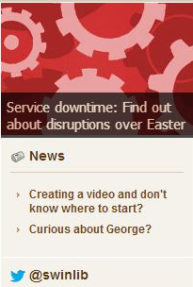
ANZ Alma Roadshow
Approaching go-live
Testing and resolving problems
Finalising configuration changes
Planning for freeze dates
Planning for manual tasks:
some things can’t be migrated
Testing Amsterdam to Singapore data centre migration

Slide 24
ANZ Alma Roadshow
Approaching go-live: Printing and self check machines
We have an odd assortment of old self-check machines.
Because of problems and time constraints we employed an external contractor to work on printing and self check machines.
For printing we used Ex Libris’s recommended third party solution Namtuk plus some configuration of our Outlook email system by ITS.
Notes:
Approaching go-live we also had to finalise a solution for printing and our self check machines.
Because we were running out of time and we didn’t have enough expertise in-house we employed an external contractor for a month to work on this.
Alma does not have built-in support for printing so for things like printing slips for items received, or holds, or items in transit you’ll need to implement a third party printing solution. Our ITS had wanted to utilise Outlook, the university’s email service, but in the end we used some Outlook filtering together with Namtuk which was recommended (maybe suggested is a better word) by Ex Libris.
It’s possible that had we had more time we might have decided we didn’t need all the slips we were printing but such a hectic and trying period is not really the time to be wondering about new workflows so we decided to implement slip printing where we thought we needed it and to defer review down the track.
Printing is an area where we think Ex Libris could provide more support. We got most of our advice from talking with other libraries.
Swinburne has an odd assortment of aged self check machines. We will be implementing RFID in 2014 so we’ll get new self check machines then, but for now we have to put up with what we’ve got. There are continuing problems wit our self check machines. We could get most of them going for a while but some proved to be unreliable, tending to lose the connection to Alma when not in constant use. Seeing as we were moving to an RFID solution soon, and closing 2 campuses, we decided to abandon the less reliable of the self check machines as long as we could keep a couple working at our busiest campus: Hawthorn.

Slide 25
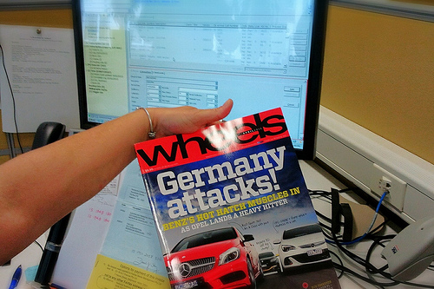
ANZ Alma Roadshow
The end of Aleph
Tech services Tue 19 Mar
3 days earlier than planned
Primo read-only Thursday before Easter: 27 Mar
Aleph circulation 1pm 2 Apr (Easter Tuesday)
Notes:
Aleph and SFX were planned to be closed on Friday 22 March but as we were the first installation into the new APAC data centre, the freeze was brought forward to the evening of Tuesday 19 March.
We should have planned for something more scholarly, but here’s a picture of the last journal received into Aleph: Wheels magazine.
The Thursday before Easter Primo was put into read only mode so people could still search but would no longer be able to place holds or do renewals.
Technically Aleph circulation could continue until lunchtime on Easter Tuesday (but did we bring it forward to the day before Good Friday?)
We all went home for Easter.

Slide 26
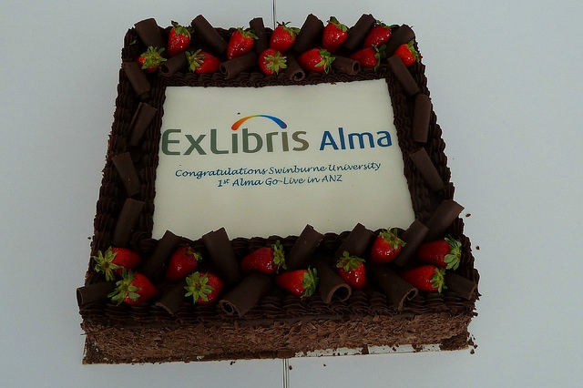
ANZ Alma Roadshow
Go live 4-5 April
Alma & Primo/Alma available for testing 1.00 pm Thurs 4 April.
Go live 5 April 2013.
Ex Libris project manager Melanie on-site for 2 days to follow up on problems and tasks.
You won’t find some of the problems until you go live.
Notes:
Alma was ready for final checking from lunchtime on the Thursday after Easter.
Everything looked ok, the Project Board met (with Melanie on site) and gave the all clear.
Alma went live on schedule 5 April 2013.
At this stage our Primo was still pointing to Aleph and we had planned to flick the switch to Primo pointing to Alma on the following Monday but things were looking ok, so we switched to Alma Priom on Friday afternoon.

Slide 27
ANZ Alma Roadshow
Manual follow up tasks
Some things won’t migrate from Aleph to Alma:
Manually entering unfilled hold requests.
Processing for missing and lost items.
Adding Instructors for course reserves.
Adding Interested users for Acquisitions orders.
Notes:
As I mentioned earlier, some things will not migrate to Alma.
Instructors in course reserves and the requester for an acquisitions order were text fields in Aleph but are patrons in Alma and have to be selected from the patron list. There were some technical issues, but these pretty much just required someone to enter the details manually.
Processing unfilled requests and missing/lost items proved more problematic.
Unfilled requests do not migrate. April is one of the busiest periods of the year for us so there was no way we could just discard these and tell our users to start again, so we got reports of unfilled requests from Aleph that we could use to enter manually in Alma, and we lined up some staff to do the data entry. I’m not sure if any other Alma libraries tried doing this before us but this turned out to be a real rookie error. We used title level holds in both Aleph and Alma. The lists we got from Ex Libris included item barcodes, so when we went to enter these holds manually in Alma, Alma helpfully assumed we wanted to create an item level hold. We didn’t discover what had happened until we tried to fill the holds and found that we had the right titles but the wrong items to fill the holds. Even worse, when we went to try to find the correct items, the hold pick list in Alma didn’t include barcodes so we couldn’t find the right items.
For items that were Lost or Missing in Aleph, this was a process status in Aleph but a workflow in Alma, so the status would be migrated to a notes field. When we went to process these items as Lost/Missing in Alma we couldn’t because Alma won’t set an item to Lost/Missing if it has a process status and the migration process itself had created a process status of Technical Migration. This was resolved in the June release.

Slide 28
ANZ Alma Roadshow
Primo
An Alma version of our Primo was built in parallel with our Aleph Primo. We switched on 5 April.
Because we were concentrating on Alma we let our Primo updates fall behind which caused Primo/Alma problems.
Early version of A-Z journals in Primo/Alma was a backward step from Primo/Aleph.
Pay attention to the Alma Uresolver.
Swinburne never used the Aleph OPAC so Primo has been our OPAC since 2010. Alma has no OPAC.
Notes:
We possibly concentrated so much on Alma that we lost track of some Primo issues. We did get the Alma version of Primo quite late for testing and the integrations came very late so we couldn’t test things like placing holds or doing renewals.
There were some Primo updates specifically designed to make it work with Alma and we had let our Primo updates fall behind. For example, where Primo merged a record for an item that had both print and electronic versions, the link to the print disappeared. This was fixed by upgrading to Primo 4.3.
The A-Z journals list in Primo via Alma was a backward step from the SFX version. By default journals were listed alphabetically which meant that if you were searching for the journal “Science” it was impossible to find. We believe this is fixed in Primo 4.4 but we were able to do a local fix through talking to another Alma/Primo library.
In an example of local Ex Libris knowledge perhaps being incomplete, we were given incorrect advice about setting up our Uresolver. The Alma Uresolver replaces the SFX menu and we had trouble getting advice about how to set this up. It wasn’t until we had a visit from our Jerusalem based customer manager (which we’ll talk about in a moment) that we had any idea that what we’d done was wrong. He looked at the screen and asked “Why did you do that?” and we said “Because Melanie told us to”.
It’s worth mentioning here that there is no Alma OPAC. When Swinburne moved to Aleph & Primo in 2010 we began using Primo as our sole discovery interface and we never used the Aleph OPAC. If you are still using an OPAC alongside Primo, this will be the time to let it go.

Slide 29
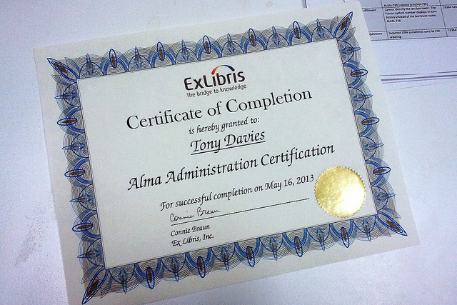
ANZ Alma Roadshow
Certification
You can only see Alma configuration after you have successfully completed certification training.
You won’t get the whole picture until certification.
Only after certification that we realised what was causing some of our problems.
Notes:
One of the issues we’ve raised with Ex Libris is that you can’t seethe Alma configuration screens until you have had certification training, usually several weeks after go-live.
We understand that you wouldn’t want people messing around in configuration until they knew what they were doing, but because we couldn’t see anything we were flying blind.
We spent a lot of time trying to get things to work and we eventually realised that scheduled processes hadn’t been set up. For example we had no claims appearing and spent weeks investigating and troubleshooting. When we had certification training we could see that the scheduled job to run the claims process wasn’t running.

Slide 30
ANZ Alma Roadshow
“Bumping up against Alma”
Can we work in the way Alma wants to work?
Can we change our practices?
Can we simplify?
Does it matter if we stop doing things?
Things we wished we had simplified more before migrating: loans conditions & acquisitions funds.
Notes:
We haven’t done a formal re-engineering of our workflows and processes but we have changed them incrementally in fairly small ways.
These small incremental changes are working out to be sometimes large changes overall.
I heard our director Teula Morgan use the term “bumping up against Alma” and when we do the first thing we ask ourselves is, can we work with Alma, can we do things the way Alma wants to do them? It will make life a whole lot easier if we can, and in most cases that’s what’s happened.
At the management level we are very much aligned to this, simplifying, letting things go… But we found that some staff are very much attached to old ways of doing things and worrying about the consequences of letting things go. The zombie library: where some staff had decided to worry about stuff that the management team didn’t care about at all, creating complexity and problems through good intentions misdirected.
When we decided to make everything in our general collection loanable, some staff worried about losing expensive reference works. If that happens we’ll buy a new one.
We had fulfillment notes popping up saying “CD in back of book” and we decided to removed the notes to cut down on mouse clicks at the loans desk. Staff worried, what if the CD gets lost. The answer from our management team is: who cares, if it matters we’ll buy another one.
If we had more time before beginning the project we should definitely have simplified our loan conditions and our acquisitions funds structures, and perhaps we shouldn’t have migrated open orders since they caused a number of problems. We might have been better in acquisitions just starting from scratch.

Slide 31
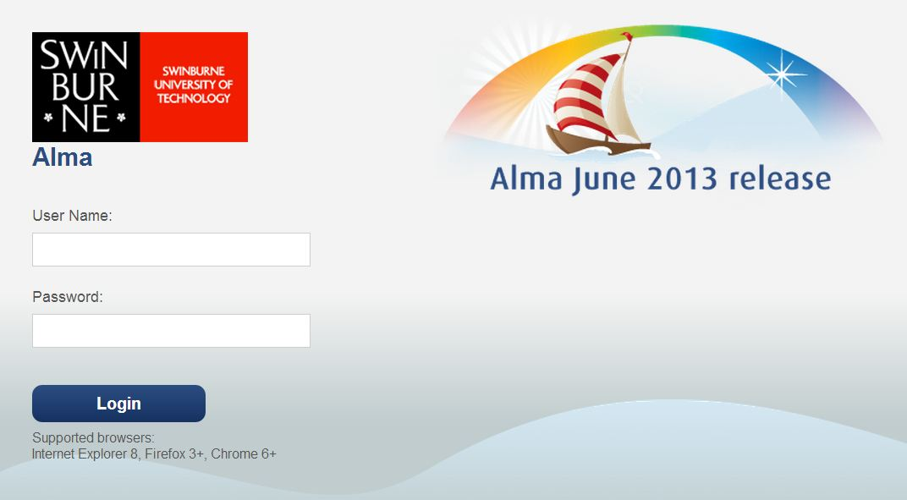
ANZ Alma Roadshow
Alma releases
New release on the third Sunday of the month.
Release notes the Thursday before.
Notes:
Currently there is a new release of Alma every month.
It happens on the third Sunday.
We get release notes on the Thursday before.
We often get told that our problems will be fixed in a certain release. We schedule a task for someone to check and confirm that the problem has been fixed.

Slide 32

ANZ Alma Roadshow
Managing for success
We now have a customer success manager:
Yisrael Kuchar, based in Israel.
Yisrael visited Swinburne for 2 days in June.
He could see some things we had got wrong.
He could see Alma shortcomings and feed these back to development.
We didn’t understand e-resource management and Yisrael has been working with us on this training gap.
Notes:
When you’ve been through a migration it’s always a bit of a concern when you move from project mode to regular support because, as good as the usual support people are, you lose the personal touch.
Ex Libris have put in place something that is working out really well.
Near the end of the project we had a formal handover to support and we had a call with the support manager. But we also now have a customer success manager: Yisrael Kuchar, based in Jerusalem.
Yisrael came out to visit us for a 2 day site visit where he got to sit with and talk to all our functional teams. He could hear their concerns first hand, see what we were doing, see ways we could change to make things work better, but also see ways that Alma was failing us and take those back to development.
He also could see our Alma is use in a real situation and he saw instantly that some of the ways we’d been set up were wrong, and he fixed them or took issues back to Israel so they could resolve tem for us.
An example of that was our Alma Uresolver where we had got it completely wrong.
Now that we’ve wrapped up our project we are continuing with our Alma team to work through the remaining issues (and sometimes we still find new ones). We prioritise those into a Top 5 list that we email to Yisrael. He follows up with development and then we have a fortnightly phone call where he lets us know how things are going. Almost always we will get a release date for a fix, so we create a testing task in our Jira, and then we can get to work on our next Top 5.

Slide 33
ANZ Alma Roadshow
Top 5
Alma team now convenes every 2 weeks to prioritise outstanding issues.
We send the Top 5 to Yisrael and he follows up with support and development.
A phone call every 2 weeks to advise of progress or a fix.

Slide 34
ANZ Alma Roadshow
Going live isn’t the end of the project
Our busiest time for dealing with issues was the month following go-live.
We didn’t find out about some problems until we were live.
As you begin to sort out the major problems you’ll notice other things that are wrong.
There are things we now need to look at:
e-resource statistics
Notes:
A final tip: we had worked towards the go-live date as the finish line but the project definitely didn’t finish then.
Project closure would usually be a month after go-live. Ours took longer as we were the first local installation and we had a number of major issues still to resolve.

Slide 35
Thanks for listening to our story
Tony Davies
tdavies@swin.edu.au

