Slide 1
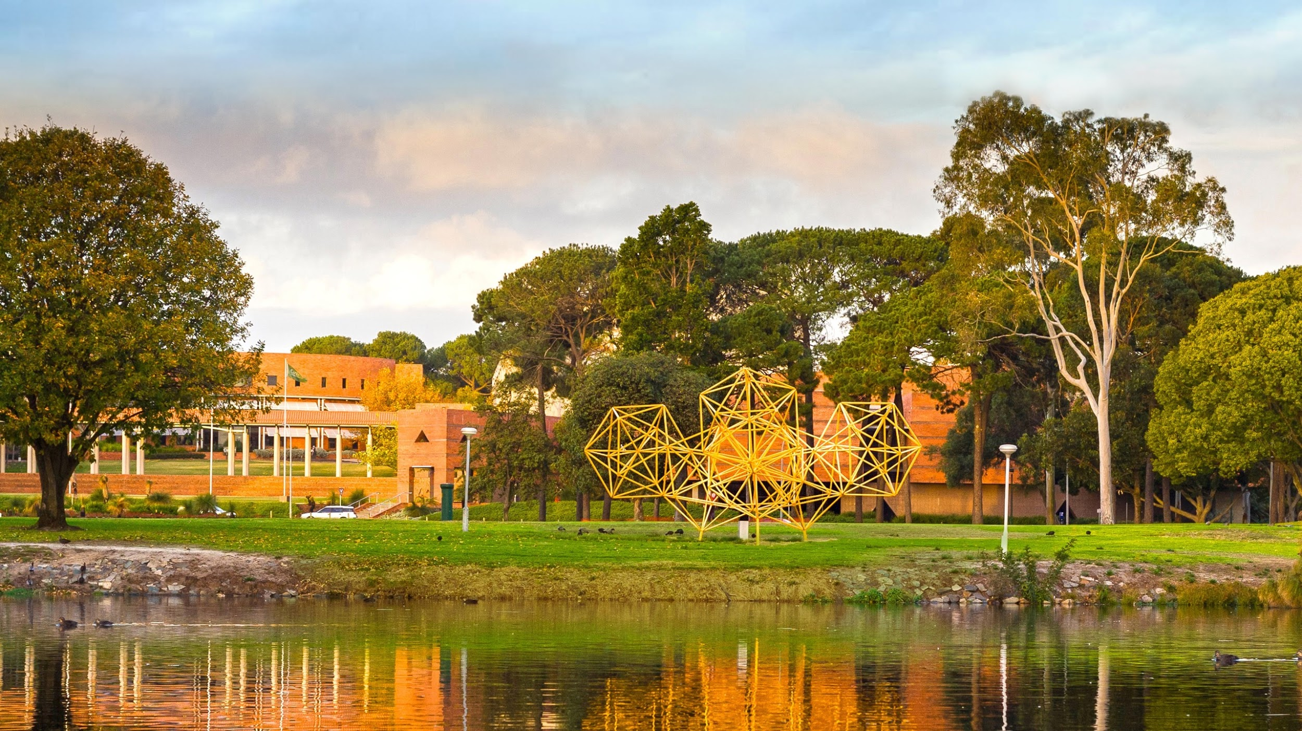
Predicting Students Success with Leganto,a proof of concept machine learning project
Mrs Linda Sheedy
October 2019
A global university Western Australia | Dubai | Malaysia | Mauritius | Singapore

Slide 2
With thanks to
Mr Peter Green, Mr Gal Darom,
Mr Tomer Katz, and Mr David Lewis
For their contributions to this project and this presentation
Notes:
Unique active courses and unique active students in 2018.

Slide 3
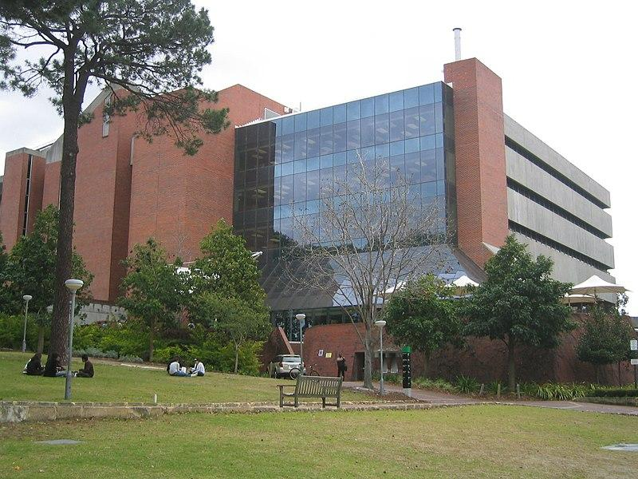
T.L. Robertson Library
at Curtin Perth

Slide 4
Leganto - Reading List Solution
In August 2015,
Curtin Library chooses the Ex Libris Leganto as its new Reading List solution
Curtin Library successfully implemented in the first Semester 2017
Between 2016 and August 2019, teaching staff have
created 4,700+ Reading Lists (includes Reading Lists migrated from previous system)
added over 115, 300 citations which resulted in
1.5 million (non-unique) full text views of resources by 42, 400+ unique active students
Notes:
Unique active courses and unique active students in 2018.

Slide 5
A “Proof of Concept” project
Ex Libris approached Curtin with a proof of concept proposal in 2017
To use machine learning to investigate the correlation between student success and activity within the Leganto Reading List
Curtin has been using learning analytics to predict student success and to identify students at risk of failing to complete their studies
Project would add to early intervention strategies
Offer from Ex Libris to partner in a proof of concept project was accepted

Slide 6
Early indication for students at risk
Advanced analytics
Gal Darom & Tomer Katz

Slide 7
Early indication for students at risk
Business
Need
Transformation
Various type of data
(structured/unstructured)
Notes:
Framing the project in machine learning terms. The business need drives the project, otherwise there is no value.

Slide 10
Time and Data
Significant time and effort to produce the Curtin data
Negotiation with Student Services and Digital and Technology Solutions
Leganto data needed to accumulate over multiple semesters
Success data is reported after the event

Slide 11
Matching Process to combine one dataset from the two data sources
Developing meaningful features from the unified dataset to improve the model accuracy
Examples:
Student engagement in relation to the average class engagement
Weighted student engagement per course
Notes:
The significant work here is creating meaningful features in the dataset. Lots of effort at this stage.

Slide 12
Complexity of Data
People need to understand the data – conversations over the phone
Course structure is complicated
Student demographics complicated
Language is not standardised – unit vs course, instructor vs coordinator
Definition of ‘success’ matured over time

Slide 14
We found that for the relevant dataset and business need the Random Forest (RF) algorithm was the best suited classifier

Slide 15
Preliminary results – Limited amount of data
data.Grade_AVG | Student historical average grades
data.STU_AVEGRAGE_USAGE_PAST | Historical usage engineered feature
Usage_stu_course | Weighted student usage per course
Age_numeric | Student age
rel_w1 | Student usage in week 1 in relation to class
The model total accuracy is 91.9%
Recall: The model will catch 18.8% of students who are at risk (25 / (108+25) )
Precision: Prediction of risk student is 69.44% (For 10 students predicted as at risk, 7 will be actually at risk) (25 / (11+25))
Notes:
2019 isn’t part of the set yet.
Caveat that this is not final and might change in a significant way.
Top left is review of five most significant elements most crucial to the model.
These have come out of the data and not dictated at the start.
Bottom left hand side.
Two values. 0 or 1. Will not struggle or will struggle.
Training set and test set.
We know if the student struggled or not but the model doesn’t.
General prediction is 91.9% but this is not the most important.
Want to know who is struggling, not who is okay.
Precision is good at 70%.
Recall is not so good, as not catching 80% of those who will struggle.
The model needs more work but in general has a high precision that everyone identified is a true positive
Need to increase recall but not at the expense of precision (always a balancing required)

Slide 16
How the Functionality May Work in the Future
Faculty / Semester
Leganto usage data
New Semester
Prediction model
Identify students at risk
Curtin data
Improve Model

Slide 17
The Future
Proof of Concept is ongoing as more time and data can improve the model
Too early for Ex Libris to know if this might feature in Leganto in the future

Slide 18
Make tomorrow better.
Thank you

