Slide 1
ANZREG 2019
Understanding user behaviour when requesting resources
Jessie Donaghey
Digital Services Librarian
Bond University, Australia

Slide 2
OUR
GOAL
Simplify and promote mechanisms for staff and students to request resources that they cannot find in Library Search
Assess our service
Understand our users
Analytics to help appreciate where we have come from and use evidence to support where we are going.
Survey requesters to discover preferences, motivations and experiences.

Slide 3
Assess our service
Analytics to help appreciate where we have come from and use evidence to support where we are going.

Slide 4
RESOURCE SHARING TIMELINE
UNTIL 2015
Requesting
Processing
Tasks involved entering data into multiple systems.
Checking user privileges.
Manually contacting users.
Manual online form.
Every request required the user to enter their identifying information.
Prone to typos/errors.
Wasn’t integrated with any library system.
Awareness
Monitoring
One webpage to request from.
Most likely had to be referred to service by librarian or colleague.
User unable to track progress.
Staff required to enter request details into separate systems and spreadsheets to track progress and use of service.

Slide 5
RESOURCE SHARING TIMELINE
UNTIL 2018
Requesting
Processing
Requesting from Primo with metadata pre-populated
Request connected to patron account in Alma.
Purchase Requests enabled.
Less manual tasks required by staff.
Automated communication between library and user.
Awareness
Monitoring
Silent login enabled.
Increased discoverability of service as requesting can happen from Primo Central Index record.
Still two extra steps to find service: a) Login to Primo. b) Select ‘Expand My Results’.
User can track progress from My Library Card in Primo.
Analytics reports to help monitor outstanding requests and track usage of service.

Slide 6
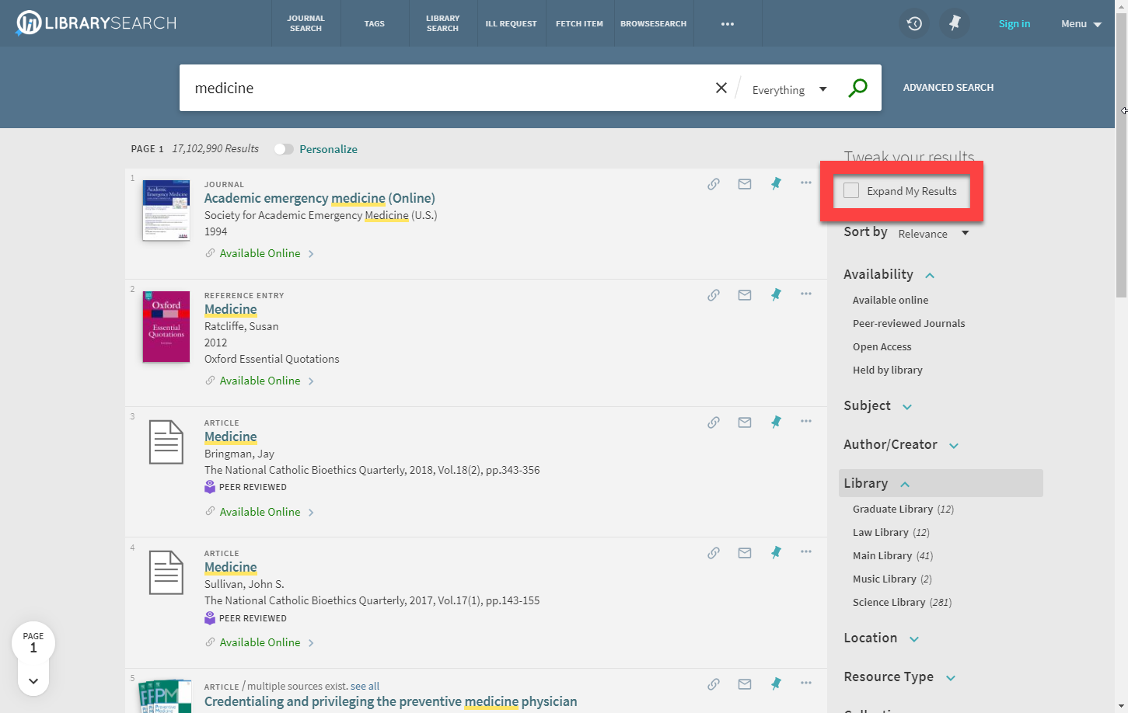
1%
EXPAND MY RESULTS
SESSIONS

Slide 7
EXPAND MY RESULTS IMPACT
2018 VS 2019
60%
Increase in requests supplied.
94%
Increase in unique requesters.
85%
Increase in first time requesters.

Slide 8
RESOURCE SHARING
TOTAL SUPPLIED REQUESTS
Predicted
Went live with Alma Resource Sharing
Enabled Silent Login for Primo
Default Expand My Results

Slide 9
Understand our users
Survey requesters to discover preferences, motivations and experiences.

Slide 10
SURVEY – MAY TO JULY 2019
WHO RESPONDED

Slide 11
SURVEY
DISCOVERING THE SERVICE

Slide 12
SURVEY
SUPPLY TIME EXPECTATION
2019
Supply time reality
3,414 journal requests received
with an average supply
time of 3 days.

Slide 13
SURVEY
REASONS FOR USING THE SERVICE

Slide 14
SURVEY
REQUEST MONITORIING
Top reasons
I wanted to track the progress of my request.
I wanted to see whether my request had been received by the Library
I wanted to find out how long it would take to receive the resource

Slide 15
SURVEY
MOST IMPORTANT FEATURE
Overall ranking
Agreement with ranking
1. Ease of placing a request
78%
2. Place multiple requests at once
59%
3. Tracking progress in My Library account
30%
4. Notified of expected delivery time
44%
5. Auto email updates on progress
33%
6. Auto SMS updates on progress
78%

Slide 16
SURVEY
FUTURE USE
Essential service
94%
Extremely likely to use the service again.
“I'm writing a biography of a musician who has been dead for 22 years, and a lot of the material I need is quite obscure!"
Efficient service
“I was really impressed with the efficiency of the system and very grateful I had access to the source in time to use it in my assignment.”

Slide 17
RESOURCE SHARING
REFLECTION & NEXT STEPS
User experiences and expectations
Positive changes
New users inclined to expect longer turnaround time.
Increase self-discovery of service, less reliance on Librarian recommendation.
Increase in use of service for resources which compliment sources already found.
Ease of requesting.
Alma ISO LADD integration.
Silent Login for Primo.
Enabling Expand My Results by default.
Future opportunities
Unpaywall Link Resolver Service.
Turnaround time communication.
Promotion of request monitoring via My Library account.
Enhancements to placing multiple requests at once.

Slide 18
THANK YOU
Jessie Donaghey
jdonaghe@bond.edu.au
Take a look at my Primo and Alma analytics reports used in the presentation: http://tiny.cc/JD-ANZREG-19

