Slide 1
Moving the goalposts: aligning project milestones to development schedules
ANZREG 2019 Conference (23-25 October 2019) #anzreg
Kendall Kousek
Discovery Services & Systems Librarian
Macquarie University
© Macquarie University

Slide 2
Contents
Introduction to Macquarie University
Influencing Leganto’s development
New functionality
Issues encountered & Roadblocks
Next stage of implementation
Milestones achieved
Those yet to come

Slide 3
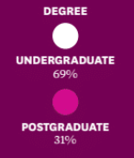
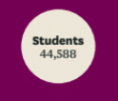
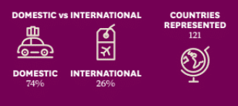
Five faculties:
Faculty of Arts – 12 departments
Faculty of Human Sciences – 4 departments
Faculty of Science & Engineering – 9 departments
Faculty of Medicine & Health Sciences – 5 departments
Macquarie Business School – 6 departments

Slide 4
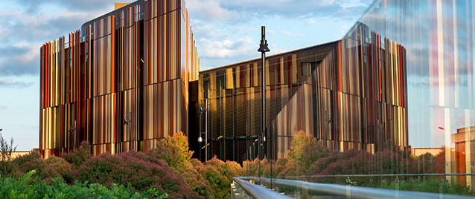
New, purpose-built library
Opened 2011
1.2 million physical items & 900,000 electronic titles
Alma, Primo, Leganto & CampusM

Slide 5
Leganto
Macquarie Library journey
 | May – Nov 2017 Faculty of Arts: Demonstration to Learning and Teaching Committee Call for volunteers 8 unit convenors, 9 reading lists Library created reading lists Individual training |  | Dec 2017 – Jan 2018 Faculty of Arts: Approached all Session 3 unit convenors 11 Unit Convenors agreed (1 repeat) Library created 10 reading lists No training uptake |  | Feb – May 2018 Faculty of Arts: 3 departments Multiple volunteers Faculty of Medicine and Health Sciences: 2 departments Faculty of Human Sciences: 2 volunteers Overall, 120 reading lists created

Slide 6
Leganto
Macquarie Library journey
 | July – Dec 2018 180 reading lists 3 faculties using Leganto Pilot project completed |  | Feb – May 2019 285 reading lists in Leganto 4 faculties using Leganto |  | Current 400 reading lists in Leganto All 5 faculties using Leganto

Slide 7
Influencing the development of the product
NERS (New Enhancements Request System) 2018

Slide 8
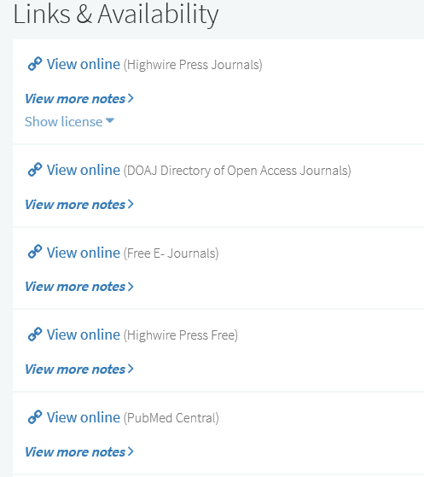
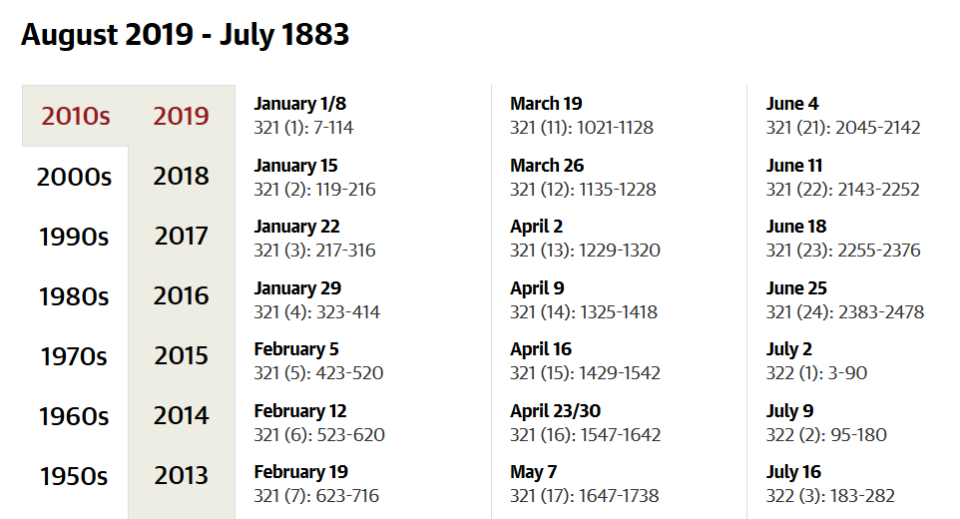
Alma Link Resolver
Links to free resources
Citation in Leganto
Journal homepage

Slide 9
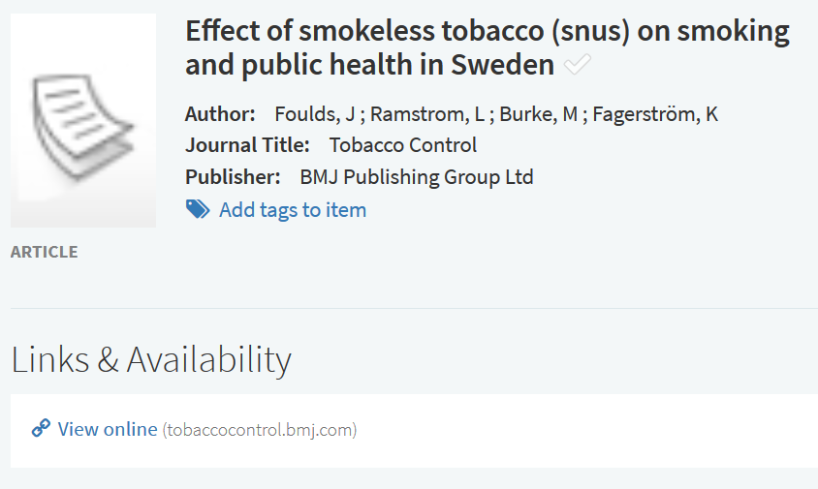
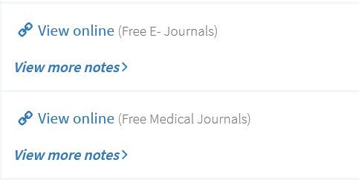
Alma Link Resolver
Links to free resources
Citation from Primo
Manually edited citation

Slide 10
NERS Enhancement
Enhancement merged
When multiple links appear in a Reading List, it would be extremely helpful to have a method of managing which links display within the Leganto interface. Links currently come from a variety of places: 1. Uploaded files 2. Citation's Source field(s) url(s) 3. Alma U-Resolver links (based on the citation's metadata) 4. Citation's associated bib record's electronic portfolios and/or digital representations. 5. Citation's associated bib record's related records electronic portfolios Ideally, it would be as easy as hiding the links you don't want to display with the push of a button (for instance an X next to the link). If that is technologically impossible, then provide functionality such as a method to "Disable Resolving" and a method to "Detach from Repository" from the edit citation screen in Leganto, available both to library staff and instructors.

Slide 11
Development of new functionality
Reading list roll over
Instructor roll over

Slide 12
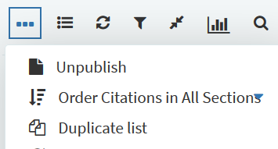
Re-use of reading lists
duplication
Option to duplicate list
Citation Status

Slide 13
Re-use of reading lists
duplication
Workflow: 1. 'Duplicate' the reading list 2. 'Associate this list with a course' to assign the new course instance 3. Select to 'Work On' reading list 4. 'Edit' citation 5. Click on 'Copyright Attributes' tab 6. Tick 'Copyright Auditing Required' 7. The 'Copyright Attributes' form appears with some fields pre-populated with data from the Citation tab EXPECTED OUTCOME: Any fields that contained information on the original citation would be populated with the same data. But the 'Number of Students', 'Date Available From' and the 'Date Available To' fields would contain the information from the newly associated course.
Case #00531891

Slide 14
NERS Enhancement
duplication
Description: When manually duplicating a reading list, provide the institution with the ability to configure how the duplicated citation's copyright is dealt with: 1. provide a configuration option for the Copyright Status - the ability to either keep the existing Copyright Status of each citation or assign a configurable default Copyright Status for all citations 2. provide a configuration option for the Copyright Auditing form in the Copyright Attributes tab - provide institutions the ability to configure whether to keep key information in the Copyright Auditing form, e.g. secondary page ranges, required chapters, if the item includes images and the source for copyright This was the 3rd top enhancement voted in 2018 NERS enhancements ballot. Votes: 273 ExL Complexity Points: 12 Planned delivery: October 2018
Leganto NERS 2018 ballot - 5922 - Ability to configure how copyright is dealt with when duplicating a reading list

Slide 15
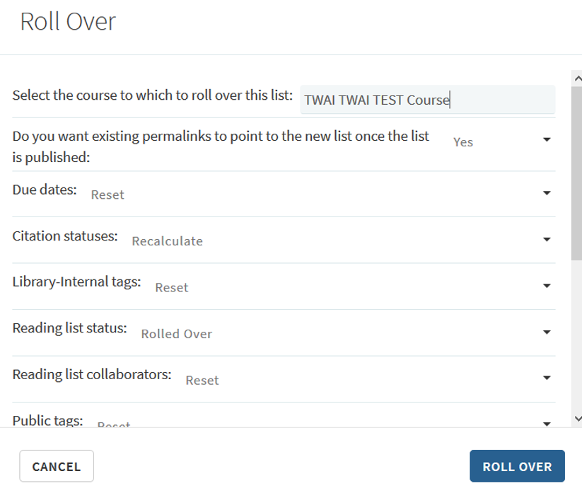
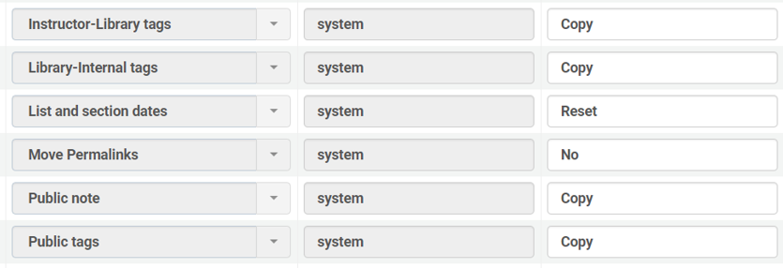
New Functionality
Instructor roll over
Librarian roll over options
Roll over options configuration
≠

Slide 16
Issues Encountered
Reading list roll over
Course loader job

Slide 17
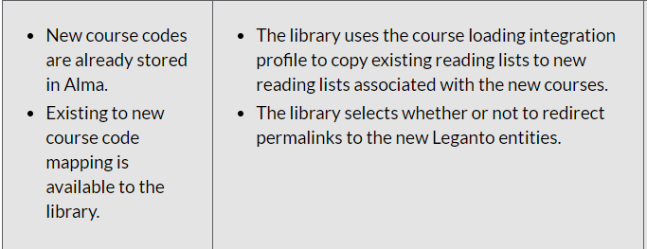
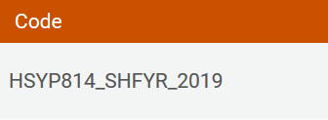
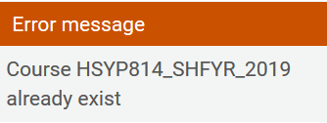
Reading List Roll Over
Course loader
Information in online help contradictory to behaviour in Alma.
“Staff convening Units in Session 1, should create their reading lists in Leganto or send to the Library by email by Monday 21st January 2019.” - Library communication

Slide 18
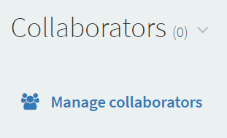
Reading List Roll Over (Cont’d)
Course loader
No owners assigned
Letters not sent

Slide 19
Reading List Roll Over (Cont’d)
Course loader
Manual processing required
Automation probably not possible
Carried out multiple times per year

Slide 20
Roadblocks along the way
Reading list access

Slide 21
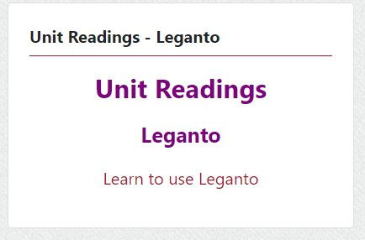
LTI link in Moodle
Leganto Access
OOTB Moodle LTI link
Custom Moodle LTI block

Slide 22
Moving to the next stage of implementation
Resource recommender in Primo

Slide 23
Reading List Discovery
Resource recommender
Resource recommender record for reading list

Slide 24
Milestones achieved
Pilot completed
Uptake from each faculty
Library staff confident with system

Slide 25
Those yet to come
Increased uptake across institution

Slide 26
Summary
NERS
Rollovers
List access & discoverability

Slide 27
Any questions?
Email:
kendall.kousek@mq.edu.au

