Slide 1
Exploring Esploro
Migration and implementation of Esploro at Southern Cross University
Margaret Pembroke
August 2019

Slide 2
Outline
About Southern Cross
The Australian repository landscape
Current infrastructure
Why Esploro
The data
Planned integrations
The benefits
Notes:
Hi and thanks for coming, I’ll start by giving you a brief outline of the presentation and tell you a bit about Southern Cross University,
To understand why we chose Esploro it’s important that I explain a little of the history and landscape of institutional repositories in Australia
I will go over the current research reporting process and our infrastructure
Why we chose Esploro
How the data migration is going
Some of the planned and potential integrations and the ones that we are most excited about
And I’ll finish up on the benefits that we expect to see

Slide 3
About Southern Cross
Multi-campus regional university on the Australian east coast
Approx. 840 FTE and 11,000 EFTSL
Home to nine research centres
Ranked “well above world standard” in 14 research fields by the latest Excellence in Research Australia
“At world standard” in a further 23 research fields
Multi-campus regional University on the Australian east coast
Approximately 840 (FTE) staff 11,000 (EFTSL)
Home to nine research centres
Latest Excellence in Research Australia results achieved the highest ranking “well above world standard” in 14 research fields
At world standard in 23 research fields
Notes:
Wing it
Southern Cross is a multi campus regional University on the East Coast Australia
We have three main campuses located at Coffs Harbour, Lismore and the Gold Coast stretching across about 300km….from the forest to the sea
As well as satellite campuses in Sydney, Melbourne, and Perth and Hotel Schools in Sydney and Melbourne.
And as you can see from our ERA results, for a relatively young, regional university we punch above our weight as far as research goes.

Slide 4
The Australian repository landscape
Historically many University repositories were created from government funding
Most became active after 2006 and ePublications@SCU in 2009
Focus on Green OA
Excellence in Research Australia (ERA)
Open Access – mandates…almost
APCs, Gold and hybrid publishing models
CAUL Review of Australian Repository Infrastructure
Photo by Ondrej Machart on Unsplash
Notes:
Wing it
Historically most repositories were created from government funding. Initial funding was allocated on a competitive basis for the development of a research management infrastructure that included open access institutional repositories (Kennan & Kinglsey, 2009).
Some of the larger organisations had a repository in place as early as 2002
Most did not become active until after 2006 at this point in time they were focussed on the green Open Access model. In 2008 Excellence in Research Australia or ERA was first proposed as a method to measure the research outputs of Universities.
From 2007 to 2008 the Australian government allocated $25.5 million to Australian universities to develop their repository infrastructure. This was the funding source for the creation of ePublications@SCU on bepress Digital Commons.
At the same time the Australian Research Council (ARC) and the National Health and Medical Research Council (NHMRC) ‘requested’ recipients of their funding to make their results available via their institutional repository.
It can safely be said, that ERA hijacked the push for Open Access repositories and that the publishers hijacked the Open Access movement, leveraging off researchers who are confused about what Open Access is and often end up paying for (gold) Open Access.
We, as an institution, have always encouraged the green Open Access model.
In 2019 CAUL published it’s Review of the Australian Repository Infrastructure as part of the Fair, affordable and open access to knowledge program.
This report identified that the Australian repository infrastructure was, in some cases, ageing….badly. Most importantly it identified that repository, “interoperability is of primary concern” (CAUL, 2019).
For Southern Cross the timing was perfect to look to building a next generation research repository.

Slide 5
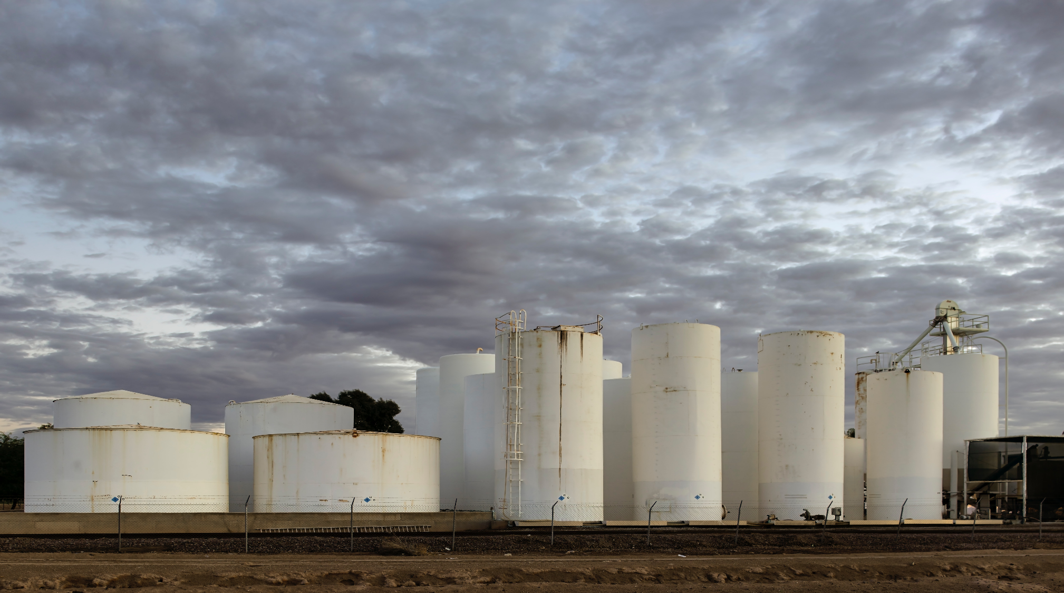
Current Infrastructure
Digital Commons (bepress)
Selected Works (bepress)
IRMA
Manual reporting and data entry
Manual reconciliation of data
No integrations
No workflows
Reliant on self reporting
Photo by Jim Witkowski on Unsplash
Notes:
Wing it
The current infrastructure at Southern Cross is a series of silos, with the Office of Research and the Library both collecting publications information for very different reasons. The Office of Research to comply with government reporting requirements and the Library to promote and disseminate our research outputs as widely as possible.
Even within the bepress platform there are silos, with digital commons containing the institutional repository assets, and selected works containing the researcher profiles.
We had never mandated that a researcher must have a profile and while the profiles were created and maintained by the library, the nature of selected works meant that a researcher was able to edit their own profile at any time, adding any content without any library mediation.
This led to questionable metadata, breaches in copyright as well as an inconsistent look and feel to some of the profiles.
Added to this the bepress digital commons interface has had very little development, apart from an overhaul of Selected Works, since we initially subscribed in 2007.
Southern Cross also has a Current Research Information System (CRIS) called IRMA, which is where the Office of Research manages its reporting for ERA amongst many other things.
IRMA does not integrate with bepress.
Currently researchers are required to report their research publications via a PDF form. They are asked to attached the accepted manuscript and the publisher version to the initial submission but few do. The Library is on copy to this submission and verifies and enters the publication details into bepress.
Staff in the Office of Research also verify and enter the publication details into IRMA.
Many researchers do not report their research because they are not aware they are required to or because they flatly refuse to.
When the Office of Research is reporting for ERA, publications data is reconciled between IRMA and ePublications using excel spreadsheets, Vlookup and a very strong cup of coffee. The Library via ePublications must ensure that we hold a copy of all research publications that are reported to ERA.
The result is a mad scramble to ensure that all assets are in IRMA and that the library has a copy of each asset being reported to ERA
Our current systems are very manual and involve an enormous amount of duplicated effort in two of our work units.
Ironically the same person is sometimes employed to enter the same data into each system.

Slide 6
Current submission process
ePubs
IRMA (CRIS)
Profiles
Notes:
The researcher writes a paper and gets published.
They download a PDF form from Southern Cross University Office of Research.
The PDF submit button opens their email (as long as they are not using webmail or on a Mac) and sends the submission to ePubs in the Library, the Head of School or Research Centre and the CRIS system IRMA.
Hopefully they remember to attach the accepted manuscript and published version of the paper.
All three systems verify that the publication exists.
The Library enters any verified research outputs.
IRMA verifies and enters the output if it fits the definition of research for ERA
The Head of School or Research Centres decide whether the research is reportable for ERA and may reassign the Field of Research codes.
They then forward the details to IRMA (Yes IRMA now has two versions of the submission)
There are multiple points where this process could fail, the most common one is that the researcher does not download the PDF form and report the research at all.
We wanted to simplify the process, ensure that all research is reported, reduce duplication of data entry and save time for the researcher.

Slide 7
Why Esploro
Early Adopter
ExLibris support for migration
Automagic harvesting
Improved processes
Analytics
Integrations
Collective intelligence
Notes:
So that brings me to Esploro and why Esploro?
We considered it an opportunity to good to refuse.
Since 2011 when I first became involved in our repository I had been looking for something that would do everything that bepress did and much, much more.
Researchers should not be wasting time entering data onto a PDF form when that metadata is readily available from the internet.
A system should have the flexibility to manage organisational restructure and name changes.
It should be a time saver not a time waster
It should support all types of research assets not just traditional publication based assets. Linking them via the grant ID or Funder codes to create a complete picture of the research outputs that were a result of particular funding
Is should be able to provide advanced analytics to support promotion, internal and external reporting
It should integrate readily with internal and external systems not “protect” itself behind proprietary software
It should be flexible so that internal work processes can be streamlined such as triggering acquisitions workflows to order items not held in the library collection
It should be simple for the researcher.
Esploro will support all of the above including automatic harvesting of assets using advanced artificial intelligence algorithms to match the researcher to the asset
As well as this we will be able to draw on the collective intelligence of the ExLibris community - the brains trust – you guys.
So we jumped at the opportunity.

Slide 8
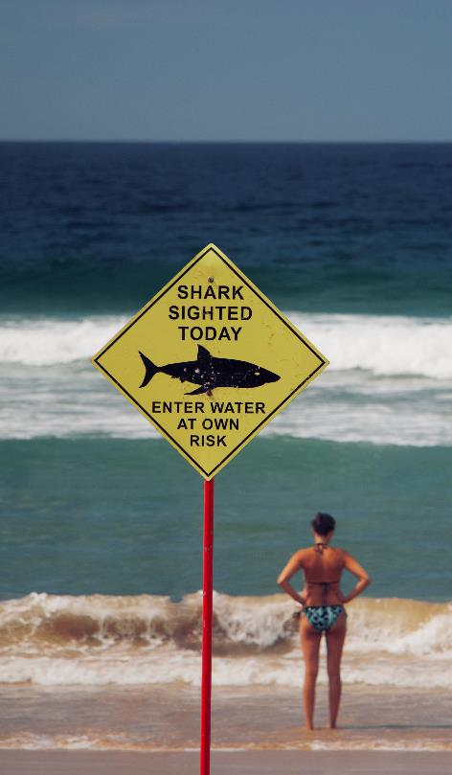
Early Adopter
A chance to influence
Ensure Esploro will fit our use case
Financial benefits
Also comes with risk
Photo by Lubo Minar on Unsplash
Notes:
The Early adopter program is a chance to influence the development of the platform and ensure that it will meet our needs
It comes with long term financial benefits but also with some risk e.g. It might not work, it might not be delivered on time, it might not have all the functionality that we require initially.
To mitigate that risk we were able to negotiate a flexible exit clause from our bepress/ Digital Commons subscription.
ExLibris have been incredibly supportive and honest with what they will deliver and when.
We are aiming for a launch date of November 15, 2019
This will be a soft launch and we will be running two systems in parallel, digital commons ePublications@SCU and Esploro.
We will continue this strategy until we are happy with the researcher profiles and research centre outward facing pages of Esploro.

Slide 9
Expect the unexpected
A twelve week Copyright Agency Electronic Use and Hard Copy Monitoring Survey
Emergence of new Research Centres
Technology Services SaaS project to move Finance and Student Services to the cloud
A technology change freeze
Photo by John Cameron on Unsplash
Notes:
Wing it
As with all projects there are some things that happen that are completely outside your control, can’t be helped and need to be dealt with. So expect the unexpected.
Copyright management at Southern Cross is also part of my remit and we were notified in February that we would be undertaking a full Electronic Use and Hardcopy monitoring survey from April until July. 12 weeks. This reporting happens approximately every 4-5 years and is part of our statutory licence agreement with the Copyright Agency. It is not fun. It is time consuming. And doing it is not negotiable.
We also had a new Deputy Vice Chancellor (Research) start in early 2019 and our research centre structure is still being bedded down. Some research centres are brand new, reflecting emerging areas of research interest for the University. This left us with a degree of uncertainty around what the organisational structure will eventually be. To simplify this in Esploro and provide flexibility for merging and movement of organizational departments we have opted for a very flat structure that will be modified once the University decides on its final structure.
Additionally Technology Services are in the process of a huge project to move our student information system and finance systems into the cloud, the SaaS project. This project consumed every developer on the planet (actually every developer at Southern Cross really). It meant that to get the researcher load xml file from the HR system was a challenge as, at times, it took longer to negotiate the release of a developer for the Esploro project than it did for the developer to do the work.
Despite competing priorities Technology Services have provided their full support for the Esploro project and continue to work towards building infrastructure, such as the ORCID API, that will provide an integration point for Esploro.
A technology change freeze was ordered across the institution to ensure resources were provisioned for the SaaS project but the Esploro project has been exempted from this freeze and we continue to get full backing from our Technology Services colleagues.
Despite and because of all the above we have managed to stay on track for our project timelines.

Slide 10
Migration
OAI-PMH export using document export
All bepress data also backed up to AWS3
Mapping of metadata
bepress asset types
Related works
Works with authors in different organisational departments
Statistics
Photo by Jorge Tung on Unsplash
Notes:
So on to the migration.
Our bepress data has been migrated successfully using the OAI-PMH Document export function which was not documented by bepress and it was only through speaking to another bepress (Bond) that I knew that it was a possibility.
In the meantime I had set an Amazon WS3 server up that contains a backup of all the digital commons and Selected works data
A plan B if you like.
ExLibris were great with the metadata mapping which was something that we had very little experience in.
We have migrated from a system where only a handful of asset types were supported (13 to be precise) to one that has around 50 and growing.
In bepress we used html and free text fields to create associations between related content. Not ideal.
Often the absence or not of a particular metadata field on a record, or a particular piece of html, determined what type of asset was being described. Conference papers and Conference proceedings being the most obvious example. The ExLibris team had to pick this apart and we are currently testing the results of the data migration. It’s looking pretty good.
Assets are associated with the correct organisational unit in Espoloro through looking at the setSpec attribute and Esploro also use a matches to the author so that an authors publication or assets can be associated with the work unit that they are employed by or have been associated with.
One of the huge plusses for migration was the ability for ExLibris to also migrate our statistics from Digital Commons. So we will be able to retain our download counts, something that the researchers love.

Slide 11
Current submission process
ePubs
IRMA (CRIS)
Profiles
Notes:
So we plan to go from this

Slide 12
Proposed submission process
Esploro
IRMA
Notes:
To this.
The researcher writes a paper and gets published.
That is all they have to do unless they choose to self submit to Esploro.
The metadata will be automatically harvested by Esploro and mediated by Library staff who will do what Library staff do best and verify the publication details and contact the researcher, via Esploro, to request the accepted manuscript if necessary.
Esploro will send scheduled analytics reports to the Head of School or Research Centre via email and an xml file to IRMA of all eligible ERA outputs for ingestion into IRMA.
This process will ensure that we are capturing all publications in the most efficient manner and reduces the duplication of effort currently being undertaken by Library and Office of Research staff.

Slide 13
Automagic harvesting
Esploro auto populates the metadata of an asset based on doi or ISBN
Utilises artificial intelligence to identify assets from various sources
Leverages off the Summon Index
De-duplicate assets
Will look to harvest from Research Data Australia, Figshare and Unpaywall to name a few
Will link to ORCID
Support OAI-PMH publishing and harvesting
Photo by Artem Maltsev on Unsplash
Notes:
Of all the benefits of Esploro the ability to automatically (or magically) harvest from the internet and match assets to our authors is one of the greatest.
The system already grabs the metadata for doi’s or ISBNs and auto-populates the deposit form but what I have seen from the harvester goes beyond that and covers all types of assets not just those with doi’s.
It looks at name variants of an author, the field of research, and the author’s research interests to locate research assets that may be associated with that researcher.
Esploro will rate the certainty of the author match and depending on configuration, the researcher or library staff can approve the asset or not. As we become more confident with the matching process we will be able to workflow assets that we are sure of to publish automatically. These would be things that are matched via a unique identifier, such as, an ORCID Id, Researcher ID or Scopus ID.
Our current system is completely reliant on author’s submitting their research via a form and we also run SCOPUS and PubMed reports that we manually enter the data from. As you can imagine Esploro will be a huge improvement and ensure that we are able to obtain a complete picture of research publications and assets associated with them at Southern Cross.
The harvester leverages off the Summon index and utilises AI to identify assets that might be associated with a researcher or Southern Cross. It de-duplicates and enriches existing metadata.
Integrations are planned with ORCID, unpaywall, Figshare and Research Data Australia. Esploro also supports OAI-PMH harvesting and publishing to Google and Google Scholar.

Slide 14
The data
ePublications contains nearly 20,000 assets
Approx. 23% are Open Access
Open Access content includes a conference proceeding, a defunct journal and Southern Cross theses
Each series represents a School, Work Unit, Research Centre, or a data collection
Relationships between the assets in bepress are managed with html hyperlinks
There was no staff load or synchronisation written for Alma
Photo by Pietro Jeng on Unsplash
Notes:
We have close to 20,000 assets in ePublications with around 23% available on open access.
This content includes a defunct journal, a conference and theses. All of these assets are Open Access and have been migrated to Alma-D. These items may or may not be associated with a Southern Cross researcher but they are associated with Southern Cross.
Some assets in the series appear in multiple series as they are authored by cross-institutional collaborators. I mentioned earlier that the information within bepress was siloed and this is the another example of that.
Our data collections are harvested by Research Data Australia and our theses are harvested by TROVE – the National Library of Australia catalogue. Both of these OAI-PMH harvests will need to be redone from scratch.
We were fortunate that the University of Iowa was also a bepress institution and they were the first Library to go live.
In our initial go live, Primo VE will be used as the data portal and I have a sneak peak of what this might look like which I will show you later.

Slide 15
Integrations
Southern Cross Staff database (Aurion)
Southern Cross Data warehouse
Southern Cross ORCID API
IRMA (CRIS)
ORCID integration is on the Esploro roadmap
Research Data Australia
Libraries Australia
Datacite for minting dois
Many more…
Photo by Clay Banks on Unsplash
Notes:
Southern Cross had never had a staff load from a University system
Staff data had been considered confidential so staff were added to Alma in an ad hoc manner at the point of need, when they wanted to borrow or request.
There were numerous errors with the data entry the most drastic being incorrect primary identifiers this all needed to be tidied up and corrected before the researcher loader was used.
The researcher load xml file is generated from the Southern Cross Data Warehouse which was only implemented in early 2019. It includes the API keys from our ORCID API and this will be the source of truth for ORCID identifiers across the institution.
We plan to integrate with IRMA not only to provide a comprehensive and timely update of the publications data on a scheduled basis but also get information on grants to include into Esploro so that publications that have been generated from a grant can be linked to each other. This will give a rich picture of the impact that a grant has had and a comprehensive view of all the assets associated with a particular grant.
We plan to utilise APIs and widgets to generate embeddable publications information for the Research Centre and School websites as many of these centres currently display the publications information on simple html pages that do not contain metadata, links to the publication nor do they display related content.
We will also be providing scheduled publications reports to Research Centres and Heads of School

Slide 16
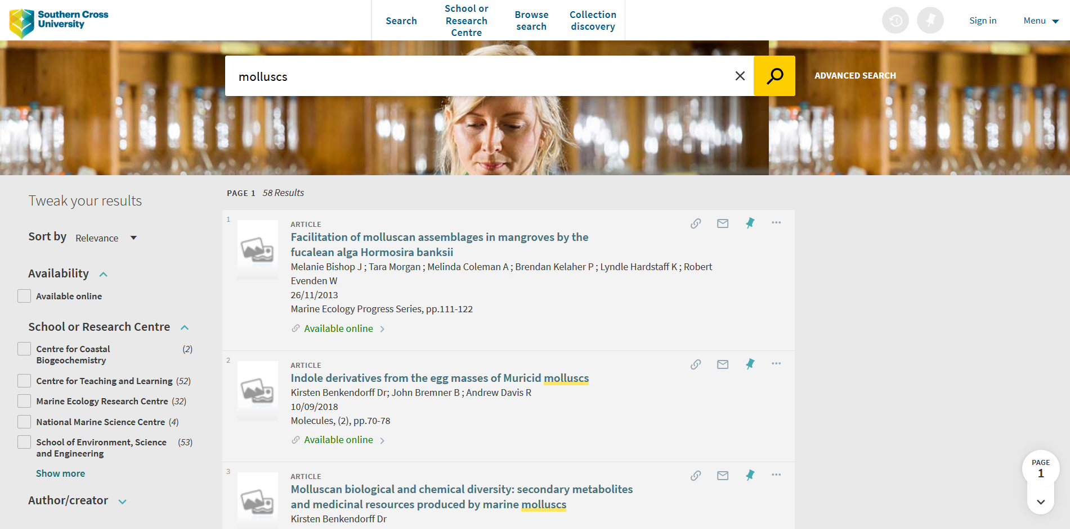
Research on Primo VE
Notes:
So this is how we are thinking Esploro will look in Primo VE initially we wanted to make it look quite different from the catalogue
Esploro offers discoverability on Google and Google Scholar and I should mention that discoverability was one of the things that contributed to us staying with bepress for so long.
There will be a dedicated discovery portal with analytics, bells and whistles as well a the researcher portal. This is on the ExLibris roadmap for 2020

Slide 17
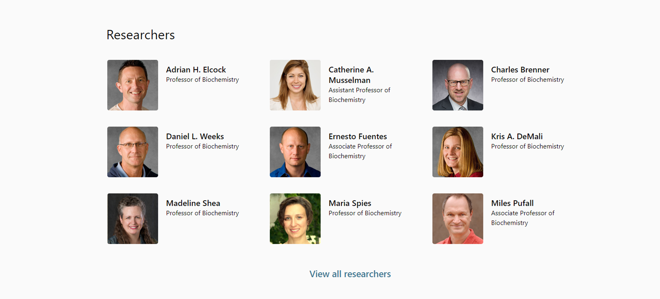
Researcher portal
Notes:
The researcher portal landing page as it is looks now obviously this may change and will be customised

Slide 18
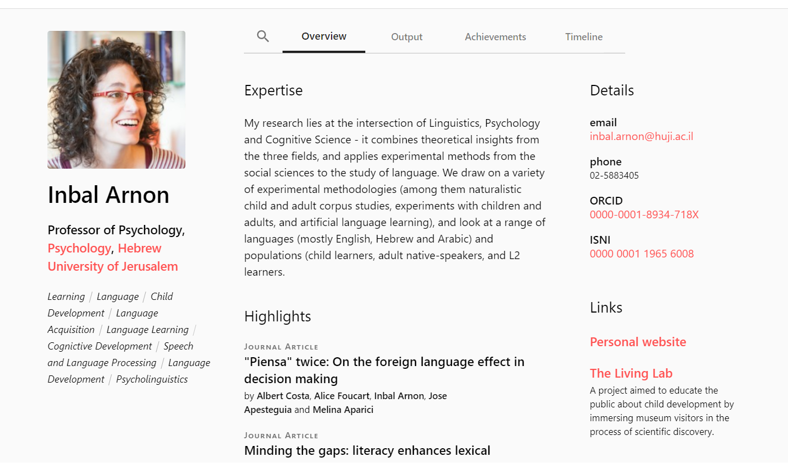
Researcher profiles
Notes:
The researcher portal and profile pages will be more comprehensively developed in 2020
These last 2 slides have been supplied from ExLibris but what we have seen of the profile pages is an improvement on what we currently have with the researcher able to highlight particular outputs, list their achievements and display their outputs in a timeline view.
The profiles tell the story of the researcher and give a richer more contextual representation of who the researcher is and what they are currently doing.
Researchers will have the ability to edit certain sections of their page and put the focus on different aspects of their research.

Slide 19
The deposit in Alma
Notes:
I have recorded the submission process from the Library Staff perspective so that you can see what this looks like from the back end.
People who are familiar with Alma will not find any surprises.
Esploro sits as the “Research” module in the top navigation.
So you select Deposit a research Asset
Associate the research with either an organisational unit or researcher, I’m going to choose and organisation unit
Select the asset type
Enter your DOI and Esploro goes off and grabs all the metadata including the additional subjects, abstract, and publisher copyright statement
You can drag and drop files on to the record or add links for remote access
Esploro has found authors that it thinks might be Southern Cross affiliated so I’ll approve them
You can add other contributors
Check and edit the imported metadata
You can link the asset to the Grant it was generated from if applicable
The abstract and keywords have populated automatically
There is a Sherpa Romeo integration so staff can immediately see what deposit terms and conditions apply to the asset and the accepted manuscript
You can add an access rights policy
And you can generate an email to notify the researcher that the asset has been added.
We currently either cut and paste this information or retype it so you can see how much time this is saving. Also, as the information is coming directly from the source there is much less likelihood of errors in the record.

Slide 20
Benefits for Library
Automatic harvesting
Automatic ordering
Staff already familiar with how Alma works
A system that supports all types of assets from blogs to data to traditional publications
Ability to apply different licenses and access rights to different versions of the publication
Ease of management of research profiles
Support from the ExLibris Community
Notes:
The benefits for the Library are multiple but my favourite is that data will be automatically harvested into the repository. Our current data entry processes are incredibly inefficient and, as most data is manually entered, at the moment there is a lot of room for error. One of which is the process of ordering a publication for the library collection if it is by a Southern Cross researcher. Currently staff have to remember to place an order in Alma after they have entered the data into ePublications….Yes that means they have to enter the data again into Alma. Esploro will create a workflow for these orders after checking whether the item is held or not.
Esploro also offers the flexibility to apply different licenses and access rights to different version of a research output. Our current system allows one version to be added to the repository, Esploro allows multiple versions to be added to a single metadata record with each version able to have different licence and access rights attached. If I can put my copyright hat on for a moment this is incredibly advantageous and will enable a researcher to load a pre-print with full access, an accepted manuscript with an embargo if required and a publisher version with no access and/or a link to the publisher version.
Research profiles are currently requested by the researcher who fills out an online form and supplies a list of publications, a biography and photo. The publications information is then entered into ePublications and harvested to the Selected Works profile manually by library staff. There is no identifier on the publication that links the publication to the author or authors.
We will have an automated load of researchers into Esploro and Esploro will create a profile for any researcher who has publications, it will automatically link the publication to the author or authors.
It will create records for non-affiliated authors so that collaborations outside of the institution can be evidenced.
Library staff will be able to send canned emails from directly within the system. This is a huge improvement on our current processes.
On top of this we will be able to create and share integrations, APIs and widgets to disseminate the data across all our platforms such as the website.

Slide 21
Benefits for Researchers
Minimal effort maximum exposure
Increased visibility
Compliance with funding requirements
Time saving for research centre administrative staff
Automatic generation of profile
Research Profiles that will be fully integrated with the repository
Time saving for the researcher
Photo by Nik MacMillan on Unsplash
Notes:
Benefits for the researcher are numerous but the main one is the amount of time that they will save. With the publications data being harvested automatically the only research assets that will need to be reported manually are assets that will not be published to the internet. The researcher portal provides an incredibly easy interface for reporting different types of assets. So for the researcher this means minimal effort for maximum exposure.
We will be able to link assets via the grant ID to ensure that researchers are meeting the requirements of their funding bodies and provide reports to the researchers, research centres and heads of school. The ARC advocates that publicly funded research should be made publicly available wherever possible and in the very least the metadata must be deposited in the institutional repository within 12 months of publication. Esploro will be able to report on how many assets attached to a grant ID are open, how many times they have been downloaded and from where.
Researchers will be automatically given a profile and that profile will be automatically updated. The profile will be fully integrated with the repository. The objects metadata will be re-used in the research profiles, the research centre profiles, and on our web site. Maximising the exposure of the publications and assets and saving time for the researcher.

Slide 22
Benefits for Institution
Comprehensive picture of research outputs across the institution
Ability to leverage of Alma analytics to create reports
Automatic dissemination of publications information
No duplication of effort for adding data
Timely reporting of publications data
Consistency
Notes:
The institution will have a comprehensive picture of all its research outputs and a single point of truth for publishing to its website. Administrative assistants will no longer have to spend hours adding simple html to a web page listing of publications that is hardly discoverable due to a lack of metadata behind each output.
We will use analytics to supply the research centres with their publications in the form of an automatically refreshed query.
We will no longer have to rely on a researcher to report their publications before they get added to the repository.
There will be consistency across all the centres in the way that the asset data is displayed on the web site.

Slide 23
Questions?
Photo by Camylla Battani on Unsplash
Notes:
I’ll just “paws” for any questions?

Slide 24
References
Kennan, M., & Kingsley, D. (2009). The state of the nation: A snapshot of Australian institutional repositories. First Monday, 14(2). doi:https://doi.org/10.5210/fm.v14i2.2282
CAUL Review of Australian Repository Infrastructure https://www.caul.edu.au/programs-projects/fair-affordable-open-access-knowledge/review-repository-infrastructure

