Slide 1
A national library perspective on Alma
Sandra McKenzie
Team Leader, Cataloguing Team 2
ANZREG 2019 Conference (23-25 October 2019) #anzreg

Slide 2
Outline
National Library of New Zealand
Legal Deposit Legislation
New Zealand National Bibliography
Volume of material
Alma: Challenges
Alma: Opportunities
Wrap-up
Notes:
4.9 million people
3 official languages

Slide 3
National Library of New Zealand (Te Puna Mātauranga o Aotearoa) Act 2003
The purpose of the National Library is to enrich the cultural and economic life of New Zealand and its interchanges with other nations by, as appropriate,-
(a) collecting, preserving and protecting documents, particularly those relating to New Zealand, and making them accessible for all the people of New Zealand, in a manner consistent with their status as documentary heritage and taonga
Notes:
Taonga is a Maori word which in this context means treasure.​

Slide 4
National Library of New Zealand
Heritage Collections held permanently:
Physical resources in temperature and humidity controlled stacks
Digital resources in digital preservation repository
Source: Imaging Services, NLNZ

Slide 5
Legal Deposit Legislation
Applies to all publishers in New Zealand
Physical resources: 2 copies (1 copy if costs more $1000, or less than 100 copies published, or annual subscription for periodical costs more than $3000)
Digital resources: 1 file format
Published in both physical and digital format? Both must be deposited
Notes:
Legal deposit which has been around in some form since 1903
We create a separate descriptive record for the physical resource and for the digital resource​
We are preserving and making accessible two distinct objects, and each object needs metadata that accurately reflects its characteristics. We are not creating records for our own exclusive use. The records we create need to work effectively for other libraries, who may have only the physical resource, or only the digital resource.​
​
​
​

Slide 6
New Zealand National Bibliography
The National Library of New Zealand is the national bibliographic agency for New Zealand
Scope of bibliography wider than legal deposit
Publish records to OCLC
Z39.50 gateway or Alma External Resource functionality
Monthly files
Dataset updated quarterly
Notes:
The National Library of New Zealand is the national bibliographic agency for New Zealand. According to IFLA (the International Federation of Library Associations and Institutions), the national bibliographic agency has “responsibility for the preparation of the authoritative and comprehensive bibliographic records for each new publication issued in the country, making records in accordance with accepted international bibliographic standards and publishing them with the shortest possible delay in a national bibliography which appears on a regular basis.” Guidelines for the National Bibliographic Agency and the National Bibliography / prepared by the IFLA International Office for UBC. Paris, 1979, p. 7. quoted on page 79 of National Bibliographies in the Digital Age: Guidance and New Directions by Maja Žumer (Ed.) Series: IFLA Series on Bibliographic Control 39 Publisher: München: K.G. Saur, 2009​

Slide 7
Volume of material
Analogue Avalanche
Digital Deluge
Publishing in physical formats
Donations as libraries around New Zealand assess their collections
Source: Mark Smiciklas CC BY-NC 2.0

Slide 8
Systems
from 2008 onwards
Go live August 2016
with Primo Classic UI
September 2018 –
Primo New UI
Notes:
We were a Voyager library for a long time before migrating to Alma. Prior to 2011 we had 3 Voyager application support specialists who were part of the library, but when the library became part of the much larger Department of Internal Affairs, they were transferred to IT team. Application support specialists helped with migration from Voyager to Alma, and then it was up to us. Now we have no application support specialists, and no systems librarian role. We have a distributed model which has both pros and cons.
​

Slide 9
Alma - Challenges
Metadata Editor
Born digital workflow
Alma publishing – Primo deduplication
Serials

Slide 10
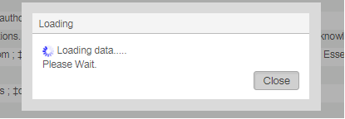
Metadata Editor
Notes:
​

Slide 11
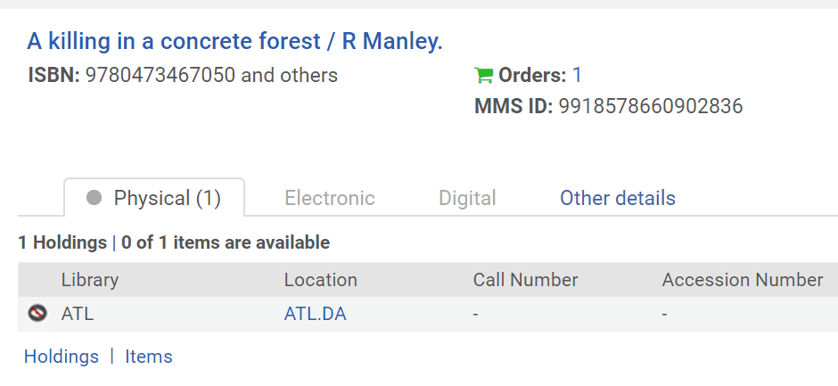
Born digital workflow
Notes:
No workflow for born digital material, and particularly for born digital legal deposit material (though an idea is now under review).
We need to be able to claim digital resources under Legal deposit. For example:​
Rex Manley applied for ISBNs for his digital publication (one for each for each digital format) A killing in a concrete forest in December 2018. It was due to be published in February 2019. We supplied the ISBNs and created a prepublication record, added a deferred purchase order using a physical workflow because there isn’t a digital legal deposit workflow. ​
We need to be able to claim the resource if it isn’t deposited with us after publication​
​

Slide 12
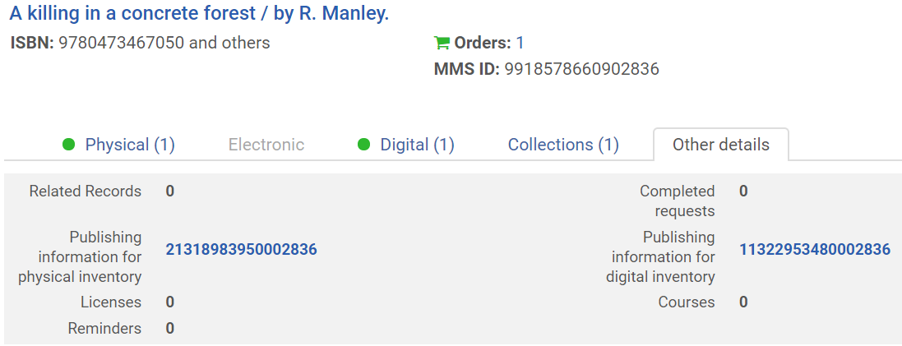
Alma publishing – Primo deduplication
Notes:
We did get a copy in March 2019– but we don’t always have such diligent publishers, and we do have to have a mechanism by which we can chase them up.​
The resource has been deposited into Rosetta and the digital representation has been created in Alma.​ So we now have a physical holding, and a digital representation​
Alma publishes a separate descriptive record for each delivery method, and they are deduped in Primo. Here you can see the publishing number for the digital inventory and the publishing number for the workaround physical inventory.​
This caused a major problem for us when we first migrated, because of the Primo deduplication algorithm which was too blunt (too aggressive) for many resources in our collection. Resources were being deduped that shouldn’t be. Maps, music scores, serials and rare books were the worst affected but we kept finding others.

Slide 13
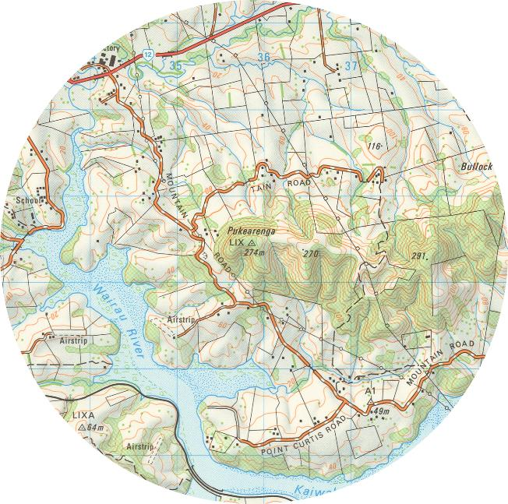
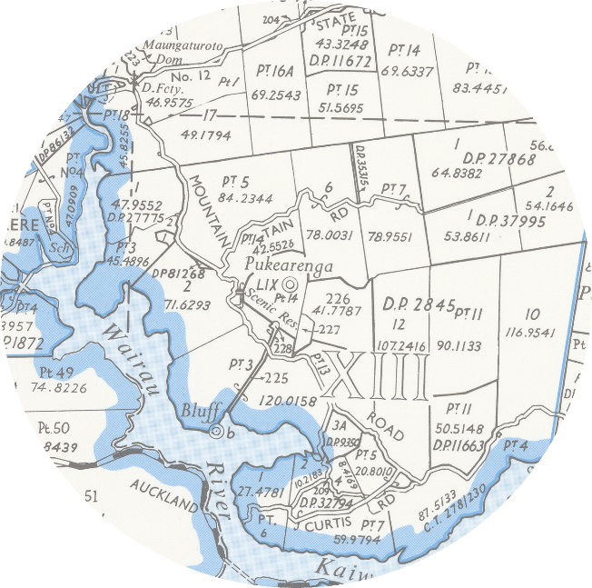
Maungaturoto. New Zealand. Department of Lands and Survey. 1981.
Series: NZMS 260 ; sheet Q08
Series: NZMS 261 ; sheet Q08
Sourced from LINZ. Crown Copyright reserved
Notes:
For example: On the left, detail from a topographic map, with contours line representing height, rivers and other geographic features marked. On the right, detail from a cadastral map, showing property boundaries. The both have the same title, they were published in the same year, and were put out by the same government department. The difference is the series to which they belong. The one on the left is in the NZMS 260, and the one on the right is NZMS 261. Conceptually, and crucially for those interested in maps, they are NOT the same work, which is why they are in different series​. Primo deduped them. This was just one example of many.​ FRBR was a problem too, and the feedback from the Reading Room staff was that the users didn't like it, and neither did they. ​We could turn off FRBR easily, but if we turned off dedup then we had a problem with our digitally born material – we would have two records in Primo for one resource. One of which lead the user nowhere. Back in 2016, our Primo implementation manager hadn’t come across this much, and there was some delay before this could be resolved and we were able to deduplicate by Alma MMS ID only.​
​

Slide 14
Serials
Ongoing challenge
Daily publications, print and digital
Item records – yes and no
Print, digital and electronic options for the same title
Source: Imaging Services, NLNZ
Notes:
Example: Otago Daily Times – digital reps = 27,589
Started in 1861- print, digital, electronic or full text access via Papers Past (1861-1950)

Slide 15
Alma - Opportunities
Normalization rules
Integration with Rosetta
New ways of working
Podcast example

Slide 16
Normalization rules
Record by record cataloguing
Metadata clean-up
Bulk record creation

Slide 17
Integration with Rosetta
Update Bib Record API
File extension information from Rosetta mapped to RDA file type and encoding format (MARC fields 347, and 500)
Track list generated for MP3 and FLAC audio files (MARC field 505)
Primo permalink (MARC field 856)

Slide 18
New ways of working
End to end – cross team approach
Records from spreadsheets
MarcEdit
Digital Collecting Specialist
APIs

Slide 19
Notes:
Partial view of a record in Primo for an episode in the Taringa podcast. The information you see is from a template. Each podcast series has its own template. The cataloguer creates the template, deciding what information should be in it.

Slide 20
Notes:
The red boxes show the data that has been extracted from the RSS feed for the episode – title, series number, date and description.
The Digital Collecting Specialist has developed a series of scripts to harvest each podcast episode, as well as data about the episode from the RSS feed.

Slide 21
Notes:
The information in the green box comes from a spreadsheet created by the Digital Collecting Specialist and filled in by a cataloguer. There are 4 types of podcast in the Taringa series, so the cataloguer enters subject headings on the spreadsheet according to the type of podcast – kupu (words) like this one, iwi (tribes) legends, or tikanga (protocol).
The template, the data from the RSS feed and the spreadsheet are the building blocks for the record. Scripts and the APIs are the tools that create it.
There are scripts that automate the ingest into Rosetta.
We have ironed out the last wrinkles and this is now Business As Usual.

Slide 22
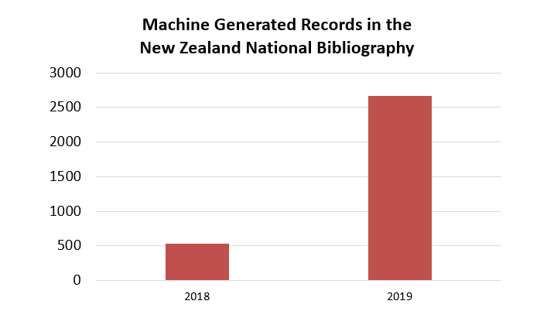
Notes:
We code the record from the previous slide as MGR – machine generated record.

Slide 23
Wrap up
The business of a national library
Challenges
Opportunities
Questions?
sandra.mckenzie@dia.govt.nz
nznb@dia.govt.nz

