Slide 1

“It should just work”: the case for next generation access technology
Kendall Bartsch
CEO & Co-Founder
kendall@thirdiron.com

Slide 3
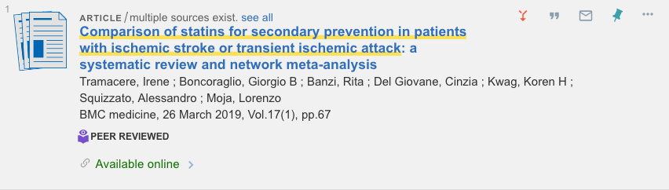
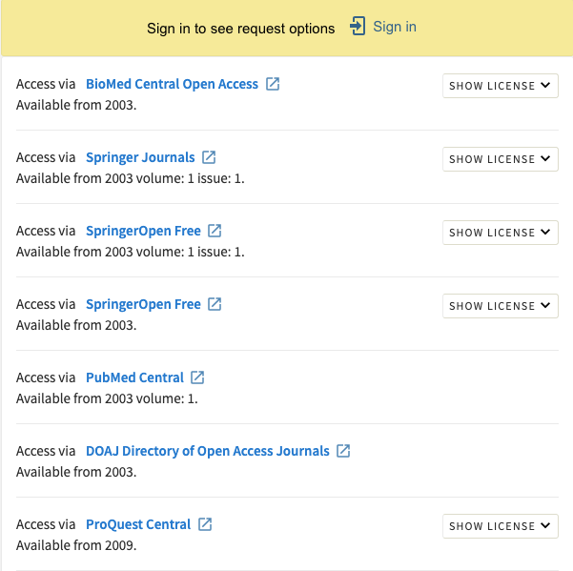
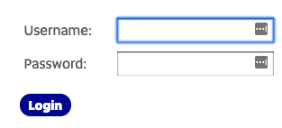
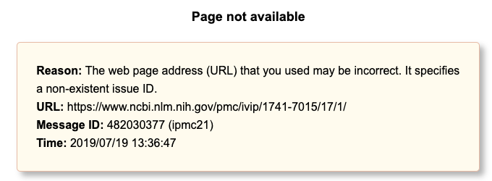
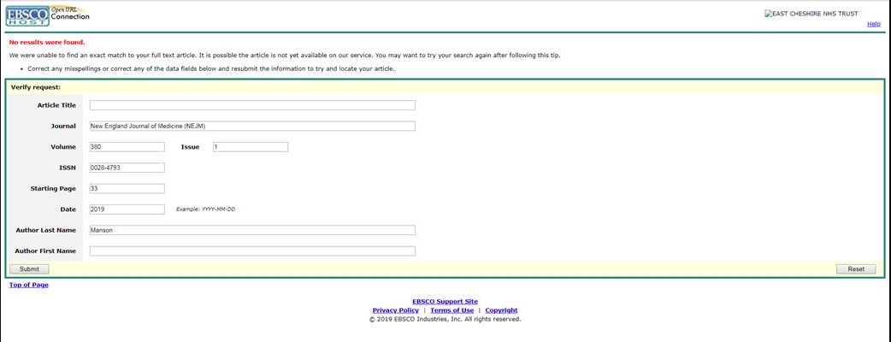
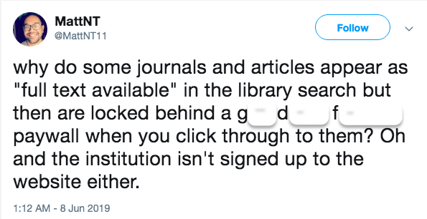
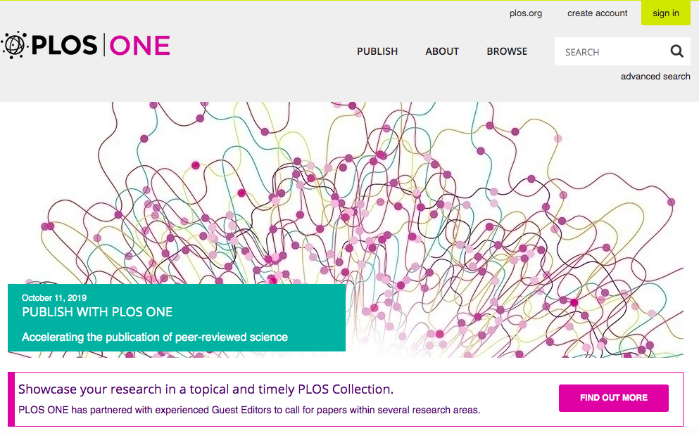
Notes:
Library systems are barriers to this engagement

Slide 4
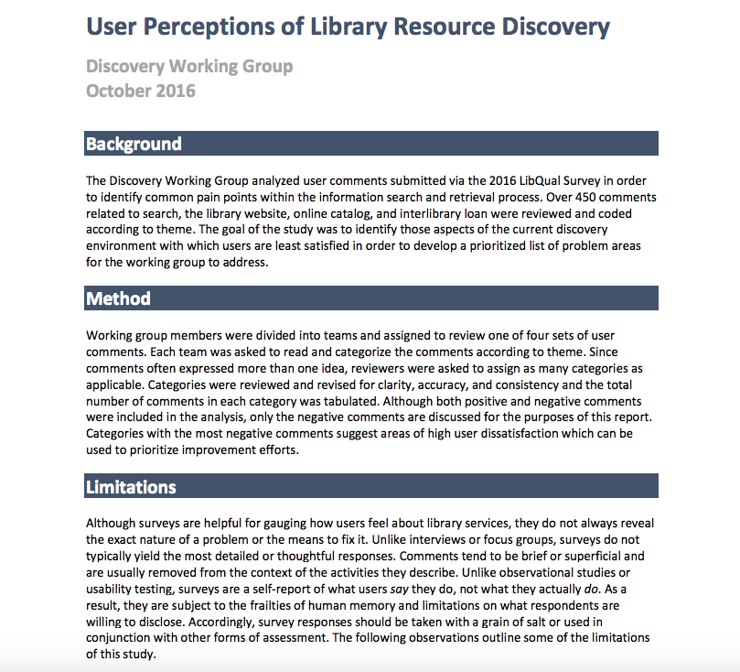
2011
2016
2017
2019
”Only 62% successfully printed five articles”
”Users find the link resolver to be confusing, cumbersome and unreliable”
“almost a quarter of study participants did not click through all links and buttons needed to get from a database citation the full text of an article”
“Library access is too difficult and takes too many clicks, just do what Sci-Hub does.”
”Users just want to get to full text; they do not want other menu options”
Notes:
2011: Imler and Eichelberger “Do they ‘get it’? Student usage of SFX citation linking software,” College & Research Libraries, assessed undergraduates’ use of SFX by having them view a results list and select and print full text for the five most relevant articles, and recording the students’ research session. Only 24 (62%) of the 39 students successfully printed five articles. Of the 26 students who even clicked on the SFX button, six did not click on ‘Go’ to get the full article.
2011: Ponsford, Sewell and Stephens, “Finding known journal articles: Comparing a citation linker to an A-Z list.” Serials review, wrote User just want to get to full text; they don’t want the other menu options
2016: Rutgers University published a study entitled User Percpetions of Resource Discovery which reported that overall “users find the link resolver to be confusing, cumbersome and unreliable”, quoting a study participant who stated the link resolver button “almost never works”
2017: Review article by Cyndy Chisare, Jody Fagan, David Gaines and Michael Trocchia, “Selecting Link Resolver and Knowledge Base Software: Implications of Interoperability, conclude simply that “As any links to full text become generally successful, our expectations that they deliver the user directly to the full text increase.

Slide 5


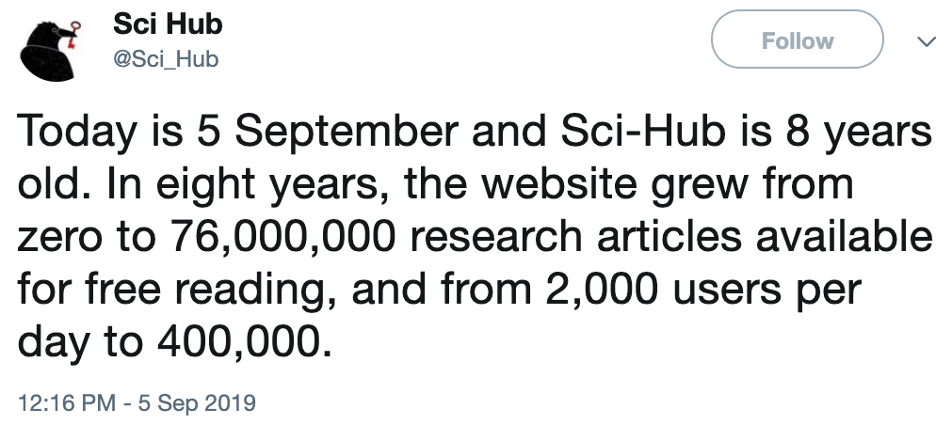

Social sharing
Piracy
Sharing and piracy ”steal” an estimated 20% of usage from publisher sites
Notes:
400,000 Sci-Hub visitors a year, 2.5B article downloads across all publishers. 400,000 users a day. Assume 1 article download per user, = 146M articles a year. SciHub is taking 5.84% of the worlds full text downloads, and that is just SciHub.

Slide 6

Redefine the user experience to provide consistent signposts regardless of starting place to connect users to library supported content
Meeting User Expectations

Slide 7
1) Article data
Identify metadata sources
Vet data (comprehensive, complete, accurate)
Correct data – missing articles, incomplete citation data, basic errors in data
Normalize data – publishers create metadata differently
Maintain – journals switching publishers, pre-print moving to publication status
Update data – users expect currency
Incorporate Open Access metadata, including OADI

Slide 8
1a) Open Access
Third Iron identifies and indexes millions of articles from thousands of Gold Open Access journals
Make use of the OADOI API to link to Open Access not otherwise identified by Third Iron
There is considerable overlap between OADOI and Third Iron indexing. Because Third Iron hosts the data, response times are exceptionally fast.

Slide 9
2) Entitlements data
Develop tools to import holdings data across different vendors – each vendor represents holding data differently
Automating the import process – reduce administrative maintenance
Normalize, analyze, and possibly correct the data – identify errors in holdings information, ensure correct linking
Develop an algorithm to automatically route to the best available source
Notes:
There are *some* standards for some entitlements data, such as Google Scholar.
We came up with an augmentation to that data format, which we call Google Scholar Plus, that a few entitlements softwares send us data in.

Slide 10

3) Library authentication & Fulfillment
Many authentication types
Track authentication type changes
Understand URL Schemes, API’s, IP ranges, Custom VPN setup instructions and more

Slide 11
Putting it all together
Article
Metadata
Library Entitlements
Data
Library Authentication
Article
Metadata
Entitlements
Data
Library authentication
Article
Metadata
Entitlements
Data
Library authentication
Article
Metadata
Entitlements
Data
Library authentication
PDF
or
Abstract URL
LibKey
DOI or PMID of interest to User

Slide 12
Simplify and expedite researcher workflow
Keep the library at the center of the research process

Slide 13



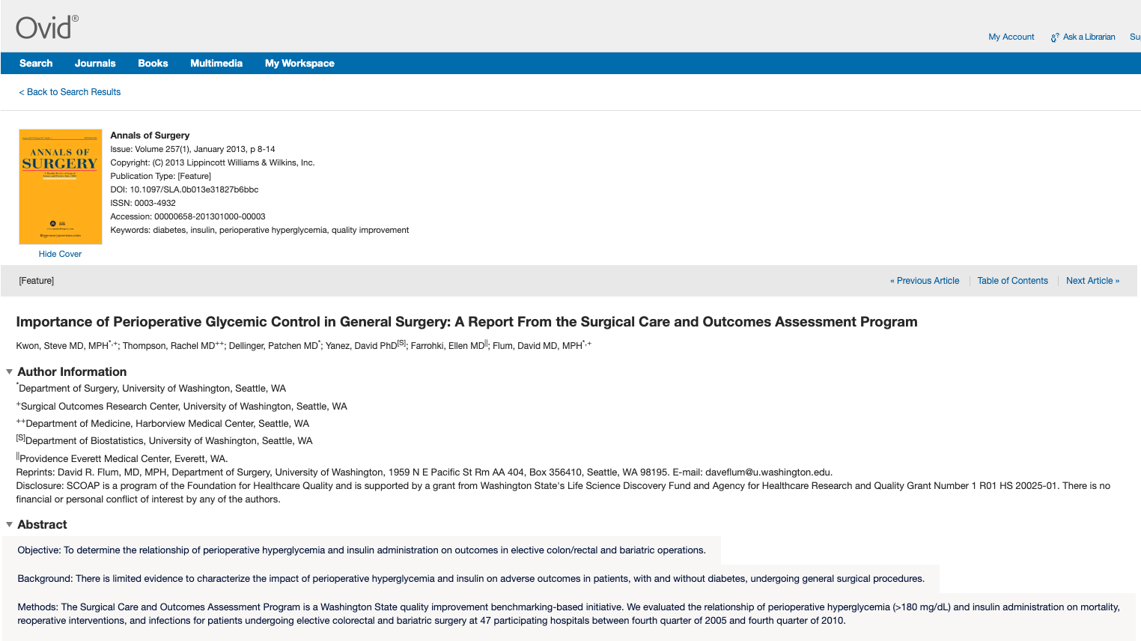

LibKey Discovery
Better linking in library systems

Slide 14

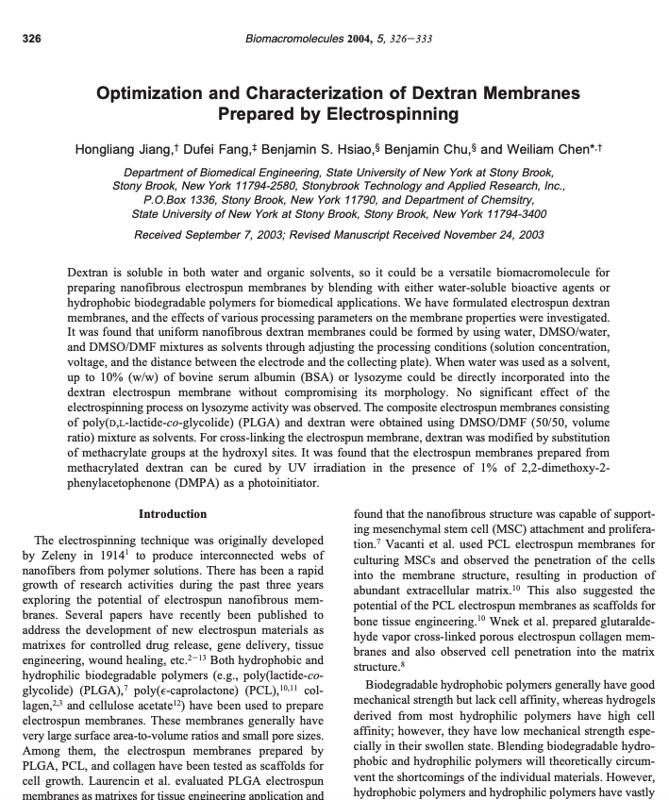
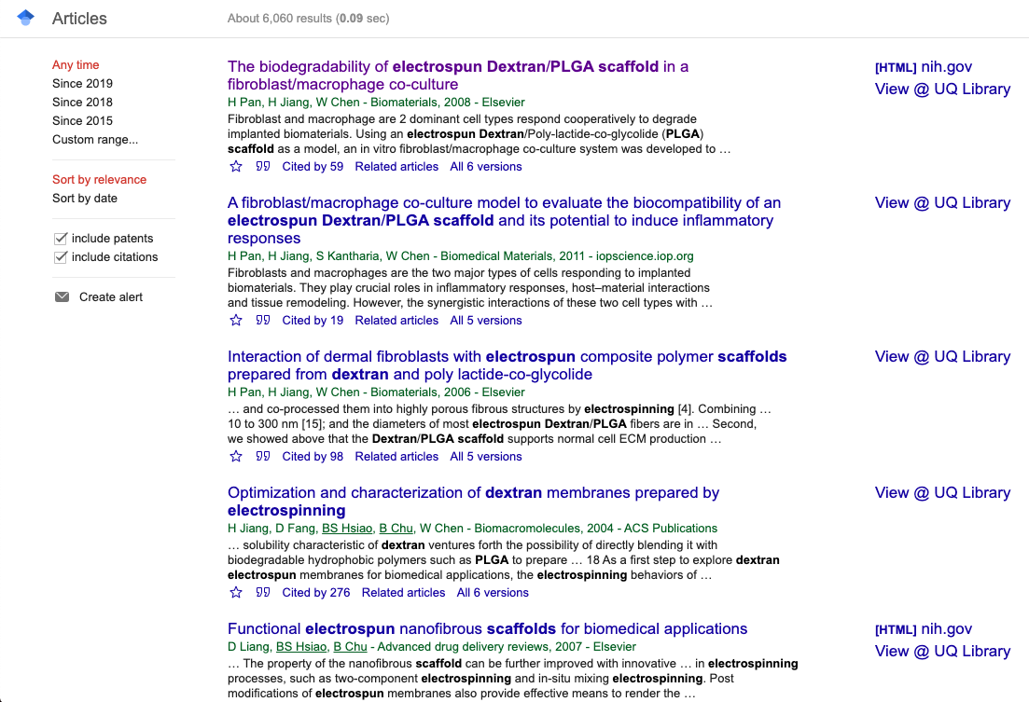
LibKey Link
Better linking in other services

Slide 15

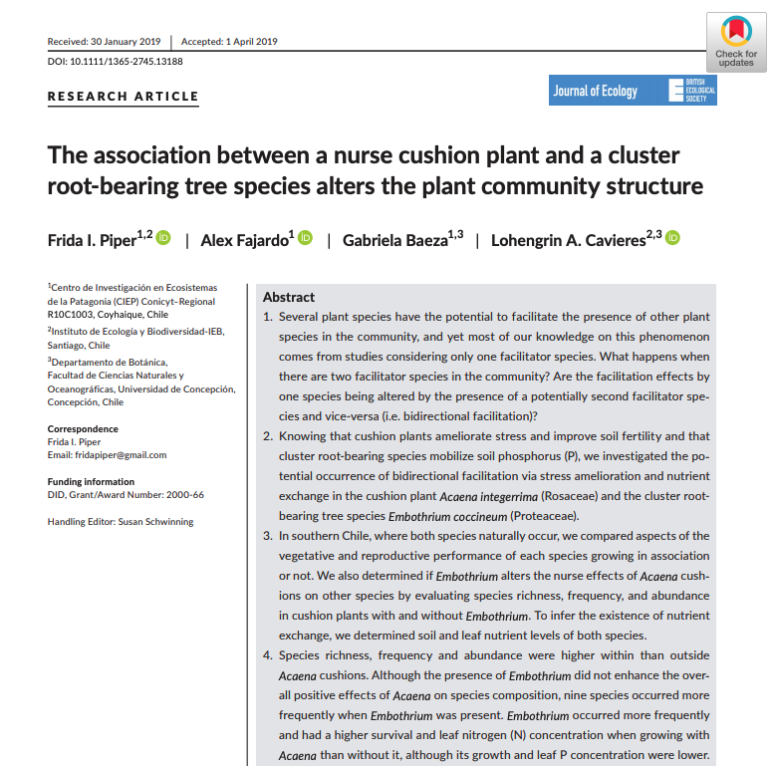
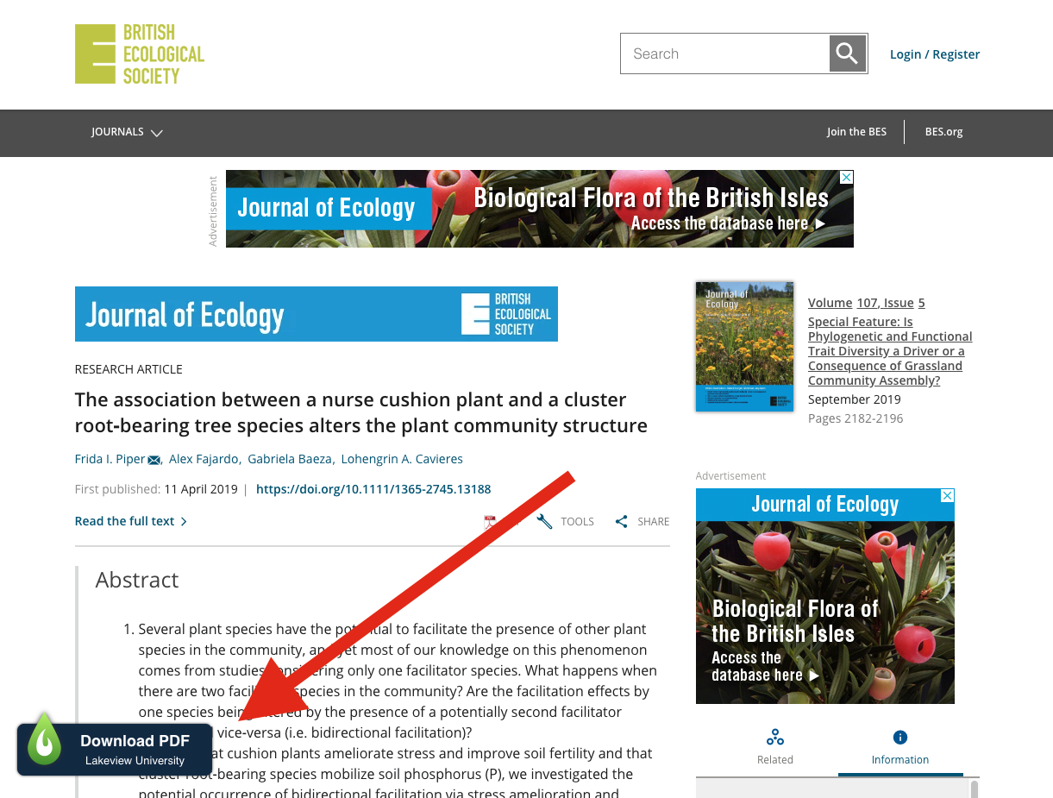
LibKey Nomad
Better linking from open web searching

Slide 16
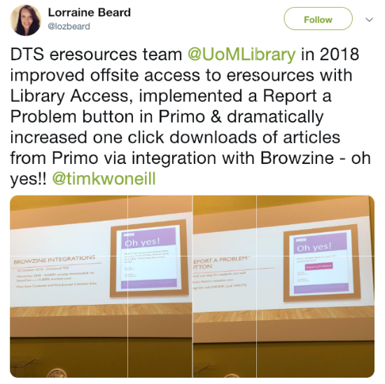
Outcomes of Improved UX/UI
“We have seen a 25% decrease in the number of Helpdesk queries…and in my view a large part of that decrease can be attributed to our LibKey integration which has significantly reduced the number of steps our students and scholars have to take to get to full-text articles.”
- Tim O’Neil
Manchester University
Meet user expectations
2MM Article requests last month
Save library time
Fewer support tickets
Save researcher time
112 Days

Slide 17



Questions?
BrowZine
LibKey
Discovery
LibKey
Link
LibKey
Nomad
libkey.io

