Slide 1

Ex Libris update
Melanie Fitter, Professional Services Director, APAC
ANZReg 2019 – Bond University

Slide 2
Alma UI – next phase
Known Issues Operator role
Central Discovery Index
COUNTER 5
Provider Zone content loading
Next Gen Resource Sharing

Slide 3
Alma UI – next phase

Slide 4
Workflow pain points – focus areas
Physical Resource Management
Physical Item Edit
Acquisition
Purchase order lines management,
Invoices management
Electronic Resource Management
Activation Task List
Fulfillment
Information on user

Slide 5
New systemwide tools – in progress
Feedback messages
Released
My Activity Centre - Recent Entities
Preparation for user testing
Multi facets selection
In analysis
Improve configuration of mapping and code tables
Preparing for user studies
Improvement in Menu
In design

Slide 6
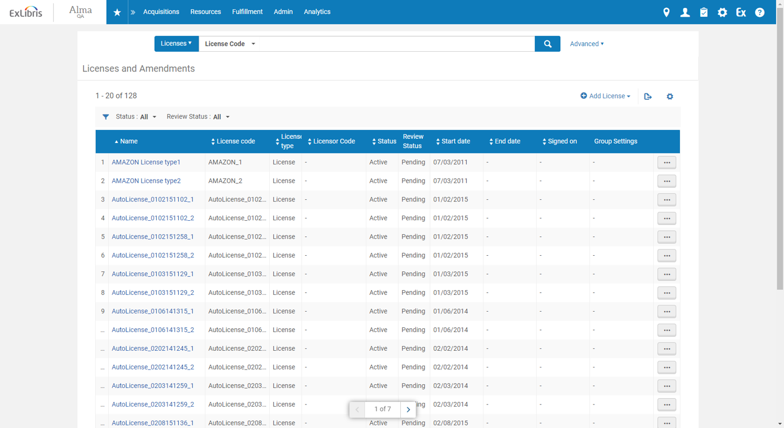
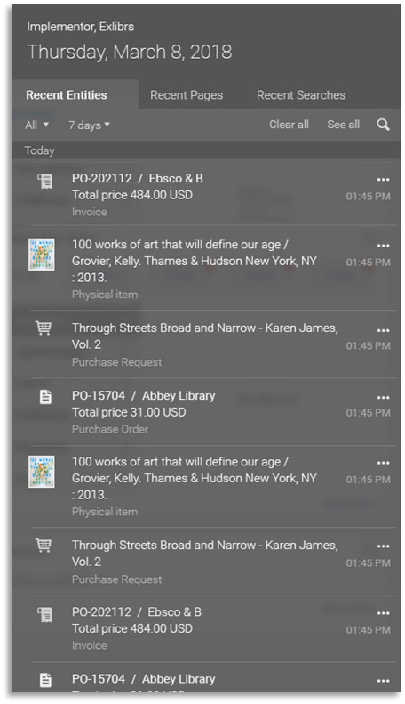
My Activity Centre - Recent Entities
Notes:
System Wide Tools
The idea is that the system can track what you have beed doing and working on
And allows you to go back to where you were
e.g. you were working on a POLine, needed to jump tpo the license and then want to go bac

Slide 7
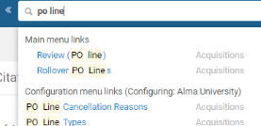
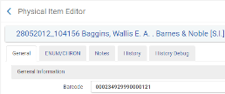
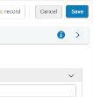

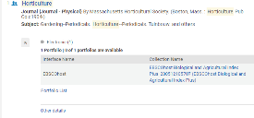
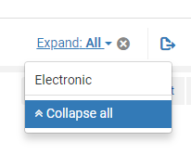
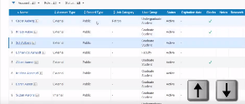
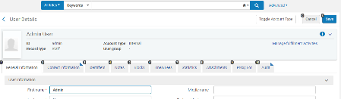

Systemwide tools - what else is new?
Search main menu
Results per page
Collapse summary
Expand all in search
Up / down navigation
Tabs hot keys
Alma user interface in the Knowledge Centre

Slide 8
Accessibility level A+AA – roadmap
Existing WCAG 2.0: Alma Accessibility Conformance Report
WCAG 2.1 (2019 Q4)
New Metadata editor (2020 Q2)
High contrast colour scheme (2020 Q3)
WCAG 2.1 without exceptions (2020 Q4)

Slide 9
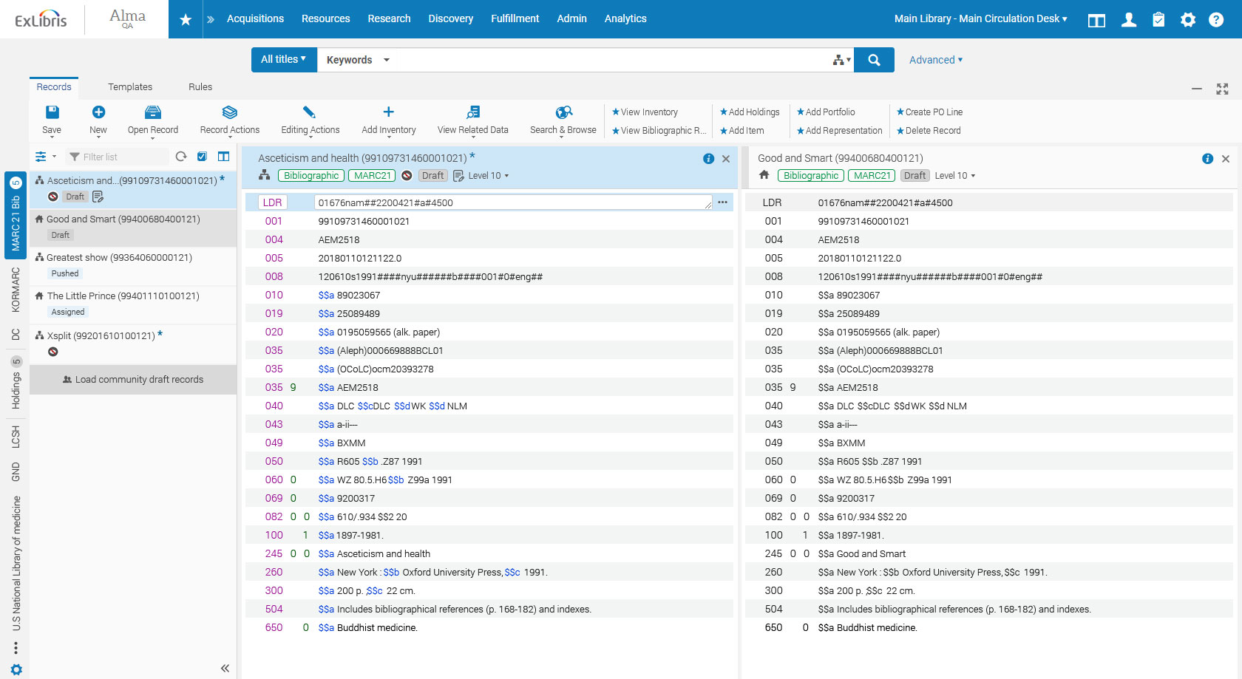
New Metadata Editor
Tailored to each cataloguer in accordance with their expertise
Distinct working areas, for records, templates and rules
Detailed record and editing information
Dynamic menus and navigation tools
Robust record editing tools, including colour coding, split screens, searching and browsing
Always on: Metadata Editor runs in the background for quick access and easy updating
A record can be put into the editing queue directly from Alma's staff-level search features
Editing areas are maximised for convenience
Introduction Video

Slide 10
Metadata Editor high-level deployment plan
Step 1 - Early adopter
UX Customer Group members testing on development demo environment
Step 2 – Testing with real data
UX Customer Group members testing on sandbox and production environment
Step 3 – Wider audience & limited functionality
All users will be able to use record editing in the new metadata editor on sandbox and production
Step 4 – All functionality
All Alma users will be able to use all functionality of the new metadata editor on sandbox and production environment
Step 5 – New as the default
All Alma users will use as a default the new metadata editor on sandbox and production environment
Step 6 – Old is out
All Alma users will use only the new metadata editor on sandbox and production environment

Slide 11
Known Issues Operator role

Slide 12
Known Issues Operator
Known Issues presents Alma users (who have the Known Issues Operator role) with an indication of the issues/bugs that currently exist and are defined as
  high priority by submitters of the case,
  identified as bugs, and
  have a fix date that was communicated to the customer(s).
Each known issue has a target release for the fix.

Slide 13
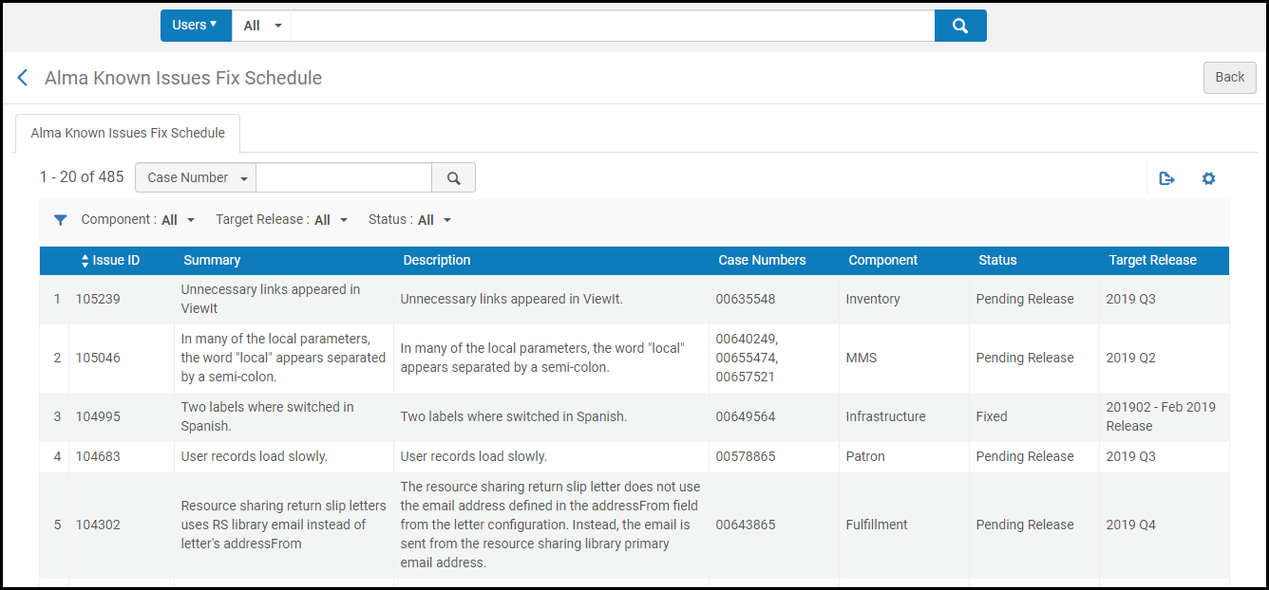
Known Issues Fix Schedule

Slide 14
Known Issues List
Includes major issues fixed in previous three releases
List is updated with monthly production release
No institution names are listed, and not all SF cases are made public
More information on the Knowledge Centre
Notes:
From the Knowledge Centre Q & A:
Known Issues present Alma users (who have the Known Issues Operator role) with an indication of the issues/bugs that currently exist and are defined as a) high priority by submitters of the case, b) identified as bugs, and c) have a fix date that was communicated to the customer(s). Each known issue has a target release for the fix.
Q: Which issues make it to the list?
A: The list contains major issues from Alma customers which were either fixed in the previous three releases. Fixes older than three releases are rolled off the list each month. This is different than the resolved issues list that comes with the Release Notes. That list contains ALL customer issues. Known Issues contains all high level defects that get version commitment and are communicated to the customers.
Defects that involve personal data are excluded from the Known Issues list and remain with the existing process.
Q: How often does Ex Libris update the list?
A: The list is updated with the monthly production release. For immediate cases see the "EXL notifications" tab.
Q: Why can't I see which institution submitted the case?
A: Due to privacy concerns, Ex Libris cannot add this information.
Q: When I copy the SalesForce number from the list and paste it into SalesForce, why can't I view the information?
A: Not all SalesForce cases are public to all. The issue is presented in the known issues list with a general description without revealing certain pieces of information due to privacy issues.
Q: The known issues list is only in English. Are there any plans to make the list multi-lingual?
A: Currently the issues are described only in English. As time passes, Ex Libris will consider adding support for more languages
Q: Why can't I see a resolution description on every known issue?
A: A resolution description is associated to a known issue only after the issue is fixed and the target release date has arrived.
Q: What if I see an issue that I am experiencing in my institution and that already exists in the list; should I submit a SalesForce case?
A: Institutions may want to wait for resolution and not submit a SalesForce case. However, submitting a case referencing the known issues list or the cases attached to it, allows Support to notify your institution directly on the fix schedule.
Q: Does a Fixed status mean that it has been confirmed fixed by the customer?
A: Fixed indicates the development stage, and not that the customer has confirmed that it is fixed. Naturally, all case resolutions are sent to the customer who reported them. In cases where the customer feels that the fix is not working as expected, a new known issue will appear.
Q: What causes issues to fall off the list even though they are still open?
A: An issue is not supposed to fall off the list. If an issue is off the list it is because it was fixed and three months has passed.
Q: I have opened a high priority case. Why can't I see it in the list?
A: Only bugs appear on the known issues lists. Many bugs can be resolved without a code change and these do not appear on the list. In addition, if a customer opened a high priority case, it first goes through an analysis and an R&D evaluation, and then, if a code fix is required, it is added to the list at the next scheduled update. If the case still does not appear in the list after this process, add a comment to the existing case (do not open a new one).

Slide 15
Central Discovery Index

Slide 16
What is changing and what is our goal?
Single Search Box
Steep increase of available material
More material
More diverse material types
Publisher and
aggregator content
Digital repositories
Research outputs & data
User expectations change
  Increased influence of social media and consumer platforms on user perception
  Expectation from faculty for users to use more diverse material
Open Access content
Library catalogue
Audiovisual content
Special Collections

Slide 17


Discovery index for the future: CDI
For operational efficiency
Quick updates, fast ingest
Scalable
Integral graph database to create and store contextual relations
With a focus on data intelligence – services based on contextual relations
  Exploration with formal and informal relationships
  Context and glanceability

Slide 18
CDI and the future of library discovery
Increase in data, increase in material types, changing user expectations
Big data is a challenge and an opportunity for discovery
CDI provides operational efficiency: A new scalable Index
CDI focuses on data intelligence: New discovery paths to deal with the increase of data and diversity
CDI enables innovation – a future proof index, offering new ways for discovery and delivery

Slide 19


The move to CDI – benefits and impact
  Enhanced performance, move to an upgraded infrastructure
  Search enhancements – specifically known items and short topic searches
Latest hardware architecture
Latest version of all application frameworks, Java, Cassandra & Solr
More efficiency, faster content updates, better quality of data
  Move to single activation via Alma/SFX with a separate role in Alma
  Optional EasyActive setting available
  Faster update cycles – 24 to 48 hours
  Merged instead of grouped records
  More granular resource types
  Note: Permalinks - ~92% will work after the move

Slide 20
Context in discovery with formal, informal and curated relationships
Formal relations, e.g.
  Books → book reviews
  Books → book chapters
  Book chapters → other chapters of the same book
  Articles → research data
Informal relations, e.g. co-usage
“Other users also looked at” - bX article recommendations
Curated relations, e.g.
  Citation trail
  Other items from the same course reading list
  Other items from the same collection (collection discovery)

Slide 21
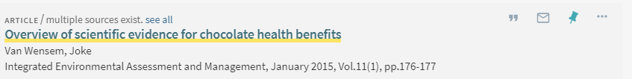
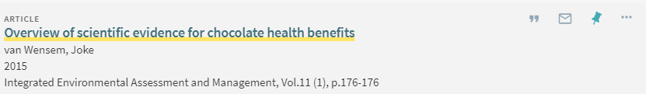
Merged record instead of record groups
Less confusing for users – better glanceability
Primo Central
CDI

Slide 22
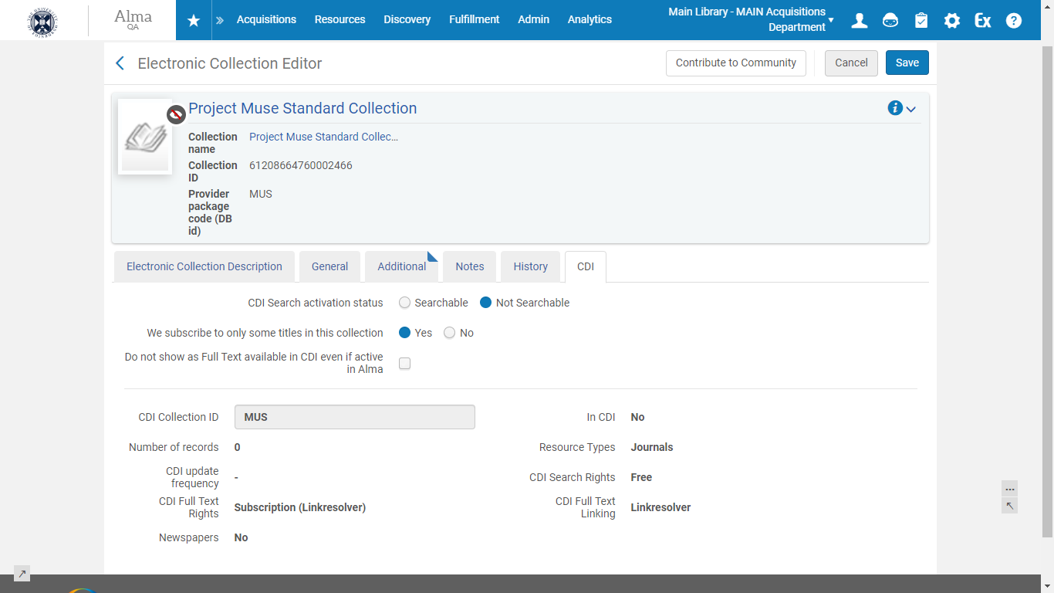

Slide 23
CDI rollout
Phase 2
Alma /Primo VE: All customers moved, switch to production on demand
Primo/SFX: Early Access
Feb 2020 - May 2020
Phase 5
Primo/SFX: All customers switch to production
November2020
Phase 0
Primo/Alma: Working Group
Aug 2019 - Nov 2019
Q4 2019
Q1 2020
Q2 2020
Q3 2020
Q2 2019
Q3 2019
Q4 2020
Phase -1
Development
May 2019
Phase 1
Summon: All customers
Primo/Alma: Early Access
Nov 2019 – Feb 2020
Phase 3
Alma /Primo VE: All customers switch to production
July/August 2020
Phase 4
Primo/SFX: All customers moved, switch to production on demand
May 2020 - Oct 2020
General rules for consortia
All consortia members are moved together
Mixed consortia (Alma AND SFX) will move when SFX is ready

Slide 24
COUNTER 5

Slide 25
COUNTER 5 in Alma
Plans for COUNTER 5 support:
  Early testing partners Sept – Dec 2019
    Manual upload of COUNTER 5 reports
    Managing COUNTER 5 SUSHI accounts
    COUNTER 5 SUSHI harvesting
    Alma Analytics reports reflecting COUNTER 5 usage
  Entire Alma community – Jan 2020
  COUNTER 5 reports and measures in the Usage Data subject area and Cost Usage in the E-Inventory subject area in Analytics – Nov 2019 (for entire Alma community, but relevant only for early testers until Jan 2020.)

Slide 26
COUNTER 5 in Alma
Institutions will be able to simultaneously work with both COUNTER 4 and 5, until COUNTER 4 support is phased out in the future
Not all vendors will support both releases
In COUNTER 5, one account can have multiple report types, whereas in COUNTER 4, each SUSHI account could only have one report type.

Slide 27
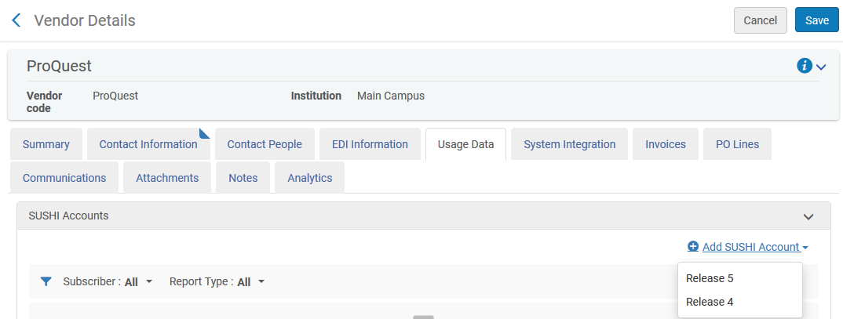
COUNTER 5 in Alma – adding a SUSHI account
Staff user chooses to which COUNTER release the SUSHI account pertains

Slide 28
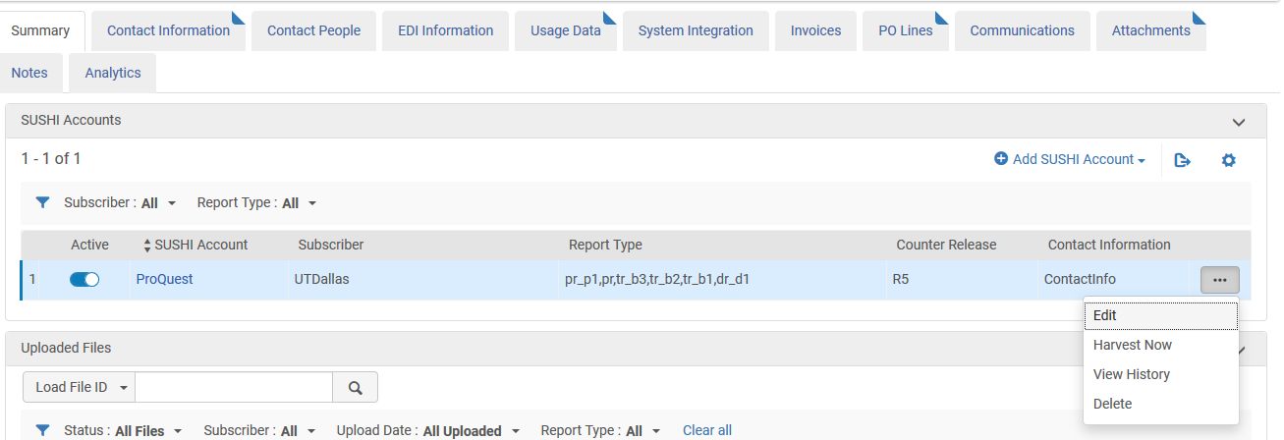
Multiple report types in the COUNTER Release 5 SUSHI account
The Harvest Now option will work on all report types associated with the SUSHI account

Slide 29
COUNTER 5 in Alma
COUNTER Release 5 in Alma and Alma Analytics User Group are early testers
Some of the institutions represented in the group:
  University of Queensland
  UT Dallas
  University of Auckland
  The University of Adelaide
  Northeastern University
  RMIT University
  Monash University

Slide 30
Provider Zone content loading

Slide 31
Content Maintenance Volume
~5,000
Content Providers
~21.5 Million
Number of Portfolios
~100
Monthly Requests for New Content
~20,000
Full Text Collections + Database Collections
~7.2 Million
Bibliographic Records
Notes:
Rael
If you feel like the CZ is not up to date or the quality is poor… this is what we are dealing with…
If you are frustrated, support cases are not addressed

Slide 32
Current Challenges
Contact Provider
Obtain Files of Title Lists
Analyse
Load Content to CZ
Update
Manual interactions and iterations
Process dependent on file exchange
Potential failure points along the way
Over time CZ collections are not identical to Provider offerings
Provider new offering are created with a delay
Notes:
Rael

Slide 33

Ex Libris Provider Zone
Community Zone Knowledgebase
Electronic Collection
Take ownership over existing electronic collections
Create and update collections
Portfolio
Portfolio
Portfolio
Provider Bib
Provider Bib
Provider Bib
Notes:
Dana

Slide 34
How the Provider Zone Works
Provider content will take over CZ collections currently maintained by Ex Libris
Providers will take ownership of:
  Collections
  Portfolios
  Optional: Bibliographic records
    Create Provider specific Bibliographic record for the Collection Portfolios
    Otherwise Portfolios remain linked to CZ Bibliographic record (maintained by Ex Libris)
Notes:
Development Partnership program
Currently – ProQuest; IEEE; Sage; Taylor and Francis
Governance and support guidelines built in collaboration with the Development Partner Providers and the Community – CWG and CZMG

Slide 35
Seamless Transition
No action required by institutions post Provider takeover
  No need to modify activations
  No change to IDs or linking
Activated collections continue to benefit from updates, regardless of owner (Ex Libris or Provider)
  All activity reflected in CZ Update Task List
New collections available for activation under Community Zone
New Bibliographic records that are created by the Provider will appear as duplicates in Alma, and resolved in Discovery
Making the simple complicated is commonplace;
Making the complicated simple, awesomely simple, that’s creativity.
                -Charles Mingus
Notes:
Dana

Slide 36
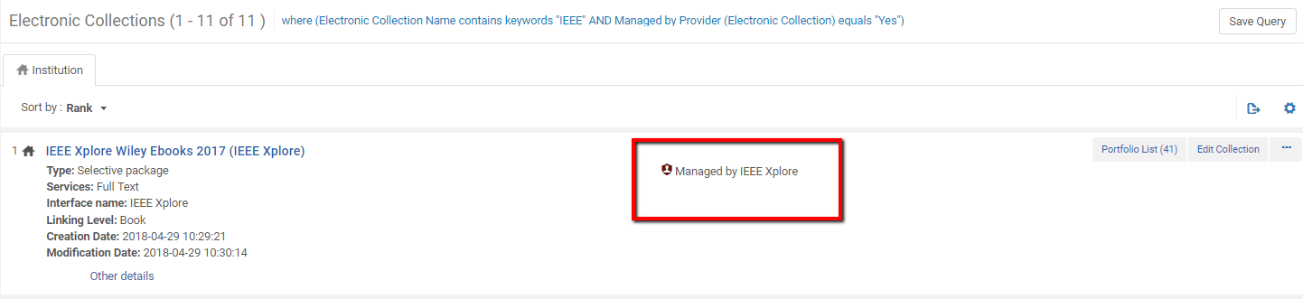
See It In Action – Collection Level

Slide 37
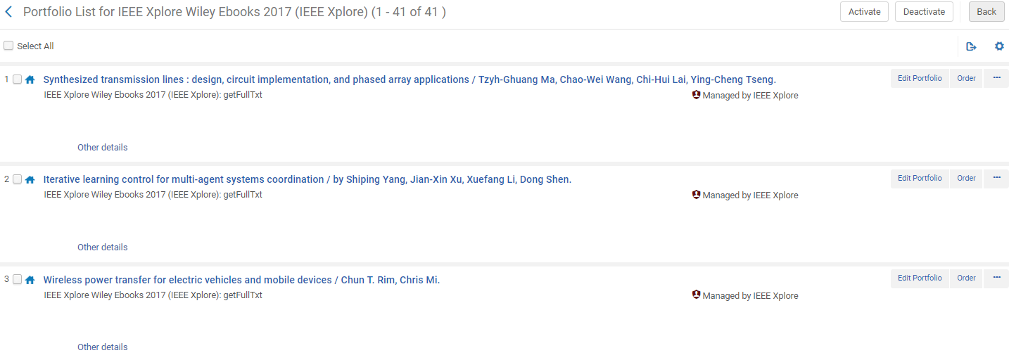
See It In Action – Portfolio Level

Slide 38
Timeline
Development Partners on Testing Environment
2019 Q3
Development Partners on Production Environment
2019 Q4
Development Complete
2019 Q2
5 Providers on Production Environment
2020 H1
Notes:
Rael

Slide 39
Next Gen Resource Sharing

Slide 40

ExLibris Resource Sharing Offerings
Both Alma and non-Alma Institutions
Alma
Peer- to- peer and consortia level
Full solution for cross consortial, national and international RS
A cross platform document delivery service

Slide 41



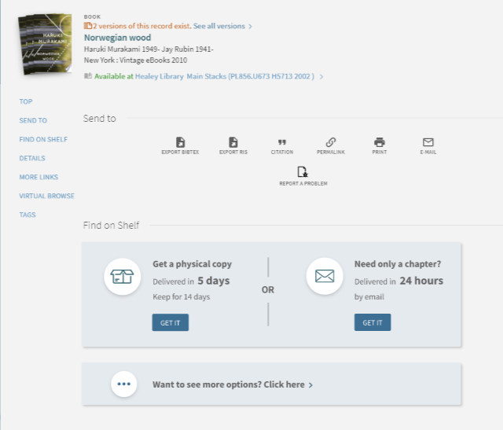


Introducing: Ex Libris Next-Gen Resource Sharing
  Focus on patron value:
  Fast, Accurate, Transparent
  (“Amazon like” experience)
Library efficiency
Streamlined integrations, advanced workflows
Shared holding index
Foundation for sharing
among groups
Show all delivery options with clear expected delivery
Notes:
Next Generation Discovery to Delivery

Slide 42
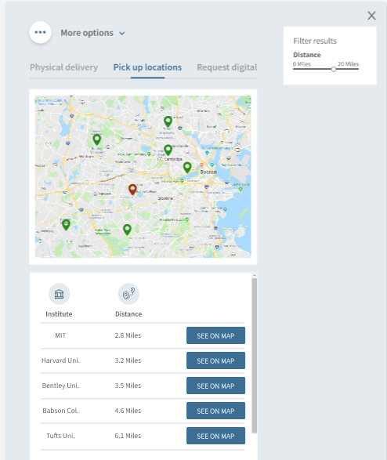
Introducing: Ex Libris Next-Gen Resource Sharing
  Focus on patron value:
  Fast, Accurate, Transparent
  (“Amazon like” experience)
Library efficiency
Streamlined integrations, advanced workflows
Get it myself: From libraries around me
Shared holding index
Foundation for sharing
among groups
Notes:
Next Generation Discovery to Delivery

Slide 43
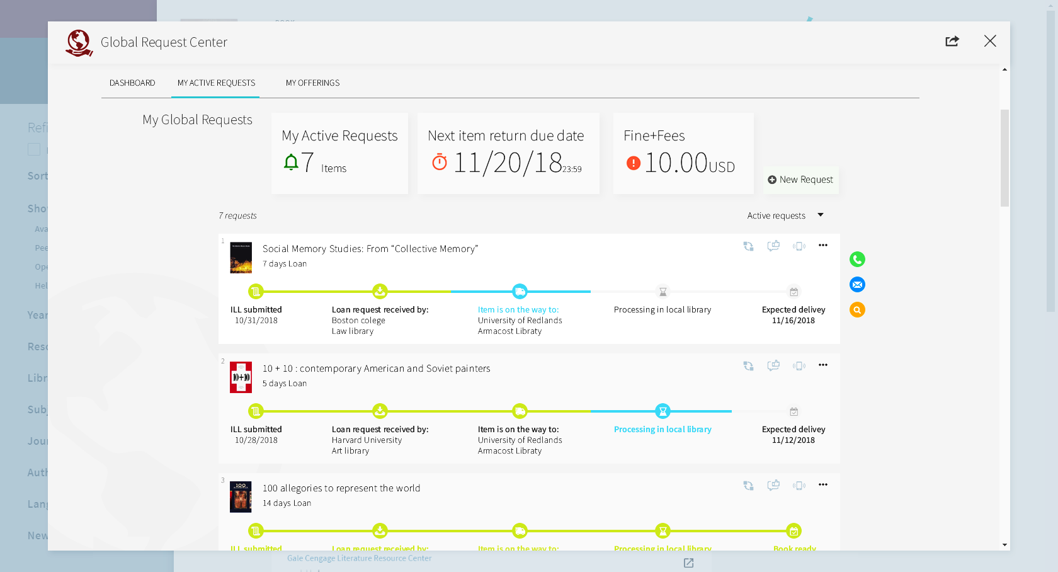
Introducing: Ex Libris Next-Gen Resource Sharing
  Focus on patron value:
  Fast, Accurate, Transparent
  (“Amazon like” experience)
Library efficiency
Streamlined integrations, advanced workflows with minimal mediation
Shared holding index
Foundation for sharing
among groups
Amazon like delivery tracking
Notes:
Next Generation Discovery to Delivery

Slide 44















Development partners – from US and Australia
Dominguez Hills
San Marcos

Slide 45

Next-Gen RS: Development plan
Jan. 2019
May. 2019
Aug . 2019
Feb .2020
Dec. 2020
Dec. 2021
Initiative Approval
Development Initiation
Development Group Partners Kickoff
Early Adopters
GA Release
(1st partner can implement)
Add non Alma institutions as lenders and borrowers

Slide 46
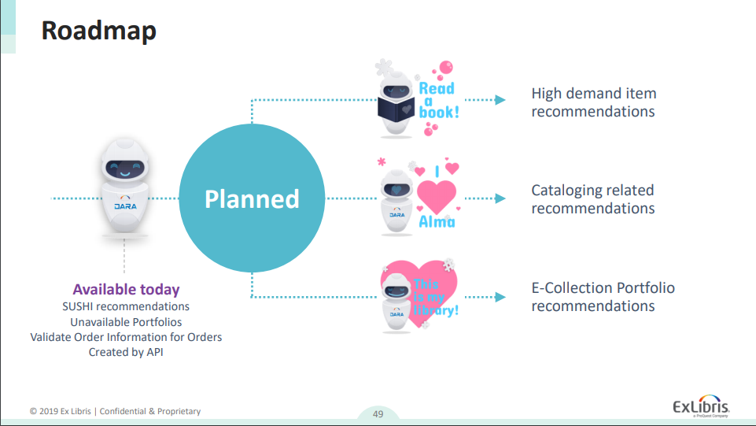

Slide 47
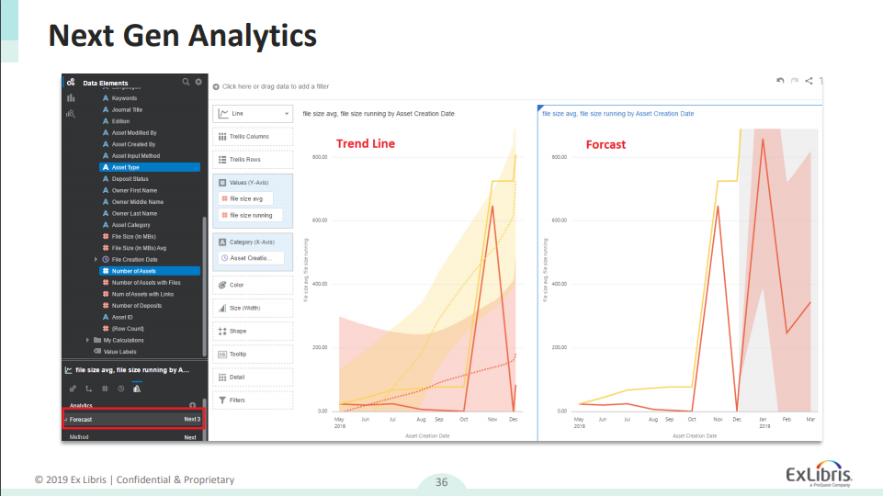

Slide 48
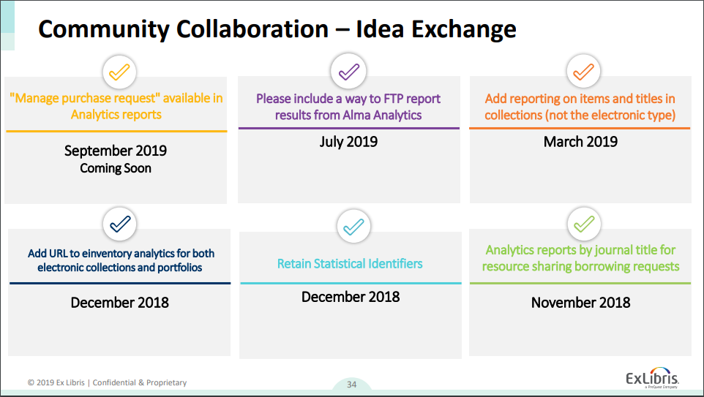

Slide 49
Thank you!
melanie.fitter@exlibrisgroup.com

