Slide 1
Rosetta Delivery and application to Alma-D

Slide 2
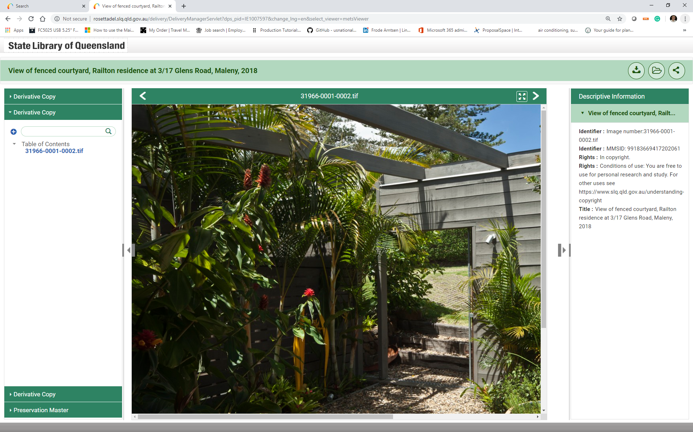
Rosetta Delivery Options - Default Option

Slide 3
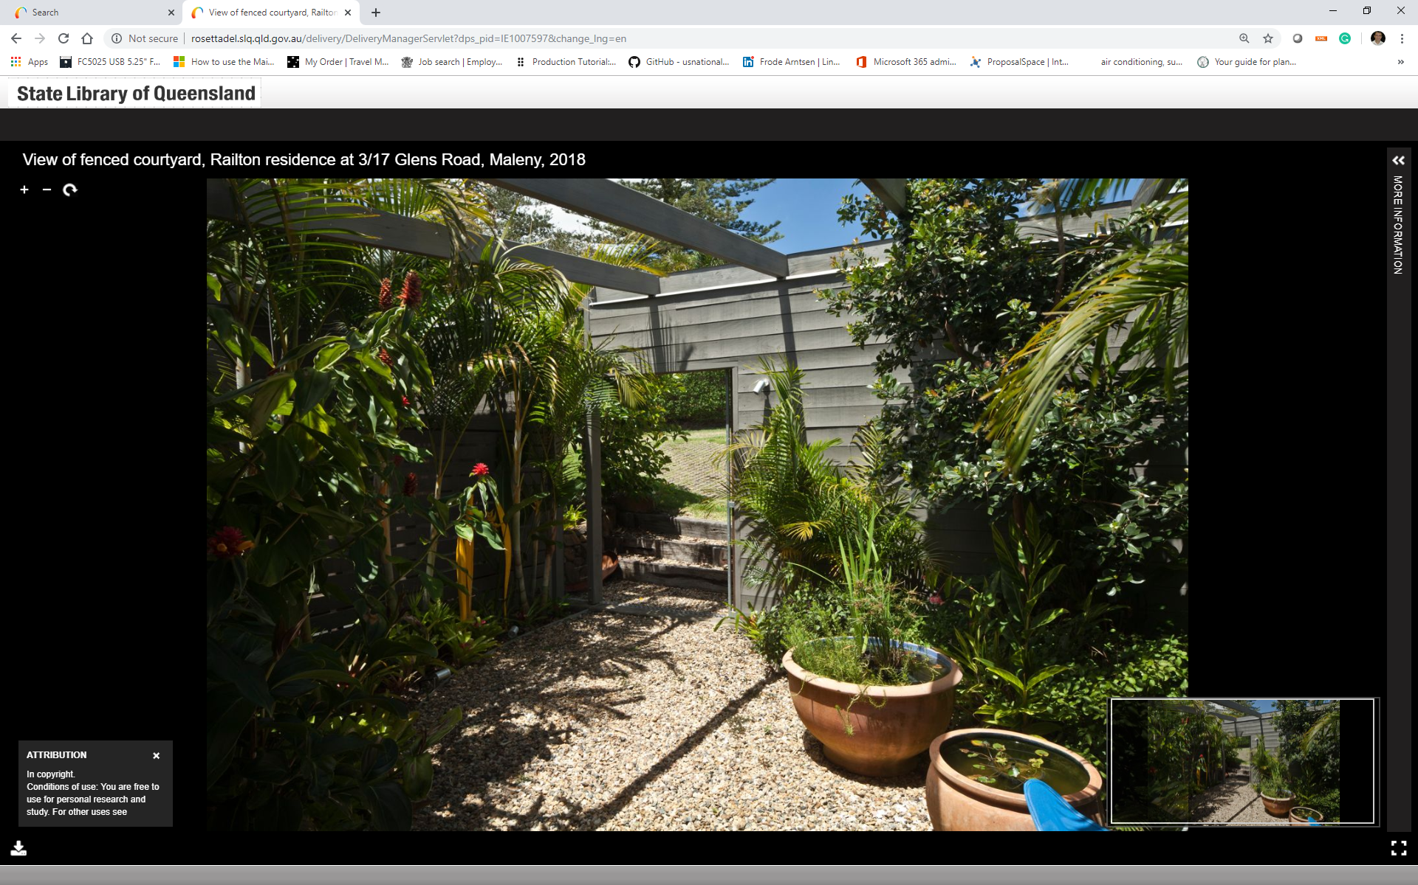
Rosetta Delivery Options - IIIF UV Viewer

Slide 4
Rosetta Delivery Options - IIIF UV Viewer
http://rosettadel.slq.qld.gov.au/delivery/DeliveryManagerServlet?change_lng=en&dps_pid=IE308046

Slide 5
Whats is IIIF
IIIF = International Image Interoperability Framework and is a community-driven framework
Example Viewers
Open Seadragon
Mirador
IIPImage
UV (Universal Viewer)

Slide 6
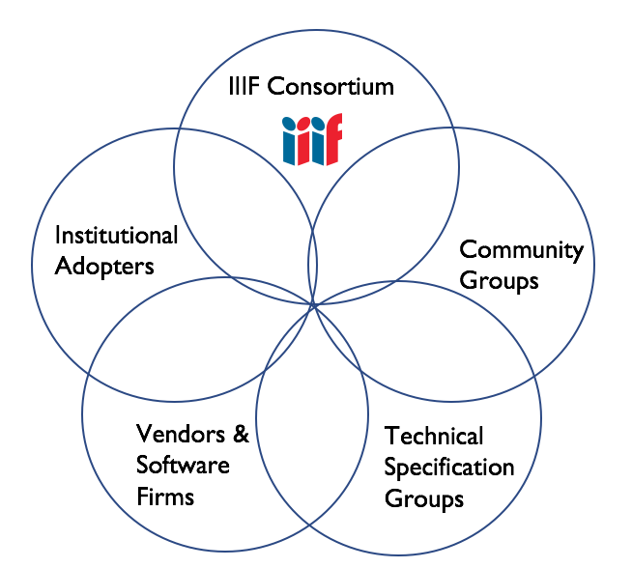
IIIF Community Landscape
Libraries
Museums
Research Institutions
Archives
Galleries
Aggregators
41 institutional members
Cogapp
Digirati
Klokan Technologies
LUNA Imaging
OCLC - ContentDM
Synaptica
Zegami
4Science
Etc.
Manuscripts
Museums
Newspapers
Software Developers
Open Source Software
Subject Experts
Mirador
Universal Viewer
OpenSeadrgon
Loris
IIPImage
Audio/Visual
Discovery
Text Granularity
Notes:
Flow chart of motion within the community:
Communication channels (IIIF-Discuss, Community Calls, Slack) →
Identifying shared areas of interest →
Identifying additional use cases →
Identifying shared areas of continued technical work →
Community groups
Technical Specification groups
Continued growth by interest
Continued growth in general

Slide 7
Example from Princeton University

Slide 8
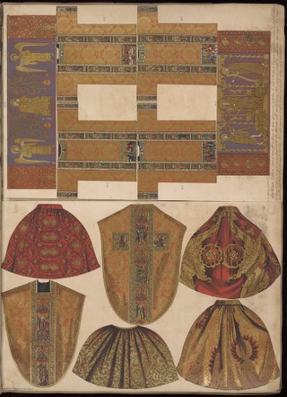
https://example.edu/{id}/full/full/0/default.jpg
Notes:
Image Service first. This is the easiest example. Full image at full size, no rotation, whatever qual. is available, jpeg.
A note about scale…litho proof, very big...
https://libimages1.princeton.edu/loris/ex.jp2/full/full/0/default.jpg

Slide 9
X
Y
W
H
https://example.edu/{id}/3930,550,980,2630/full/0/default.jpg
Notes:
Walking through the parameters. Region first.
https://libimages1.princeton.edu/loris/ex.jp2/3930,550,980,2630/full/0/default.jpg

Slide 10
X
Y
W
H
https://example.edu/{id}/3930,550,980,2630/full/0/default.jpg
Notes:
https://libimages1.princeton.edu/loris/ex.jp2/3930,550,980,2630/full/0/default.jpg

Slide 11
https://example.edu/{id}/3930,550,980,2630/full/0/default.jpg

Slide 12
https://example.edu/{id}/3930,550,980,2630/full/0/default.jpg
Notes:
The image we just made is actually really big, if you look in a browser.

Slide 13
https://example.edu/{id}/3930,550,980,2630/250,/0/default.jpg
Notes:
Resizing
https://libimages1.princeton.edu/loris/ex.jp2/3930,550,980,2630/250,/0/default.jpg

Slide 14
Many Size Options:
w,
,h
!w,h
w,h
pct:n
https://example.edu/{id}/3930,550,980,2630/,670/0/default.jpg
Notes:
Many options! So we have a canonical syntax to help further improve caching.
(Step out of deck and play if time)

Slide 15
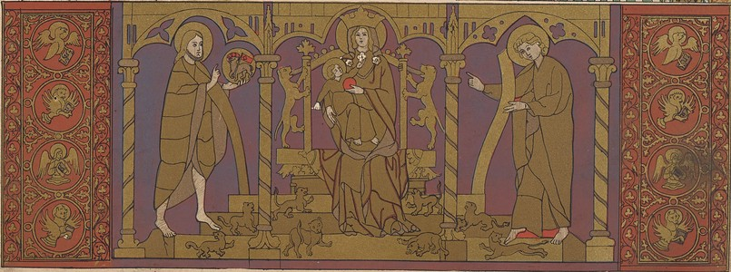
https://example.edu/{id}/3930,550,980,2630/250,/90/default.jpg
Notes:
Rotation
https://libimages1.princeton.edu/loris/ex.jp2/3930,550,980,2630/250,/90/default.jpg

Slide 16
https://example.edu/{id}/3930,550,980,2630/250,/45/default.jpg
Notes:
Rotation
https://libimages1.princeton.edu/loris/ex.jp2/3930,550,980,2630/250,/90/default.jpg
(Go back and do mirroring if you get a chance. Results of ! here are difficult to explain b/c image is rotated.

Slide 17
https://example.edu/{id}/3930,550,980,2630/250,/90/default.jpg
Notes:
Quality
https://libimages1.princeton.edu/loris/ex.jp2/3930,550,980,2630/250,/90/default.jpg

Slide 18
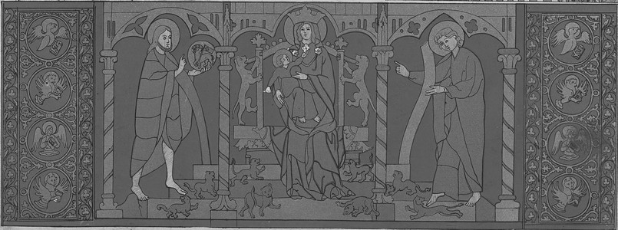
https://example.edu/{id}/3930,550,980,2630/250,/90/gray.jpg
Notes:
When doing format / png also go back to region ‘square’ as this is the common use case.

Slide 19
https://example.edu/{id}/full/200,/0/default.png
Notes:
Finally, we can also change the format. Going back to a full, small image, as pngs are commonly used for thumbnails
When doing format / png also go back to region ‘square’ as this is the common use case.

Slide 20
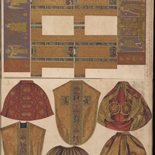
https://example.edu/{id}/square/200,/0/default.png
==
https://example.edu/{id}/0,998,5204,5204/200,/0/default.png
Notes:
https://libimages1.princeton.edu/loris/ex.jp2/square/200,/0/default.png
Another use case for thumbnails that came up in the latest revision was a desire
to have shorthand essentially a shorthand way to request a square version of the
Image. This can always be calculated, but when you want to make a page full, which
Is a common design pattern, it can get expensive quickly.

Slide 21
https://example.edu/{id}/square/200,/0/default.png
==
https://example.edu/{id}/0,998,5204,5204/200,/0/default.png
Notes:
Also, the server may be smart enough to choose the most interesting square. Spec
doesn’t say anything other that the entire short edge must be show.
Preserve short dimension...

Slide 22
{
"@context": "http://iiif.io/api/image/2/context.json",
"@id": "https://libimages1.princeton.edu/loris/ex.jp2",
"protocol": "http://iiif.io/api/image",
"height": 7200,
"width": 5204,
"profile": [
"http://iiif.io/api/image/2/level2.json",
{
"formats": [ "jpg", "png", "gif", "webp" ],
"qualities": [ "default", "bitonal", "gray", "color" ],
"supports": [ "canonicalLinkHeader", "profileLinkHeader", "mirroring", "rotationArbitrary" ]
}
],
"sizes": [
{ "height": 225, "width": 163 },
{ "height": 450, "width": 326 },
{ "height": 900, "width": 651 },
{ "height": 1800, "width": 1301 },
{ "height": 3600, "width": 2602 },
{ "height": 7200, "width": 5204 }
],
"tiles": [
{
"scaleFactors": [ 1, 2, 4, 8, 16, 32, 64, 128 ],
"width": 1024
}
]
}
https://example.edu/{id}/info.json
Notes:
https://libimages1.princeton.edu/loris/ex.jp2/info.json

Slide 23
https://example.edu/{id}/0,1024,1024,1024/1024,/0/default.jpg
Notes:
Tile Servers
OSD Demo: https://libimages1.princeton.edu/osd-demo/?feedme=ex.jp2

Slide 24
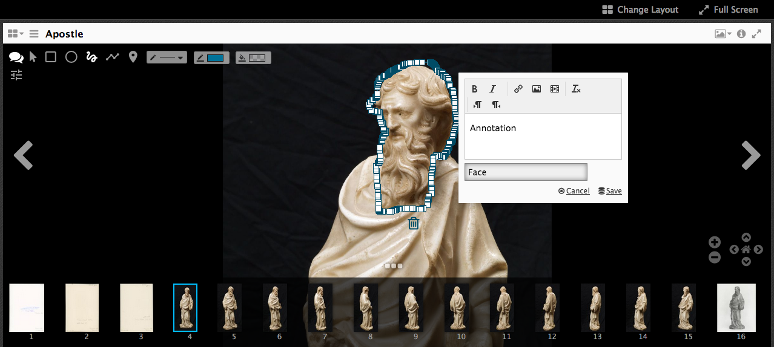
Other Interesting Stuff - Annotations

Slide 25
Other Interesting Stuff - Searching
http://universalviewer.io/examples/#?c=&m=&s=&cv=&manifest=http%3A%2F%2Fwellcomelibrary.org%2Fiiif%2Fb18035723%2Fmanifest&xywh=-1336%2C-197%2C5240%2C3936

Slide 26
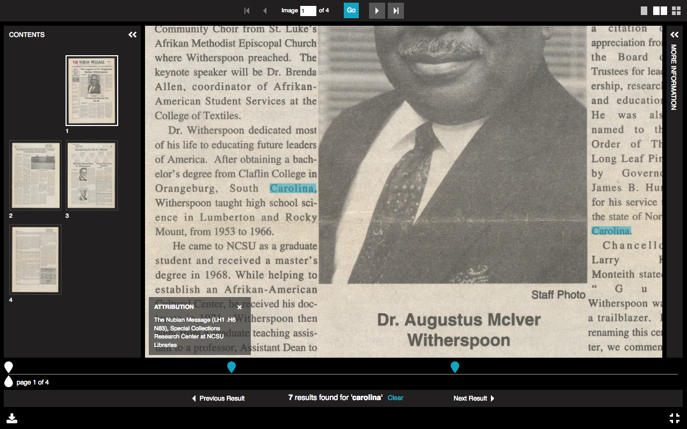
Other Interesting Stuff - Searching

Slide 27
Other Interesting Stuff - 3D Viewer
http://universalviewer.io/examples/#?c=&m=&s=&cv=&manifest=http%3A%2F%2Ffiles.universalviewer.io%2Fmanifests%2Fnelis%2Fanimal-skull.json
https://youtu.be/nsJ6BL9U9PQ

Slide 28
Other Interesting Stuff - AV Player
https://wellcomelibrary.org/item/b16748967#?c=0&m=0&s=0&cv=0
https://ddmal.music.mcgill.ca/IIIF-AV-player/
https://tomcrane.github.io/fire/

Slide 29
Other Interesting Stuff - Slide viewer
https://resources.digirati.com/iiif/an-introduction-to-iiif/dee-sbs.html

Slide 30
Other Viewers - Mirador

Slide 31
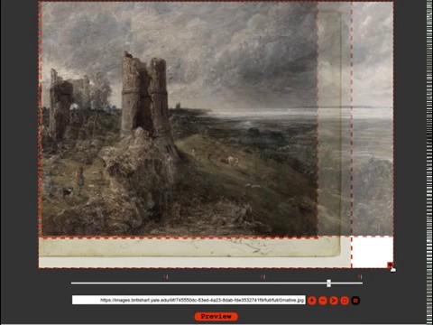

Slide 32
What does this mean for us
Ex Libris is waiting fo V3 of the IIIF
Rosetta enhancement processes
Alma-D involvement

Slide 33
For more information, questions, etc please contact me
dave.allen@slq.qld.gov.au

