Slide 1
An alternative holdings comparison :
a simple auditing process
Written by
Karl Lehtonen
Senior Team Member
Electronic Resources Unit
UNSW Library
Notes:
Who am I and where is Karl? (slide 1)
Good morning I am Derek. Sorry Karl could not be here today due to unforeseen circumstances. I will be presenting his papers on his behalf so apology I may need read some of the paper.
Just to give you some background: UNSW decided to load marc records as a local collections for all eBooks that we have purchased (if available). This means GOBI provides marc records for all the firm orders and approval plans. And for eBook collections, we either obtain the records from the vendor site or OCLC.

Slide 2
The UNSW Example… and “Platform Creep”
EBL eBooks merged with Ebrary, exposing inaccuracies and inconsistencies in our local data
Similar data issues can happen with any large data set created incrementally
Checking or ‘auditing’ allows us to:
Ensure owned material is made available
Eliminate a source of dead link reports
2
Notes:
How “the auditing” started (slide 2)
The reason UNSW Library decided to look into organised auditing was largely due to the merger of the Ebrary and EBL platforms into ProQuest Central eBooks. This merger left us with inaccuracies and inconsistencies in our data, including URLs, and a lot of duplicated portfolios and bib records, namely for material that we held on both EBL *AND* Ebrary. Removing the duplication, standardizing the URL and ensuring the accuracy of BKEYs used in the resulting ProQuest collection became key in ensuring ongoing access to this material, as we did not want to rely on automatic forwarding for an extended period.
Furthermore and in spite of our best efforts, we acknowledged that access will occasionally drop off for titles or even groups of titles in *ANY* collection. We have named this "platform creep" - remote services that are added to incrementally either with individual orders, title by title, or by purchasing subsequent packages of eBooks - these platforms tend to suffer from "platform creep"; where holdings diverge further and further over time due to a combination of human errors, automated data mismatches or plain old gremlins.
Books missing, or incorrectly added tend to multiply over time as your collection grows. This is especially true when speaking of larger aggregated collections such as ProQuest eBooks, on which UNSW has well over 70,000 titles, but also publisher owned platforms such as Springer. UNSW had a process of importing Springer records from their online admin/marc website based on specific Springer collections we have purchased, yet we found the marc records supplied through this tool did not always match our actual holdings. In order to alleviate our concerns about the accuracy with Springer it became necessary to perform some sort of comprehensive data checking or 'audit'. This would ensure all the material we have “paid for” is accurately reflected in ALMA and our discovery layer, minimising dead links, and eliminating a source of frustration for our patrons.

Slide 3
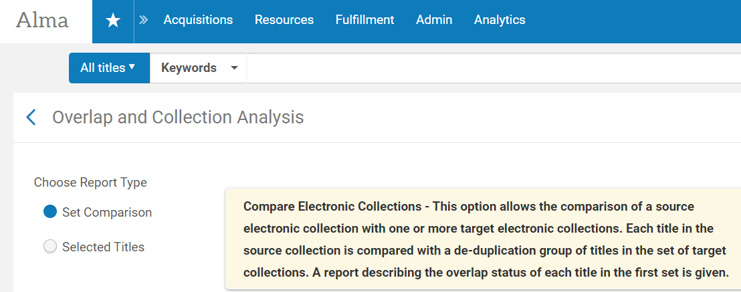
Doesn’t ALMA have tools for this already?
Alma has -
Overlap and Collection Analysis functionality:
Matches largely on marc field 035
ISBN
Fuzzy matching titles (false positives and negatives)
3
Notes:
*What does ALMA already have? (slide 3)
ALMA's overlap and collection analysis tool can help you with which titles you have in common between electronic collections, and also from an input file. In order to be interpretable the file must be in a specific layout with particular labels on the columns as well as in a particular order - and the report will output in what may or may not be a useful format for you, and in the case of missing material simply spit out a single column of ISBNs with no further data. As overlap analysis largely relies on ISBNs for an accurate match (or fuzzy matching) and we know there can be multiple ISBNs for a single item. This may also highlight any limitations with the MARC records in ALMA.

Slide 4
Auditing
The process needed to be:
Simple
Not reinvent the wheel
Spreadsheets allow:
initial comprehensive visual checking for errors and inconsistency
Identification of duplicates
VLOOKUP keeps the process simple
4
Notes:
*Auditing (slide 4)
UNSW wanted a method of data comparison without the bottlenecks and tight data formatting required by overlap analysis, but without reinventing the wheel. Simple VLOOKUP's on the parser parameter or URL were chosen for several reasons; they are easy to visually check errors in consistency, excel contains built in functionality for removing or highlighting duplication, and in using URL or parser parameter, there are less formatting concerns when it comes to a mixture of letters and numbers that you will be sure to understand if you've ever tried to enter a 13 digit number into excel... that is it's scientific notation.

Slide 5
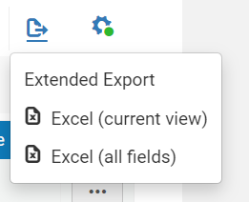
How does it work?
Simply sort your data, perform some basic visual consistency checks, then:
VLOOKUP on vendor spreadsheet to query your extended export sheet, then
VLOOKUP on your extended export spreadsheet to query your vendor spreadsheet
Are there any unusual things to be found on either? Both?
5
Notes:
*Workflow: (slide 5)
ALMA provides "Extended Export" functionality, an export of the portfolios within that collection, which gives us a spreadsheet of relevant bibliographic data with identifiers and URLs. This is therefore easily comparable to a holdings report that may be downloadable from the admin back-end of many eBooks platforms. We start by combining these two reports into two separate tabs of a new Excel file to easily facilitate formulas, and for easy storage of the data for later reference.
From here we sort the data in both spreadsheets alphabetically A-Z on the URL column, and in the Extended Export from ALMA complete a visual assessment of the URL column to spot any inconsistencies. Complete any non-formula based alterations to ensure consistency, then two VLOOKUP's are performed. One lookup on the vendor supplied sheet, comparing every entry to items on the Extended Export sheet from ALMA. This process exposes problematic URLs, changed bkeys, errors in bkeys/URLs, or that are missing from ALMA. Be mindful, it is likely that some are eBooks that are newly purchased and not yet imported.
The second VLOOKUP compares the Extended Export sheet with the vendor data. It highlights data that needs fixes, for example, titles we have activated are missing from vendor holdings, basically the reverse of the first VLOOKUP.

Slide 6
What do we do in Excel…
Sorting highlights URL issues
VLOOKUP – comparing the library data with vendor’s
3. VLOOKUP – comparing vendor data with the library’s
6
Notes:
<view example?> (slide 6)
demonstrate:
-how sorting can highlight issues with URLs (spaces, http/https, inconsistency, obviously misfiled portfolios)
-how highlight duplicates works (another benefit of sorting)
turn on filter for VLOOKUP on spreadsheet 1
-show the mismatched titles only - vendor data may contain mismatched titles that are new and have not been loaded into your local system yet in addition to titles that were missed, or differ from your local system.
turn on filter for VLOOKUP on spreadsheet 2
-show the mismatched titles only - shows titles that are missing from your vendor platform entirely, or because the data differs from the vendor system.
In both instances of data differing, the best course of action is to change your local system to match the vendor Bkey, or URL so that further mismatches on future audits are minimised in the future. Errors that cannot be rectified can either be followed up with the vendor and fixed at their end if appropriate, or removed from your system entirely.
Saving the reports for future reference will help you to diagnoise issues between audits and past reports may assist you when approaching vendors with access issue.
(Sometimes the history of an earlier vendor holding report proved we have purchased the title but the title was not appeared in a later report or the access dropped off)

Slide 7
I have errors! Now what do I do?
You fix them! And …
Ask what happened? Is there anything to learn from the errors in the data?
Is there anything the team needs to do differently in the future?
Do any of our data sources have issues?
What about vendor supplied data?
Benefits
It is quick and effective
It eliminates the need of manual checking of URLs
7
Notes:
*Actions (slide 7)
After fixing the issues, we can reflect on the process,
*what happened? is there anything to learn from errors in the data? is there anything the team needs to do differently?
*does the source of your local data have issues?
*are there problems with vendor provided data?
To begin with, we ran an audit every 3 months on key eBooks collections. We found over time data quality improved, and therefore less frequent auditing needed. A side benefit of this process is that it eliminates the need for manual checking of URLs.
This is a simple, logical and efficient process that has dramatically improved our data quality and consistency.

Slide 8
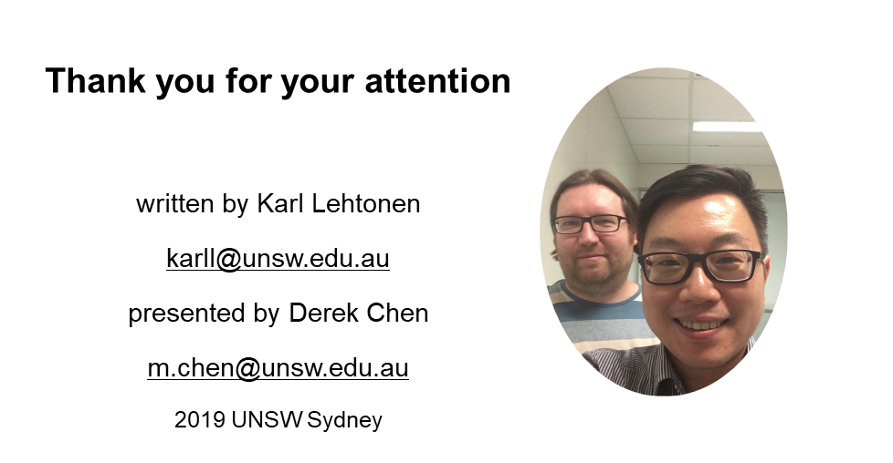
Questions?
8

