Slide 1
"Primo is broken, can you fix it?"
Converting anecdotal evidence into e-resource access solutions
ANZREG 2019 Conference (23-25 October 2019) #anzreg
Petrina Collingwood
Digital Access Specialist at CQUniversity
p.collingwood@cqu.edu.au

Slide 2
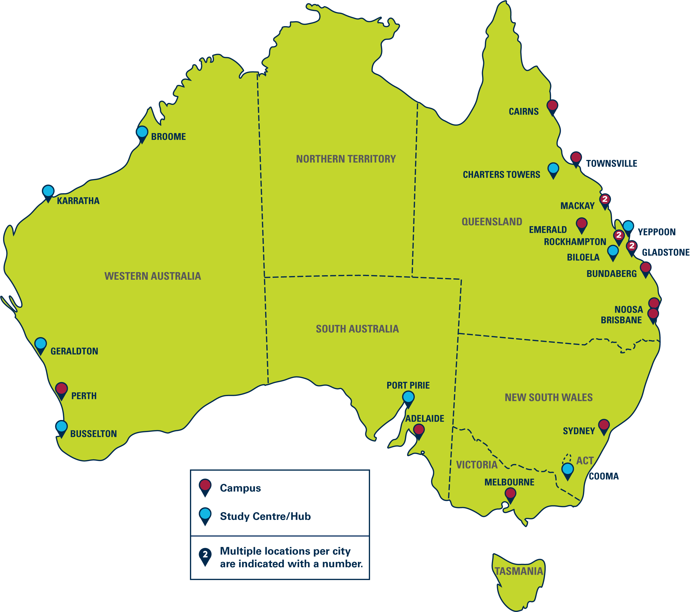
CQUniversity
Main campus - Rockhampton, Queensland
11 campuses in Queensland and 4 in other states (Melbourne, Sydney, Perth and Adelaide) plus several Study Centre/Hubs
Over 30,000 students
16,000 studying on campus
13,000 studying via distance education
VET, Undergraduate, Postgraduate and Research Higher Degree courses

Slide 3
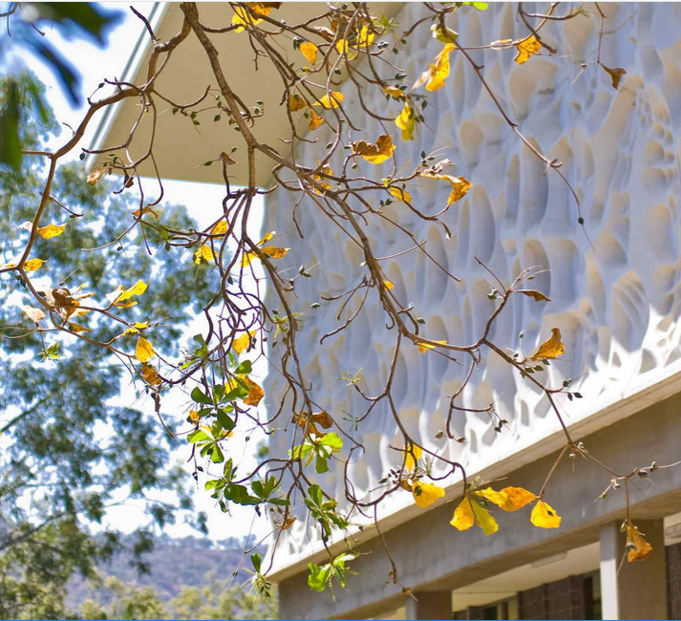
CQUniversity Library
Libraries at 14 campuses with main library at Rockhampton North
Combined Library and IT service
Implemented Ex Libris Alma and Primo in late 2016
Implementation faster than
Ex Libris’ ‘Fast’ offering
Implemented Leganto in 2018
EZproxy and ADFS for authentication

Slide 4
“Primo is broken, can you fix it?”
Yes...and no
https://www.eyerys.com/sites/default/files/broken-links-building-2.jpg

Slide 5
Introduction
The problem
Contributing factors
The approach
Errors and major issues
Statistics
EBSCO in-depth
‘No full text available’ error
Conclusion/outcome

Slide 6
The problem
Alma/Primo implemented quickly in late 2016
Anecdotal reports of broken links in Primo during 2017, particularly off-campus EBSCO links
Limited staff resources to optimise use of Alma/Primo and troubleshoot issues
New Digital Access Specialist position created in 2018
Main priority - identify and fix electronic resource access problems
Notes:
This presentation looks at the approach and methods used to identify linking issues and the strategies used to fix these problems.

Slide 7
Disclaimer
Not intended to make Ex Libris or EBSCO look bad
Unforeseen issues resulting from a configuration choice made by CQU
Both companies have gone above and beyond to help resolve issues

Slide 8
Contributing factors
Fast implementation of Alma/Primo
Limited staff resources
EBSCOhost database authentication moved from EZproxy to SSO

Slide 9
Approach
Sought linking problem examples from library staff
Devised a plan for resolving issues including:
Systematic check of P2E records from Virtua (4232 portfolios)
Check of all parsers in Alma (particularly EBSCO parsers)
Check static URLs are correct (particularly EBSCO static URLs)
Sample check of collection and portfolio service linking configuration (in particular whether EZproxy is enabled or not, with initial focus on EBSCO)
Check stanzas in the EZproxy configuration file

Slide 10
Cause of errors
Incorrect metadata in Primo Central Index (PCI)
Incorrectly configured parsers in Alma
Errors in electronic service linking configuration
generic static URLs for EBSCO resources
EZproxy enabled for EBSCO resources
Electronic resources not configured or configured incorrectly in EZproxy
Limitations of EBSCO link resolver (requires vol & issue number)
Incorrect metadata in the target databases
Insufficient metadata in a PCI records
Incorrect coverage dates or volume/issue numbers in Alma
Links not proxied in Primo
Incorrect availability
Notes:
LAST 3
Incorrect coverage dates or volume/issue numbers in Alma - one example took a whole year to get an answer for - coverage ended November, but when ending month added in, it didn’t work until I put the starting month as well
Links not proxied in Primo - Proquest direct links in Primo are not being proxied for the Dissertations database records. Fixed by adding Ezproxy to Primo institutional profile.
Incorrect availability - Alma holdings file not matching actual availability. Some changes in availability fall through the cracks - scheduled a weekly no harvest pipe in Primo to reprocess records

Slide 11
Major problems found
EBSCOhost links
Alma parsers
Static URLs
EBSCO Link Resolver Plugin
EBSCO’s link resolver
Dynamic URL
EZproxy not enabled on some collections/ portfolios
EZproxy config.txt stanzas not maintained
Standalone portfolios from Virtua - Static URLs not maintained
‘No full text available’ error in Primo
Notes:
2. EZproxy not enabled on some collections/ portfolios - many standalone portfolios from old library system (over 2000 not proxied) - couldn’t fix in bulk, moved some into a collection

Slide 12
Some statistics
15,000 Kanopy standalone portfolios not proxied - moved to collection
Approx. 2500 other standalone not proxied - came from old library system
10 collections not proxied
2 collections needed to be deactivated
1 collection with 2019 portfolios we didn’t subscribe to
2 collections with incorrect parser parameters
EZproxy stanzas reduced from 260 to 95 (63% ⇩)
EZproxy config file reduced by 700 lines (24% ⇩)
All 22 EBSCOhost collections had major issues

Slide 13
The EBSCO Saga
Late 2017 moved EBSCOhost from EZproxy to SSO
Students no longer needed to login again to access personalised EBSCO account
https://me.me/i/ificould-turn-back-time-memegenerator-net-if-i-could-turn-back-3be14902500a4635adf4dea53e4cab12

Slide 14
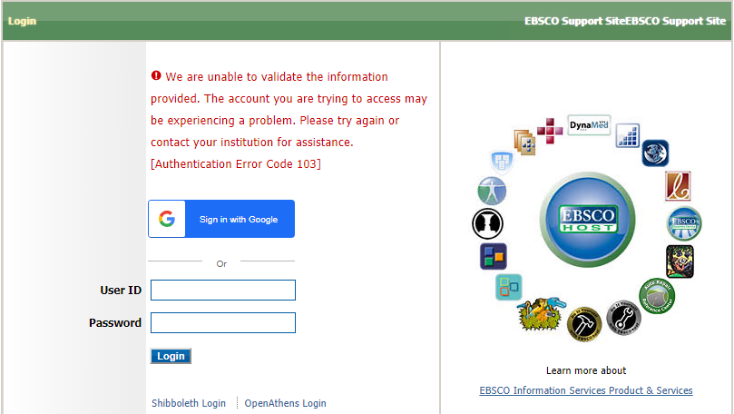
EBSCO link parameters and off-campus users
EBSCOhost link generated by Alma:
https://search.ebscohost.com/login.aspx?direct=true&scope=site&db=bsu&AN=95750557&msid=201334637&IdpId=
Link that correctly redirects to CQU login page:
https://search.ebscohost.com/login.aspx?direct=true&scope=site&db=bsu&authtype=sso&custid=s3716178&AN=95750557&msid=201334637&IdpId=

Slide 15
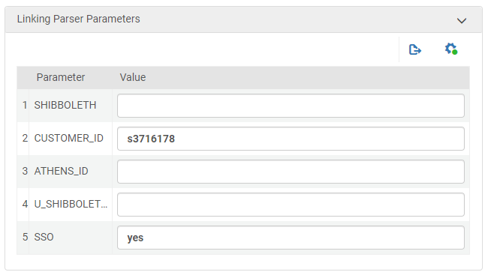
EBSCOhost parsers in Alma
authtype=cookie,ip,shib for all 22 EBSCOhost collections
Needed authtype=sso
authtype parser parameter not configurable - opened salesforce case to make it configurable

Slide 16
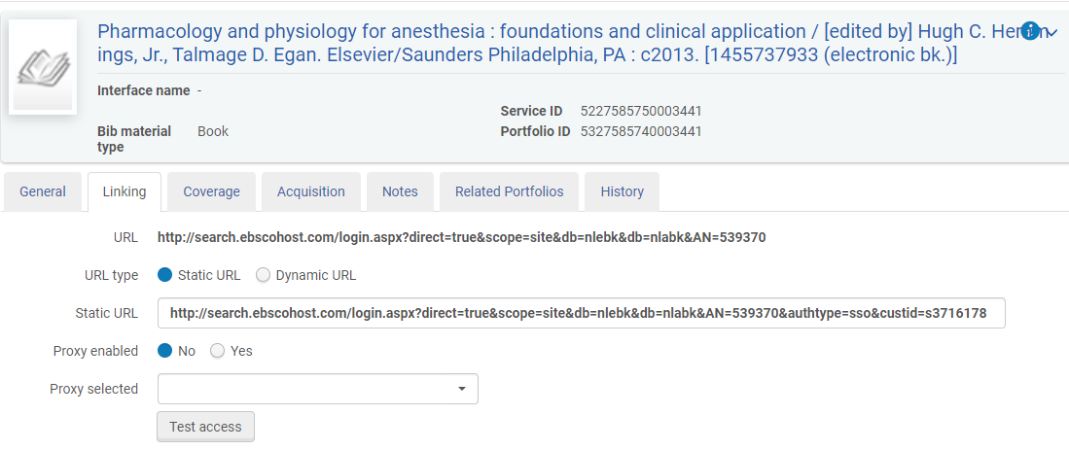
Static URLs for EBSCO
140 standalone EBSCOhost portfolios without authtype and customer ID parameters
Had to be manually edited to add ‘&authtype=sso&custid=s3716178’ to each Static URL

Slide 17
Problem solved?
https://www.memedroid.com/memes/detail/2371701

Slide 18
EBSCO Link Resolver Plugin
14 EBSCOhost collections with EBSCO Link Resolver Plugin enabled
Uses EBSCO API to retrieve more accurate links with ID numbers instead of OpenURL
Example with ‘AN’ ID:
http://search.ebscohost.com/login.aspx?direct=true&scope=site&db=pdh&AN=2015-25430-001
Links more accurate than OpenURL, but missing CQU parameters - authtype and custid

Slide 19
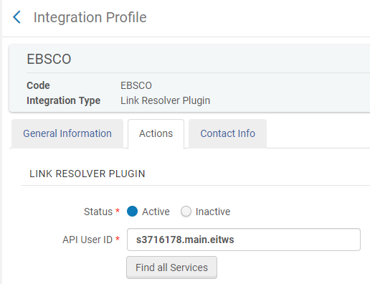
EBSCO Link Resolver Plugin
Link resolver plugin
integration profile:
Contains CQU API User ID, but no username/password to access CQU account
Alma uses generic API so URLs are returned without institution-specific parameters
Ex Libris would not fix this for CQU - recommended Ideas Exchange

Slide 20
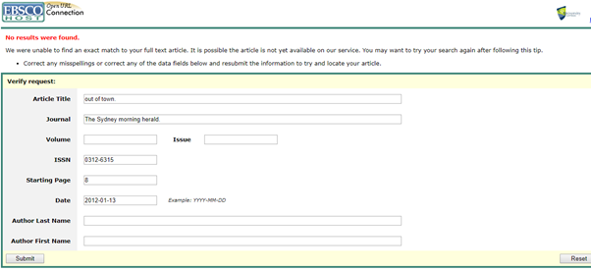
EBSCO Link Resolver
When EBSCO Link Resolver Plugin is not enabled, OpenURL is used:
https://openurl.ebscohost.com/linksvc/linking.aspx?sid=azh&volume=&custid=s3716178&atitle=out+of+town.&date=20120113&spage=8&issn=0312-6315&stitle=&genre=article&issue=&authtype=sso&title=The+Sydney+morning+herald.
EBSCO Link Resolver does not work without volume and issue numbers
EBSCO has no plans to fix this, only offers workarounds

Slide 21
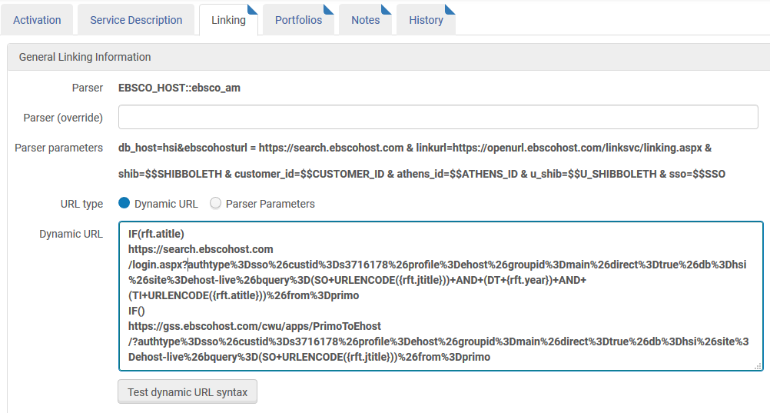
Dynamic URL
EBSCO’s workaround to the parser parameters and vol/issue problem: Dynamic URL
Option in the Electronic Service
Notes:
This overrides the parser

Slide 22
Dynamic URL
IF(rft.atitle)
https://search.ebscohost.com/login.aspx?authtype%3Dsso%26custid%3Ds3716178%26profile%3Dehost%26groupid%3Dmain%26direct%3Dtrue%26db%3Dbsu%26site%3Dehost-live%26bquery%3D(SO+URLENCODE({rft.jtitle}))+AND+(DT+{rft.year})+AND+(TI+URLENCODE({rft.atitle}))%26from%3Dprimo
IF(rft.pubdate,rft.btitle)
https://search.ebscohost.com/login.aspx?authtype%3Dsso%26custid%3Ds3716178%26profile%3Dehost%26groupid%3Dmain%26direct%3Dtrue%26db%3Dbsu%26site%3Dehost-live%26bquery%3D(DT+{rft.pubdate})+AND+(TI+URLENCODE({rft.btitle}))%26from%3Dprimo
IF(rft.btitle)
https://search.ebscohost.com/login.aspx?authtype%3Dsso%26custid%3Ds3716178%26profile%3Dehost%26groupid%3Dmain%26direct%3Dtrue%26db%3Dbsu%26site%3Dehost-live%26bquery%3D(TI+URLENCODE({rft.btitle}))%26from%3Dprimo
IF()
https://search.ebscohost.com/login.aspx?authtype%3Dsso%26custid%3Ds3716178%26profile%3Dehost%26groupid%3Dmain%26direct%3Dtrue%26db%3Dbsu%26site%3Dehost-live%26bquery%3D(SO+URLENCODE({rft.jtitle}))%26from%3Dprimo
Notes:
talk through IF statements
combos depending on database

Slide 23
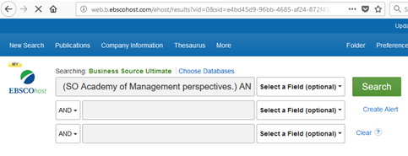
Dynamic URL
Article URL:
https://search.ebscohost.com/login.aspx?authtype=sso&custid=s3716178&profile=ehost&groupid=main&direct=true&db=bsu&site=ehost-live&bquery=(SO+Academy+of+Management+perspectives.)+AND+(DT+2011)+AND+(TI+Two+Decades+of+Russian+Business+and+Management+Research:+An+Institutional+Theory+Perspective)&from=primo
Creates search in EBSCOhost:
(SO Academy of Management perspectives.) AND (DT 2011) AND (TI Two Decades of Russian Business and Management Research: An Institutional Theory Perspective)
Notes:
Example of an article
bquery generated which does a search in EBSCO
If there is only one result, it links through automatically to the full record, otherwise displays list of results.

Slide 24
Dynamic URL problems
rft.pubdate comes from 264c field and might include extra characters - [2011] or ©2011
URLENCODE function full of bugs
diacritics
& not encoded
curly quotations, hyphen and en dash not handled
too many brackets breaks it
No access to jkey parameter
big problem for regional newspapers where a keyword search doesn’t work: (SO Central Coast (Wyong,(NewSouthWales,Australia)))
Notes:
EBSCO said they could handle the date issue - send metadata via EBSCO server which modifies the date field before passing it on to the database
URLENCODE function bugs reported to Ex Libris - in development
jkey not accessible and won’t be
decided not to go ahead until at least URLENCODE is fixed

Slide 25
Surprise!
Recently discovered change to parser behaviour in EBSCOhost Newspaper Source Plus
Using Dynamic URL for articles
Still using parser for journal titles - accessing jkey
Good in theory except for URLENCODE bugs

Slide 26
Another day, another EBSCO problem
Photo by Tim Mossholder on Unsplash
Notes:
For a while there, it was literally another day, another EBSCO problem found.
Moved EBSCO to SSO to fix problem but it caused many more problems
Solutions would cause even more problems

Slide 27
Solutions for EBSCO?
Go back to EZproxy
Implement OpenAthens
Unsubscribe to all EBSCO databases
Do nothing (keep current FAQ workaround)
Turn off the EBSCO Link Resolver Plugin in Alma and implement 'Dynamic URLs' after URLENCODE bugs are fixed
Once URLENCODE bugs are fixed, ask Ex Libris to use Dynamic URLs for articles in all collections
Notes:
MBA/Moodle affected
OpenAthens and is a major undertaking

Slide 28
https://www.kapwing.com/
Notes:
Basically…

Slide 29
‘No full text available’ error in Primo
Incorrect metadata in Primo Central Index (PCI)
Incorrect coverage dates or volume/issue numbers in Alma
Incorrect metadata in the target database
Insufficient metadata in a PCI record
Incorrect availability
Primo ‘View It’ links querying on only one ISBN

Slide 30
Only one ISBN used for matching
The PNX record has:
<addata>
<isbn>9780729585569</isbn>
<isbn>9780729541107</isbn>
<isbn>9781336243958</isbn>
</addata>
The Alma bib record that it should match
to has:
020 __ |a 9780729581103 |c 720.00 (3U)
020 __ |a 9780729541107
9780729541107 is the matching ISBN which gives the Primo record the status of ‘Full Text Available’

Slide 31
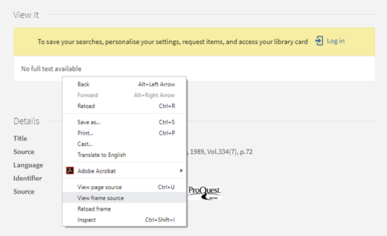
Accessing debug code
-> Right click on ‘No full text available’ box
-> Click ‘View frame source’

Slide 32
Debug code
<!-- DEBUG:
<li>http://cqu.userservices.exlibrisgroup.com/view/uresolver/61CQU_INST/openurl?svc_dat=CTO&debug=true&debug=true&ctx_enc=info:ofi/enc:UTF-8&ctx_id=10_1&ctx_tim=2018-08-01T09%253A10%253A59IST&ctx_ver=Z39.88-2004&url_ctx_fmt=info:ofi/fmt:kev:mtx:ctx&url_ver=Z39.88-2004&rfr_id=info:sid/primo.exlibrisgroup.com-ingram_myilibrary&req_id=&rft_val_fmt=info:ofi/fmt:kev:mtx:book&rft.genre=book&rft.atitle=&rft.jtitle=&rft.btitle=Potter%20%2526%20Perry%27s%20Fundamentals%20of%20Nursing%20-%20Australian%20Version%20-%20INKLING&rft.aulast=&rft.auinit=&rft.auinit1=&rft.auinitm=&rft.ausuffix=&rft.au=Crisp,%20Jackie;Taylor,%20Catherine;Douglas,%20Clint&rft.aucorp=&rft.date=2012&rft.volume=&rft.issue=&rft.part=&rft.quarter=&rft.ssn=&rft.spage=&rft.epage=&rft.pages=&rft.artnum=&rft.issn=&rft.eissn=&rft.isbn=9780729585569&rft.sici=&rft.coden=&rft_id=info:doi/&rft.object_id=&rft.eisbn=&rft.edition=&rft.pub=Elsevier%20Health%20Sciences%20APAC&rft.place=&rft.series=&rft.stitle=&rft.bici=&rft_id=info:bibcode/&rft_id=info:hdl/&rft_id=info:lccn/&rft_id=info:oclcnum/&rft_id=info:pmid/&rft_id=info:eric/((addata/eric%7D%7D&rft_dat=%3Cingram_myilibrary%3E9781336243958%3C/ingram_myilibrary%3E,language=eng,view=61CQU&svc_dat=viewit&rft_pqid=EBL1724206&is_new_ui=true&Force_direct=false</li>
END DEBUG-->
Primo only takes the first ISBN (&rft.isbn=9780729585569) and can’t find it in Alma, so it shows ‘No full text available’
ISBN 9780729541107 would have matched if added to the query URL
Ex Libris Salesforce case status: Pending Development

Slide 33
Conclusion
Primo linking issues demystified
Educated library staff about linking issues
Resolved many issues:
Alma electronic service configuration corrected
EZproxy added to Primo BO for Primo links
EZproxy configuration fully updated
Still working to resolve some issues:
EBSCO a work in progress with FAQ workaround
Working with EBSCO and Ex Libris on unresolved issues

Slide 34
Thank you!
Feel free to email me for more information –
Petrina Collingwood
p.collingwood@cqu.edu.au

