Slide 1
Extending Library Service through Mobility
Tony Chan, Presales Consultant Asia Pac, Mobile Campus Solutions

Slide 2
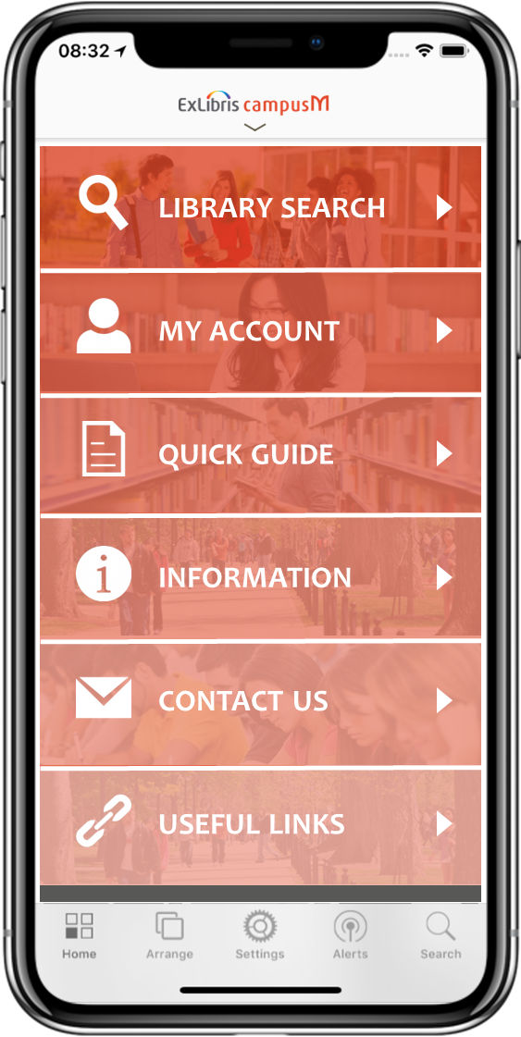
Serving the Academic Library Patrons
“Book a study room at the library on next Tuesday”
“Search for resources on global warming”
“How can I get in touch with the Digital Initiatives Librarian?””
“When does the Main Library open and close?”
“Open the library guide on finding online articles”
“How many requests do I current have waiting”

Slide 3
Library Services & Technology
MOBILE
LAPTOP
DESKTOP
CATALOG
Resource Discovery
Cards
OPAC
Native App

Slide 4
Make the Library Part of the Student Day-to-day Life
READILY AVAILABLE
Side by side with academic and social systems
CONVENIENT
On the go wherever the user is
EASY TO USE
Mobile and accessible
FAST
Showing account details at-a-glance

Slide 5
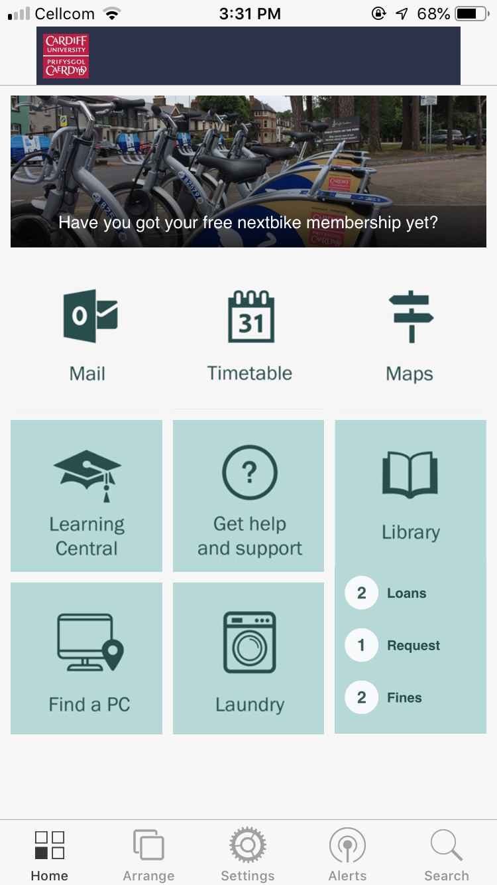
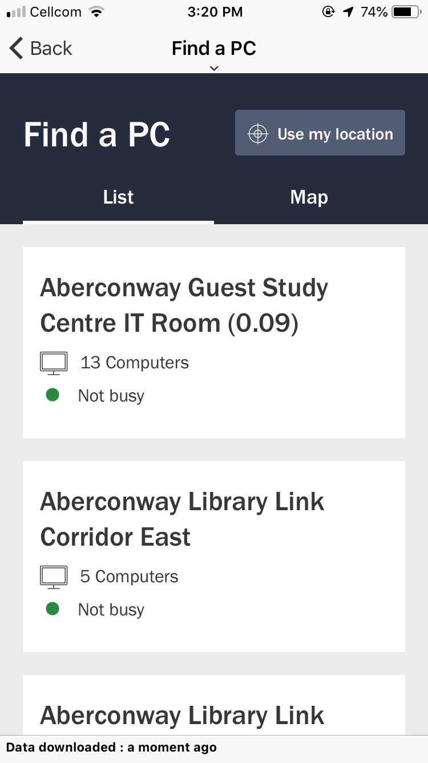
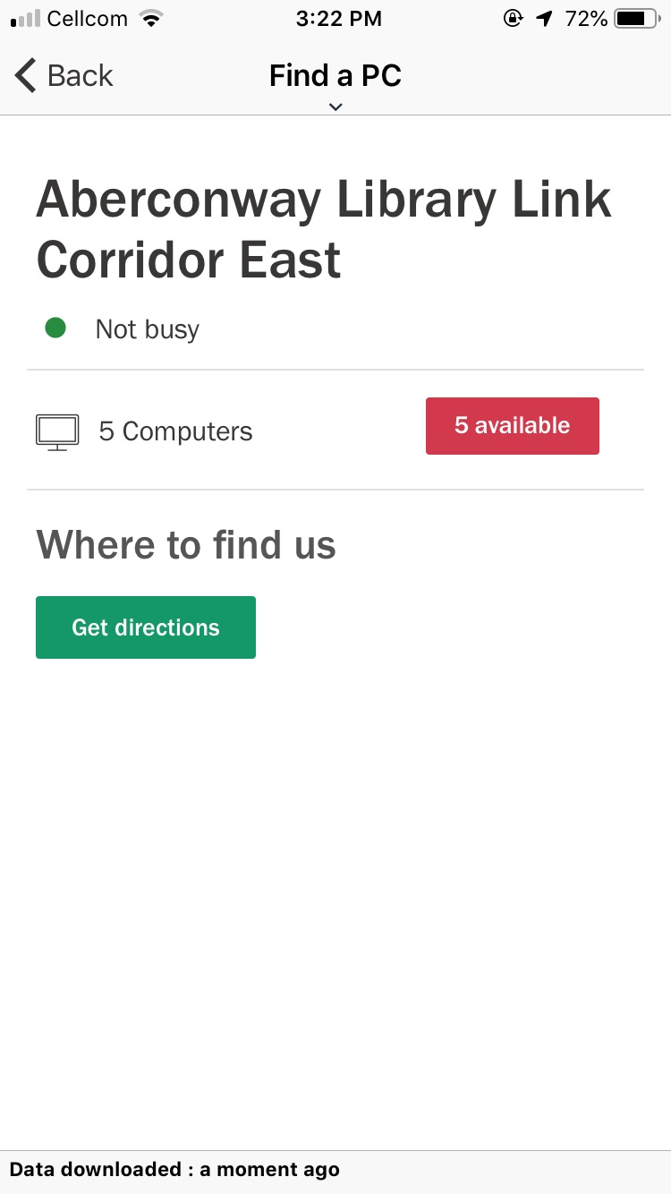
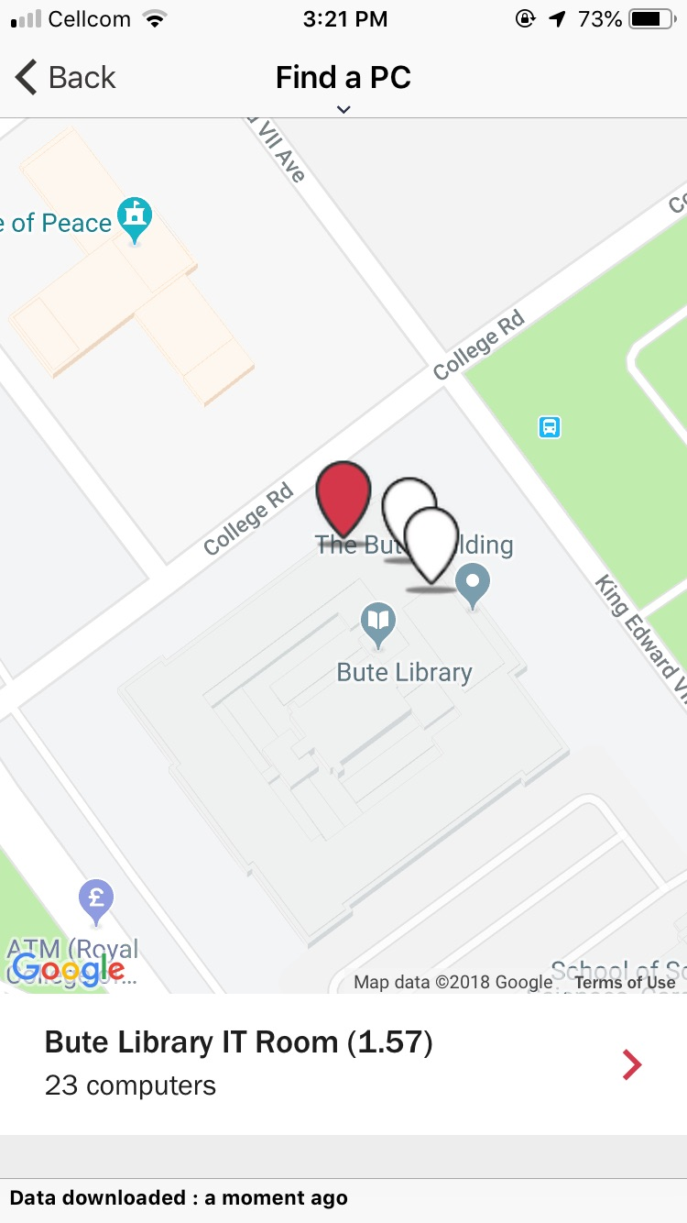
“Where can I find a near by PC to work on?

Slide 6
How Is It Done?
MOBILE APP PLATFORM
(e.g. Admin, Push Notifications)
Student Information
PRODUCT FEATURES
(e.g. Maps, News, Content)
LMS
SYSTEM INTEGRATIONS
(e.g. LMS/VLE, Library, Timetabling)
Library
Email
USER EXPERIENCE FEATURES
(e.g. Personalization)
And many more…
BUSINESS APPS
(e.g. Attendance)

Slide 7
Mobile App and Web Portal
PUSH
NOTIFICATION
EVENTS
MAPS
ATTENDANCE
NEWS
RESOURCES
Notes:
Jane: TO ADD NOTES

Slide 8
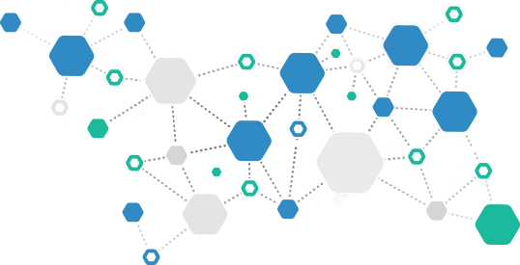
Students Lives are Challenging
Peer Pressure
Exams
Relationship
Assignment
Bullying
Grades
Depression
Midterms
Student Loan
Self-Esteem
Tuition Fees

Slide 9
Understanding the Digital Lives of University Students
2018 Research Findings based on 2,420 Student Responses
Smartphones are the most often used device for study and
college-related tasks, especially for simple, quick activities
Proportion of students who own each device who use it at least once a day for university

Slide 10
In Their Own Words
“The integration, or ability to have Primo search results within a tile, within campusM, has been a benefit to the library. It allows users to do a search, find direct results that are coming from our libraries… Students have made use of this service and we’re looking at different ways to customize it going into the future.“
John Greer,
The University of Montana

Slide 11
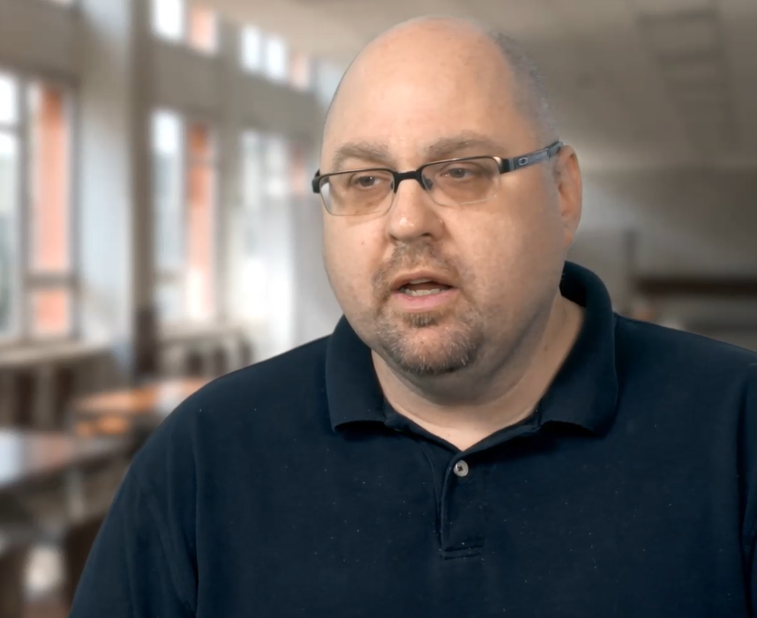
In Their Own Words
“Our mobile traffic has increased significantly from our students because it’s embedded in the New School app as opposed to them having to remember to go to the library and the library URL. So, it’s already in their phones and they are already using it.“
Allen Jones,
The New School

Slide 12
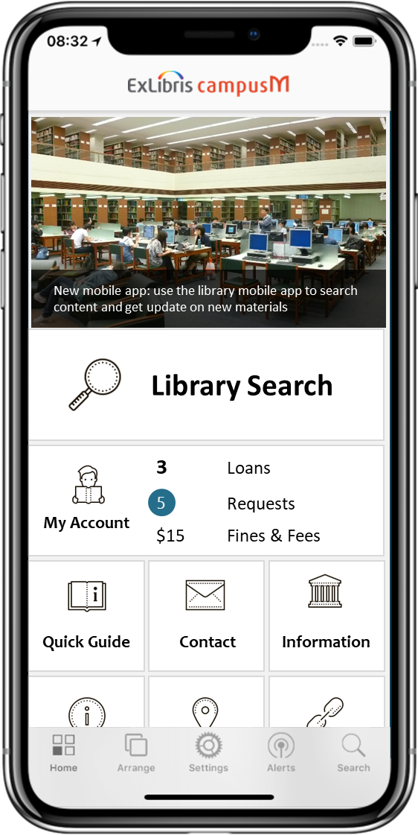
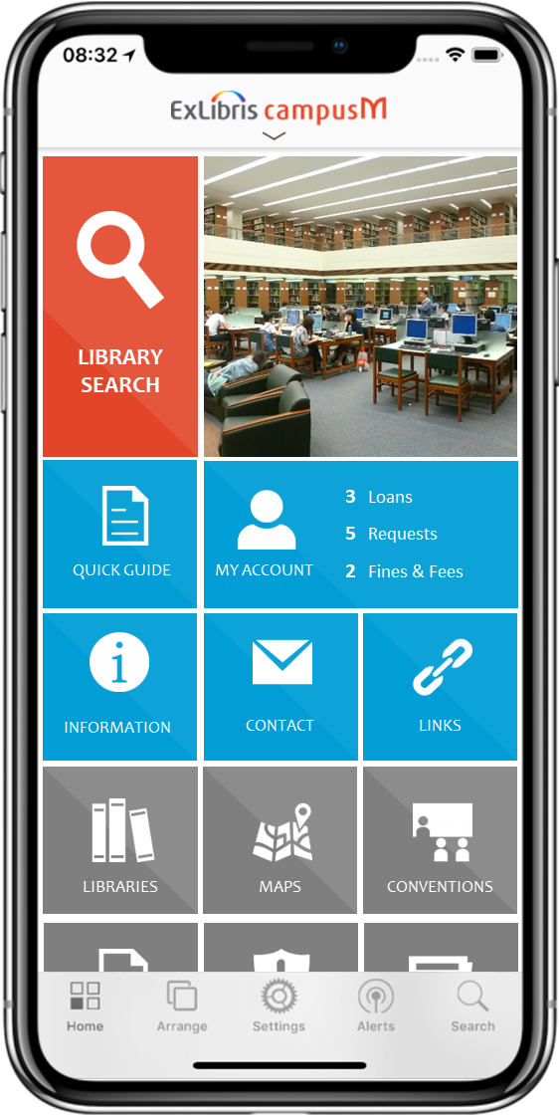
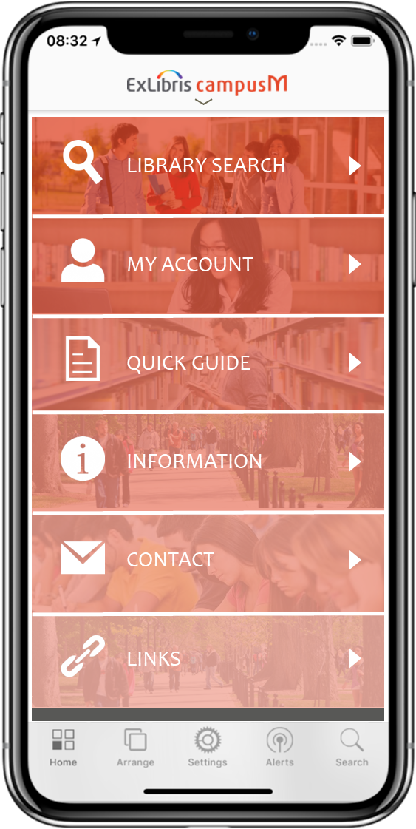
Deliver and Engaging Patron Mobile Experience
Fully branded interface owned and managed by each institution
Integration with library services including search, my account, guides and more

Slide 13
Tony.Chan@ExLibrisGroup.com

