Slide 1
rss2oai: harvesting Wordpress into Primo
Deborah Fitchett
Lincoln University Library, Teaching and Learning
ANZREG 2019 Developers’ Day

Slide 2
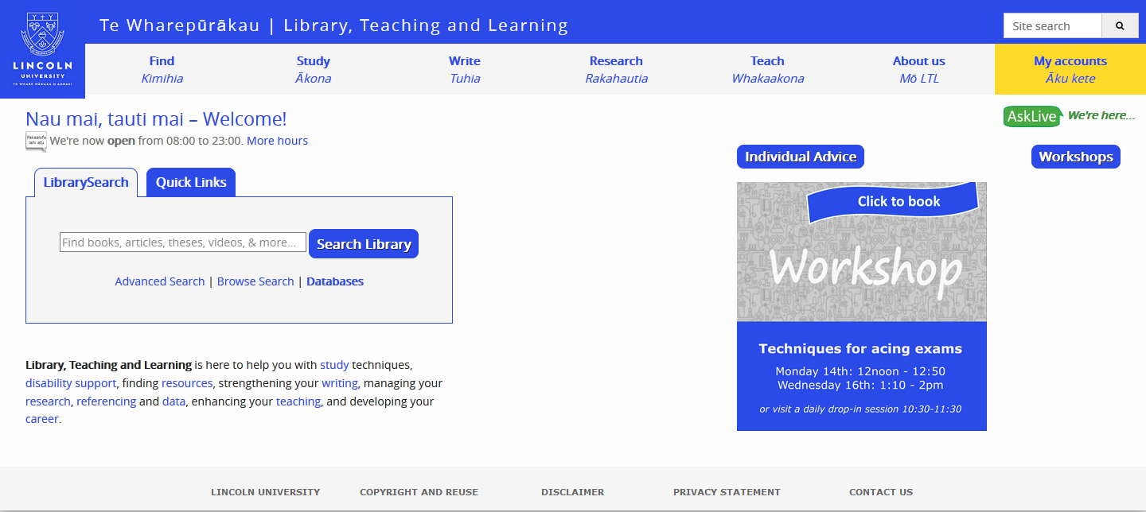
Searching the LTL website
Notes:
Our website has a site search box at the top right, and a Primo LibrarySearch box in the middle. Students come along looking for information about the APA referencing style, don’t see it jump out at them, and type it into a search box. Guess which box they search in?
So we wanted a way for Primo to return results from the library’s website.
This was before “Best bet” functionality was available, but the solution we came up with works better anyway: it indexes the whole site, and it maintains that index whenever any website pages change.

Slide 3
OAI feeds
Research@Lincoln
Primo
LTL website
Living Heritage
Notes:
When we first went live with Primo, Ex Libris set it up to index our two digital collections at the time:
our institutional repository Research@Lincoln, and our historical and community collection, Living Heritage. These sites both provided OAI-PMH feeds for all their public records, which Primo uses pipes to harvest. Over the years I’d done enough fiddling with them that I was pretty confident that I could create a new Primo pipe to harvest another OAI feed –
if only the LTL website had an OAI feed.

Slide 4
WordPress plugins
OAI-PMH?
Notes:
Luckily our website is built on Wordpress, which comes with a stunning array of plugins. First I looked to see if there was an out-of-the-box OAI-PMH plugin.
1. Sadly there wasn’t. (There is an OAI-ORE plugin, but on the one hand I wasn’t clear how that relates to OAI-PMH, and suspected it didn’t sufficiently; and on the other hand in any case it had been created a long time ago and was hardly being used, so support might not be reliable.)
2. Then I thought: Well, Wordpress does have an RSS feed. And RSS and OAI-PMH are both XML. So how hard would it be to transform one to the other?
Before I got started, the main flaw I saw in this plan was that by default, the Wordpress RSS feed only includes blogposts – but we’d developed our site primarily using static pages.
3. So I went back to the plugins search and found the “RSS Includes Pages” plugin which does what it says on the tin: it amends the RSS feed so that it includes pages as well as posts. (With the pro version you can also include or exclude specific posts or pages, but we didn’t need that functionality.)

Slide 5
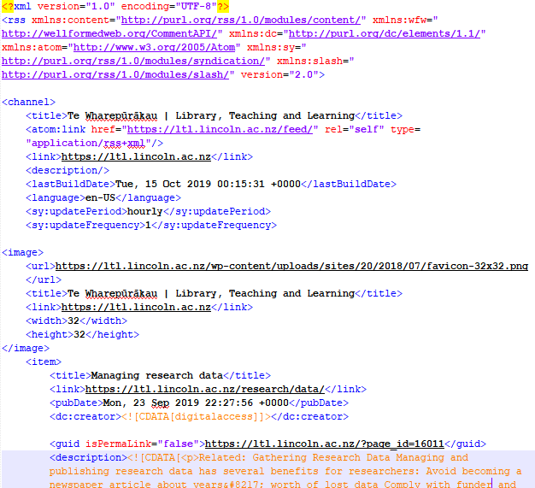
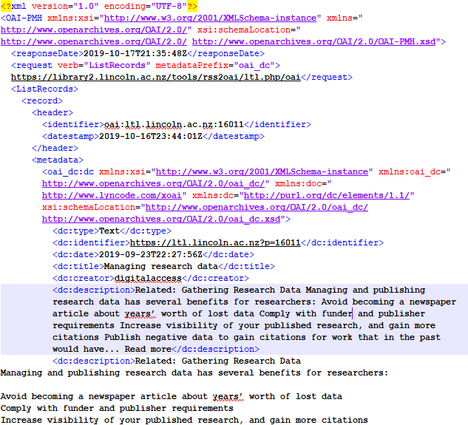
The XML
Notes:
So now our RSS feed included every page on our website, updated on an hourly basis.
1. The next step was just to convert it into an OAI feed which we’d import into Primo with a daily pipe.
2. That meant converting RSS to OAI,
3. channel information to request information,
4. and of course RSS item to OAI record:
5. Title,
Publication date
Creator,
Permalink
Description, etc
(The RSS feed includes both a “description” element with a short snippet of text, but also a “content” element which includes all the text on the webpage. This meant Primo would be able to index the full-text of the website.)

Slide 6
How
https://library2.lincoln.ac.nz/tools/rss2oai/ltl.php/oai
?verb=ListRecords
&metadataPrefix=oai_dc
&from=2019-10-24T11:10:00Z
Primo
PHP-enabled server
LTL website
Harvest Pipe
GET
PHP converts RSS to OAI in real-time
Notes:
So here’s the overview of how we do this. First we set up the Primo data source using our PHP code as the base URL.
When the pipe runs, it goes there using standard OAI syntax to ask for
a list of records
in OAI_DC format
starting from the date the pipe last ran.
5. The code then fetches the RSS feed from our website,
6. does a bit of magic to convert it, and sends it to Primo in the correct new format.

Slide 7
The PHP
Basic parameters
Build $data if:
$verb = Identify
$verb = ListRecords
$verb = ListMetadataFormats
errors
fetchRSS($feed,$page)
fetchFull($feed,$from)
assocArrayToXml($data)
Notes:
This is an overview of the main cases the PHP code itself deals with, and the main functions it uses. A full OAI feed is also meant to provide responses for GetRecord, ListIdentifiers, and ListSets – but I checked with Ex Libris and Primo doesn’t use any of these so I got lazy. Otherwise I relied on the official “Open Archives Initiative Protocol for Metadata Harvesting” specification, version 2.0.
The next set of slides will go into each of these steps in a bit more detail.

Slide 8
The PHP
Basic parameters
$feed = "https://ltl.lincoln.ac.nz/feed/";
$adminEmail = "digitalaccess@lincoln.ac.nz";
$rights = array(
"© Lincoln University; see https://ltl.lincoln.ac.nz/services/copyright-re-use/ for full copyright and re-use statement",
"Creative Commons Attribution",
);
$serveSSL = true;
$useBuildDate = true;
Notes:
The basic parameters include:
The URL to fetch the RSS feed from
An admin email to include on the OAI Identity page
Rights statements, since these aren’t included in the RSS feed – we use both a copyright statement and a Creative Commons license
$serveSSL should be true if you’re going to make the OAI feed available over https
$useBuildDate is needed because of how WordPress dates its RSS entries, and that needs a bit more explanation.

Slide 9
$useBuildDate
Created = 2017-08-08 14:00
Modified = 2017-08-08 14:00
Harvest from = 2019-10-24 11:00
$useBuildDate = true
Primo
rss2oai
Created = 2019-10-24 15:00
Modified = 2019-10-24 15:00
$useBuildDate = false
$useBuildDate = true
$useBuildDate = true
Created = 2017-08-08 14:00
Modified = 2019-10-25 10:00
Build date = 2019-10-25 10:00
Notes:
Primo scheduled pipes generally harvest only OAI entries modified since the pipe was last run – in this case, yesterday morning.
But there are two kinds of date in the WordPress RSS feed we could be checking.
One is for each item’s creation date. No matter how recently or how often the item has been modified, the item’s date in the RSS feed will always be its creation date.
1. With $useBuildDate = false, only the middle item here would be harvested, because that’s the only one created since the “harvest from” date. That’s usually fine if it’s a blog and you won’t have modified posts much. But for a webpage, we might have changed all the wording, and we want the most recent edits to be harvested for full-text indexing in Primo.
2. The second kind of date in the WordPress RSS feed is the build date. That’s the date the RSS feed itself was most recently built – which is when any page was most recently modified.
3. So with $useBuildDate = true, as long as at least one page was modified since yesterday morning, every page will be reharvested into Primo. Primo then overwrites existing records with new data. This is the option that works best for our website, but I left it configurable in case it would work better the other way for anyone else.
The only thing that won’t get picked up in either case is deleted items. Every now and then we manually go in and run a full delete-and-reload pipe to deal with these.

Slide 10
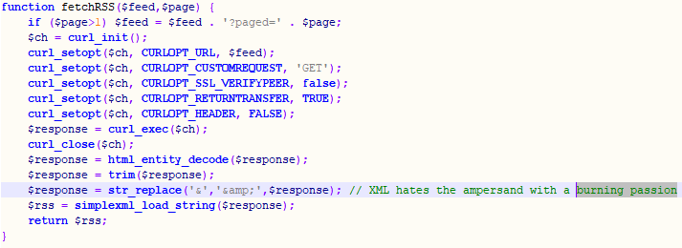
The PHP
Basic parameters
Build $data if:
$verb = Identify
fetchRSS($feed,$page)
Notes:
For the “identify” page we just need some basic information. Some of it comes from the initial parameters, and we fetch the RSS feed to get a couple of details from the channel data, like the website’s name and URL.
The function to fetch the RSS is pretty straightforward. It’s coded so it can deal with resumption, but otherwise it’s a straightforward cURL GET call, http-decoded and loaded out of the XML. The only tidying I’ve done is to trim whitespace and convert any ampersands. Our website “Library, Teaching & Learning” caused a lot of error messages before I figured that out.

Slide 11
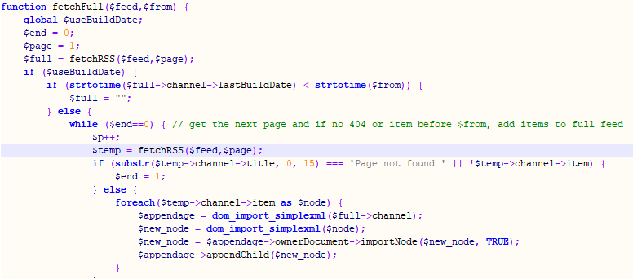
The PHP
Basic parameters
Build $data if:
$verb = ListRecords
fetchRSS($feed,$page)
fetchFull($feed,$from)
Notes:
The ListRecords response is the most important one – that’s what provides the actual records to the Primo pipe. So there’s a lot of if/else logic to handle different cases. If we’re using the build date and the RSS feed hasn’t been changed since we last ran the pipe, then we return an empty feed. Otherwise we loop through fetching all the pages of the RSS feed until we run out of pages to fetch, and import all of those items.
Or (in the section of the code not shown here) if we’re using the item creation date instead of the build date, then we need to loop through again but as we fetch items, we delete anything that’s older than the last date the pipe ran.

Slide 12
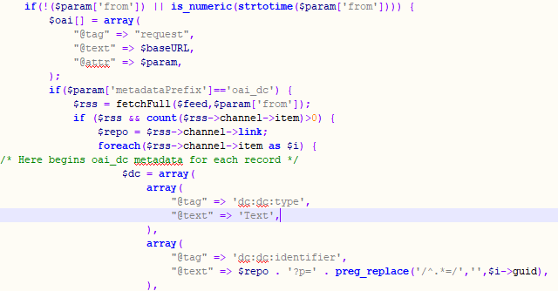
[…]
Notes:
Then we go through building an array with all the data the OAI feed is going to need: there’s the basic schema information, response date, and request parameters to start with. Then for each item the type is always text, the identifier is derived from the RSS permalink, the date is converted into a different format, the title has ampersands replaced with the word “and” because XML continues to hate ampersands with a burning passion, and so forth.

Slide 13
The PHP
Basic parameters
Build $data if:
$verb = Identify
$verb = ListRecords
$verb = ListMetadataFormats
errors
fetchRSS($feed,$page)
fetchFull($feed,$from)
assocArrayToXml($data)
Notes:
I’m not talking to the assocArrayToXML function here because looking at it, and knowing my coding style, I’m fairly sure it’s a lightly edited version of something I stole from StackExchange. But basically it converts the array we’ve built into an XML object – so the last thing we do is just echo that XML to output.

Slide 14
OAI feeds
Journals@Lincoln
Research@Lincoln
Primo
LTL website
Living Heritage
Data @Lincoln
Notes:
So we had our institutional repositories feeding into Primo,
1. and now we got the LTL website feeding into it.
More recently, we’ve added two new data sources, both based on their OAI feeds:
2. first was our Open Journal System, where we host two journals, possibly more coming soon.
3. The other is our Figshare instance which we launched this July.
But there’s still another piece of our puzzle....

Slide 15
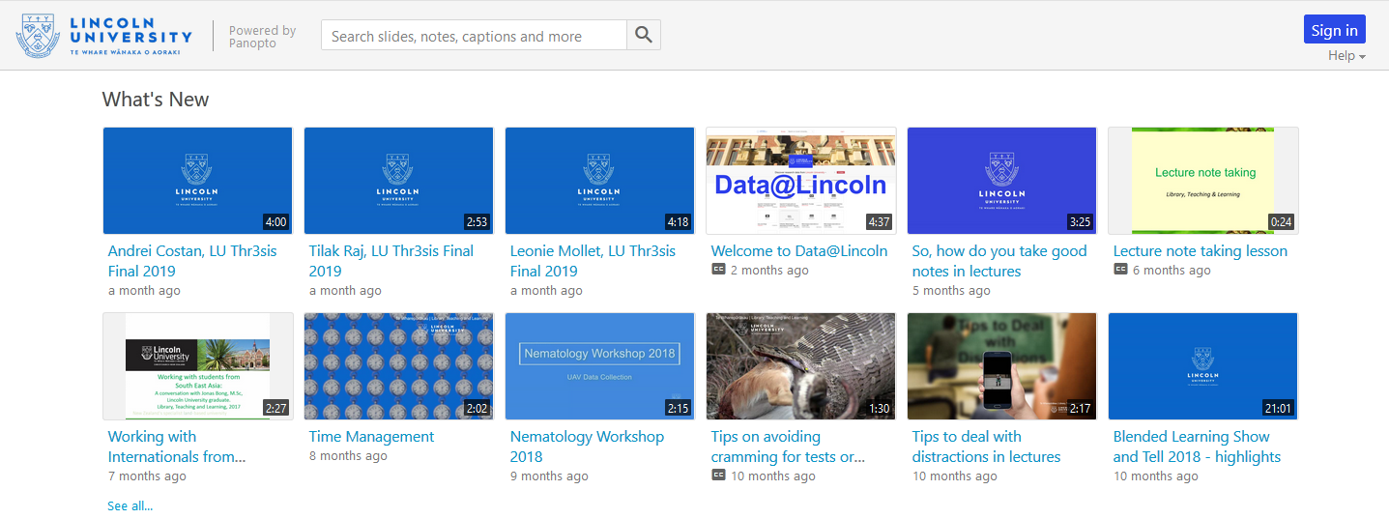
Next up
Notes:
This year we also launched Panopto to record, host and stream our lecture recordings and other videos. We’ve got a small but growing collection of these videos, and we’d like to index them in Primo too.
Panopto has recently created a RESTful API so it should theoretically be possible to create some “api2oai” to do the same thing. I’d hoped to have a demo ready in time for ANZREG but unfortunately I’m not the most expert coder and Panopto’s API isn’t the most well-documented so I’m still working with their Support people on making the calls I need. But I’ll share my code on GitHub and the Primo list when it’s up and running.

Slide 16
Open source code
https://github.com/LincolnUniLTL/rss2oai
deborah.fitchett@lincoln.ac.nz
Notes:
In the meantime, the code for rss2oai is up on Github for anyone interested in using or modifying it, and I’m happy to answer any questions.

