Slide 1
The fight against academic piracy
Sam Germein
Systems Librarian

Slide 2
Today I’ll be talking about
Notes:
Today I’d like to discuss the ongoing security issue of academic piracy within the library and an alert I developed for detecting it using Splunk.
Investigating for unauthorised access or systematic downloading of EZproxy content has been a part of my role since commencing with the Library. However, prior to Splunk (for the benefit of those in the room who are not familiar with Splunk. Splunk is a tool to analyse and display log data) it was a rather time consuming task of going through logs via the EZproxy admin screen.
Excel could help us by highlighting duplicate usernames potentially indicating access from multiple countries; still, it was a very hands-on process that was susceptible to human error.

Slide 3
Splunk to the future
Notes:
Then along came Spunk
Through the use of some clever dashboards designed for the library things became a whole lot more visual.
We could suddenly see things like a list of the top 10 downloads for a given time period, allowing us to easily see users that had downloaded more than the mean.
We could also perform lookups on usernames and see what countries their access was coming from

Slide 4
Identifying the gaps
Dear Librarian,
This is to notify you that IP addresses 123.456.789.100 associated with your organization, UNIV OF SOUTH AUSTRALIA, has been blocked from accessing content on the XYZ Database Company website due to unusual for your account excessive download violation. The IP block occurred on Thu Nov 16 16:39:01 EST 2017. To restore access to the IP address, please investigate the situation, provide the originating/external IPs connected with the downloads, and inform us of your findings.
Unfortunately, valid users from your institution might also be blocked if they use the same IP address, or if the account is set up using a proxy IP address.
Please investigate and contact XYZ Database Company directly at ipblock@xzy.co to request restoration. This IP address will remain blocked until XYZ Database Company directly is contacted and the situation is satisfactorily resolved.
Notes:
Although using Splunk reduced the amount of time taken looking for unauthorised access and increased our ability to identify it, there was a weak link in our process. Vendors where still contacting us with reports of unauthorised access to their content across weekends or out of business hours. This led to situations where vendors sent alerts in the form of an email over the weekend and blocked our access. Typically, these reports where not actioned until a Monday morning leading to outages for our students and academics.
Then the light bulb moment came along, Splunk has an inbuilt alert function, what if I could develop a query to test for suspicious access and get it to alert me via my email with the results in an Excel document.

Slide 5
The design solution
Notes:
I began thinking out the design process for the solution, as I was largely responsible for investigating these types of access. I had to determine the initial process and requirements.
Access from more than one country seemed like a good place to start, however my experience using Splunk told me that a lot of people used VPNs so perhaps testing for just two countries would turn up a very high number of false positives.

Slide 6
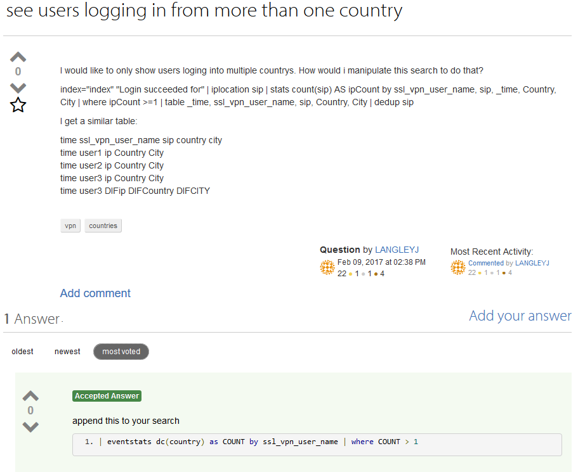
Learning the ropes
Notes:
Having no real knowledge of anything but the most basic query in Splunk I took to the internet. Throwing out some very broad search terms like ‘Splunk, show access from more then one country’ and ‘Splunk, show access from more than one IP address’. I began to gather some examples of code snippets.
Once I built a working prototype I quickly determined that testing for two countries was turning up a high number of false positives, upping this to 3 produced more meaningful results.

Slide 7
Testing 1
Notes:
At this stage of the development cycle it was still only me involved in the project. I had working query running once every 12 hours set up that was sending alerts to my mailbox. Things where looking good, where were becoming more proactive in our blocking of misuse on EZproxy and vendor complaints appeared to be decreasing. Still the alert was quite basic, I started to think what else could I do to improve its success rate.

Slide 8
Testing 2
Notes:
Adding database information would be a good idea, if a user had accessed from 3 countries for example but had only accessed one or two databases, there was potential that they could be a student in a country where accessing academic content was potentially blocked (e.g. China) and they were using a VPN.
Also, what about how much they had downloaded? This would also be useful.
Again, I was unsure how to display this information, it was already in our proxy logs but my Spunk skills just were not there yet. Fortunately, the dashboards I mentioned earlier contained examples on how to do this. So off I went to reverse engineer them and get the information in my reports.

Slide 9
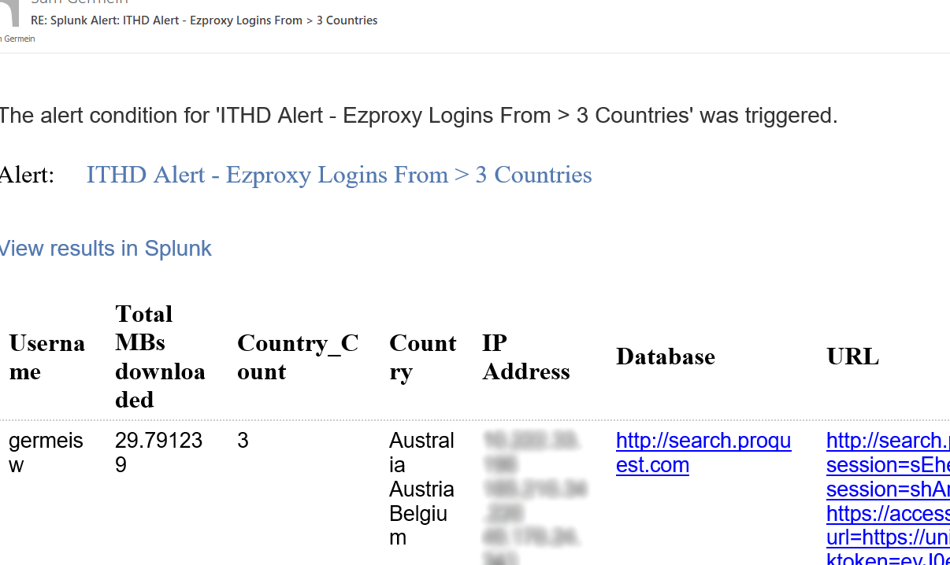
Testing 3
Notes:
Further testing was also highlighting the fact that depending on the device used to receive these alerts (for example a phone) it was impossible to access Spunk to view the alert and the attached spreadsheet was hard to make sense of on a small screen.
Splunk had an option to embed the data in the email body solving that issue, I also made some refinements to the display of how much data the user had downloaded converting it from bytes (the native EZproxy format for display) to megabytes.

Slide 10
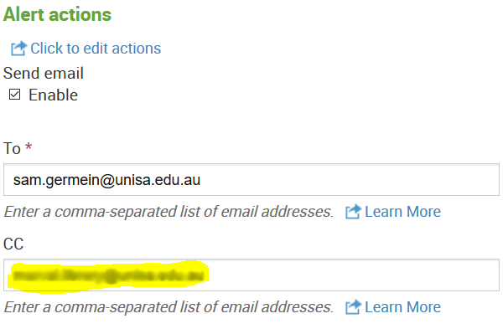
Deployment
Notes:
Now I had quite a good working prototype, I extended the alert to be sent to other members of my team and to Marval (our helpdesk software) so formal jobs where logged in the system.

Slide 11
Refining the process
Notes:
Not long after this the ITHD became involved in managing the Security of EZproxy, naturally, these alerts were extended to them, this in turn showed up some areas for further improvement. We were still getting a fair number of false positives. I wondered if an easy way to perhaps reduce these further was to add a test for the amount a user had downloaded. I’d kept a development alert running that was just emailing me, so after some more research I was able to code in a test to see if a user had downloaded more than X megabytes. Some tweaks, and the feature was rolled out to the production alert, I also made some small refinements to the way the database information was displayed.
I was also aware that the alerts was only running one a day, some after some discussions with the ITHD and the Security team (who own Splunk) it was agreed to increase it to every 6 hours (this was deemed the best mix of alert frequency and not impacting Splunks performance).
The final piece of the puzzle was for me to hook the alert into an existing function in the library API that could automatically take the value from the username field and add it to the EZproxy deny file, fully automating the blocking process.

Slide 12
ROI
Notes:
This alert has completely changed the way we investigate unauthorised access to our EZproxy content at UniSA, its reduced workload massively and taken out the human error, there is still some potential for false positive and future enhancements could be made, but we are now on the front foot when I comes to stopping these kinds of access.
Vendor complains are down, and we now find ourselves mostly making the initial contact with vendors rather than the reverse. Vendor instigated blocks on databases and journals are very rare now.

Slide 13
What else can we do?
Notes:
Whilst we test the implementation of Ezproxy 6.5, I have imported the EZproxy blacklist to Splunk mimicking the API call to IP-instrusion.org built into version 6.5. This has some limitations in that the list needs to manually updated in Splunk. Splunk has the ability to make an API call to get the list from Github but further testing locally is needed with that feature.
I have also managed to combine a series of tests so the alerts tests for access from a Blacklist IP address OR access from greater then 5 IP address OR access from 3 or more countries AND a user that has downloaded more the X megabytes.
The regex and dedup functions have also been updated to reduce duplicate values in the Database column.

Slide 14
Thanks
Notes:
I’d like to acknowledge building this alert was not my work alone and like to thank those colleagues both current and past who’s wisdom and advice went into the development.

Slide 15
Any questions?
sam.germein@unisa.edu.au

