Slide 1
What do Primo users want?
or finding evidence to understand user behaviour in Primo
Megan Lee, Application Librarian
Rachelle Orodio, Application Administrator
Monash University
ANZREG 2019 Conference (23-25 Oct 2019) #anzreg2019
Notes:
At Monash University we run a professionally managed Library User survey every 2 years, with seven other Australian Universities. One of the questions we ask users in this survey is to rank a list of Library services from most important to least important.
In 2017, users listed the following library services as most important

Slide 2
PROJECT DRIVERS
PROJECT DRIVERS
(PRIMO)
Notes:
The 4th most important service listed - Library Search facility that enable me to find Library resources quickly – is Primo and
And the 9th most important issue - When I am away from campus, I can access the Library resources and services I need – is both the Library’s proxy server and Primo
And while it’s encouraging to know that users value resource discovery, when users completed the free text section of the survey, they made comments about Primo like these.

Slide 3
USER FEEDBACK
The online portal for accessing journal articles is very slow and bulky.
Accessing articles through the library search portal takes way too many steps.
Online resource availability tends to be very good although search results can be hard to navigate.
Some links online for certain articles link to a different article, it makes it hard to find the actual journal article you need when the links don't work
Notes:
While UX research tells us that most feedback has either a heavy positive or negative bias - as only users with strong feelings about an issue will spend the time to provide feedback – in 2017, we received five favourable comments about Primo, and sixty one unfavourable comments.
Equally, many of the issues described in the feedback related to Primo design and system functionality, which we have limited capacity to change.
As Primo administrators, we can at most configure predefined settings, or tweak Primo’s screen design and layout. It’s more difficult to address issues like the number of screens a user needs to navigate to get from one search results screen to another, or to a pdf link or physical item availability statement (although we’ve added a few plugins that have helped with this).
And every customisation we develop builds in a service overhead. This overhead has to be repaid each time we run an upgrade; in the people hours spent reapplying custom scripts, in configuration choices and in regression testing.
We think this highlights an underlying tension for Primo administrators, which we recognised when we planned the approach we would take in this project.
One of our goals was to limit our development work, to changes that would provide a tangible ‘return on investment’.
To do this, and because a full Primo UX review is a major project that impacts on a broad range of Library users and staff, we ran the project using a formal project management approach.
This project plan included:

Slide 4
STRATEGIC OBJECTIVES
Develop discovery and access pathways to information
Enhance the online Library environment
Notes:
Strategic objectives

Slide 5
PROJECT OBJECTIVES
Investigate if Primo user interface usability is improved by focusing on heavily used screen elements
Investigate if Primo user interface usability is improved by simplify the number of elements present in the Primo screen design
Based on user feedback, investigate if Primo search results are more relevant when search metadata is simplified
Improve Primo search results by analysing zero search results
Investigate user acceptance of FRBRisation
Investigate user acceptance of application plug-ins to extend Primo functionality, eg Browzine integration at detail results screen
Notes:
Project objectives

Slide 6
SUCCESS FACTORS
Improved feedback on Primo usability in 2019 Library user survey (in progress)
Improved Primo user search metrics in 2019 Library Annual Report (in progress)
Improved user feedback collected either directly during three month post implementation survey or via ask.monash
Positive feedback from Road Shows conducted at various branches, reported to IRSC and LMC as a result of Primo usability review
Data collected from embedded feedback utility, as a basis for the three month post implementation review
Notes:
And Success factors
Our project plan provided a project implementation map, and criteria against which we could evaluate the project’s success, and identify future potential improvements.
Out of the project plan we developed project milestones, which recognised both available project resources and ongoing application management commitments:

Slide 7
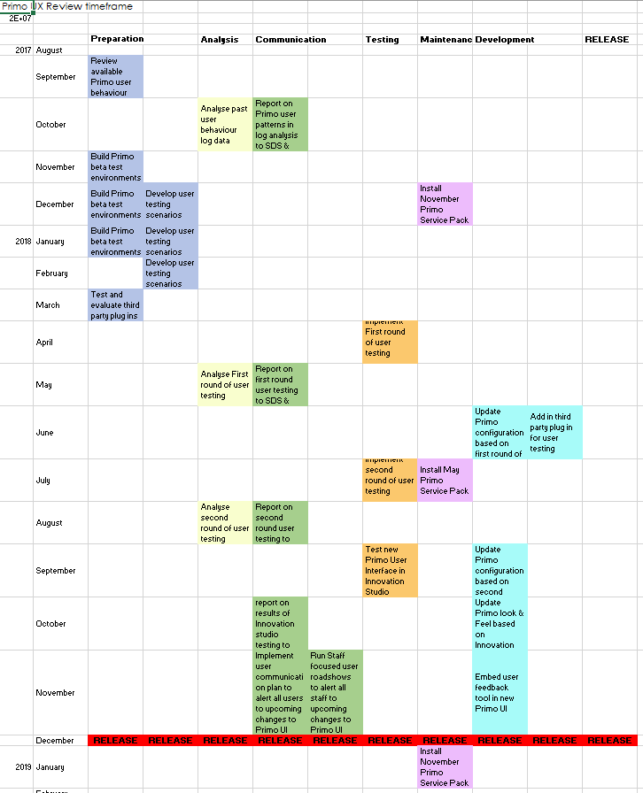
PROJECT MILESTONES
Notes:
Each of these stages had an estimated start and finish date, and allocated staff resources.
Based on this planning, we started the project by collecting data that described our users’ past behaviour in Primo.
We saw this as a way to identify trends and make recommendations for the next stage of the project; user experience testing.

Slide 8
PRIMO USER BEHAVIORAL TRENDS
a year’s worth of Primo usage logs from our Primo server
Primo and Alma analytics and
Google analytics
Notes:
We started our data collection process by sourcing:
A year’s worth of Primo usage logs from our Primo server
Primo and Alma analytics and
Google analytics
We ingested the Primo usage logs into Splunk to organise and analyse them, and compared the results with the Primo, Alma and Google analytics reports, for verification.

Slide 9
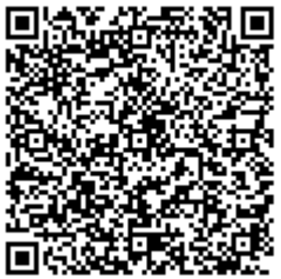
RESEARCH DATASET 1
https://tinyurl.com/y5k4nzr4
Notes:
We developed a large research data set (Research dataset 1) that you can access using either this URL or QR code.
And we used this intelligence as a starting point to answer questions like

Slide 10
RESEARCH QUESTIONS
How do users search in Primo?
Where do they start their searches?
Which screen elements do they use most heavily, and which they ignore and
What can we understand from how users structure their searches?
Notes:
How do users search in Primo?
Where do they start their searches?
Which screen elements do they use most heavily, and which they ignore and
What insights can we glean from understanding how users structure their searches?
We reviewed and organised this data by categorising them into functional themes, which allowed us to identify trends and make development recommendations.
The questions we asked were, how do users:
Start a search?
Do they narrow their search results?
Do they broaden their search results?
Do they personalise their search results?
Do they Save their search results or user information for reuse
What we found was:

Slide 11
How users start a search
Source Primo analytics
Notes:
90% of user start searching in the basic search screen
And 98.5% of searches were run in the default “All resources” search scope.
When we started this project, we had four search scopes;
All resources – a blended scope
Library collections & Rare Books – a local scope
Online articles – a PCI/Deep search scope and
Popular databases – a Remote scope
In early analysis of this data, the project team queried if users were making a conscious decision to select a search scope, or if they were simply unaware of the scope choices available to them. This question was noted for further investigation.
User Sign-in function
We identified the Primo sign-in as a critical system function, so it was disappointing to see that only 15% of users signed into Primo during a session.
The project team identified the importance of making it more visible to users, through both system redesign and user education.

Slide 12
Narrowing search results
45% of Primo actions were Resource availability seeking actions
Source Primo analytics
Notes:
Users can narrow their search results by linking to:
1. Resource availability information:
45% of Primo search actions were “Resource availability seeking actions” actions.
Of these
51% of actions was “Click on availability statement”
45% of actions were “View it” links
Users can also narrow their search results by filtering brief search results:
11% of Primo search actions were refining actions applied to result in the brief results screen.
Of these actions
56% of search refining actions were filtering by facets
42% of actions were selecting the next page link.

Slide 13
Narrowing search results
Source Primo analytics
Notes:
5% of Primo search actions were filtering by facets. Most users (45%) used the Top Level facet option that includes; Peer reviewed articles (35%), Full text on line (8%) and Available in the library (3%)
5% of Primo search actions were “Item detail” refining actions, which includes; accessing the Details tab (80% of the time), the Reviews tab or the Virtual browse tab
0.35% of Primo search actions were “sort by” actions, which included sorting by Descending date (60% of the time), by Rank, by Popularity, by ascending date or by title
Users select Citations and recommenders actions about 0.1% of their activity in Primo. Users selected “Display Citations from results list” 55% of the time and “Display Cited By from results list” 45% of the time
From this data the project team were able to map typical user search behaviour in Primo. Typically, when our users Search in Primo, they:
Use the default sort-by option
Do not use citations or recommender
Do not display reviews
This suggested that we could test:
Reducing the number of facets available to users in the brief results screen, to top five and language facet
Remove all sort-by options except sort by ascending & descending dates, which are relevant for Special Collections.
Remove the recommendations tab from the item details screen.
We felt these changes would have minimum impact on user activity in Primo

Slide 14
Broadening search results
Source Primo analytics
Notes:
In Primo, users have the option to discover resources serendipitously, through browse searching and embedded links. From the available data, they didn’t appear to make any use of these options.
The project team agreed that few users would experience a loss of functionality if we removed the “Browse” search link from the Basic and Advanced search screen header in UX testing.
Because bX recommender is a separate subscription service, we decided to investigative if the low take up of the bX hot articles was due to its low visibility on the basic search results screen.
We agreed to move the bX link to a more visible location during user testing, to evaluate if this would improve user take up.

Slide 15
Personalising search results
Source Primo analytics
Notes:
The data available from Primo analytics for My account usage is problematic because, by default, the My account screen opens in the loans screen, BUT loans usage is only recorded if the users accesses the Loans list directly.
The project team felt that this biased the metrics recorded for the number of times users access their Loans information in Primo.
However, we felt more confident about the data that described Tags usage, Reviews usage and the usage of personalized results profile options. We determined to we disabled these functionas with minimal impact on users.

Slide 16
Source Primo analytics
Reusing search results
Notes:
In Reusing search result, we included:
Export citations
Save session or saved query
Add eShelf - in brief search results, details, viewit and getit screens
Access resources via eShelf and
Deep link & Permalink
Our evaluation of these services was that while there is very little take up of these features, none of them is visible on the landing page or in the brief result set screen.
They are integrated Primo functions that would require significant effort to remove, so we decided to leave them as they are.
We did identify a potential benefits for users if they were more aware of these services, and noted that it may be worth developing some research skills resources to promote them.

Slide 17
Analysis of user search strategies
44% of user searches are two to four words long.
69% of searches are either under seven words long
14% of searches include more than fifty words
Most searches are fairly simple, eg ‘marketing mix’ is the most commonly occurring search term
1.13% of all searches were unsuccessful
Notes:
An analysis of how users structure their searches in Primo shows:
44% of user searches are, two to four words long.
Most searches are either under seven words long (69%) or include more than fifty words (14%).
The search terms used in most searches are fairly simple, eg ‘marketing mix’ is the most commonly occurring search term; it occurred in 24% of the 7,284 top 20 searches.
User get no search results for about 1.13% of all searches
This data suggested that our users have two primary search strategies. They either;
To enter a few keywords into Primo to start a search, or
They copy and past their research topic or a full citation into Primo.
The project team did recognise that there was an outlier group of about 9% of user who did not fit this model.
Unlike the prevailing 91% of users, this 9% of users started their searches in the advanced search screen, and applied both pre and post search filtering.
However, the project team prioritised the needs of the 91% of unsophisticated users over the 9%, both because of the size of each group, and because in the continuum of discovery applications that the library maintains, we see Primo, primarily, an undergraduate discovery service, as illustrated in the next diagram:

Slide 18
Library discovery application hierarchy
Notes:
At the end of the first stage of the project, we had collected and analysed a large data set. From this data, we had proposed some Primo features we wanted to highlight through screen design and configuration, and other features we wanted to remove.
In the next stage of the project, we would develop two test environments, to evaluate users response to these potential design changes.
Rachelle will outline how we ran this testing and what we discovered about our users:

Slide 19
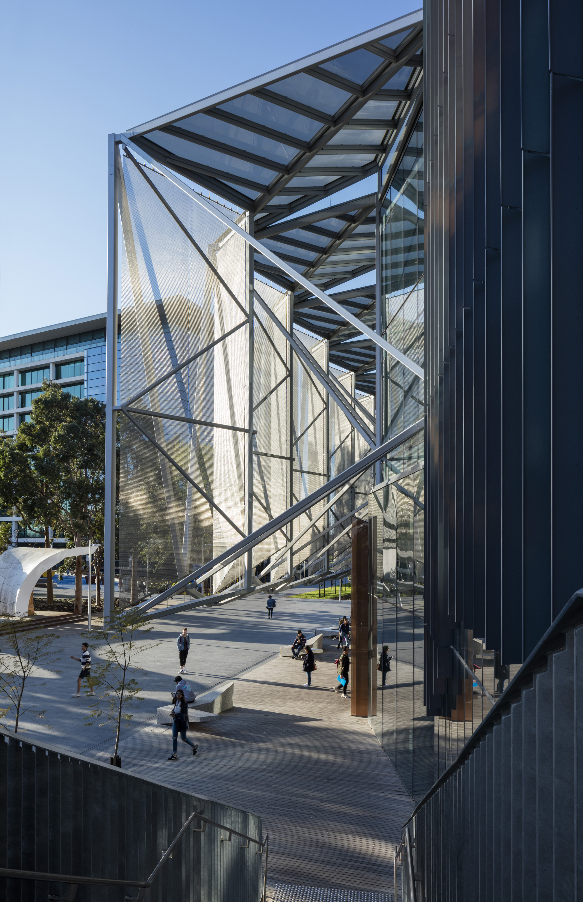
PRIMO ENVIRONMENT
Primo since June 2010
Direct Hosted Back Office (can SSH),
3 Alma Institutions and 1 Primo Instance with 3 Views
Multi-search scopes
Alma & PCI + 3 additional local data sources
Authentication: SAML Okta (Multi-factor authentication)
2.1M Electronic + 1.6M Print Bibliographic Records
78K Students, 17K Staff, 206 Library staff
4.1M physical visits to the Library
Notes:
Let me describe to you our current Primo Environment.
We have been running Primo-Voyager since June 2010 and then migrated to Alma-Primo in September 2013.
Our current Primo instance is Direct Hosted, so we have access to both Back-Office and can SSH (login) to our instances.
We have 3 Alma institutions each to manage our international campuses in Australia, Malaysia & South Africa.
We only have 1 Primo instance and maintain 3 views, 1 for each Institution.
Our Primo uses multiple search scopes. We also have 3 additional data sources on top of Alma & PCI.
We use SAML Okta for Multi-factor authentication configured in PDS.
And we have a total of 3.7M bibliographic records.
We had to consider these variables in planning our approach to UX testing.

Slide 20
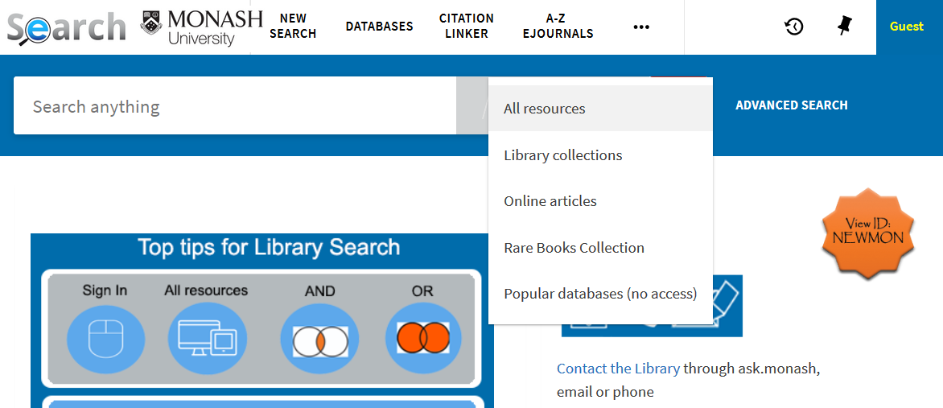
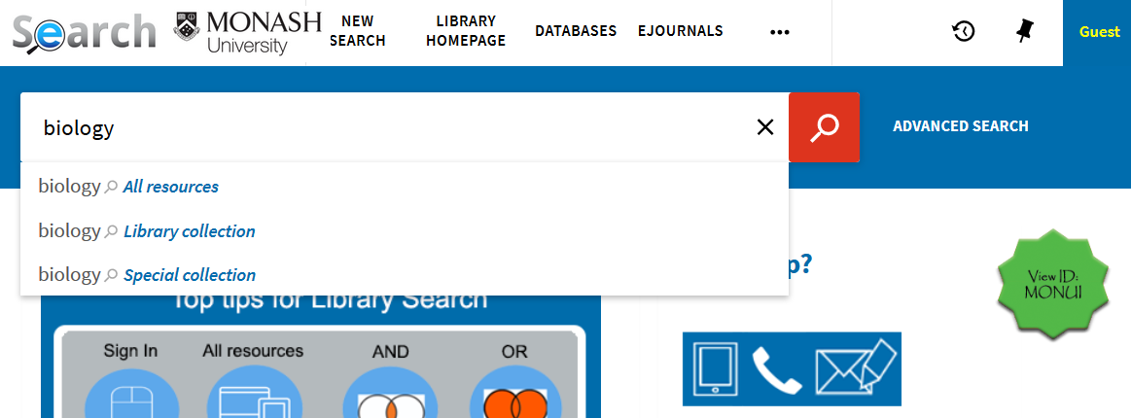
PRIMO UX TESTING PROCESS
1
2
3
Observation & Survey Data
Observe Users
Usage Data
VIEW 1
Pre-Test
Post-Test
VIEW 2
4
5
Notes:
Megan described our project stages earlier.
In our UX Testing, we took an iterative process to understand our users needs.
We had 2 rounds of user testing which took this flow of activities.
Based on usage statistics from: Splunk, Primo Analytics and Google analytics
we identified which screen elements were used most frequently by our users.
This was then used to design our two test views.
2. The first view was designed to slightly mimic the classic view in terms facets, scopes & send-to options.
The second view was a trimmed down version where it had lesser facets & modified scopes.
3. We then gathered volunteers from various cohorts to help with testing.
Users were provided test scenarios for each view and were asked to think aloud.
The testing was observed by 2 Research & Learning staff & the UX expert.
The users had to answer a pre-testing and a post testing survey too.
We allocated about 1.5 hrs to run each session.
4. The observation & survey data, were then collated.
We ran a workshop with the observers to summarize data and make recommendations.
The recommendations were classified into 3 themes:
User Education, System changes & System limitations.
5. Any cosmetic changes that were easy to implement, went through as input for the 2nd round of UX testing.
Then we went through the same process for the 2nd iteration.

Slide 21
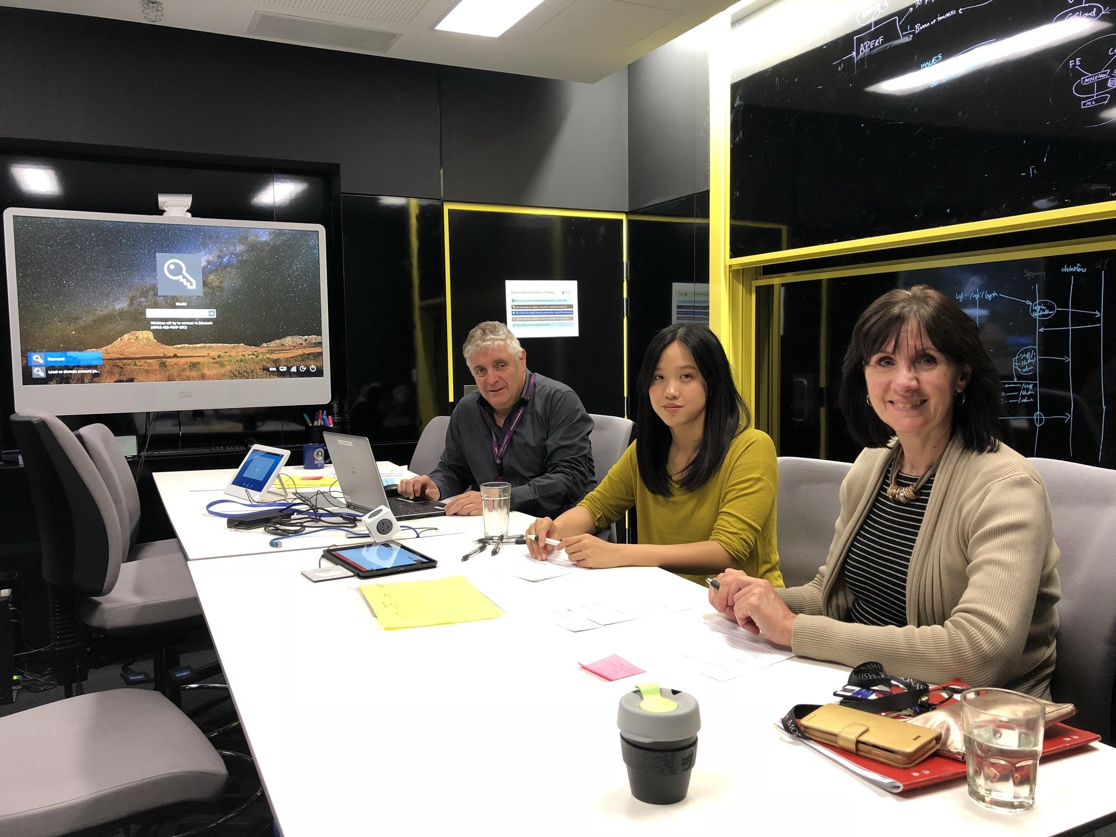
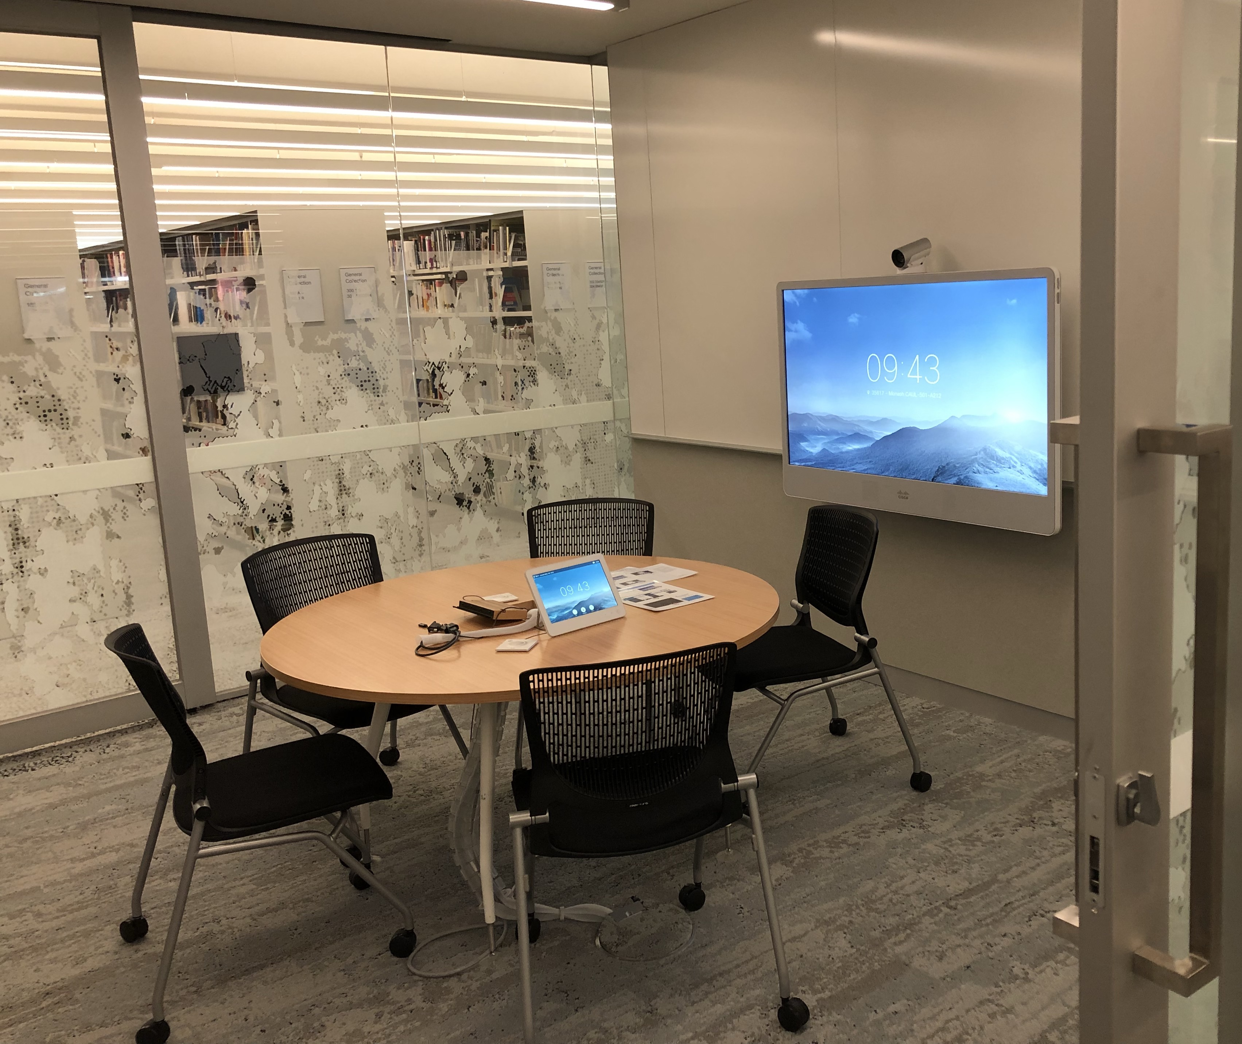
VENUE OF UX TESTING SESSION
The observation setup at the Monash University Innovation Studio & Monash University Caulfield Library.
Notes:
We conducted the 1st Round of testing in early May 2018.
We had 10 testers for Round 1.
In a standard UX study, they say it is enough to have 6 testers, however we took on an extra 4 to better understand our users.
Our testing was conducted across 2 branches, one at the Innovation studio, and a Library Teaching room.
The eSolutions Innovation Studio is a purpose built space
that helps students and staff collaborate, to improve user experience, advance innovation and design for University wide applications.
They have access to a suite of UX tools, devices and testers.
We got the university UX Team involved because:
Primo is used by large number of users, particularly students
And it is a system that performs critical university work
During the UX testing the laptop session was projected to the big screen
to allow observers to see better what was happening.
The session was recorded in Morae, so we can go back and review the session recording.

Slide 22
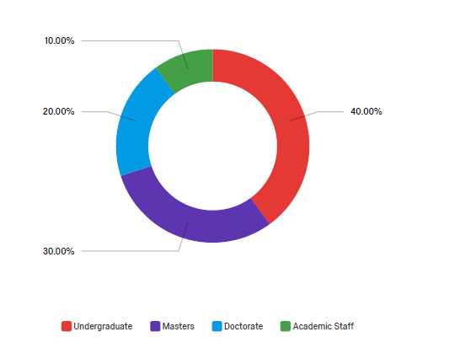
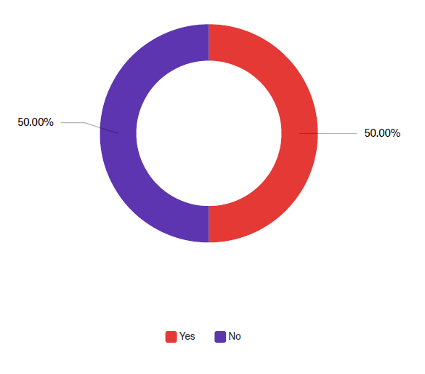
USER DEMOGRAPHICS
Faculties
Year levels
Local and International Students
English as their first language
Years at Monash
What is your Asscociation?
Are you an International Student?
Notes:
When we gathered volunteers, we made sure we had representative from various cohorts.
We wanted most faculties represented, as each course may have different searching requirements.
Different year levels had different needs or experience.
We made sure we had undergrads, postgrads and academics.
Also making sure that there was representation from both International & Local students.

Slide 23
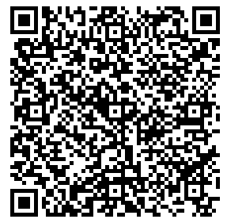
UX TESTING KITS:
Test scenarios:
Known title
Subject
Journal article
Resource Type
Call Number
Availability
Qualtrics Pre-testing Survey
Qualtrics Post-testing Survey
User Consent Form
Observers questions
https://tinyurl.com/y4fgwhhx
Notes:
URL to Google Drive: https://drive.google.com/drive/folders/1M0VoCopP0cA7e8dgl3SVZksZ1w3zcgd3?usp=sharing
If you wish to preview our Testing Kits you can access it through the QR code on this slide.
It includes the testing scenarios, & questionnaires we used during the sessions.
The Test Scenarios we used were based on various papers
including one’s from Exlibris, Flinders Uni, La TRobe Uni & other researches we’ve came across.

Slide 24
PRE-TESTING SURVEY
Pre-testing survey
Q. WHERE TO SEARCH FOR AUTHORITATIVE INFORMATION?
1. First preference & discipline specific databases:
2. Then Primo:
3. Discipline specific databases:
Notes:
In our Pre-Testing Survey, we tried to ask users where they start searching for online materials.
We tried to make a distinction between General Study topics and Authoritative information.
When we asked them where they search for authoritative information,
CAN you guess what they specified as their top searching tool? <<PAUSE>>
Thirty percent said, their first preference is Google Scholar
& discipline specific databases, they were familiar with in their course of study.
Primo came second. This normally meant,
they hit a paywall issue on Google Scholar so they needed access through Primo.
If they couldn’t find anything, in the first two approaches, they would try other databases for searching.

Slide 25
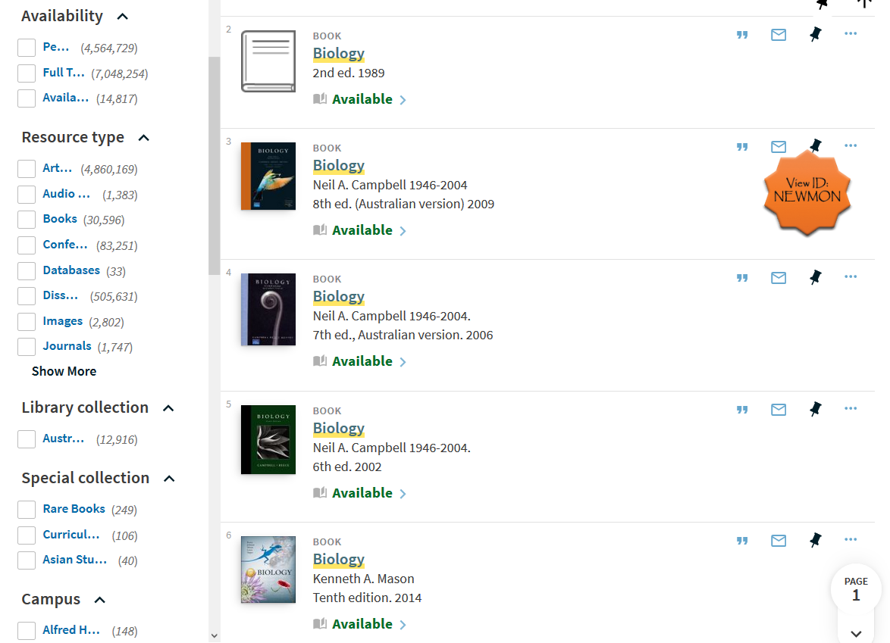
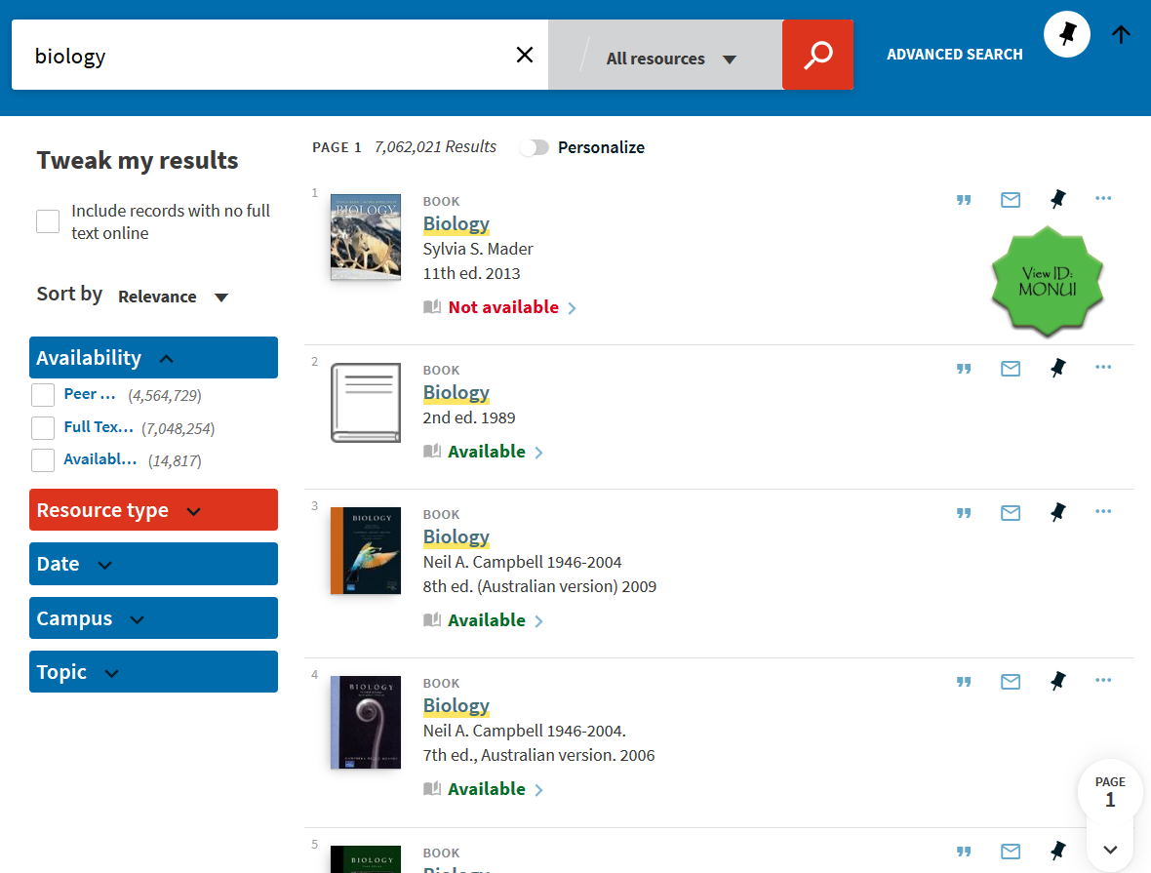
POST-TESTING SURVEY
User Preferences
vs
VIEW 1
VIEW 2
Facets, Scopes, design similar to Classic UI
Simplified & striped down view
Notes:
In our UX testing we asked users to run tests on 2 different views.
At the end of the testing we asked them to rate which of the 2 views they preferred.
View 1 was slightly similar to the classic view.
View 2 was the simplified view.

Slide 26
POST-TESTING SURVEY
VS
VIEW 1
VIEW 2
Feedback on the views ….
6 users noticed the difference
5 users strongly agreed that View 2 was easier to find resources in.
Most useful features:
Advanced search
Favourites;
and Citation Link to Styles (e.g. APA/MLA etc)
Notes:
Between the two views …. <PAUSE>
We had more positive feedback on the simplified view.
50% of the users strongly agree
that View 2 was easier to find resources in.
Out of 14 screen elements we highlighted in the survey,
the top 3 most useful elements from their perspective were:
The Advanced search, followed by the Favorites
and lastly Citation Link to Styles.

Slide 27
UX TESTING (2nd ROUND)
User Preferences
Q. WHAT ATTRIBUTES DID YOU LIKE ABOUT ANY OF THE VIEWS?
(25%)
Expanded Facets list (25%)
Browzine Plugin (37.5% )
(25%)
Notes:
So on the 2nd iteration, when we asked them what they like with the new view,
they mentioned:
The Grouping of titles
Displaying location information next to availability
And their favorite, was the Browzine Download Now feature,
they even wanted this feature available across all the Online articles that were searchable on the page

Slide 28
QUANTITATIVE + QUALITATIVE
+
Notes:
In the next few slides, I will try to compare the usage findings we gathered in Stage 1
Against the observation data, made by our Research & Learning observers.
I will also try to mention some of the recommendations they have provided as part of the workshop.

Slide 29
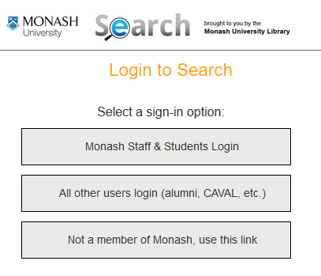
USAGE DATA + OBSERVATION (Sign-In)
Primo UX Review
1
Sign in (Usage Logs):
3
2
UX Observations:
Recommendations:
Users did not sign-in unless they needed too (e.g. check loans, read an article)
Educate users to sign-in
Auto-login users when clicking on Primo.
Notes:
In Stage 1 we gathered that only 15% of users sign-in.
We confirmed from the observations, that users do not sign-in by default.
They will only login if they need too to place holds, check loans and read an article.
We recommend that, we need to educate users to sign-in by default.
We also wanted auto-login for users to happen,
specially if they were already logged in to their Monash Account.
According to users, an extra 2 clicks is cumbersome so we are continuing to pursue this with Exlibris.

Slide 30
USAGE DATA + OBSERVATION
1
2
3
UX Observations:
Recommendation:
Basic search was mostly used by users
There were a few individuals who used Advanced Search.
However Google Scholar is their preferred searching tool.
Modify the embedded search box in the Library homepage to allow multiple ways users can run searches
Notes:
Our stats say, Basic Search is where users launch their searching.
We confirmed in our observation, only a handful of users used the Advanced search.
Also, Google Scholar is their preferred tool for searching online articles.
We recommended: Aside from simplifying the Primo main menu,
modifying the embedded Library search box would be good,
to allow users to have multiple ways of searching.

Slide 31
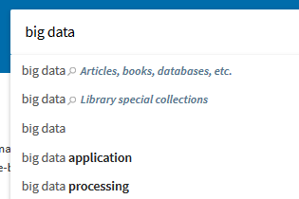
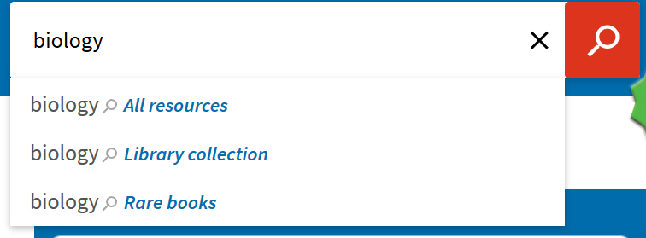
USAGE DATA + OBSERVATION (Scope)
Primo UX Review
1
2
3
UX Observations:
Recommendations:
Most users use the default All Resources scope.
The auto complete search box helped make the scopes visible.
Use the auto complete search box to make scopes more visible
Rename labels to make the scope clearer
Notes:
The Usage data showed, All resources was the busiest scope.
Observation confirmed this.
“All resources” is what most users use.
And they do not change scope.
Auto complete feature, made the scopes more visible.
It was then recommended that we implement the auto complete feature.
Also renaming the scopes to make the coverage clearer.

Slide 32
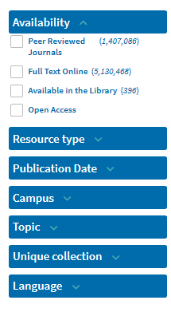
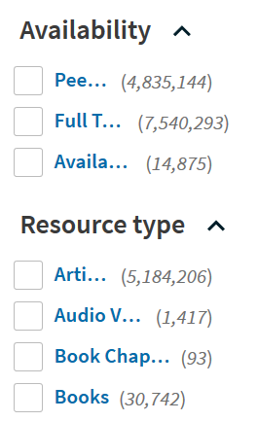
USAGE DATA + OBSERVATION (Facet)
1
2
3
Primo facets that narrow search results (Usage logs):
UX Observations:
Recommendations:
Users preferred the expanded list of facets
However facet navigation was limited
Strip down the facet list but keep it expanded.
Use the top 5-6 used facets.
Notes:
We confirmed in the observation that users facet use is limited
Users also preferred the expanded facet.
It was recommended, to strip the facet list to the top 5-6 used facets.

Slide 33
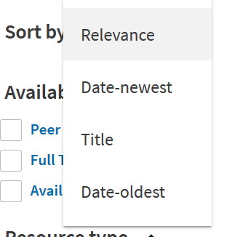
USAGE DATA + OBSERVATION (Sorting)
1
2
3
Primo sort-by options to narrow search results (Usage logs)
UX Observations:
Recommendations:
Confirmed that users do not change sorting order
Default location wasn’t visible
Move the location of sort-by so it is visible
Educate how to use sorting feature
Understand what relevance ranking means
Educate how to identify new materials
Notes:
When we compared usage data for sorting,
We also observed that users do not change the sorting order, when searching.
We recommended user education when it comes to using the sorting feature.
It would also be good to have a better understanding
Of the meaning of relevance ranking.
We also relocated the Sort-By option to make it visible to users.

Slide 34
USAGE DATA + OBSERVATION (Availability)
1
2
3
Primo availability information (Usage logs):
UX Observations:
Recommendations:
The lesser the clicks the better
Have location & availability on the brief results page
Display location & availability information on the same page
Educate users about Sign-in to make better use of this function.
Notes:
We’ve confirmed that users prefer lesser clicks.
They want all information in one page, to avoid too many clicks on the screen.
We recommended adding the location information, next to availability.
We will also need educate users in the benefits of signing
Before conducting searches.

Slide 35
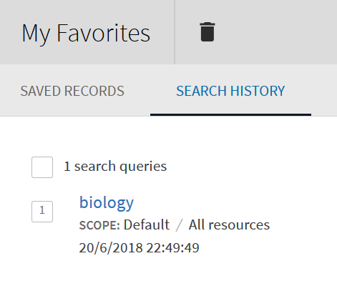
USAGE DATA + OBSERVATION (Saved Query)
Primo UX Review
1
2
3
Primo saved queries (Usage logs):
UX Observations:
Recommendation:
Users are not familiar with the Saved Queries & Session Searches feature.
Educate users on how these features can help them.
Notes:
Users are not familiar with the Saved Query & Session searches feature.
But when we demonstrated it in UX testing, they actually liked it.
We recommended that it would be good, to educate users
on the benefits of using save queries
especially when user are logged in.

Slide 36
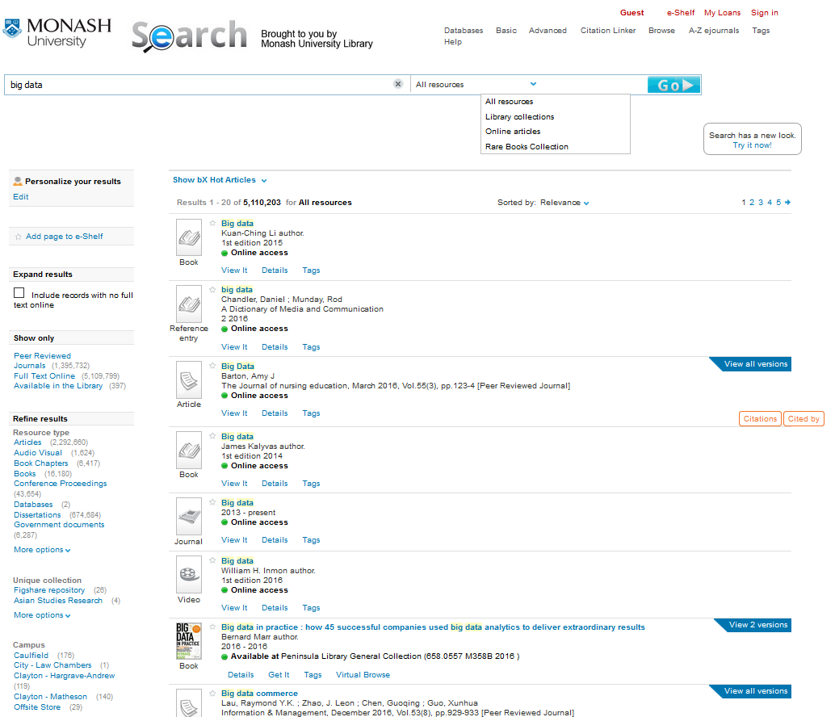
From the
busy Classic
User
Interface
Notes:
So from our busy 8 year old classic user interface …..

Slide 37
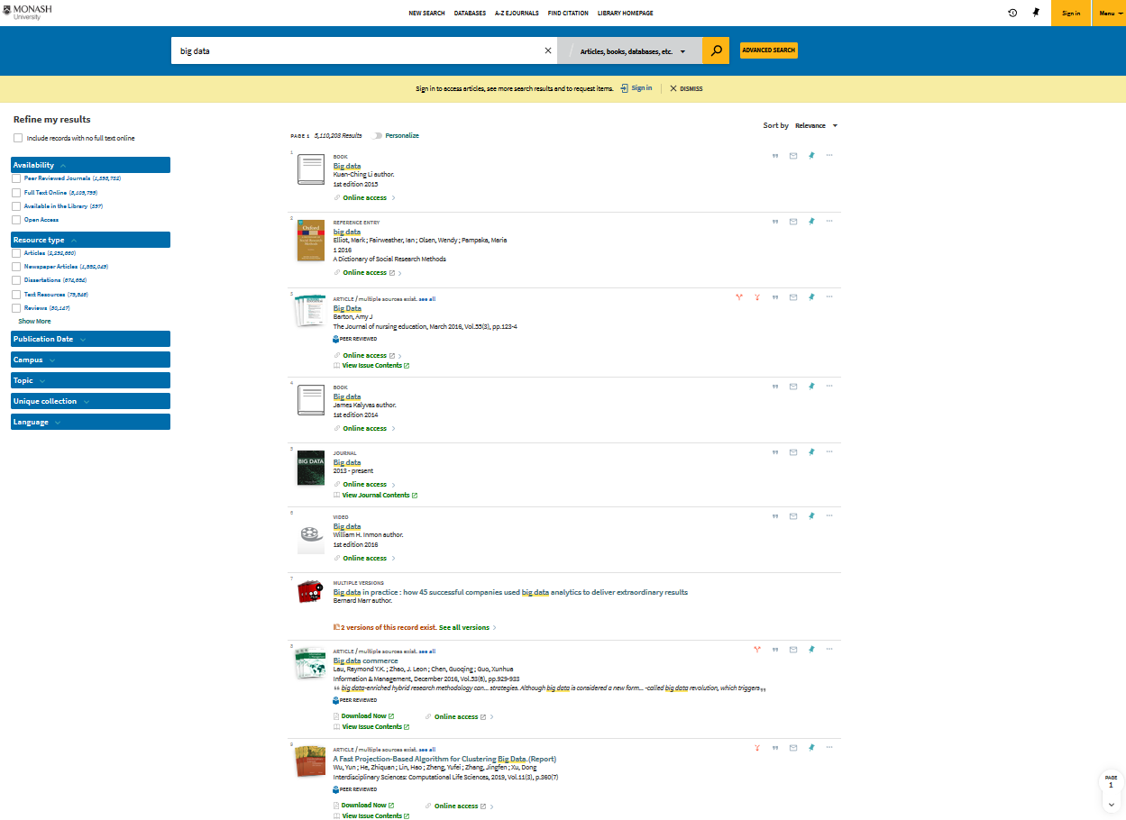
To the new
simplified
User
Interface
Notes:
We released the new simplified user interface

Slide 38
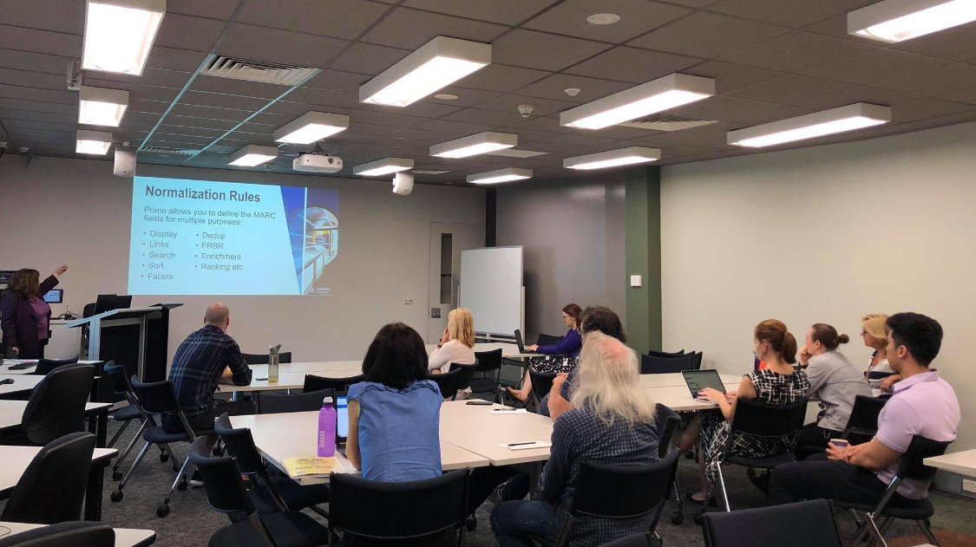
IMPLEMENTATION PROCESS
BETA: Dec & Jan
PROD: Feb 2019
Roadshows: Jan & Feb 2019
Monthly Communications via Staff Blog
Peer Learning sessions
Notes:
As part of the implementation process
we released the interface as Beta in Dec & Jan
to allow us to make more modifications prior to the start of Semester.
Then released it to production in February 2019.
As part of the release process we also ran Roadshows across branches.
From experience, the key to a successful Change Management Process is communication and involvement from staff.
By extending the project to various Library Staff across branches,
it made them have a sense of ownership for the project.
We also tried our best, to send monthly communications through our staff blog.
Recently we ran Peer Learning sessions to communicate to our Research & Learning staff findings & recommendations for possible user education sessions.

Slide 39
POST-IMPLEMENTATION FEEDBACK
Feedback from users from: Dec 2018 to May 2019 via Hotjar on Primo New UI
Notes:
We wanted to gather feedback post-implementation,
So we’ve implemented a feedback tool called Hotjar
and embedded it on the Primo New UI.
A small pop-up window appeared, where you can rate the new interface and provide detailed feedback.
My favorite, was its ability to allow users to take a screenshot of the page, they were reporting an issue on.

Slide 40
HOTJAR LIMITATIONS:
Visitors not using one of the supported browsers
Visitors with disabled JavaScript
Visitors that have opted out from our opt-out page.
Visitors with disabled cookies.
Visitors using Private mode in some browsers, such as Firefox and Safari - or when localStorage and sessionStorage are not available
Visitors who run browser plugins such as Ghostery, unlock or Adblock which explicitly excludes them from loading tracking scripts such as ours
Visitors that have DO NOT TRACK enabled in their browser
Visitors have their IP blocked within the Hotjar settings
Visitors live in country, like UAE, where government blocks the use of Hotjar.
NOTE: Data is stored in EU & are in full commitment to GDPR Compliance
Notes:
Hotjar is a web-browser tracking application,
it doesn’t collect everything as it has limitations as listed below.
If Javascript is disabled or Adblockers are enabled, it won’t collect information.
As this is tracking online information, it may have implications on privacy.
Hotjar has a full commitment to GDPR, according to their website.
So please check with them if you have further data privacy and security concerns.

Slide 41
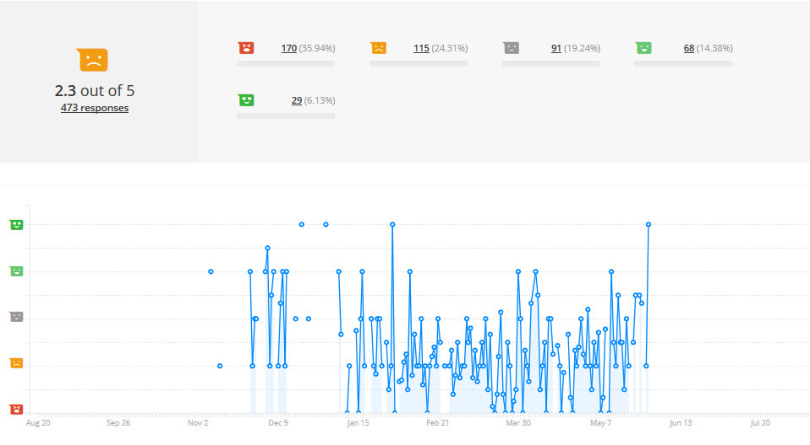
PROD FEEDBACK
User feedback collected through HotJar from Dec 2018 to early May 2019.
Notes:
By 1st semester the new UI was rated 2.3 out of 5 by users.
Collecting feedback is normally tricky. It can be an avenue for getting a lot of unrelated complaints.
I guess from personal experience, if I have a real passion to complain about something, I will fill in a complain letter,
but not really spend a lot of time providing positive feedback (unless there was some compensation at the end.)
if users were just neutral, they would just move on and ignore it.
So we think, this is not really a clear indication of the overall feedback from users,
However, it is a good way to understand their needs.

Slide 42
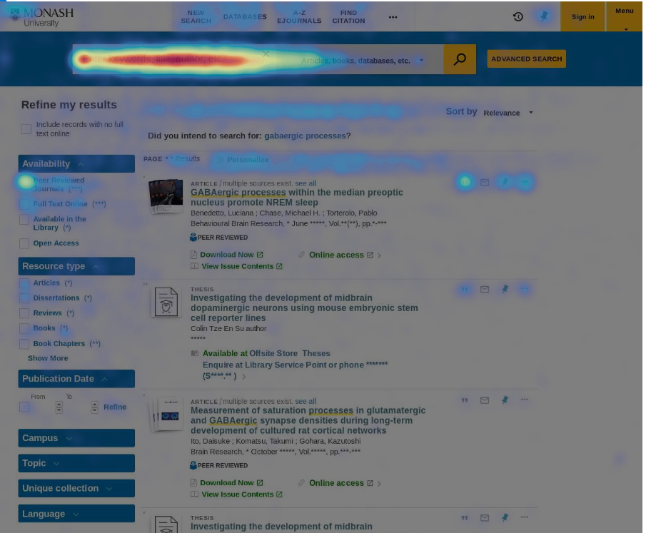
SEARCHING
Heatmap showing mouse movements.
Notes:
This heatmap shows the mouse movements on the Brief Results page.
You will notice that:
The search box is the busiest section
Followed by the Availability facets
showing users are really interested in “Peer Reviewed Journals” & “Full Text Online Access”
NOTE: May 16 Data <Week 10>

Slide 43
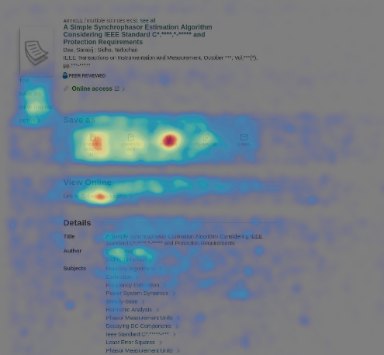
FULL DISPLAY
Heatmap showing mouse movements.
Notes:
This heatmap shows the mouse movements on the Full Display page.
In this page, you will notice that the Citation & Endnote Desktop download
are the busiest parts of the screen.
The Link to the article & author hyperlinks are also busy.
NOTE: May 16 Data <Week 10>

Slide 44
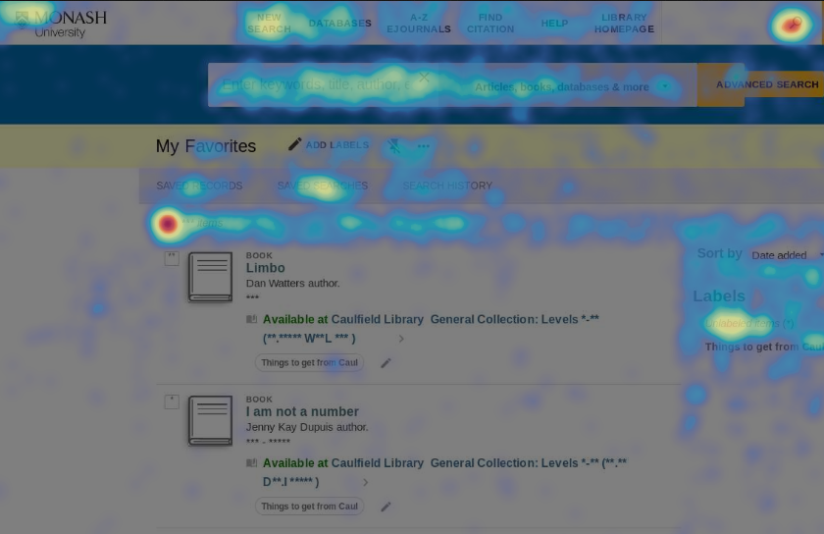
FAVOURITES
Heatmap showing mouse movements.
Notes:
On the Favourites page
The checkbox and labels are the busy screen elements

Slide 45
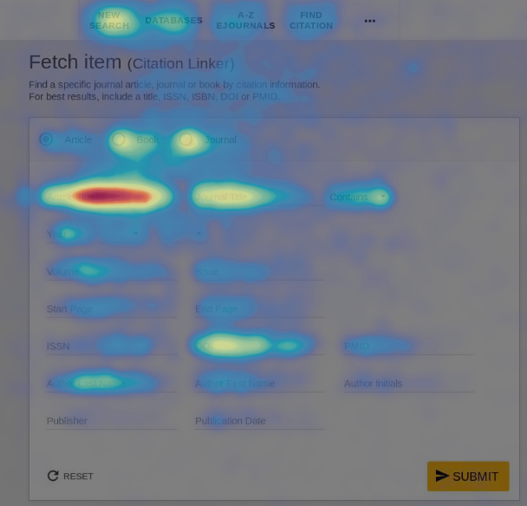
CITATION LINKER
Heatmap showing mouse movements.
Notes:
And for the most common information users specify when they use Citation Linker:
These include:
Article title
Journal title
And DOI

Slide 46
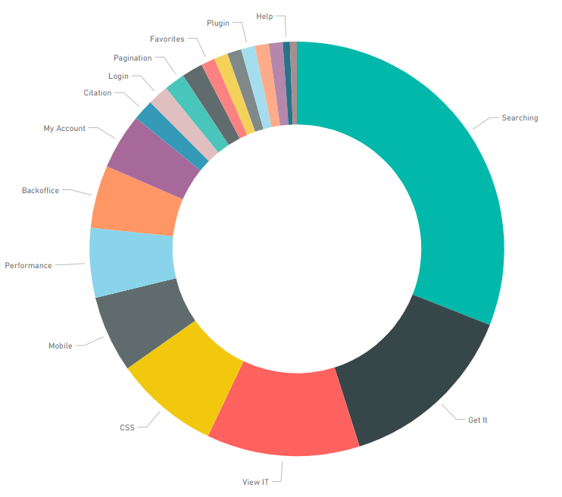
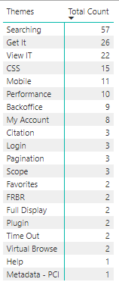
Feedback themes
Notes:
We tried to manually classify, the themes for the incoming feedback
And based on our analysis, the most feedback were related to
Searching and Accessing materials through the Get IT & View Online features

Slide 47
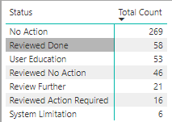
SAMPLE FEEDBACK
Notes:
Here are some sample feedback we collected
and those we manually classified as user education

Slide 48
REFLECTIONS
Notes:
At the beginning of this presentation we looked at past user behaviour as a starting point for our Primo redesign. This showed us what they valued and didn’t value about Primo.
Rachelle has also described the redesign and UX testing process that followed. Now, at the end of this presentation, I’d like to reflect on the our expectations of Primo, as the Library discovery system
We want it to be

Slide 49
Library expectations of Primo
a SHOWCASE for Library resources
SIMPLE to search
provide INTUITIVE search results
offer a SEAMLESS experience from searching to access
EMPOWER our users
Notes:
A SHOWCASE for Library resources – to demonstrate our value to the University
SIMPLE to search in, with results that can be understood INTUITIVELY
We want the user experience, from searching to access, to be SEAMLESS
We want users to experience SUCCESS when they search for specific resources
We want Primo to be ‘TOP OF MIND’ for users when they need to manage loans and prevent overdues
We want searching in Primo to be an EMPOWERING experience for our users
From our Primo user logs and our UX testing, we know that this isn’t always our user’s experience in Primo.
So while we think that we’ve made significant improvements to Primo as a result of this project, there’s still a gap between what we can deliver with Primo, and what users expect from the Library’s discovery service.
So what are our plans to address these shortfalls? We know we need to focus on our user’s needs
We need to stop falling into the traps of thinking we know what our users want; we have to keep asking our users what they need.
But we also have to recognise that we’re working within the constraints of the functionality and configuration choices available in Primo.
To balance these tensions:
we hope to increase our user education for Primo - because humans are more adaptable than software, and
we need to remember that there’s always a gap between system functionality and user expectations that it is impossible to bridge.
We can remind ourselves that Primo development is evolutionary and by working with the Primo user community, we can influence this development.

Slide 50
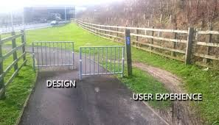
If Primo doesn’t meet our users needs
They’ll look for a solution outside of Primo & the Library
Notes:
This is vital, because we know that when Primo doesn’t met our user’s needs, they will look for alternative discovery solutions outside of Primo

Slide 51
CONTACT US:
Megan.Lee@monash.edu Rachelle.Orodio@monash.edu

