Slide 1
YOU ARE WHAT YOU COUNT
MEGAN LEE, Application Librarian
RACHELLE ORODIO, Application Administrator
OCTOBER 23-25, 2019
ANZREG 2019 CONFERENCE #anzreg2019
Notes:
You are what you count.
If you work in systems, there’s a strong temptation to collect the statistics your systems can generate.
This is why so many libraries collect data on the number titles in our collections, number of loans, etc.
While this data is potentially useful it is not a complete measure of the Library’s impact on our organisations.
Library performance metrics can have far more impact if they are designed to measure the library’s capacity to achieve a stated goal.
In 2016 Monash University Library undertook a project to align the metrics we record with the Library’s strategic plan.
We focused on designing metrics that demonstrate:
The Library’s success in achieving our stated goals and
The contribution the successful achievement of these goals makes to the success of the University.
To do this we:
rethought which metrics we should collect
redesigned how we would collect them and
Implemented new systems to store, enrich and build visualisations with this data
Today’s presentation is an overview of the Monash University Library's Strategic Metrics Dashboard which is built to showcase library activity, using data extracted from Alma, Primo, Relais, EZproxy, LibCal, figshare, website logs, google analytics and google forms

Slide 2
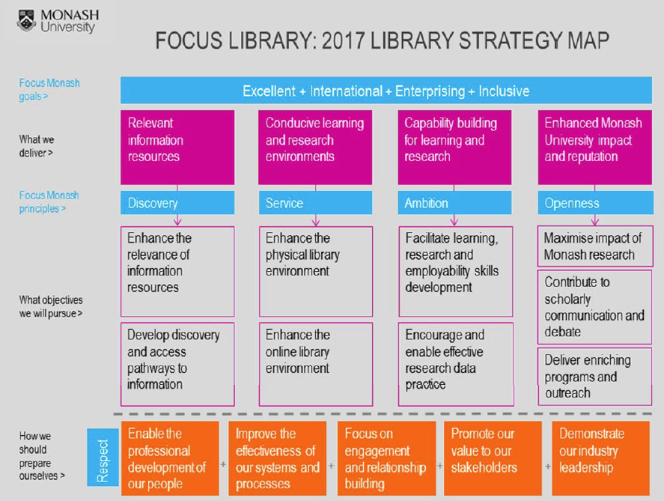
What metrics should we collect?
Notes:
As part of this project the Library developed a new strategic tool: “Focus Library: 2017 Library Strategic Map”.
This document was designed pinpoint the Library’s key contributions across the University.
With these key contribution areas defined, the project team then started work to identify metrics that would describe the Library’s ability to deliver these activities.
It is an evolving document and the current version now looks like this

Slide 3
2019 Library strategy map
Notes:
The project team also developed principles that were considered important in relation to metrics collection.
These were developed to ensure robust and sustainable data collection, storage and reuse in a variety of situations.

Slide 4

Library Performance Metrics Principles
Strategic - goal driven and evidence based
Purposeful - substantial
Attributable – clear ownership
Systematic - pattern identification
Consistent - repeatable
Accurate - data integrity
Secure and Accessible - data integrity
Efficient - simplicity
Integrated - re-use
Notes:
Strategic – Library metrics are linked to Library strategies or planning objectives (goal driven).
Qualitative narratives will demonstrate a clear relationship between the Library activity and University outcome (evidence based)
Purposeful –Library metrics are defined by a clear business case (useful). Narratives have either a broad impact across a significant group or enable a high value University activity (substantial).
Attributable – collection of Library metrics is assigned to a specific staff role (ownership).
All qualitative narratives specify the University work group, eg Academic unit or Professional work area, which is engaged by and / or benefits from, the Library activity (ownership).
Systematic – Library metrics are collected in meaningful time series and reviewed on a regular basis (pattern identification).
Consistent – Library metrics are collected following standard processes (repeatable).
Accurate – Library metrics are collected from primary data sources (data integrity).
Secure and Accessible – Library metrics are saved to secure location(s), facilitating data access and preventing data change or loss (data integrity).
Efficient - Automated data collection processes are preferred over manual data collection processes. All processes should be designed for ease of use (simplicity).
Integrated – Where manual data collection is required, it is integrated with normal work practices (re-use)
To meet these principles, we not only needed clear strategic direction but we also needed to rethink our data collection, storage and visualisation tools.
Before we began this project, all Library metrics were saved in an excel spreadsheet that was cloned at the end of each year, as the basis for the following year’s data collection.
All data was manually transcribed into this spreadsheet, irrespective of the data source and data collection methods.
In line with the Library Performance Metrics Principles, the project team sought to develop core metrics that would reflect the key Library activities we wanted to describe both within and beyond our organisation; this was strategic and purposeful data collection

Slide 5
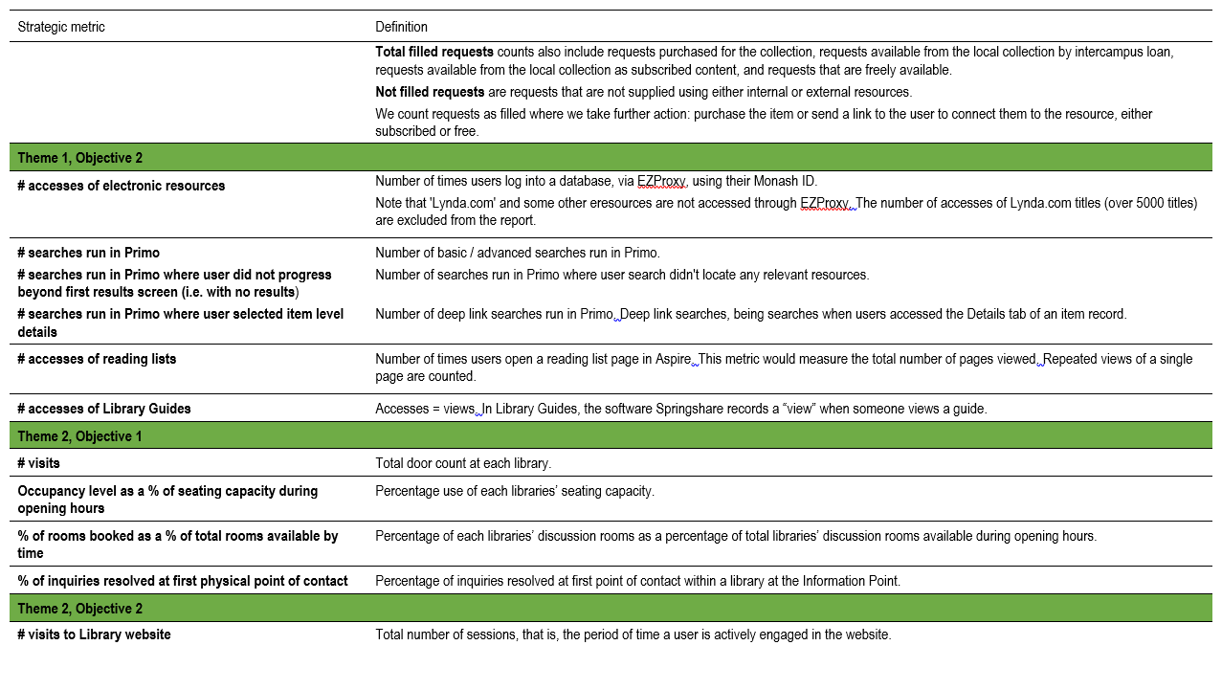
Library strategic metrics program: metrics definitions
Notes:
We identified 35 different metrics, 17 of which are sourced from library and other systems such as Alma, Primo, ReLais, Talis Aspire, web pages etc and 18 which are manually recorded into google forms, Qualtrics, and other temporary storage
All of this data needed to be consolidated into a data storage system that would allow us to automate the data collection (where possible) and store the data in the most reusable format to allow us to cross reference data from multiple data sources to create new information.
We also wanted to implement systems that would allow us to create data visualisations and info graphics that could be used to share and communicate our metrics.
One of the project’s driving principles was that data is only valuable if it can be used and shared, to make evidence based decisions or to illustrate Library impact.
So we started a market survey to evaluate available software

Slide 6
TOOLS USED
Tableau Visualization
  Tableau connector to Alma
  Issues with Primo connector
Splunk
Power BI
Excel
OpenRefine
Google Data Studio
Notes:
Here are a few tools we used as part of the metrics project:
Mainly used Tableau for the visualization.
We’ve been using Splunk for Ezproxy logs.
There is a university initiative of using Power BI with it’s Data warehouse.
Other tools include Excel, OpenRefine for data cleanup and even Google DataStudio

Slide 7
DATA SOURCES
Alma & Primo Analytics
Google Analytics
Custom software (MU Publishing)
Google spreadsheets / forms
Manual recording
Ezproxy
Figshare
Libcal & Libguides
People counter (WinPC7)
Notes:
After each QTR, Subject Matter Experts (SMEs) are requested to provide quarterly data from the following data sources.
Various analytics reports, Google spreadsheets, Apache log files & even people counter data.
The Strategy & Planning Officer processes & summarizes data into Tableau.

Slide 8

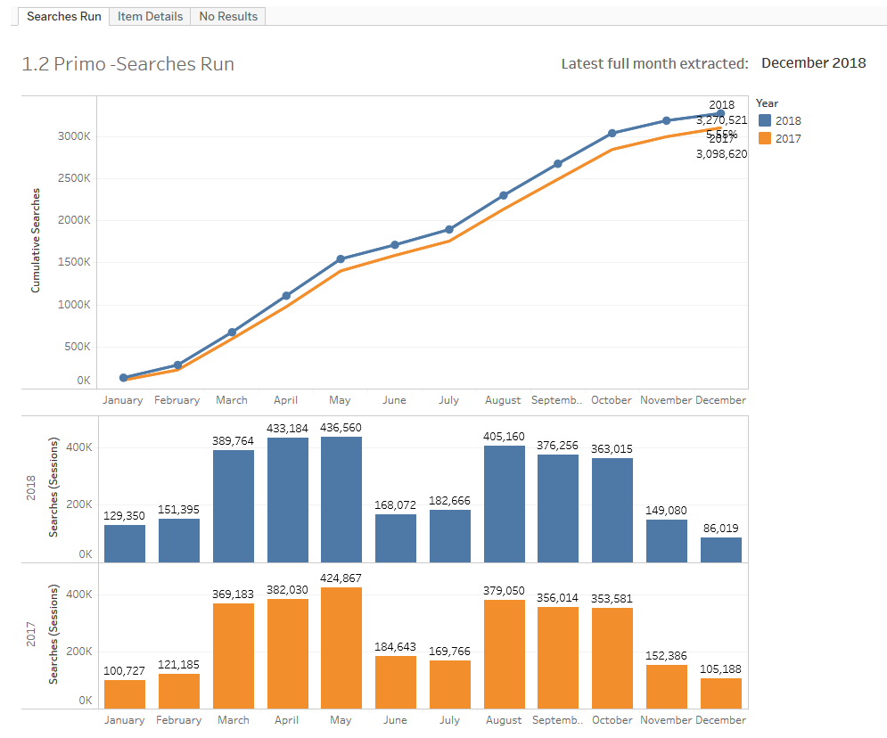
DASHBOARD
No. of searches in Primo
How many check Item Details
How many searches produce zero results
Notes:
Here is an example of data available on our dashboard using Tableau.
This is published on the Library Intranet so we are unable to provide a live demonstration.
In this example you can see the number of searches ran on Primo for 2017 and 2018.
As you can see the peak times of searching is in the months of March to May and August to October.
The other tabs on this dashboard shows how many check the Item details and how many searches produce zero results.

Slide 9
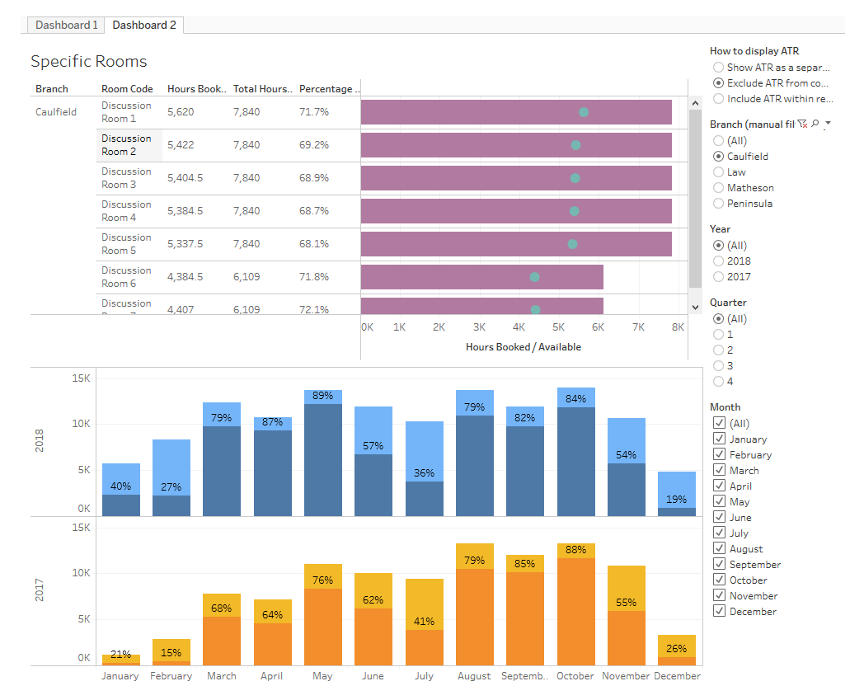
DASHBOARD
Usage of individual discussion rooms
Overall usage of discussion rooms
Notes:
This second example shows you the usage of our discussion rooms compared against room availability.
In this case, our discussion rooms at Caulfield have an average of 70% usage.
In Tableu you can shows filters to allow users to limit data.
In this case, you can change branches and time periods.

Slide 10
TABLEAU
Expensive annual fee for licenses.
Requires server environment to share reports/dashboards securely, at an additional cost. (There is also a free public environment for publishing which is not suitable for sensitive data and may not meet your Institutional privacy policy.)
Not as easy for users to become familiar with functionality compared with Power BI (which is consistent with other Microsoft products). Therefore better for focused users / analysts rather than general users.
Sophisticated visualisations, greater options than Power BI.
Has integration with a large number of data sources.
Ideal for deep analysis and large data sets.
Notes:
After consulting our Strategy and Planning Officer she provided these pros & cons of Tableau.
What makes Tableau good is that it has
Good visualizations
A number of integrations available
Ideal for large data sets
However the cons are:
Annual licenses are expensive, around $500/yr per license
Requires a Tableau server environment to publish reports/dashboard.
Not as easy to learn compare to Power BI.

Slide 11

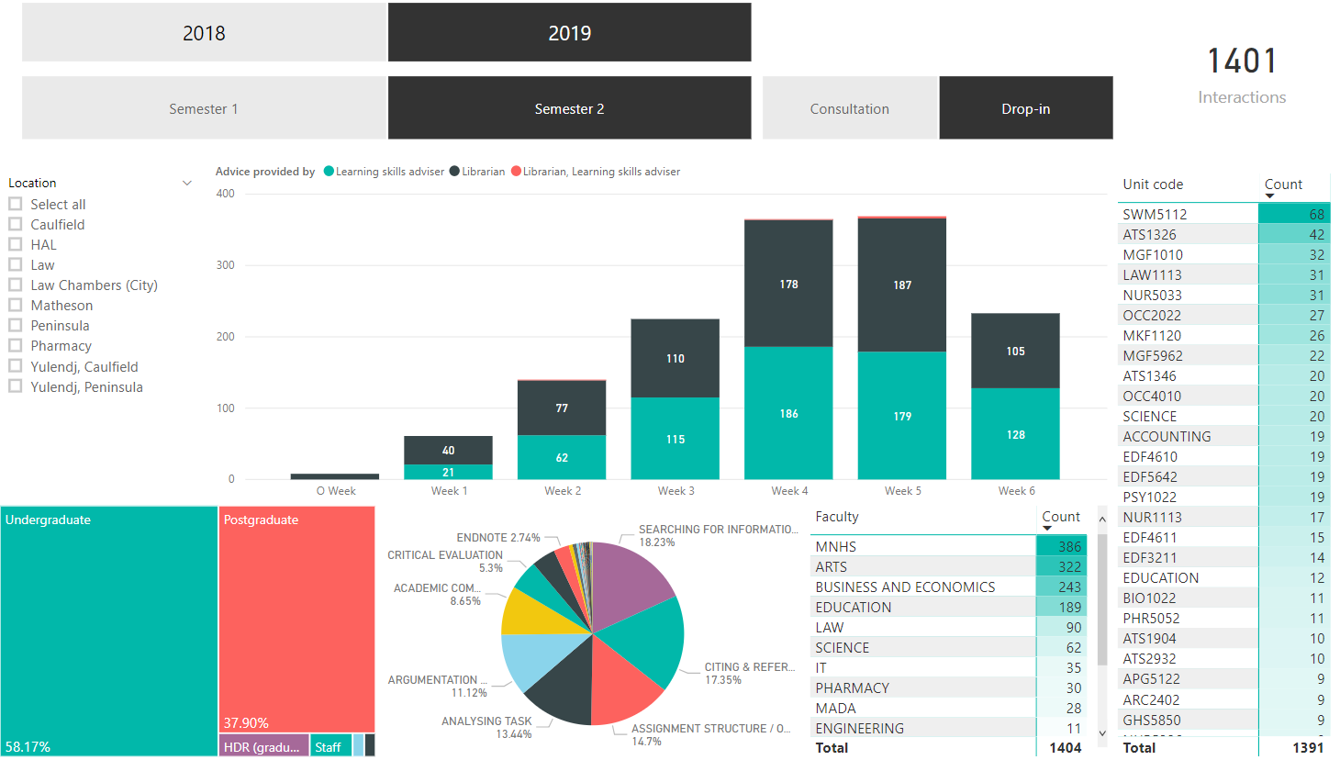
DASHBOARD
Research & Learning Consultation
Notes:
We are currently learning how to use Power BI.
This is an example of how we’ve visualized consultations at our Research & Learning points.
This data comes from a google spreadsheet that librarians manually enter information in.
As you can see on this report we can identify:
Which faculty receive most inquiries
What course code it is related too
Which weeks are the busiest
What type of inquiries they receive
Based on this 2019 data, our biggest inquiries are from undergrads.
About 18% are related to searching for information, followed by citing & referencing
We get the most inquiries from students of Medicine, Nursing & Health Sciences faculty.
And it’s the SWM5112 – Research for social work practice that got the most inquiries for that period.

Slide 12
POWER BI
- easy to learn; if you can use a pivot table in Excel you can use Power BI
- you have most of the functionality with the free version. You have to login with an institutional email address like @monash.edu as non-institutional accounts like @gmail.com don't work
- full control over the layout and can change colours, titles, visualisation type, renaming variable names, data labels etc.
- it's interactive in the sense that you can have four graphs on one page and when you click on one graph changes are reflected immediately in the other graphs
- it's a great option for presenting data to small groups where sharing the data isn't an issue
- numerous excellent tutorials available: Microsoft site LinkedIn Learning
Free Version:
- the interactive graphs can't be shared with others
- the only way to share the graphs is to export them into a PDF or PowerPoint. The graphs are then just static images
Power BI Pro (next level)
- You can share the interactive graphs with others only if they have Power BI Pro
- Cost is $60 per users per year outside it looks like it’s $165 per user per year.
Power BI Premium (third level)
- Dedicated cloud computing and storage at $6,858/mo.
Notes:
Here’s a summary of the pros and cons of using Power BI.
It is easy to learn. Most functionality is available on the free version.
You can’t use gmail accounts.
Full control about layout.
A change to one graph reflects on the other graphs.
Lots of tutorials available.
As for cons:
can’t share interactive graphs on the free version. Export them to PDF or Powerpoint.
If you want to share with others you and they need to have Power BI, which cost around $60-$165/yr
For cloud computing and storage it’s around $7k.

Slide 13
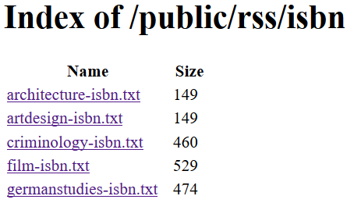
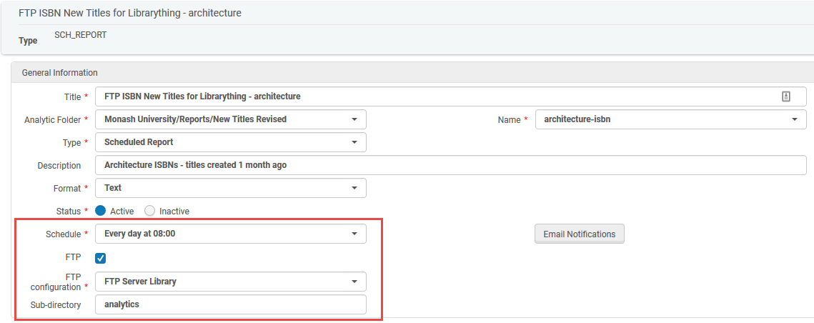
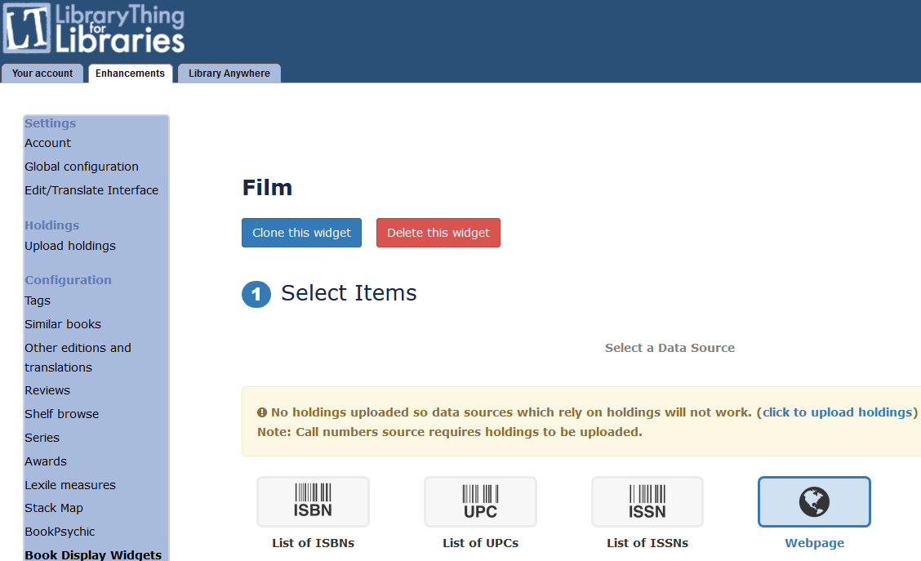
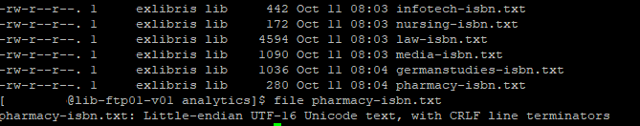
ALMA ANALYTICS FTP
1
3
2
4
Notes:
On a different note, but somewhat analytics related, you may have noticed the FTP feature of Alma Analytics.
Something that you can use for automating processes, if you feel like the Analytics API is not for you.
We’ve also noticed that the Alma Analytics data connector with Tableau is quite problematic, so we haven’t been using it.
So you can investigate this feature for your Tableau or Power BI integration.
We’ve recently used this FTP feature to revise the way we’ve developed the New Titles List.
We used the Titles Subject Area in Analytics.
Gathered the list of ISBNs for each identified subject topic given by our subject librarians.
Reprocessed these text files to remove duplicates.
Stored the files on to the webserver.
Configured LibraryThing to point to the url with the list of ISBNS.

Slide 14

ALMA ANALYTICS FTP (for eResources)
Notes:
Then display the LibraryThing book carousel on the Library webpage.

Slide 15
LEARNINGS
Who is the target audience?
What are their needs & level of detail?
Purpose: operational vs strategic
Identify all data sources, methods of connection
Document processes
Make stakeholders aware of the time and resources needed for effective implementation
Notes:
As for our learnings in this Metrics Project:
- Scoping the audience is important.
- Understand their needs and level of detail required.
- Identify the purpose of the dashboards whether they are Strategic level or Operational use. Visualizations and coverage may change depending on managers needs.
- Clearly identify all data sources, methods of connection, and ensure that you document processes.
- It takes considerable time to build your dashboards and set up processes to update the data, so make sure that stakeholders are aware of the time and resources needed for effective implementation.

Slide 16
DEMO
Notes:
Here’s a quick demo on Tableau

Slide 17
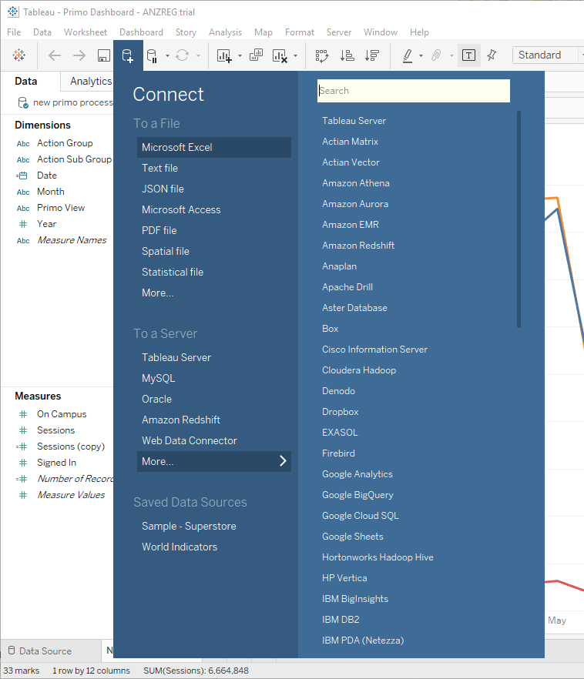
DEMO
Select your
Data Source:
Notes:
You can select a variety of data sources:
Excel, text, access, pdf, databases, even connectors to Alma & Primo analytics

Slide 18
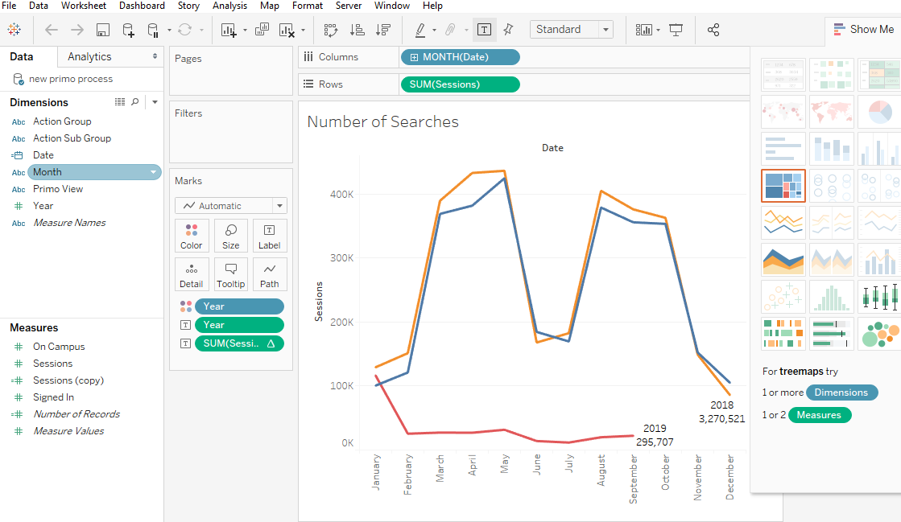
DEMO
Select which fields you wish to display and summarize
Notes:
Once you’ve selected the source, then you’ll have to decide which tables, dimensions you’d like to visualize.
Sometimes you need to create new calculated fields, summaries.
Then just decide on how you want to present them.

Slide 19
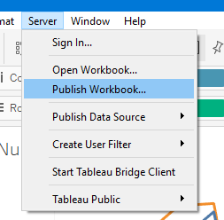
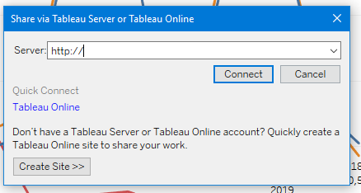
DEMO
Publish workbook
Notes:
Once you’re satisfied with the output you can publish your workbook to your Tableau web dashboard.
In our case this is managed by the university eSolutions group.

Slide 20
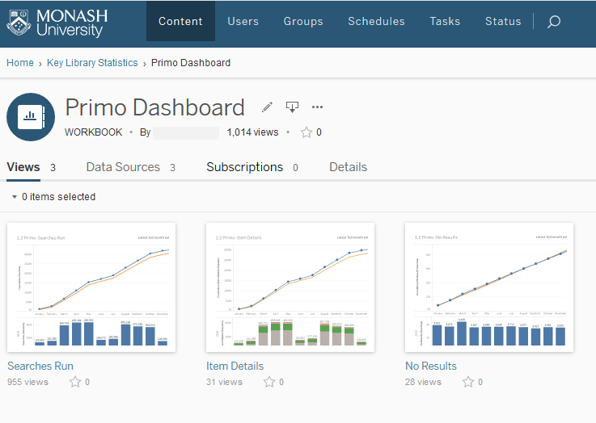
DEMO
Configure your Web Dashboard
Notes:
Within your Web Dashboard you can select you can access them, how frequent they need to be updated if an automatic process is in place.
If you recall the Searches dashboard earlier, you may have noticed the multiple tabs?
Each tab is equivalent to each data source under this specific dashboard.

Slide 21
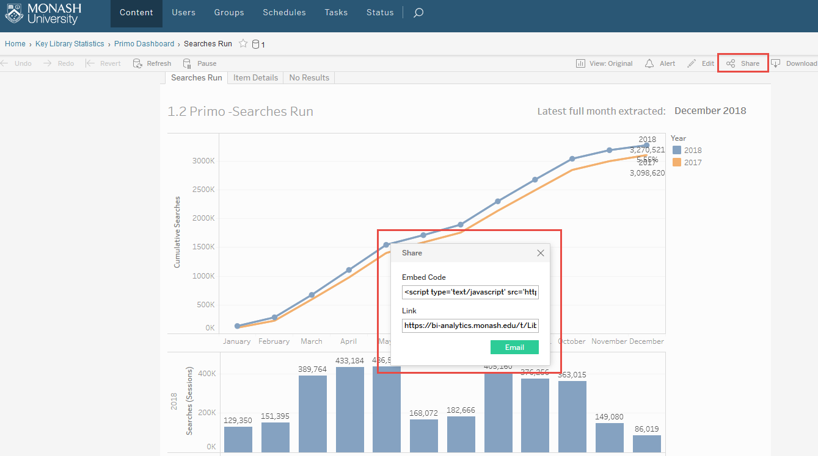
DEMO
Share or embed your dashboard
Notes:
You can also share your dashboard using direct links or embed code.
Find the Share button and provide the code or link to whoever will embed your dashboard.

Slide 22
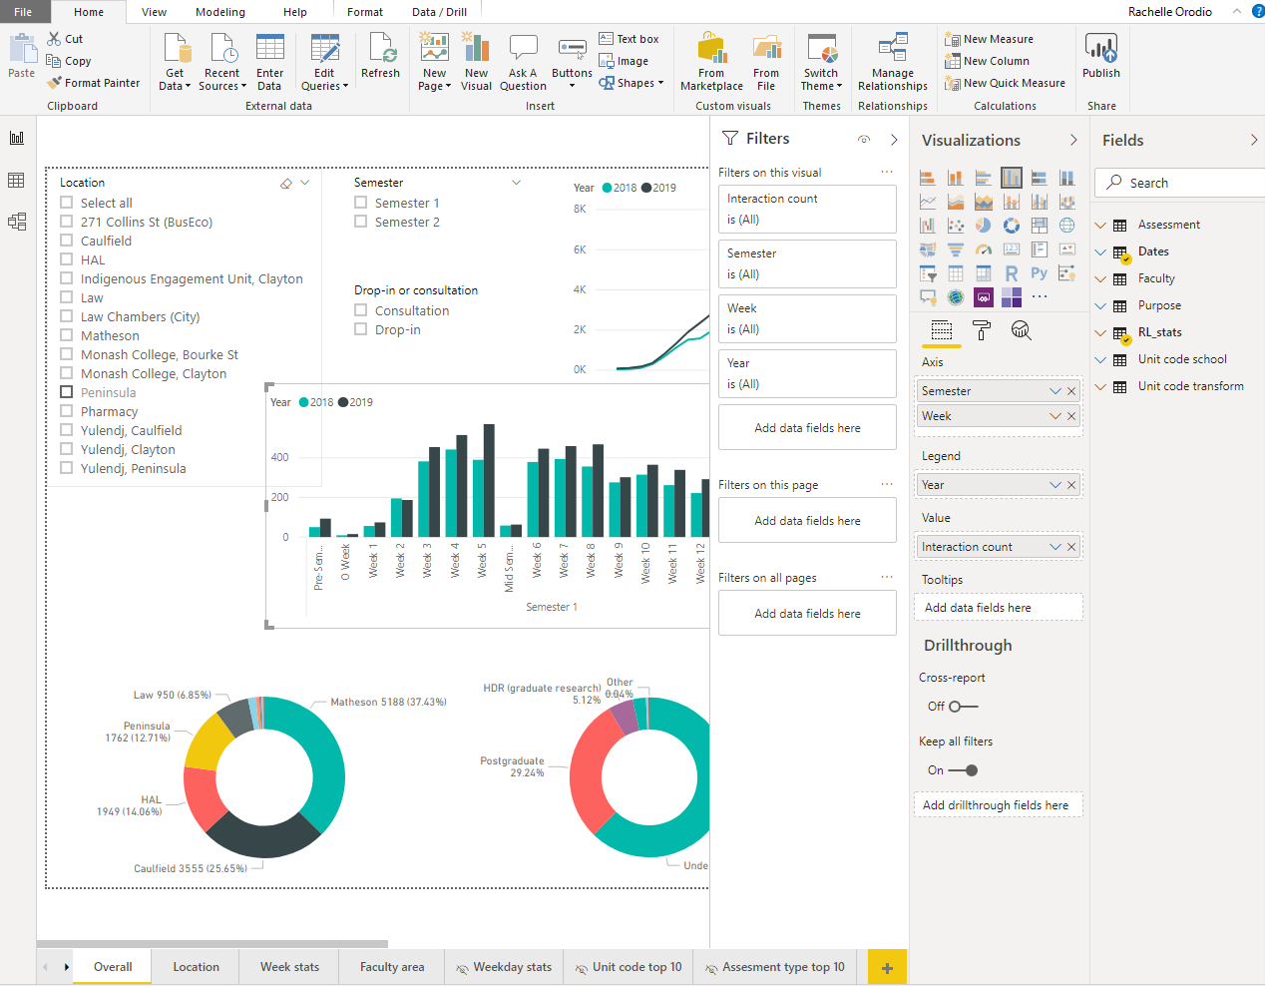
DEMO
Notes:
This screen on the other hand is the look of Power BI’s interface.
Similar to Tableau, you can select the and visualizations available for you.

Slide 23

QUESTIONS
Rachelle.Orodio@monash.edu
&
Megan.Lee@monash.edu

