Slide 1
CDI Working Group
ANZREG 2019 Conference
23-25 October 2019 #anzreg
Erin Montagu Sonja Dunning
Presenter Project Manager
@MontaguErin sonja.dunning@uwa.edu.au
Notes:
In March this year UWA was officially invited to join Ex Libris’ Central Discovery Index Working Group, after we indicated our interest earlier in the year. The working group was officially scheduled to commence in August, and we commenced preparation by watching their webinars in May. A link to the webinar and another more recent webinar can be found on the final slide in the presentation.
UWA utilises Alma for our Library Management System and Primo VE for our discovery layer. We haven’t ever been a Summon user, so I’m not able to speak on what the experience will be for Summon institutions. However, while representatives from the Ex Libris working group aren't able to attend ANZREG today, they are happy for you to ask questions of them and have provided an email address which will be shown on the final slide.
I am not a member of the Working Group, but am presenting on behalf of Sonja Dunning, the Project Manager of the UWA working group.

Slide 2
Topics
What is the CDI?
User benefits
Benefits for Ex Libris
UWA’s expectations
The working group
Project timeline
Additional tasks
Screenshots
Roadmap
Notes:
During this presentation I’ll be discussing the features of the CDI and it’s benefits, UWA expectations and experiences on the working group, how we’re planning to approach the change & the Project timeline including the rollout for all institutions.
I’ll end with some screenshots that will highlight the changes within Alma and Primo VE, and I’ll mention some additional changes to be deployed, although at this time we don’t have the ability to view them in the test environment.
The final slide will contain links to resources Ex Libris have published so far, and from which some of the information in this presentation was derived.

Slide 3
What is the CDI?
Central Discovery Index
Unify & replace PCI and Summon
Integrated into Alma
Electronic Collection Activation workflow
Notes:
The Central Discovery Index will unify and replace both the Primo Central Index and the Summon Index, and support both Primo and Summon to give access to Ex Libris provided data.
To provide a brief background, the Primo Central Index (PCI) is a centralised index that encompasses hundreds of millions of metadata records, harvested from many publishers and aggregators. These metadata records include journal articles, eBooks, conference proceedings, newspaper articles, and more. The records are harvested into Primo based on what collections are activated in the PCI ie. if your institution subscribes to a publisher’s collection and activates it in the PCI, the metadata records of that database will be harvested into Primo and can be searched. The PCI is currently managed as a separate system to Alma and Primo.
As part of the migration to Central Discovery Index (CDI), rather than having to maintain a separate system, for Primo VE users such as ourselves this system will be integrated within Alma so that activation of collections for search and discovery in Primo becomes a part of the Electronic Collection Activation workflow, instead of being a separate system.

Slide 4
Benefits for users
Faster update cycles
Single content activation
Daily rights update
Merged records
New search algorithm
Expanded indexing
Granular resource types
Notes:
Ex Libris have stated that the benefits for users of Alma and Primo will include:
Faster update cycles for availability settings and activations (including new content) from once a week as it currently stands to within 24-48 hours
It will be a single activation to publish content to Primo rather than having to activate a resource in Alma and then again in Primo Central, so our workload is halved and reduces the possibility of Primo Central activations being forgotten.
There will be a daily rights update for electronic holdings (for example indexed for search and/or delivery, whether or not you have full text access)
Rather than the grouped records that currently display in Primo search results when there are multiple PCI records for the same article, the results will be merged into one Primo record eliminating the ‘Multiple versions’ record in Primo.
There will be a new search algorithm that will result in some changes in search and ranking within Primo
Expanded indexing; and
More granular resource types within the CDI then in the PCI

Slide 5
Benefits for Ex Libris
Better ingest capacity | Increased scalability
Enhanced algorithms Increased stability | Improved infrastructure
Notes:
There will also of course be benefits for ExLibris themselves. They believe that the move to the CDI will result in:
Better capacity for content ingest
Enhanced ranking algorithms
Increased stability
Increased scalability and an improved infrastructure that is designed to address future challenges

Slide 6
UWA’s expectations
Enhanced discovery
Streamline library management
Operational efficiencies
Notes:
UWA had several reasons for responding to Ex libris’ call for nominations to join the CDI working group:
Enhanced discovery - we’ve found that the quality of some of the metadata in the PCI has been lacking, and can often cause access issues for our users due to incorrect details such as DOI’s, page numbers, article titles etc. Management and correction of these issues has proven to be difficult and time consuming. We’re hoping that the unification of the PCI and Summon records will result in better quality metadata
Streamline library management - rather than maintaining electronic collections in two systems ie. activating the collection in Alma, as well activating it for search in the Primo Central Index, we’ll be able to activate and deactivate resources for access and for search as part of the one workflow in Alma: the Electronic collection Activation workflow.
Operational efficiencies - we currently have different teams managing Primo Central activations and the electronic collection activations within Alma so there is duplication of effort by staff and some delays in activation.
We’re hoping that by joining the working group we hope to ensure that some of these issues are resolved.

Slide 7
Group members
Harvard University
MNPALS Consortia
University of Edinburgh
University of Liège
University of Western Australia
Notes:
The CDI Working Group is made up of staff from five institutions worldwide, who along with UWA include Harvard University, The Minnesota Program for Automated Library Systems Consortia, University of Edinburgh, and University of Liège
We have so far had three webinar sessions with Ex Libris (due to time zones we met separately to the other institutions): once to kick off the working group and the first stage of testing, and once more each for testing phases two and three. These sessions would last around 45 minutes, during which Ex Libris would present a PowerPoint of what to expect during the testing and what kind of feedback they were seeking, such as interface appearance and language, in addition to the more technical aspects.

Slide 8
Project timeline
ACTIVITY | DURATION | COMPLETION
Project began |  | 12 August
Testing part 1 | 2 weeks | 30 August
Testing part 2 | 3 weeks | 27 September
Testing part 3 | 4 weeks | 7 November
CDI Implementation | 8 weeks | December
Notes:
The Project timeline includes the tasks given by Ex Libris to the Working Groups, and Ex Libris’ expected timeline. There have been some delays to the commencement of test phases two and three while Ex Libris conducted analyses of the results, but so far we’ve been able to keep to our deadlines.
Testing part 1: Primo Central – CDI move report
In preparation for the first phase of testing ExLibris migrated all our PCI activations to the CDI. As sometimes this was not a 1 to 1 relationship between the two systems the aim of this part of the testing was to ensure that the PCI to CDI activation report (or “Move Report”) provided by ExLibris was correctly reflecting our activations in the CDI. In addition to a test plan and test scenarios, in order to conduct this testing Ex Libris provided us with a PCI activation report, i.e. what resources we already had active in the PCI; and an Alma activation report, i.e. what electronic collections we already had set up in Alma; and a “Move Report” of CDI activations.
Testing part 2: Single activation from the Alma User Interface
This part of the testing aimed to compare current PCI activations to the activations within the Alma test environment, to ensure that results are as expected and also to test the workflow of activating CDI collections as part of the electronic collection activation process. In order to conduct this testing ExLibris gave us access to the test Alma CDI environment, a known issues list, and two test checklists.
Testing part 3: CDI searching and full text indication
The third and final phase of testing is aiming to confirm that the search and ranking is working as expected in Primo VE, and that full text is correctly indicated. For this part of the testing we are also expecting to be provided with a known issues list and a test checklist for testing the search and ranking in Primo , as well as a dedicated Primo CDI testing URL.

Slide 9
Phase 1 testing
What was tested: | Outcomes of note:
Migration report | Local collections not mapped
PCI & Alma report | Duplicate collections
Notes:
Looking at each phase in more detail. The purpose of Phase 1 of the testing was to verify the effectiveness of the migration tool, and ensure the export of activated resources from Alma and the PCI would be accurately reflected in the CDI, and that unactivated PCI collections weren’t moved from Primo Central to Alma.
The testing itself comprised of an analysis of several reports and spreadsheets. We came across a couple of concerns, firstly that our local collections won’t be mapped so we may have to change the way they are set up in Alma, and that there were duplicate collections in the PCI, which Ex Libris is now investigating.
This phase of the testing also had a “sub-task” planned in case the migration needed to be re-done, which would only be necessary if there were issues that need to be fixed and then retested. As far as we understand this wasn’t required.

Slide 10
Phase 2 testing
What was tested: | Outcomes of note:
View in Alma | Collections not in CDI
Search functionality | Inaccurate result counts
Update and export
User roles
Notes:
The purpose of this part of the testing was to make sure that the Alma interface changes were user-friendly and could be used to:
View and filter on CDI related fields for electronic collections included in CDI
Activate, deactivate and update electronic collections included in CDI
View, update and export activations for Search in CDI
Assign users different user roles and check their impact on the CDI functionality in the Alma interface. The user roles that will be associated with CDI are:
Electronic inventory operator - which will be only be able to view the CDI settings for an electronic collection, but not edit it
CDI inventory operator - that will be able to edit the CDI settings for an electronic collection, but not edit the rest of the collection
Combined Electronic + CDI inventory operator - that will have editing rights for the full electronic collection including the CDI component
We raised a few issues with Ex Libris, such as the fact that a large number of collections (over three thousand) were returned in one search scenario that were not in the CDI or at least did not have CDI fields displaying. There were also inaccurate results counts for keyword searches.

Slide 11
Phase 3 testing
What will be tested:
Increased results | Full text rights
Differences in search | Record display
Differences in ranking | Language
Notes:
I’m not able to speak on the outcomes of Phase 3 of the testing, as we had yet to commence this at the time of writing the presentation.
However, we know that it will be focused on the Primo User Interface, in particular user experience and end to end flow, and that it should entail:
Increase in the number of results due to improvements in the search algorithm
Differences in search and ranking between Primo Central and the CDI
The full text rights are behaving as expected with regards to indication and linking
How a record displays in Primo VE when either guests or users are signed in
Languages other than English are displaying, including those with different characters sets and diatrics

Slide 12
Additional tasks for UWA
ACTIVITY | DURATION | COMPLETION
Ensure PCI up to date | 8 weeks | November
Analysis of search result effectiveness | 4 weeks | February 2020
Ongoing maintenance guidelines | 6 weeks | March 2020
Notes:
Separate to the activities of the working group, at UWA we have planned to undertake several additional tasks as part of our migration to CDI.
For some time we have wanted to review our guideline for Primo Central Index (PCI) maintenance, including criteria for resource activation and deactivation. We also decided to take this opportunity while working on the project to review our current PCI activations and ensure they are correctly reflected in the PCI prior to its migration to the CDI.
We also intend to conduct an analysis of PCI performance prior to the CDI implementation as well as an analysis of CDI performance after implementation in order to measure any changes and/or improvements to search outcomes. We will be examining elements such as search result relevance, the quality and accuracy of metadata, etc.
Lastly, following completion of the project, we intend to streamline the process of managing CDI resources in order to increase accuracy, decrease staff processing time, and improve student experience. This will include determining criteria for enabling and disabling resources within the CDI, and to integrate this within our established collection management practices.

Slide 13
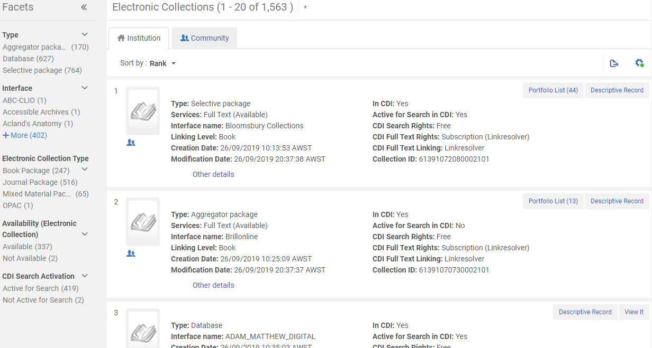
Alma CDI – Institution
Notes:
Unfortunately I can’t show you a live demonstration of what the CDI activation process will look like within Alma as it is still on a test environment that is locked to specific IP addresses, however to give you an idea of what it looks like here is a screenshot of the Electronic Collection search results within the Alma_CDI test environment.

Slide 14
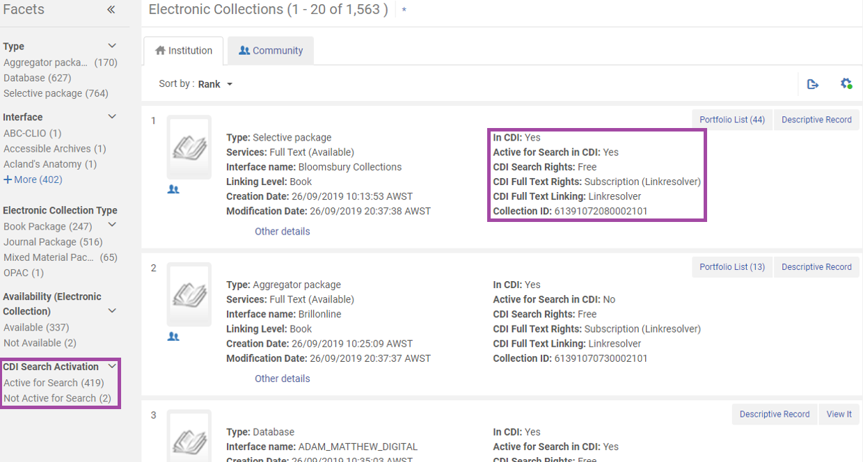
Alma CDI – Institution
Notes:
Those collections that are in the CDI will have the CDI information on the left of each record.
Also added to Alma are new facets related to the CDI – “Active for Search” and “Not Active for Search”. Ex Libris plans to add more CDI facets prior to implementation.
There will also be a button in this view for activation and deactivation of the resource within the CDI.

Slide 15
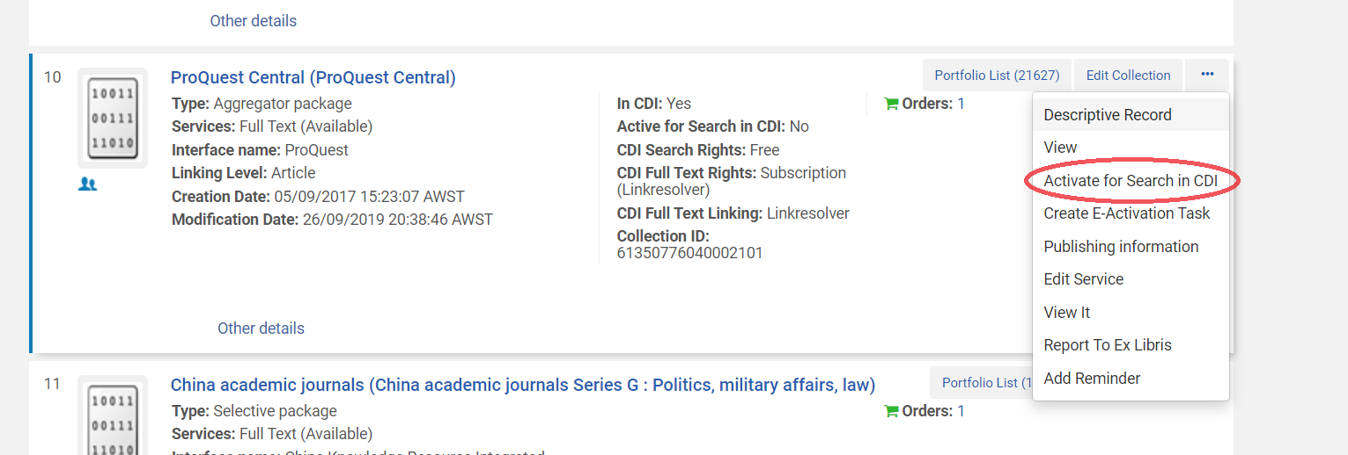
Alma CDI – Activation
Notes:
This is a screenshot of where you will be able to Activate and Deactivate a collection for search in the CDI from within the Electronic Collection search.
We have found through our testing at UWA that the new activation and deactivation workflow for collections is much easier, faster and streamlined than managing it in the PCI, but one criticism we’ve had is that a lot of the information you get about collections in the Primo Central Index is not available in the new CDI view. For example, the descriptive paragraphs about a collection and what it contains is not currently being migrated into Alma, and we feel this may remove some of the troubleshooting functionality of the current PCI.

Slide 16
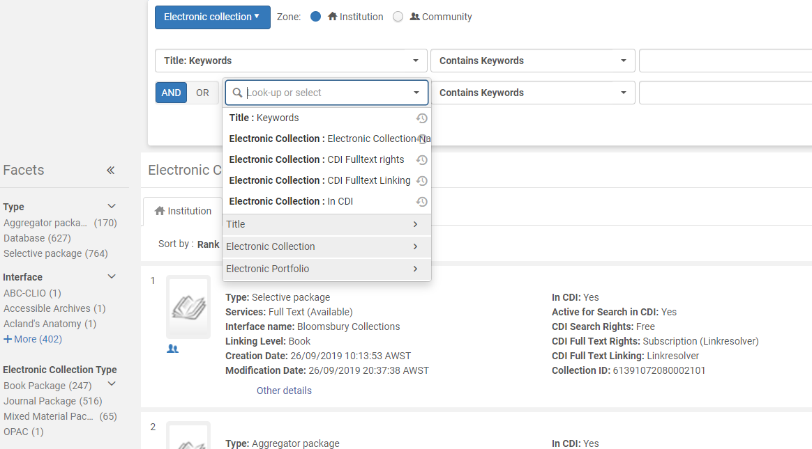
Advanced search
Notes:
Screenshot of Advanced search results in the Alma_CDI test environment, showing some of the additional filters that will be available.
Phase 1 of the testing was made up of confirming the behaviour of these views.

Slide 17
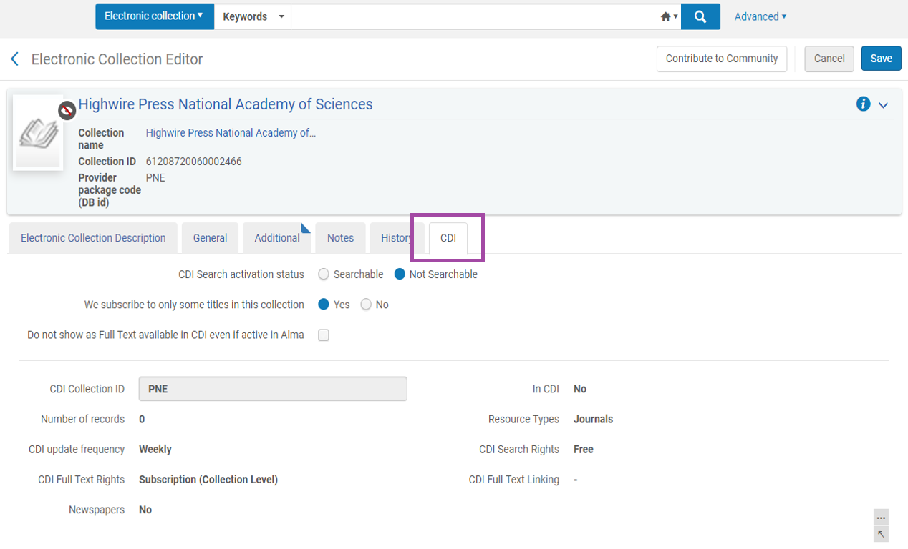
Collection CDI tab
Notes:
Moving on to the electronic collections themselves, as you can see in this screenshot there will be a CDI tab added to the collection record,
A new Alma user role for CDI activations will be created, called “The CDI Inventory Operator”, and users with this role assigned will be able to customise this tab. Ex Libris will recommend that this role be combined with the existing Electronic Inventory Operator role.

Slide 18
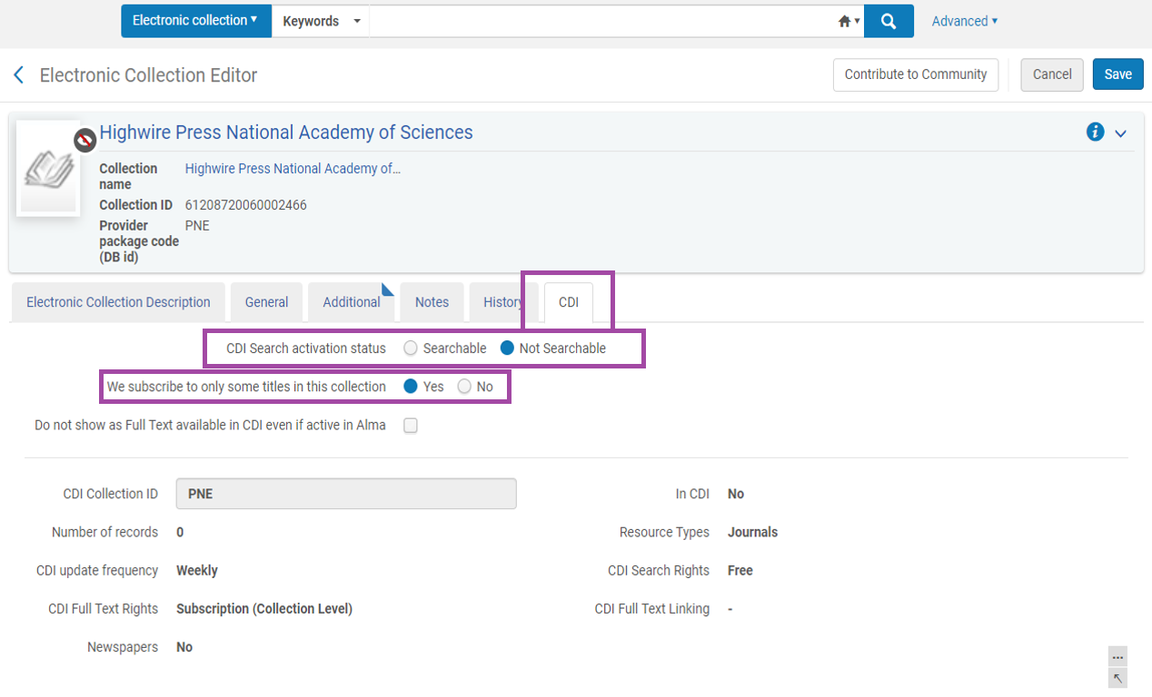
Collection CDI tab
Notes:
The tab is where the button for Activating or Deactivating a collection for Search in the CDI will be located, along with the ability to categorise the package as selective or full text.
Ie. So if you edit this tab so that the activation status is Searchable, the associated metadata records will then be harvested into Primo for searching. If you subscribe to all titles in the collection, then all associated metadata records will be harvested. If it’s selective full text, only the records that match your institution’s holdings will be harvested.

Slide 19
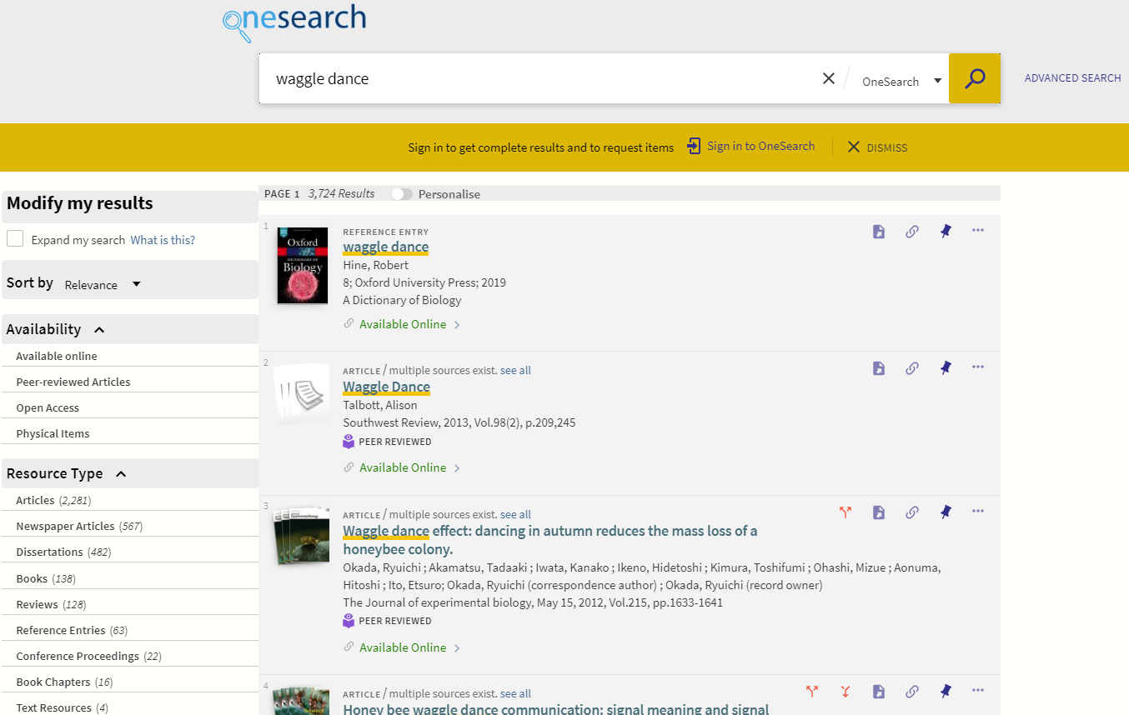
PCI search results (Before)
Notes:
The next set of screenshots will be of Primo, showing before and after CDI implementation. This is what will comprise the third phase of the testing.
This screenshot is of the current search results in our discovery layer OneSearch, which is the UWA branding of Primo VE. The post CDI features I’ll highlight are still under development of course, so are in the draft stage and subject to change.

Slide 20
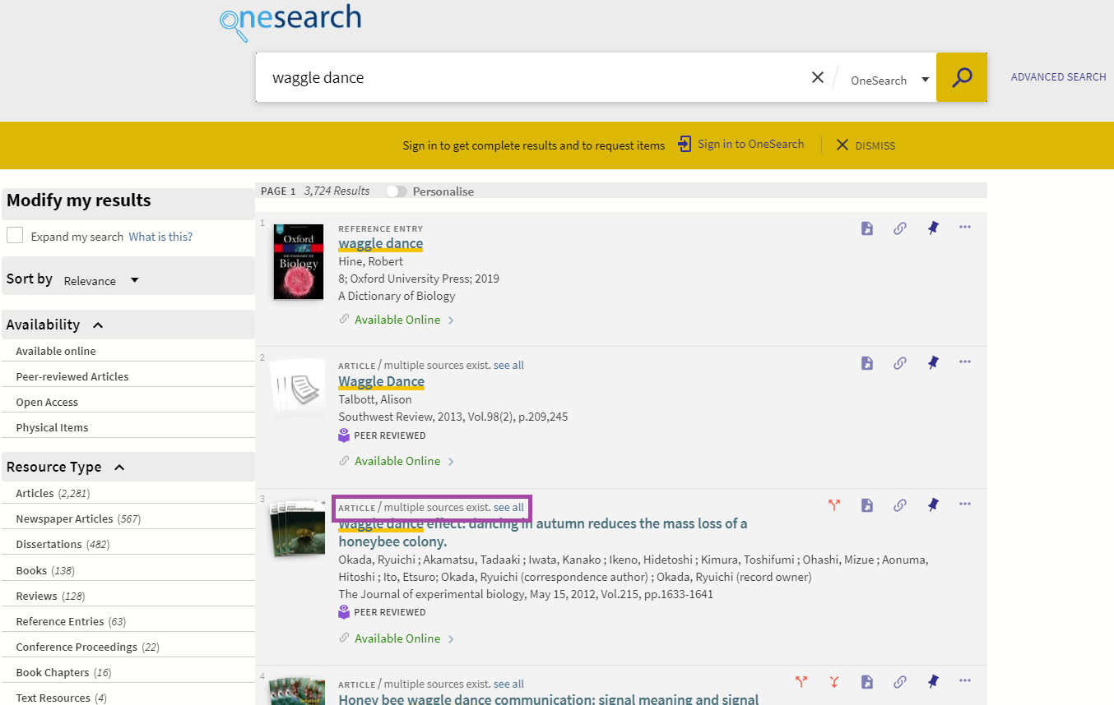
PCI search results (Before)
Notes:
You can see here that in the current Primo environment with PCI, the multiple records are grouped together in one representative record in the result list, which the user can ungroup if desired.

Slide 21
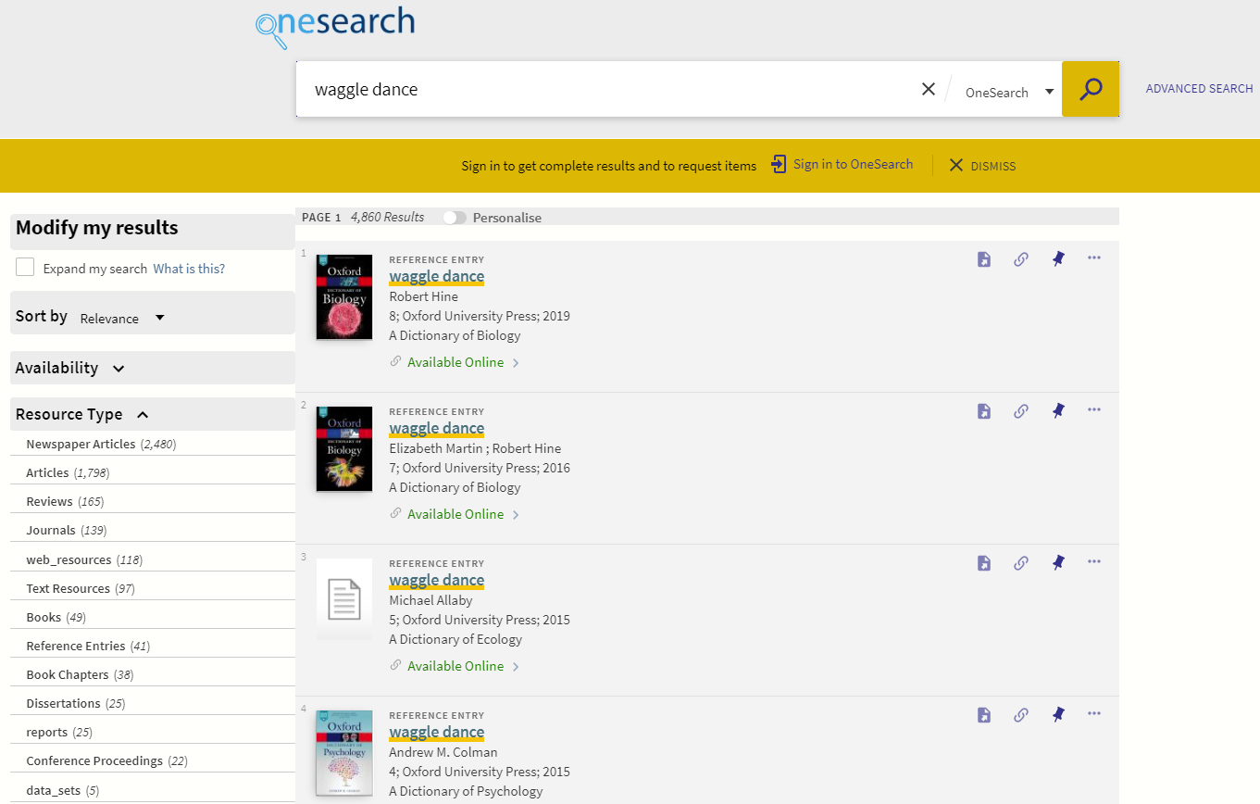
CDI search results (After)
Notes:
Here is a screenshot of the same search results in the test CDI discovery layer environment, reached by adding to suffix “&searchCDI=true” to our URL.
Ex Libris is still building the full functionality and algorithm for the CDI in Primo VE, which is why all of the records in this screenshot are reference entries. This won’t be the case in the final product.

Slide 22
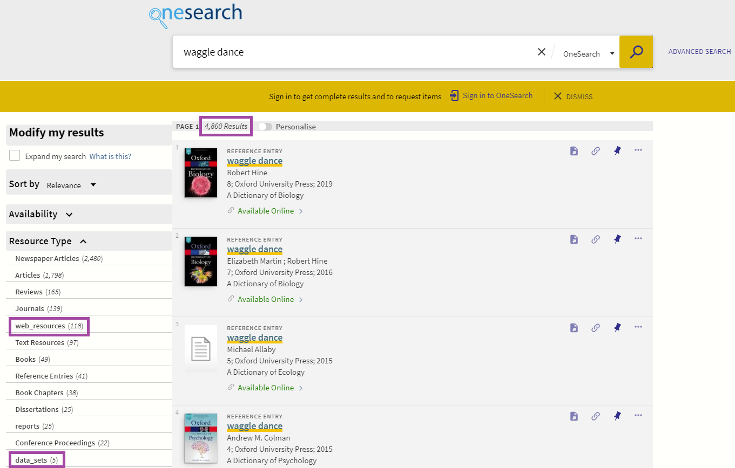
CDI search results (After)
Resource Types in CDI
Notes:
The first major difference is that the record count has increased - up from 3,724 to 4,860, - this is due to the improved search algorithm.
Also that the “Multiple sources exist see all” message no longer appears. This is because the CDI merges records instead of grouping them, as it is believed this will be less confusing for users – to use Ex Libris’ terminology, this improves “glanceability”.
New facets have also been added, for example here you can see one for web resources. There are also new “data_sets” and “reports” facets that appear further down in the Resource Type list. There may also be more resource facets than this to be added that we’re not yet aware of.
Still to be added to the Primo view that aren’t yet available to view are:
• Personalisation options
• Query expansion
• Citation Trail
• Number of times Cited
• Facets
- new Collection facets
- facet display name normalisation
At the bottom of this slide we have linked the Knowledge Centre article on resource types in the CDI if you would like further information when the presentations are released.

Slide 23
Roadmap
“Enablement” : Feb/Mar 2020
Individual switchover: Mar - Jun 2020
General switchover: Jul 2020
Consortia: Jul 2020
SFX users
Notes:
In November the UWA Alma production environment will be upgraded for early access and the working group will draw to a close early in the new year.
For all other Alma customers the move to CDI will consist of the following phases:
Enablement (February/March 2020) – For Primo customers, activations in Primo Central will be copied to Alma and all CDI functionality will be activated. A notification will be sent by ExLibris a week prior and then again when the move has taken place. Existing activations in Alma will not be affected. Ex Libris suggests subscribing to the CDI move notifications and familiarising yourself with the new activation workflow in order to prepare for this.
Individual Switchover (March - June 2020) – Customers will be able to manually switch to CDI in their Alma production environment. This can be done by setting a flag in the Primo Central institutional profile which, when set, will prompt the system to direct all searches to CDI instead of Primo Central.
General Switchover (July 2020) – During this phase, all remaining customers will automatically be switched to CDI.
All members of consortias will be moved to CDI and switched to production with CDI at the same time. However, if some consortia members use SFX rather than Alma, no switching will take place until single activation is available in SFX later in 2020 and all members will be switched together then. Ex Libris have stated further information will be made available about this in due course.

Slide 24
Topics
What is the CDI?
User benefits
Benefits for Ex Libris
UWA’s expectations
The working group
Project timeline
Additional tasks
Screenshots
Roadmap

Slide 25
Questions or experiences?
CDI Overview
CDI FAQs
Resource Types in CDI
Ex Libris Customer Webinars
For more information on the development of CDI: cdi_info@exlibrisgroup.com
Thank you
Notes:
We are happy to take some questions, but please be reminded that I’m not from ExLibris, so can only speak on our experiences. I would also like to encourage you to share your institution’s experiences of the Primo Central Index. How have you managed it, what you would like to see improved?
I have provided the ExLibris CDI team’s email address if you would like to direct any technical questions there.

