Slide 1
Grappling with ProQuest Ebook Central integration in Alma
ANZREG 2019 | Best Practice Day
Roshan Thapa
Coordinator, Library Discovery Services & Fulfilment
25 October | Bond University | Gold Coast | QLD

Slide 2
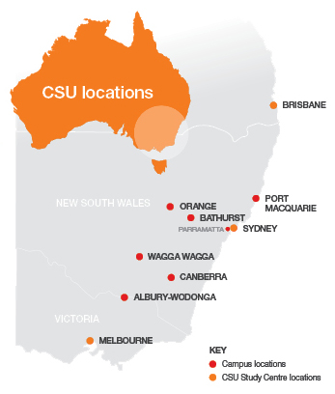
Charles Sturt University: Multiple Campus Libraries
Resources (Oct 2019)
Physical: 524,715 items Electronic: 426,346 portfolios
Images: Charles Sturt University

Slide 3
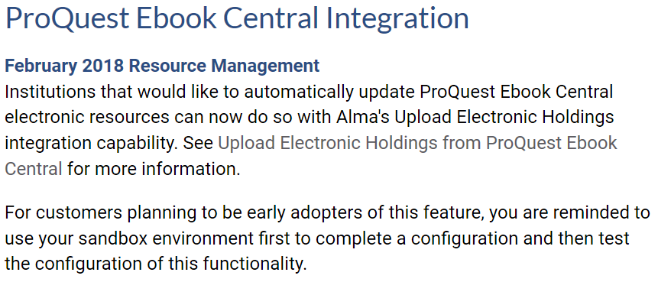
Alma release – Feb 2018
Source: Alma 2018 Release notes

Slide 4
eBook portfolios
Oct 2019

Slide 5
Why did we want to try this integration?
Existing process for updating collection was manual
Obtain monthly files from PQ
Use Portfolios Loader for incremental updates and deletes
Integration Features
Source: Alma Product Documentation

Slide 6
Setup and testing in Sandbox
Job failed straight away, & kept on failing
SF case raised (#548433) May 2018
ExLibris - May be related to a known issue already under investigation
Requested by ExLibris to modify the site ID to lowercase
Electronic inventory reindexed by ExLibris
3 electronic collections with same CZ ID existed – deleted 2 of them
Issue to be fixed in July HF release
Additional fix part of August release
Issue to be fixed in January 2019 release
Re-indexing repeated but did not fix the job
Issue to be solved in March 2019 release – This time it got FIXED!!!
Finally the job ran successfully – YAY!!!
May 2018 – Failed
(x6)
Jun 2018 – Failed
(x13)
Jul 2018 – Failed
(x1)
Aug 2018 – Failed
(x6)
Feb 2019 – Failed
(x6)
Mar 2019 – Success

Slide 7
Sandbox – Observations, Issues, Solutions
34000+ Technical PO Lines in review – how to handle?
Unable to bulk close via running job on set
Can bulk cancel but gets created again when the job runs next
Can close individual PO Line by clicking 'Order now'
ExLibris: POLs would follow the library’s workflow according to the rules set up in its environment – What rules and where???
Setup purchasing review rules
to automatically send these PO Lines into ‘Auto Packaging’ which then get closed by the overnight ‘Packaging job’
Finally satisfied to an extent – move on to Production

Slide 8
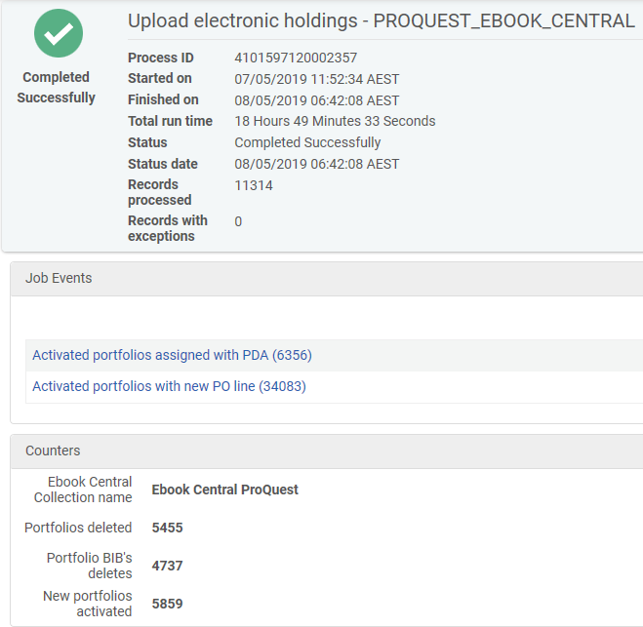
Production - Moment of Truth
Job ran successfully – YAY!!!
New technical PO Lines went straight to ‘Auto Packaging’ - Double YAY!!!
(a big) BUT
Lots of issues – troubleshooting was like peeling onion to get answers

Slide 9
Scheduling Problematic
Source: Alma Product Documentation
Titles get deleted if activated before the job run on Monday, as the file from PQ would not have included those titles
cannot wait for the job to bring titles (delay of a week or longer)
need to activate the resource after purchase for discoverability in Primo for access
delay not going to work
require the job to run as soon as the file becomes available
Wednesday - no detail on what time or the time zone
(Later we would find)
PQ EBC deposits file on Wed 10:10pm UTC (Thurs 8:10am AEST)
Includes all visible titles in Proquest Lib Central
Best scenario – MANUALLY run the job every Thursday morning

Slide 10
Impact on ordering workflow
GOBI platform for most orders
Turn around time of 3 days for the title to appear in the PQ Lib Central
Manually run job Thursday morning
INEFFICIENT
Restrict GOBI orders to Thurs & Fri

Slide 11
Other issues
~ 300 portfolios with existing PO Lines brought in with new technical PO Lines
WHY? Almost impossible to work out the reasons
Had to manually fix them
Mismatch in CZ
Titles owned in PQ EBC but not yet available in CZ
Gets deleted by the job if activated locally in Alma
After job run – NEED to review all portfolios with new technical PO Lines

Slide 12
Our Expectation
Integration will not delete any portfolios with existing PO Lines
Tested many times
Each time portfolios got deleted (when not in the PQ file, not linked to CZ, mismatch or not yet available in CZ)
Contradicted our understanding of portfolios will not be deleted if they have PO Lines attached
Needed further clarification on this
Job has no details on what portfolios got deleted
Best scenario – portfolios with PO Lines attached not to be deleted

Slide 13
One GOOD thing in all of this mess
The DDA titles (not purchased) were also brought in, which meant we had access straight away without having to wait for monthly manual updates
The auto purchases came with a Technical PO Line
Non-issue for us as we do not create any orders in Alma for DDA auto purchases

Slide 14
What to do NEXT?
What’s the point in implementing functionality when it does not do what you want?
Since integration was already implemented in production, we decided to monitor it for the next few weeks before making a final decision on whether to pursue it further or revert back
Email Alma list, obviously – such an amazing community

Slide 15
Enter ExLibris (+ProQuest)
My frustrations in Alma-L alerted ExLibris Product Management
reached out to discuss the integration and the problems
We brought ProQuest on board
May 2019
Meetings - ExLibris, Charles Sturt University team, ProQuest
Lots and lots of email communications
numerous clarifications
issues with examples
potential solutions
enhancements & fine tuning

Slide 16
Clarifications & Solutions
Process was designed to automatically update the content of the 'ProQuest Ebook Central DDA & Perpetual' collection
Any manual addition of portfolios are in risk to be deleted by the process
Process will now be enhanced to preserve manually added portfolios (local or CZ) that have a PO Line attached
Process can only be scheduled to run on Monday
Provide additional scheduling options
CZ issues (mismatch and not available)
Raise SF

Slide 17
Progress
Mid-July 2019: 2 changes deployed
Portfolios that have a PO Line will not be deleted
Controlled by using a customer parameter (turned off by default)
Additional scheduling options for the integration profile
Ability to choose any day of the week, BUT
Still uses the weekly update file deposited on Wednesday

Slide 18
Better results
Job run after enhancement was the best so far
No deletion of portfolios that we wanted to keep in our collection. Yay!!!
Continuing issues
Mismatch with CZ
No details in job report for deleted and activated portfolios

Slide 19
Is the process beneficial to us?
Yes
Less time spent managing collection
Weekly updates instead of monthly including access to DDA titles
Improved engagement with students
Weekly monitoring after job run (minimal time spent)
Still a work in progress

Slide 20
Some suggestions
Definitely Sandbox first
Liaise with ProQuest before setting up the integration
Link portfolios to CZ
Setup Purchasing Review Rules for auto handling of technical PO Lines
Turn on the parameter to not delete portfolio with PO Line
Do not add local portfolios if not required for discovery
Wait for it be available in CZ
Monitor portfolios after weekly job run for issues

Slide 21
Things to note
Integration matches portfolios by bkey
When bkey changes, new portfolio is added instead of updating existing portfolio
Integration will not look for existing bib records
If portfolio does not exist in the collection, it will activate portfolio from CZ along with the bib record
The technical PO Lines are only associated with portfolios and not to the bib record

Slide 22
Further enhancements to come
ExLibris working on developing the capability to run integration daily
Job report will be improved including details on deleted titles
Subscription titles will be added
Purchase model will be indicated at the portfolio level
Discontinue creation of technical PO Lines for OWNED titles
Delivery target date is early 2020
We will get early access for testing and feedback
Ideal situation – Setup & Forget

Slide 23
Resources on Upload Electronic Holdings from ProQuest Ebook Central
Webinar
Product Documentation

Slide 24
Acknowledgements
Kerrie Goldspring, Library Officer, Acquisitions
Jill English, Library Officer, Acquisitions
Janine Friedrich, Librarian
Phillipa Barlow, Team Manager Cataloguing & Metadata
Andrew Press, Team Manager eResources & Acquisitions
Dana Moshkovits, Director of Product Management, ExLibris
Amanda Norton, ProQuest
Alma Community

Slide 25
Thank you
Roshan Thapa PhD, GradDipInfoStud CSturt, BForSc(Hons) Melb Coordinator, Discovery Services & Fulfilment
Library | Charles Sturt University
Leeds Parade | Orange NSW | Australia
T: +61 2 6365 7789 | E: rthapa@csu.edu.au
Certified Administrator: Alma, Primo VE & Primo

