Slide 1
Seamless Access
The successor to IP Filtering
Rich Wenger
E-Resource Systems Manager, 4/1/2003 – 3/31/2019
MIT Library

Slide 2

Disclaimer
IANL
I am retired and do not speak for the MIT Library.

Slide 3
TOC
Brief review of RA21 and its accomplishments
A more detailed look at SeamlessAccess.org.
A demo of the central services currently in beta status.
The view ahead

Slide 4
In the beginning…
Early days of the internet
No portable devices or smart phones
Static IP addresses
Unspoken assumptions

Slide 5
The march of technology
Portable PCs, laptops, tablets, smart phones
DHCP: dynamic IP addresses
‘Off-campus’ users did not fit the model

Slide 6
Playing games
Pretending nothing had changed: Proxy servers and VPN
Virtualization at multiple levels: e.g. NAT

Slide 7
Bottom line
The assumption that an IP address reliably indicates a user’s physical location is false.
The further assumption that a physical location reliably indicates an authenticated, authorized user is false.
IP filtering is about where a user is (which is completely obscured by proxy servers and VPNs), not who the user is.

Slide 8
Bottom line
IP filtering
  Conflates IP address with location and identity.
  Requires proprietary portals, in direct opposition to modern discovery practices.
  Is a maintenance nightmare.
  Is unsecure and easily exploited.
  “Without IP filtering, Scihub could not exist”*
* Atypon presentation on Data Piracy at SSP confernece in Boston, June 2017

Slide 9
Two major areas of concern
Improve the user experience
Respond to the security deficits

Slide 10
Improving the user experience
The point of referral for authentication must be located at providers’ sites, not in our portals.
Institutional affiliation defaults must be preserved across browser sessions without compromising privacy.
All devices must be supported appropriately.
Patrons’ privacy must be preserved.

Slide 11
Security
Focus on who the patron is, not on where they are.
Use institutional credentials, not proprietary ones.
Preserve patron privacy by using opaque session identifiers. In case of inappropriate downloading, individual sessions can be blocked.
Support SSO across all devices.

Slide 12
A way forward
Federated Identity Management, robustly implemented by providers and subscribers.
  SAML-based: highly secure, stable, open source.
  Federated metadata.
  Authentication at the point of need, using institutional credentials.
  Support for affiliation at multiple institutions.

Slide 13
RA21: 2016 - 2019
Two major outputs
  A detailed set of recommended best practices certified by NISO.
  A small set of optional light-weight central services hosted by a non-profit consortium.
    Standardized WAYF menu
    Persistent storage of institutional affiliation(s).

Slide 14


SeamlessAccess.org
Infrastructure Collaboration for FIM:
Federated Identity Management
for more streamlined digital authentication
Heather Flanagan, Program Director

Slide 15
What is SeamlessAccess.Org?
The operational successor of RA21
Implementing the Best Practices as described in NISO document:
Recommended Practices for Improved Access to Institutionally-Provided Information Resources: Results from the Resource Access in the 21st Century (RA21) Project
Built on thiss.io
At long last, a certified set of best practices to which we can refer!

Slide 16
Summary of NISO-certified best practices
Guiding principles for:
  Privacy
  Security
  User experience
  Governance.

Slide 17
Summary of NISO-certified best practices
Recommended practices:
  2.1 Adopt Multilateral Federated Authentication.
  2.2 Establish Multilateral Federations where they do not exist.
  2.3 Ensure Privacy is Preserved while Enabling Convenient SSO and Granular Authorization.
  2.4 Improve the User Experience of Identity Provider Discovery (WAYF menu).
  2.5 Establish a Cross-domain Identity Provider Persistence Service.

Slide 18
Summary of NISO-certified best practices
Recommended practices:
  2.6 Improve Metadata Quality and Apply Consistent Standards.
  2.7 Set Session Timeout Periods based on Type of Resource and Institutional Risk Management Policy.
  2.8 Establish Security Incident Reporting Frameworks
  2.9 Leverage new or Existing Inter-federation Services for SP and IdP Interoperability.

Slide 19
Summary of NISO-certified best practices
Endorsement of GÉANT Data Protection Code of Conduct:
  General Data Protection Regulation (GDPR) compliant.

Slide 20
Federated Identity Management, FIM:
Why is FIM so important ?
For streamlined online access from any place and any device into:
  Library resources
  Research facilities
  Collaborative labs
  Scholarly collaboration tools
  Open Science platforms
  Open Access authoring sites
  Preprint servers, sharing sites, etc
For preservation of user privacy via SAML federated authentication technology
See initiatives for
FIM4R: Researchers
FIM4L: Libraries

Slide 21
Tackling several Big Issues:
Privacy – leveraging a distributed technical approach, working with librarians, academia, infrastructure partners; a system from scholars for scholars, the data stays at and belongs to the institute
Transparency - we are transparent with everyone about how it works, what the approach is, where the data remains
Interoperability – this is infrastructure, operated by GÉANT, that works for any institution. Any provider of resources can join.
Speed & Convenience & User Experience – integrated design and architecture, serves as the backbone of the collaboration between GÉANT, STM, NISO, Internet2 and ORCID.

Slide 22
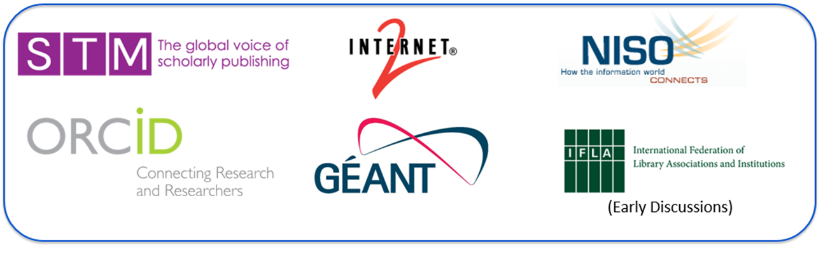
Made to support a shared research infrastructure
For more Open Science
For more international research collaboration.
For access to resources from any place and any device.
For secure identity management and network safety.
For local management of data privacy issues.
Governed and initiated by:
STM
NISO
GÉANT
Internet2
ORCID
(Invitation extended to IFLA
Int’l Federation of Library Associations)

Slide 23

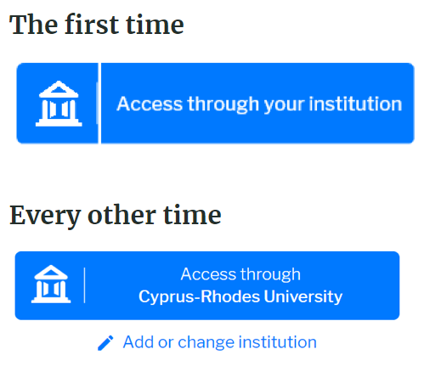
SeamlessAccess.org preserves user privacy and maintains institutional control for secure access
A Modern and Reliable Approach to Resource Access
Ensure access to resources and services to those entitled to have it. It is increasingly complex to identify legitimate users. Seamless Access enables access using individual’s federated authentication (sign on.)
Proven User Experience
The Seamless Access solution remembers user’s last sign-on choice, simplifies institution search, and uses clear language and images to meet user expectations.
Single Sign On… For Real!
Seamless Access enables true Single Sign On. Users will be able to sign in using their preferred sign in credentials (for example, those from their institution), and will not be bothered for them again for all Seamless Access-enabled sites.

Slide 24
Project timeline of SeamlessAccess.org
December 2016 – June 2019
Piloting phase RA21
July 2019 – June 2020
SeamlessAccess Beta Phase Operational
July 2020 - onwards
Full service operational

Slide 25
Seamless Access central services in action
Demo

Slide 26
A look ahead
Broad implementation of the NISO-certified best practices by providers and subscribers. (SpringerNature)
Entity Categories and Attribute Bundles working group has just been launched.
See Section 3. Future Work Items page 40.
Greater collaboration between libraries and campus IT.

Slide 27
Closing the Policy Void
Getting serious about privacy
Technical evaluation of new access models
Contract language is underutilized

Slide 28
A collaborative multi-stakeholder effort
Individuals from more than 60 different organizations have been involved in RA21 since its inception in late 2016.
AbbVie Pharmaceuticals
American Medical Association / JAMA
American Chemical Society
American University
American Psychological Association
Association of Research Libraries
American Society of Civil Engineers
Atypon Systems
BASF
Bibliotheksservice-Zentrum
Brill Publishers
Brown University
Centre for Agriculture and Bioscience
Carnegie Mellon University
Clarivate Analytics
Cambridge University Press
Copyright Clearance Center
Denver University
EBSCO Information Services
Eduserv
Elsevier Publishing
Emerald Publishing Group
Erasumus University Rotterdam
ETHZ
GEANT
GlaxoSmithKline Pharmaceuticals
Harvard
Highwire Press
Hypothes.is
IEEE
Informed Strategies LLC
Internet2
Institute of Physics Publishing
JISC
Johns Hopkins University
KTH Royal Institute of Technology
Liblynx
MIT
MyUniDys
NISO
Novartis
OCLC
Open University
ORCID
Opitcal Society of America
Oxford University Press
Proquest
Ringgold
Roche Holding AGG
Sage Publications
Silverchair Information Systems
Springer Nature
STM
SUNET
Switch
Taylor & Francis Group
Thieme Medical Publishers
Tilburg University
UC Davis
Universiti Putra Malaysia
University at Buffalo
University of Bath
University of Nottingham
University of Surrey
Wiley
Wolters Kluwer Publishing
Corporation
Academic Institution
Software/Service Provider
Publisher
Notes:
Chris

Slide 29
Finis
Seamlessaccess.org
Rich Wenger rwenger@mit.edu
Phone 339-368-1436

