Slide 1
DIY for Academics
Achieving Self-Management in Leganto

Slide 2
Kirstie Nicholson

Slide 3
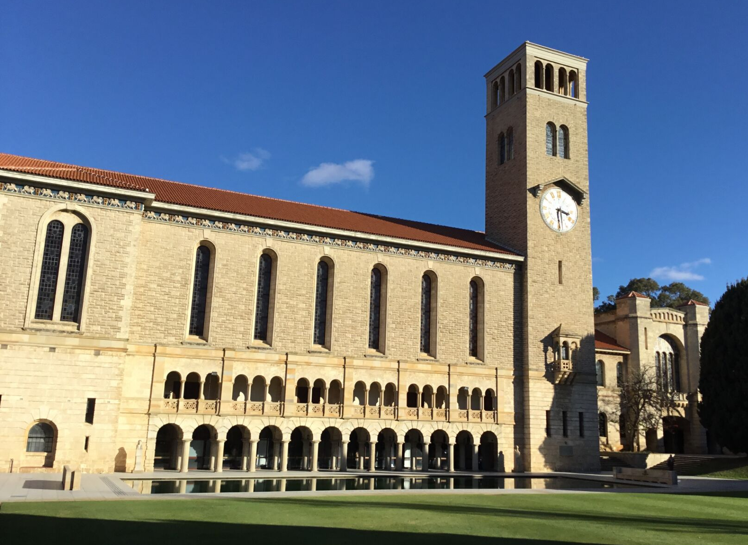
University of Western Australia (UWA)

Slide 4
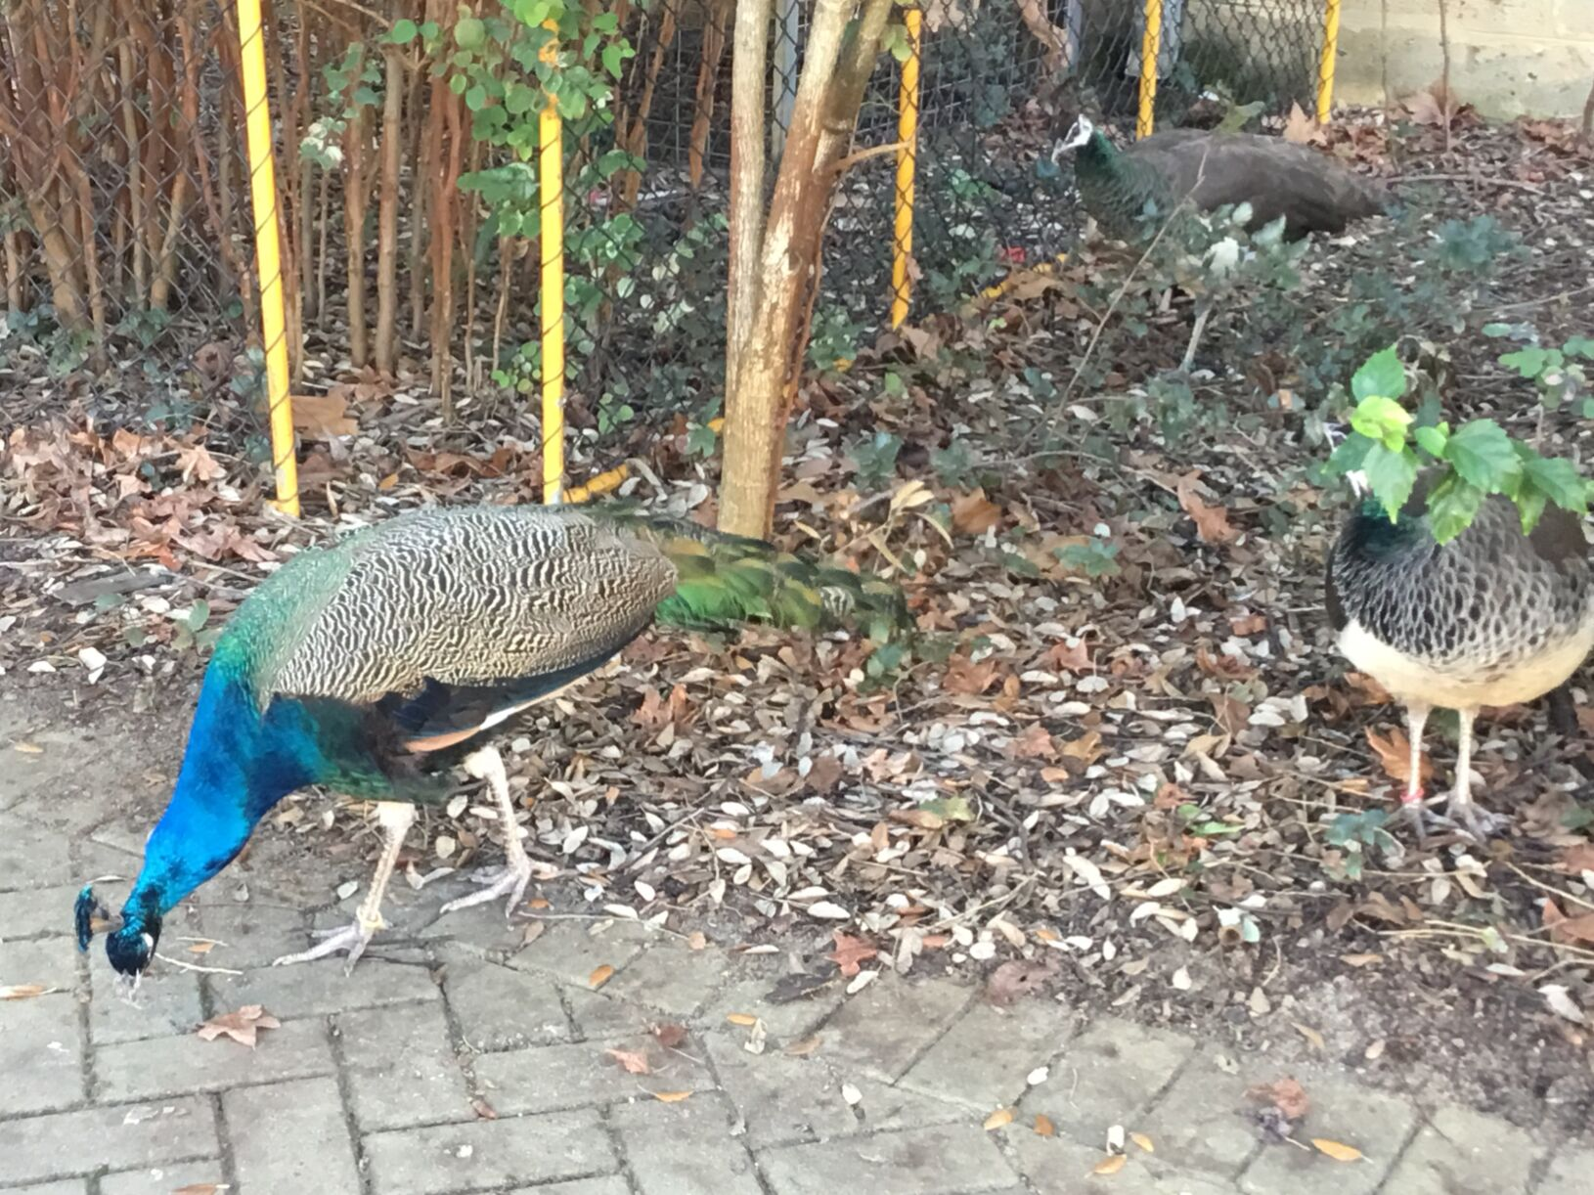

Slide 8
Coordinator, Discovery

Slide 10
Self-Management
Unit Coordinators creating, editing and submitting lists in Leganto
Autonomy for Unit Coordinators
Work efficiencies for Library

Slide 11
DIY for Academics
Reasons for Change
Results
New Service Model
Challenges
Implementation
Future Plans

Slide 12
DIY for Academics
Reasons for Change
Results
New Service Model
Challenges
Implementation
Future Plans

Slide 13
Lists submitted via email
Lists created in Alma Course Reserves
Student access via Primo
List processing team liaised with Unit Coordinators

Slide 14
Temporary system now permanent
Essential items only
Unit Coordinator interaction
Low usage
100% library-managed
Inefficient to process

Slide 15
DIY for Academics
Reasons for Change
Results
New Service Model
Challenges
Implementation
Future Plans

Slide 16
Self-management encouraged & supported
Student access via Learning Management System
Non-essential items on lists
Engagement Librarians liaise with Unit Coordinators

Slide 17
Don't want to learn new system
Too busy to self-manage
Want the Library to create lists
Won't use Leganto

Slide 18
Academics busy and under pressure
Lack of administration staff
Another system launching at same time
Previous implementations

Slide 19
Library-managed list option

Slide 20
DIY for Academics
Reasons for Change
Results
New Service Model
Challenges
Implementation
Future Plans

Slide 21
10 Unit Pilot
Full implementation in July 2018
Unit Readings
Existing lists rolled over
Discovery & Engagement staff

Slide 22
DIY for Academics
Reasons for Change
Results
New Service Model
Challenges
Implementation
Future Plans

Slide 23
97% lists self-managed in 2018
99.5% lists self-managed in Semester 1 2019
Library managed list option for regional campus, overseas location and training obstacles

Slide 24
I'm loving this interface - so intuitive and easy-to-use compared with the previous CMO
It's easy to use, easy to integrate with LMS. Most of all it's fast and responsive. You can make a variety of resources—online journal articles, print books, e-book chapters—available quickly, without the long lag and turnaround times

Slide 25
7 Unit Coordinators, 10 Units
Unit Coordinator Champions
Survey comments
Confidence boost
Affirmed self-management
One-on-one training

Slide 26
Leganto functionality

Slide 27
All Library staff invested
Roles well-delineated
Confident in benefits
Librarians equipped to support Unit Coordinators

Slide 28
Top down approach
Create awareness
High level
Used best Library to Faculty contact point

Slide 29
University supported project
Library supporting unit preparation
Benefits and why academics should be on board

Slide 30
Emailed lists cue for liaison
Library managed lists as last resort

Slide 31
Pilot
Leganto functionality
Library Staff confidence
Communication strategy
Library managed lists used as liaison opportunity

Slide 32
DIY for Academics
Reasons for Change
Results
New Service Model
Challenges
Implementation
Future Plans

Slide 33
Publishing
Full engagement with interface
Using more self-management functionality
Support content

Slide 34
Transitioning users of old system
Uneven usage across faculties
Use of Learning Management System

Slide 35
DIY for Academics
Reasons for Change
Results
New Service Model
Challenges
Implementation
Future Plans

Slide 36
Publishing

Slide 37
Student Benefits

Slide 38
Targeted Communications

Slide 39
Support Model

Slide 40
Educational Enhancement Unit

Slide 41
User experience testing

Slide 42
DIY for Academics
Reasons for Change
Results
New Service Model
Challenges
Implementation
Future Plans

Slide 43
DIY for Academics: achieving self-management in Leganto
Kirstie Nicholson
kirstie.nicholson@uwa.edu.au
Created with Canva

