Slide 1
UNSW Library
Alma Resource Sharing
Partner records: initial and ongoing data updates using Alma API
By Xiaobo Ni from Digital Library Initiatives Team, UNSW Library

Slide 2
Table of Contents
Background
Requirements
GitHub Repo
Overview of the Script
Initial Partner Record Load
Daily Partner Record Update
Questions?

Slide 3
Background
Implement Alma resource sharing
Load partner record data to Alma
Australian library data: LADD Suspension directory
New Zealand library data: Directory of New Zealand Libraries
Update partner record data to Alma
Data resource: emails from delivery-anz@vdxhost.com

Slide 4
Requirements
Understand Alma Resource Sharing Partners API
Alma API Keys
PHP 5.5 above (with CURL extension)
Git
Gmail Account
Gmail API Package
Email server configuration (optional)

Slide 5
GitHub Repo
Alma Resource Sharing Project Repository
https://github.com/DLITEAM/alma-rs-public
Master branch (PHP IMAP)
Gmail API branch (Gmail API package)

Slide 6
Overview of the Script
Two components
Initial Partner Record Load
Daily Partner Record Update
Data storage
All data save in CSV files

Slide 7
Overview of the Script
Folder Structure
src/ - all php script files and data files
src/data/ - all data files (initial and update data files, exclude in Git Repo)
src/log/ - all log files (exclude in Git Repo)
src/template/ - data templates for Alma API and email notification
vendor/ - Gmail API package and other support apps (exclude in Git Repo)

Slide 8
Overview of the Script
Data format of Alma API
Partner Template (Initial_PartnerTemplate.json)
Fixed Value Template (Initial_PartnerFixed.json)
Contact Template (Initial_ContactTemplate.json)

Slide 9
Overview of the Script
Files
Variable file: Initial_Const.php
Functional files: Alma_API.php, File_Func.php, Gmail_API.php, LogClass.php
Data collection files: Partner_Data.php, readData.php
Initial load files: Initial_Partner.php, Initial_Progress.php
Daily update files: ProcesEmail.php, EmailStruct.php, Contact.php, Suspension.php, Update_Progress.php

Slide 10
Initial Partner Record Load
Collect Partner Data
>php readData.php
Collect data from ILRS
Library Code
Library Details
Collect data from LADD
Save data to CSV
Format selected data from both CSV file
Save data to CSV as initial load data
Collect data from DNZL
Save data CSV

Slide 11
Initial load data files: /src/data/initial/
DNZL data: dnzl_data_time.csv
LADD data: ladd_data_time.csv
Initial data: initial_records_time.csv -> initial_records.csv

Slide 12
Load initial partner records to Alma (create and delete)
>php Initial_Progress.php –a PROD –p ADD
Check exception
Build API data set
Read initial record data
Save error records to CSV
Create log file and send email
Send request through API call
Handle API response
Loop each record

Slide 13
Daily Partner Record Update
>php Update_Progress.php –a PROD
Add new Locations through API
Add/update new Contacts through API
Read email
Locations
No
ISO-ILL
Contacts
Yes
Yes
Suspensions
Backup CSV
Merge Record
Update
Categories
Save to CSV
Update Suspensions through API
No
Content process
Change Label
Log file
Email
Email process

Slide 14
Daily record update data files: /src/data/update/
Add location data: add_partners.csv
Add/update contact data: update_contact.csv
Update suspension data: update_suspension.csv

Slide 15
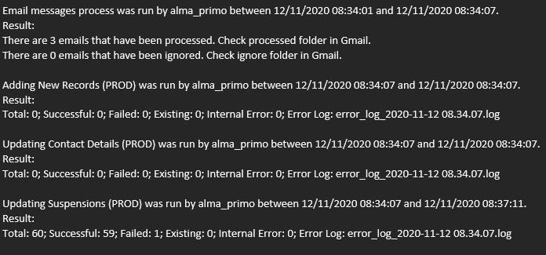
Email Notification:

Slide 16
Questions?

